Slide 1
Early Civilizations:
Prehistory-1570 A.D.
Unit 1

Slide 2
Foundations of Civilizations
Prehistory – 300 BC

Slide 3
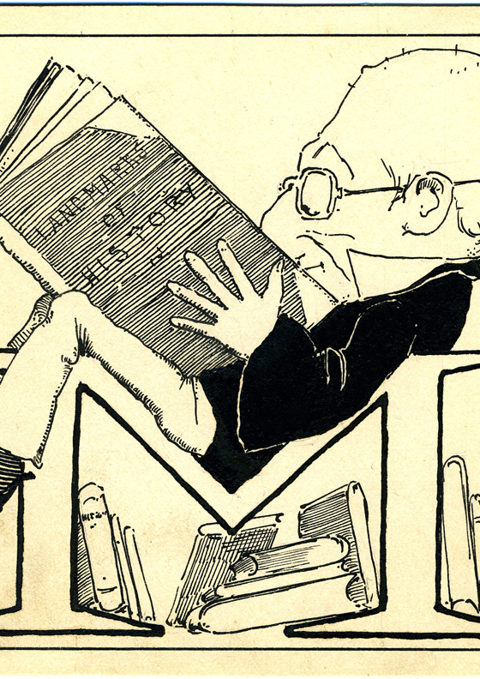
Understanding Our Past
Prehistory – the long period of time before people invented writing
Historians – scholars who study and write about the historical past
Artifacts – objects made by humans such as clothing, coins, artwork, and tombstones, etc.
Written records are much more useful however because they provide a clear account of what happened

Slide 4
Understanding Our Past
Even so, historians need to behave like detectives to get a full account of what happened
They do this by examining all of their findings (evidence) then come to an educated conclusion of the past
What are some things that can contribute to misinformation?

Slide 5
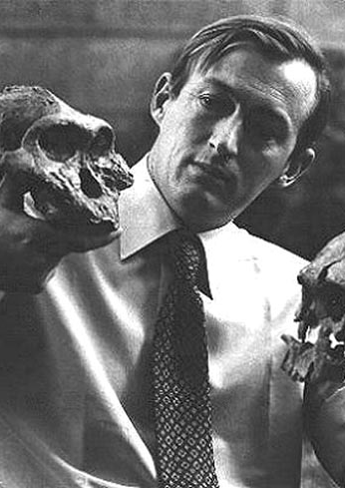
Investigative Tools
Anthropology – the study of man; the study of the origins and development of people & their societies
  Culture – the way of life of a society
Archaeology – they study of past people and cultures through their material remains
  Archaeologists study buildings and artifacts (weapons, pottery, clothing, jewelry, etc.)

Slide 6
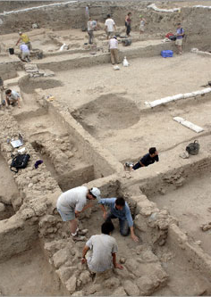
Archaeologists at Work
Archaeologists pick a place where they believe they can find some remains; this place is called a site
They dig until they find some kind of artifact and treat it with great care. Why?
After analyzing the artifact the archaeologist can determine what it was used for and even what time period it came from

Slide 7
Discoveries in Africa & Beyond
1930s: Mary & Louis Leakey searched for clues of past humans in Tanzania
As they dug they found ancient tools chipped from stone and came to the conclusion that these tools were man-made and were used for survival
Technology – the skills and tools people use to meet their basic needs
The Leakey’s believed that there must be evidence of people who used these tools

Slide 8
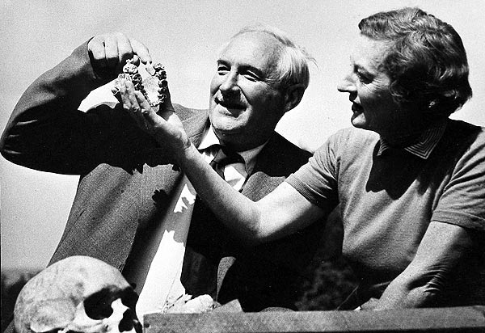
Discoveries in Africa & Beyond
After search for more than 20 years, the Leakey’s found a skull at Olduvai Gorge (canyon in Tanzania)
After testing the skull they concluded the skull belonged to an early hominid which are the closest relatives to humans

Slide 9
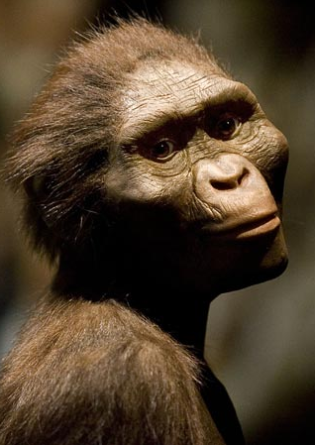
Early Hominid Groups
Archaeologists have determined that a number of different groups of hominids have existed over several million years
The earliest group are called australopithecines & one of the most famous one was Lucy who left her footprint in Laetoli (Tanzania, Africa), they lived about 7 million years ago
About 2 million years ago another group emerged called Homo habilis, “handy man”. Why so?

Slide 10
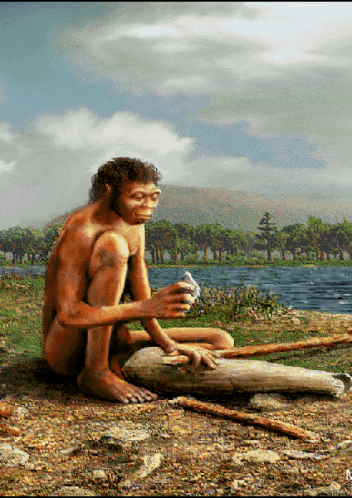
Early Hominid Groups
Also about 2 million years ago another hominid group emerged call Homo erectus which means “upright man”. How do you think they got this name?
They had larger brains and bones and smaller teeth than other hominids
They are also thought to be the first hominids to learn how to use fire
What other tools did the Homo erectus use?

Slide 11
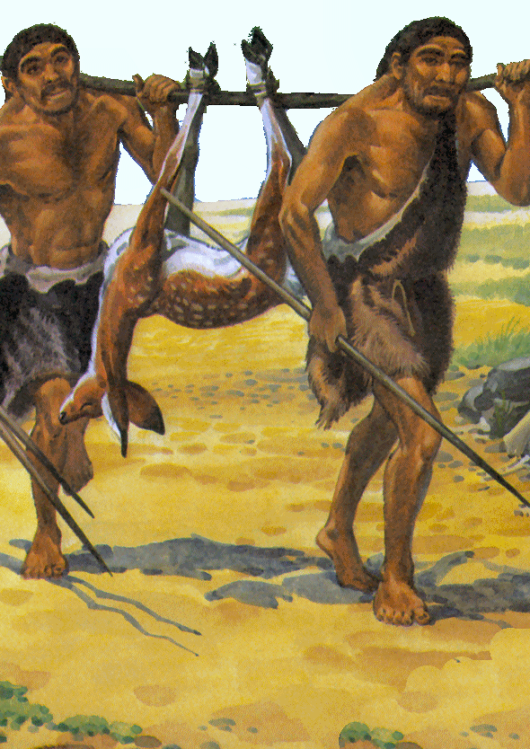
First Humans Around the World
Between 250,000 – 100,000 years ago, Homo erectus disappeared and Homo sapiens emerged
Modern humans belong to the Homo sapien group which were divided into 2 groups: Neanderthals & modern humans
Neanderthals are believed to have lived mostly in Europe and western Asia but they disappeared between 50,000 - 30,000 years ago
Today we only have modern humans

Slide 12
Turning Point: The Neolithic Revolution
Chapter 1 – Section 2

Slide 13
The Stone Age
Old Stone Age/Paleolithic Period – period from at least 2 million BC to about 10,000 BC
New Stone Age/Neolithic Period – period from about 10,000 BC until the end of prehistory
During both periods people began to develop different technologies
However it was during the New Stone Age that drastic changes occurred in everyday life

Slide 14
Skills/Beliefs of the Old Stone Age
Early modern people were nomads where they lived in a group of 20 or 30 people
They hunted and/or gathered
Men hunted or fished
Women and children gathered berries, fruits, nuts, grains, and other things
  This kind of food kept them alive when animal meat was unavailable or scarce

Slide 15
Humans Develop Strategies for Survival
Early humans depended heavily on the environment for their survival
They built tools and weapons out of stone, bone, or wood
They also built fires and used animal skins for clothing
We know that at one point they developed a language to communicate with each other even though they had not created a system of writing

Slide 16
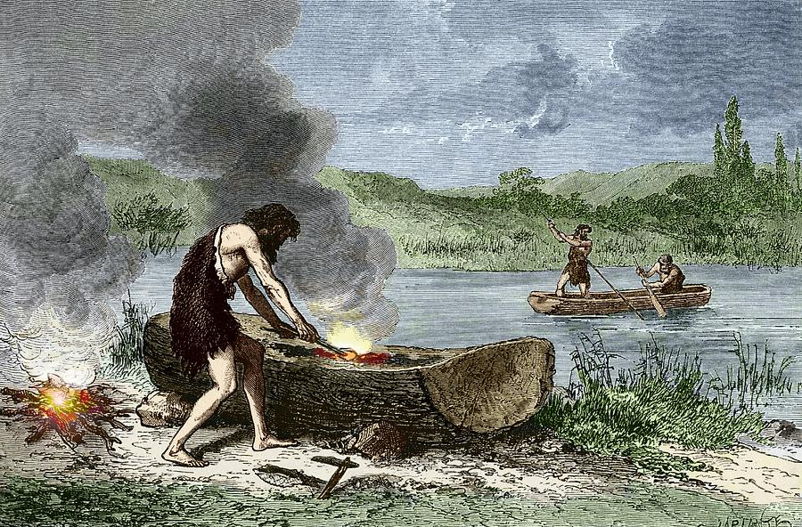
Interesting Fact
Early humans as early as 40,000 years ago traveled by boat from southeast Asia to Australia
They stopped for years at islands along the way

Slide 17
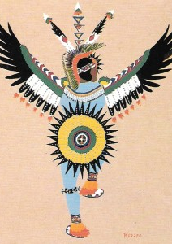
Early Religious Belief
There is evidence which suggests that Old Stone Age people had some sort of belief in the afterlife
They began to bury their dead with special tools they thought they could use in the afterlife
Former beliefs included the belief that the world was filled with spirits and forces which resided in animals, objects, or dreams and is referred to as animism

Slide 18
New Stone Age: Farming
At around 10,000BC people of the New Stone Age learned how to farm
What affects would this have on their nomadic life?
This new transformation in their lives brought about the Neolithic Revolution

Slide 19
Domesticating Plans & Animals
These early farmers were also the first humans to domesticate (raise them in a controlled way that makes them best suited to human use) plans & animals
Plant domestication – began when people realized that the seeds could be planted and used to grow more plants
Animal domestication – began when people realized they could round up animals and use them for their everyday use such as for food or skin or even milk/eggs

Slide 20
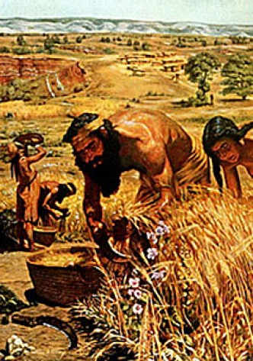
Neolithic Revolution Brings Dramatic Change
This was perhaps the greatest revolution that changed the way people lived in all of history
  Perhaps up until the Industrial Revolution which took place in the late 1700s

Slide 21
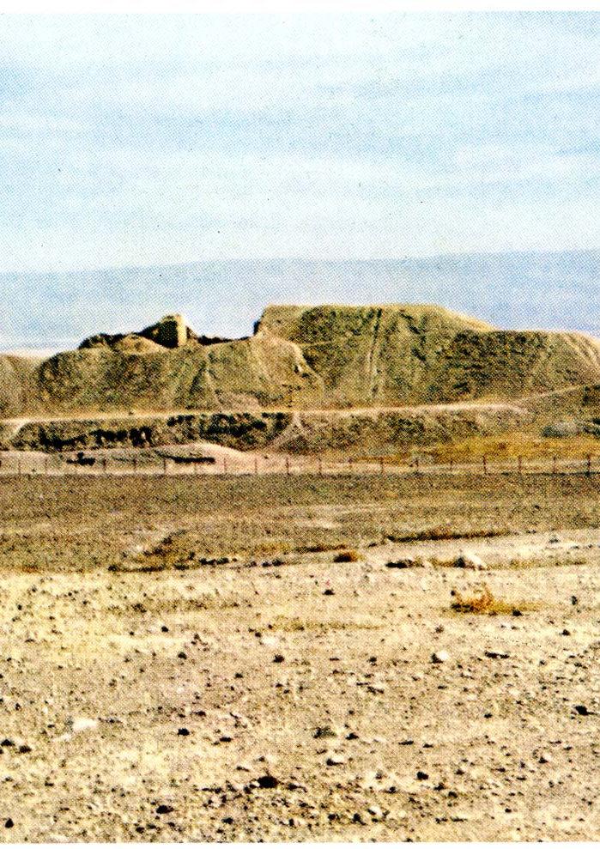
Earliest Villages
Some of the earliest Neolithic villages were found in:
  Jericho in present-day Palestine/Israel and was built between 10,000BC and 9,000BC
  It was surrounded by a huge wall which meant that it had some form of government or a leader with great ambitions
  And had a few thousand residents

Slide 22
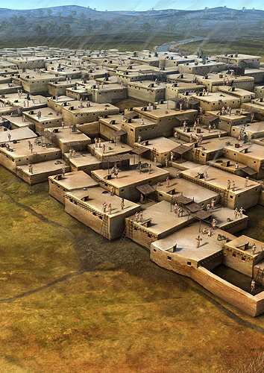
Earliest Villages
  Çatalhüyük in present-day Turkey
  It may have developed around 7000BC with a population of around 6,500 people
  It was three times larger than Jericho and had hundreds of rectangular mud-brick houses
  They were all connected and the same size

Slide 23
Settled People Change Their Way of Life
Early humans also divided the work based on gender and age just like their ancestors
  Men: dominated family, economic, and political life
  Older men: heads of families, formed a council of elders and made decisions about when to plant and harvest
  Warriors: during famines or droughts wars erupted and these men asserted their power over others
Settled people often accumulated more personal property than their nomadic neighbors
This perhaps gave a rise to a difference in wealth

Slide 24
Beginnings of Cilivzaion
Chapter 1 – Section 3

Slide 25
First Cities & Civilizations
The earliest civilizations to develop were all situated near major rivers
These river valleys helped the people farm and the floodwaters helped spread silt
  Silt – tiny bits of rock and dirt from the river bottom
  They spread across the valleys and renewed soil and kept it fertile

Slide 26
First Cities & Civilizations
Farmers were able to produce surpluses – more than what is necessary
This allowed them to feed the growing populations and store food for the future
In these cities, people were able to work at jobs other than farming

Slide 27
River Valley Civilizations
The rise of cities was the main feature of civilization
  Civilization – complex, highly, organized social order
The River Valley Civilizations
  Sumer – between the Tigris & Euphrates rivers (Middle East)
  Egypt – along the Nile River (Africa)
  The Indus – along the Indus River (India)
  The Shang – along the Huang River/Yellow River (China)

Slide 28
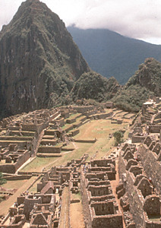
First Civilizations in America
Unlike the civilizations in Africa and Asia, these civilizations rose away from river valleys
They emerged in the highlands of Peru, Mexico, and Central America
They learned to farm on the sides of mountains

Slide 29
Basic Features that Define a Civilization
Organized governments
Complex religions
Job specialization
Social classes
Arts and architecture
Public works
writing

Slide 30
Organized Governments
These included things such as a council of elders or chiefs in the smaller cities/villages
In larger cities there was a structured government where they could coordinate the production of large amounts of food
They could also bring people together for projects such as building dikes, digging canals, and carving out irrigation ditches

Slide 31
Organized Governments
They could issue laws, collect taxes, and organize systems of defense
Over time though governments became more complex and separate departments often evolved to oversee different functions
In some places priests had the highest power, in others warriors were the main political leaders
But often times these people claimed their right to rule came form the gods and they passed their power on form father to son

Slide 32
Complex Religion
Most of these ancient people were polytheists – they worshiped many gods
  Such as sun gods, river goddesses, and others who they believed controlled natural forces or even birth and war
Priests and worshippers sought to gain the favor of the gods through complex rituals such as:
  Ceremonies
  Dances
  Prayers
  Hymns

Slide 33
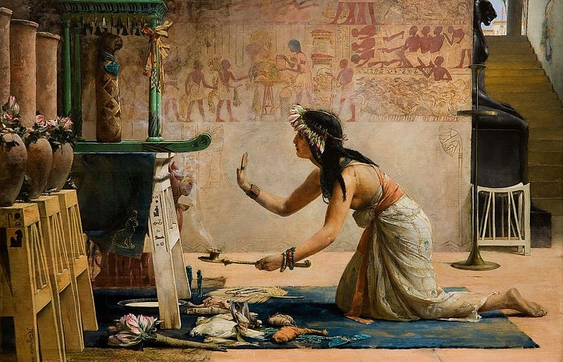
Complex Religion
To receive divine help, these people built temples and sacrificed animals, crops, and sometimes humans

Slide 34
Job Specialization
Urban people developed many new crafts
Individuals began to specialize in certain jobs and some became artisans - skilled craftspeople
Metal-working was very important because people learned to make tools and weapons out of copper, bronze, or a mixture of copper and tin
Bricklayers built city walls, soldiers defended the walls
Merchants sold goods, singers and dancers and storytellers entertained the public

Slide 35
Social Classes
People were ranked according to their jobs and this led to the growth of social classes
Top: priests & nobles
Next: small class of wealthy merchants, then artisans
Below: majority of people such as peasant farmers
Very bottom: slaves who were sold by poor families, or to serve a punishment, or a prisoner captive in war
  Most of them were women
  Why?

Slide 36
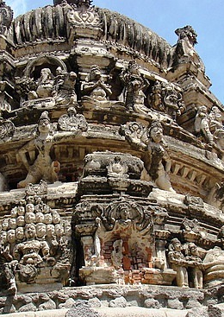
Arts & Architecture
Temples & palaces dominated the city landscape
  Ordered to be built by the ruler in order to remind the people the power of their government & religion
  Skilled workers decorated them with wall paintings, statues of gods, goddesses, or rulers

Slide 37
Public Works
Projects included:
  Irrigation systems
  Roads
  Bridges
  Defensive walls
They were expensive and required a great amount of human labor

Slide 38
Writing
Some of them, not all, developed writing
They were first used in temples by the priest to record amounts of grain collected, accurate information about the seasons, and rituals and prayers
In other places, writing was used on buildings to tell of the great achievements made by the ruler at the time
Pictographs – this was one of the first forms of writing that were simple drawings that look like the objects they represent

Slide 39
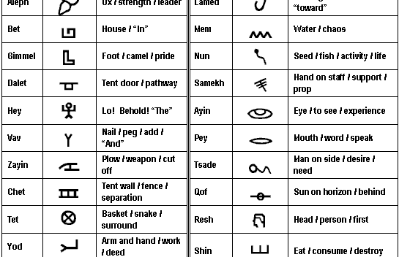
Pictograms

Slide 40
Nomadic Life vs Civilizations
How would you compare nomadic life to civilizations?

Slide 41
Civilizations Change Over Time
The main cause of change were:
  Shifts in the physical environment
  Interactions among people
Major result?
  Expansion of cities into larger political entities

Slide 42
Environment Affects People’s Lives
People depended on the environment because they needed rain and fertile soil to be able to produce crops
They also needed timber, stone, or metals
Sometimes drastic events would devastate a community
An earthquake could wipeout an entire population
Farming the land too much could destroy soil fertility

Slide 43
Culture Changes Hands & Changes Shape
Another major source of change was cultural diffusion
  The spread of ideas, customs, and technologies from one people to another
  It occurred through migration, trade, and warfare
Once people migrated, they interacted with others whose lives were different, they share and adapt newer customs
Trade also aided cultural diffusion
Writing sometimes passed religious scriptures from one people to another
Warfare: victorious armies incorporated the ways of a conquered people into their society

Slide 44
Cities Grow Into City-State
As rulers gained more power, they also gained more territories which gave rise to the city-state
  A political unit that included a city and its surrounding lands and villages
Rulers, priests, or nobles controlled the lands outside of the city and forced the peasants to give them some of the crops they grew on it

Slide 45
First Empires Are Established
As neighboring rulers fought each other, one of them had to come out victorious
The victor would conquer the other city and build an empire
  A group of states or territories controlled by one ruler

