Slide 1
The Depression & FDR
1929-1941

Slide 2
The Great Depression
In the 1902’s the economy was booming and many Americans felt very confident
They felt they had entered a prosperous era
The chairman of General Motors urged the public to invest in the stock market every month; that’s how confident they were
Suddenly in 1930, everything changed over night and many people (rich & poor) lost almost all of their money/savings

Slide 3
The Boom
A stock exchange is an organized system for buying and selling shares in corporations
However, since many investors didn’t have the money to buy more stock, they purchased on margin
This means they paid only a fraction of the stock price and borrowed the rest from their brokers

Slide 4
The Boom
Brokers, in turn, borrowed the money from banks
Investors
Brokers
Banks

Slide 5
The Crash
Some people feared that the boom market would end soon so they started to sell their stocks in late September
This made stock prices fall quickly
Brokers demanded repayment of loans, and this forced investors who (bought on margin) to sell their stocks

Slide 6
The Crash
Some experts thought this was just a scare and nothing to really worry about
However, for three straight days, stock prices dropped dramatically as investors sold millions of shares each day
Traders sold almost 13 million shares on October 24, this day would come to be known as “Black Thursday”

Slide 7
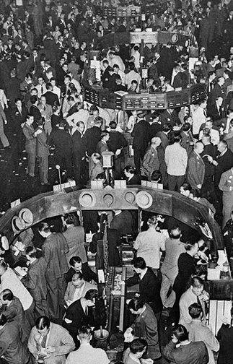
The Crash
How did it happen?

Slide 8
The Depression
These next two years would be one of the most sever economic crisis in US history
It came to be called The Great Depression
However the crash of the stock market was not the sole factor which caused this depression
An unbalanced economy, a credit crisis, international depression, and joblessness and poverty were also factors

Slide 9
Unbalanced Economy
Farm income shrank
Industries declined
The automobile and construction industries suffered from lagging orders
Employers cut wages and laid off workers
With incomes slashed, Americans could no longer afford consumer goods

Slide 10
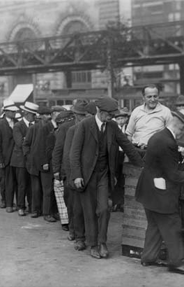
Unbalanced Economy
The growing gap in wealth between the rich & most Americans
In 1929: less than 1% of the population owned nearly 1/3 of the country’s wealth
75% of American families lived in poverty or on the very edge of it

Slide 11
Credit Crisis
Farmers bought land, equipment, and supplies on credit
Consumers bought cars
Investors borrowed to buy stocks
Small banks suffered when farmers defaulted (failed to meet loan payments)
These losses forced thousands of banks throughout the nation to close; millions of people lost their money

Slide 12
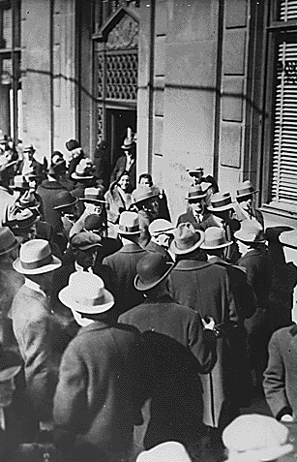
International Depression
Europeans relied on borrowing money from American banks & to sell goods to American consumers in order to repay their WW I debt
However bank funds for loans dried up
International trades slowed down
Without American loans other nations had less money to spend

Slide 13
Joblessness & Poverty
Millions of Americans lost their jobs during the Great Depression
1932: 25% of American workers were out of work
Unemployment remained at 20% for a decade
Workers worked only part-time or for reduced wages

Slide 14
Joblessness & Poverty
Long lines of hungry people waited for hours just for a slice of bread, a cup of coffee, or a bowl of soup
Unemployed people tried to earn some money by shining shoes or selling apples
Those who lost their homes, lived in shelters they made out of old boxes
People called these places Hoovervilles because of President Hoovers failure to act

Slide 15
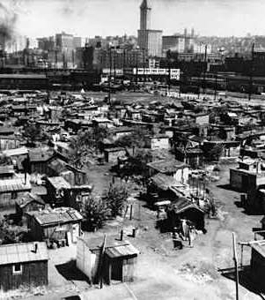
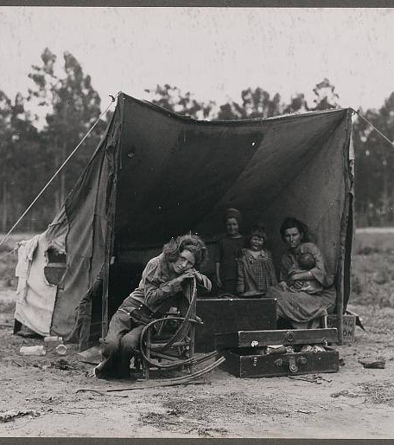
Hoovervilles

Slide 16
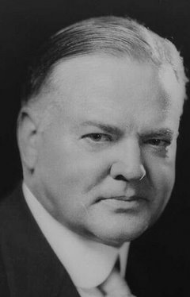
Hoover & the Crisis
Hoover believed: prosperity was “just around the corner” and that the “depression cannot be cured by legislative action or executive pronouncement”
He did, however, call on businesses to not cut wages or production
  Also for charities to do their best for the needy

Slide 17
Hoover & the Crisis
Charities, churches, and volunteers worked to provide relief
  Aid for the needy
Some cities withheld part of city workers’ wages to fund soup kitchens
But the number of people in need of help was overwhelming

Slide 18
Government Action
Eventually Hoover realized that the government needed to step in
1931: he authorized federal government spending on public works – projects such as highways, parks, and libraries
He did this in order to create new jobs
State and local governments ran out of money
All 3 levels of government declined

Slide 19
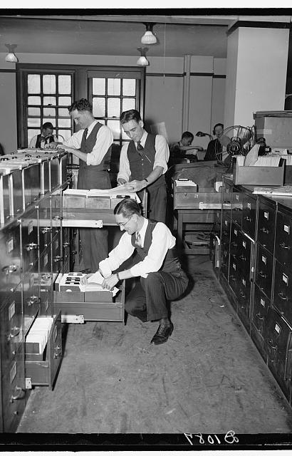
Government Action
Hoover then tried a different approach
January 1932: he asked Congress to create the Reconstruction Finance Corporation (RFC)
It lent money to businesses and provided funds for state & local programs for relief

Slide 20
The Bonus Army
Bonus Army turned many Americans against the president; Americans who already blamed the president for the depression
These were veterans from WW I who were jobless and wanted to receive the $1,000 bonus right away
They marched to Washington to demand their money

Slide 21
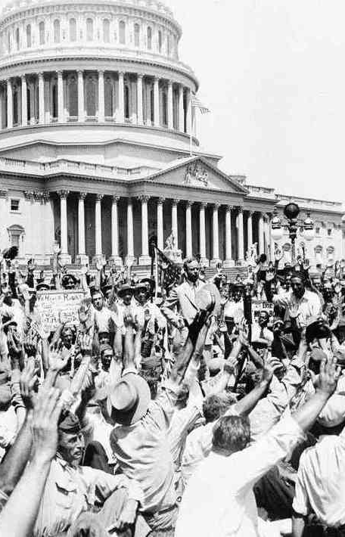
The Bonus Army
The Congress and the president turned them down
Many of them left but 2,000 still remained along with their families
The police was sent to disband the veterans’ camp, a conflict broke out, and two people were killed

Slide 22
Hoover’s Response
Hoover responded by sending in the army along with tanks, machine guns, and cavalry who were led by General Douglas MacArthur and his aide Dwight D. Eisenhower
Veterans and their families fled in terror as troops burned their camps

Slide 23
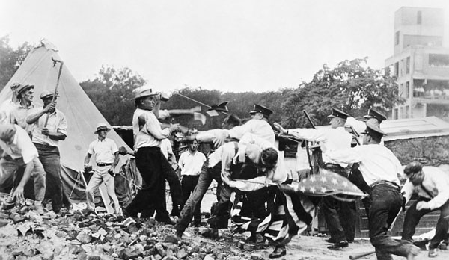
Hoover’s Response

Slide 24
Americans’ Response
Many Americans were horrified that the government had attacked its own citizens, particularly war veterans
Hoover seemed cold, distant, and out of touch with ordinary people
Many thought that time had come for a change in government

Slide 25
Roosevelt’s New Deal
The Depression & FDR

Slide 26
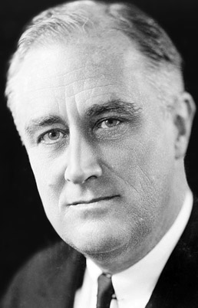
Franklin D. Roosevelt
Democrats chose Governor Franklin D. Roosevelt of NY as their candidate for the presidential election
FDR found out he was nominated by the Democrats and flew to Chicago to give the first ever acceptance speech at a convention
Republicans nominated President Hoover for reelection

Slide 27
Early Years of Promise
FDR was a distant cousin of former president Theodore Roosevelt
He married Eleanor Roosevelt – the niece of Teddy Roosevelt
His politics began in the election to the NY state senate in 1910
1913: he became assistant secretary of the navy
1920: chosen by Democrats for vice president

Slide 28
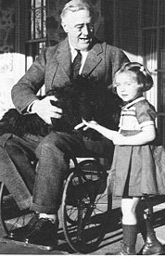
Unfortunate Event
1921: Roosevelt was struck with polio and left him paralyzed in both legs
Yet he remained strong

Slide 29
Return to Politics
He never publicly mentioned he was paralyzed
He also told journalists not to photograph his leg braces nor his wheelchair
As governor of NY he relied on the advice of a group of progressive lawyers, economists, and social workers
  They were known as the Brain Trust

Slide 30
FDR Takes Charge
Americans were charmed by FDR’s confidence and his power of action
November 8: Americans elected for FDR in a landslide
He received 472 of the 531 electoral votes
Democrats also won victories in Congress
People really wanted a change in government

Slide 31
FDR Takes Charge
March 4, 1933: at the inauguration, FDR told the nation that:
  “the only thing we have to fear, is fear itself – nameless, unreasoning, unjustified terror”
  “the greatest primary task is to put people to work”

Slide 32
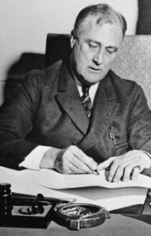
Restoring Confidence in Banks
2 days after inauguration, Roosevelt ordered all banks to close for 4 days
He called Congress in for a special session where he presented his ideas on how to fix the crisis
7 hours later, Congress passes the Emergency Banking Relief Act
It proposed a wide range of presidential powers over banking and set up a system by which banks would open again or be reorganized

Slide 33
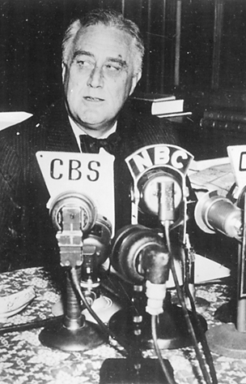
Restoring Confidence in Banks
FDR had a way of using media to better communicate with the American people
He held many radio talks which he called fireside chats because he sat next to a fireplace in the White House as he spoke
These chats helped FDR gain the public’s confidence

Slide 34
The Hundred Days
After solving the banking crisis, FDR turned towards other problems
He sent Congress a stack of proposals for new programs to help the economic problems
They were 15 proposals and Congress approved all of them

Slide 35
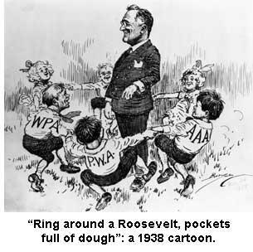
The Hundred Days
The special sessions FDR held with Congress became to be known as the Hundred Days
They were very productive and it filled the nation with optimism
Journalists called it:
  “The gloom, the tenseness, the fear of the closing months of the Hoover administration had vanished”

Slide 36
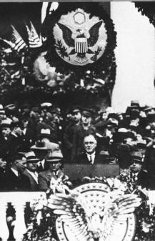
The New Deal Takes Shape
New Deal – new laws that Congress passed during the Hundred Days and the months that followed
They affected banking, the stock market, industry, agriculture, public works, relief for the poor, and conservation of resources

Slide 37
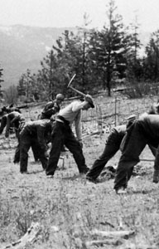
Jobs & Relief
FDR planned to help the unemployed with work relief programs
In his 1st month in office, FDR asked Congress to create the Civilian Conservation Corps (CCC)
Over the next 3 years, the CCC employed about 3 million young men to work on projects

Slide 38
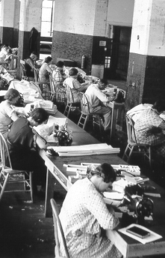
Jobs & Relief
He made aid to the poor and suffering his top priority
He established the Federal Emergency Relief Administration (FERA) to give money to the states for use in helping people in need
He also helped agriculture
May 12th: Congress passed the Agricultural Adjustment Act (AAA)

Slide 39
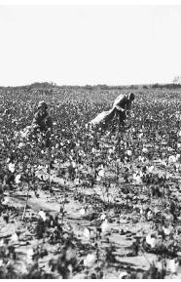
Agricultural Adjustment Act
Its goals:
  1) to raise farm prices quickly and
  2) to control production so that farm prices would stay up over the long term
During the first year the supply of food was greater than the demand

Slide 40
Agricultural Adjustment Act
To control production & farm prices, the AAA paid farmers to leave some of their land uncultivated
If prices of farm products fell below a certain leave, the AAA would pay farmers subsidies – grants of money – to make up the difference
First 3 years: farmers’ incomes rose by about 50%

Slide 41
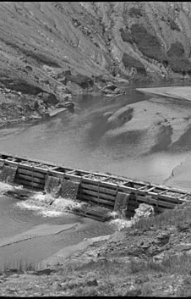
Rebuilding a Region
The Tennessee Valley Authority (TVA) aimed to control flooding, promote conservation and development, and bring electricity to rural areas along the Tennessee River
Some criticized the TVA because it should be used to support programs nationwide

Slide 42
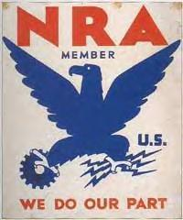
Helping Business & Labor
On the last days of the Hundred Days, Congress passed the National Industrial Recovery Act (NIRA)
FDR called it the “most important and far-reaching legislation” ever passed in the US
It aimed to boost the economy by helping business regulate itself

Slide 43
Helping Business & Labor
The National Recovery Administration (NRA) encouraged businesses to set a minimum wage and abolish child labor
It also tried to set up codes governing pricing and other practices for every industry

Slide 44
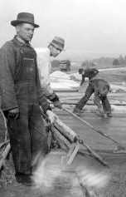
Helping Business & Labor
Public Works Administration – launched by the NRA and was used to stimulate the economy through the building of huge public works projects that needed large numbers of workers
Construction of roads, shipyards, hospitals, city halls, and schools

Slide 45
Helping Business & Labor
Federal Deposit Insurance Corporation (FDIC) – created to avoid future banking crises
It insured bank deposits
The government guaranteed that money placed in a bank insured by the FDIC would not be lost if the bank failed
Securities & Exchange Commission (SEC) – was passed to help regulate the sale of stocks and bonds
It also gave the SEC the power to punish dishonest stockbrokers and speculators

Slide 46
Life During the Depression
The Depression & FDR

Slide 47
Hard Times in America
Not everyone lost their homes, job, or need aid during the depression
But they had to live with less; less of everything
They made it through the depression by pulling through with families

Slide 48
Women Go to Work
There was a prejudice in American society which thought that women should not work if the men are unemployed
But, desperation drove people to make changes to their social lives
More women started going to work, even if they earned less than a man

Slide 49
Women Go to Work
Women had it hard because they had to work and also take care of the house
Since families did not have enough money to buy things, women started sewing clothes for their children and husbands
Some started home businesses such as laundries or boardinghouses

Slide 50
Women Go to Work
Frances Perkins – was the first woman to be appointed to a cabinet position, appointed by FDR
Ellen Sullivan Woodward – started a program to give jobs to women
Hattie Caraway – became the first woman to be elected to the US Senate

Slide 51
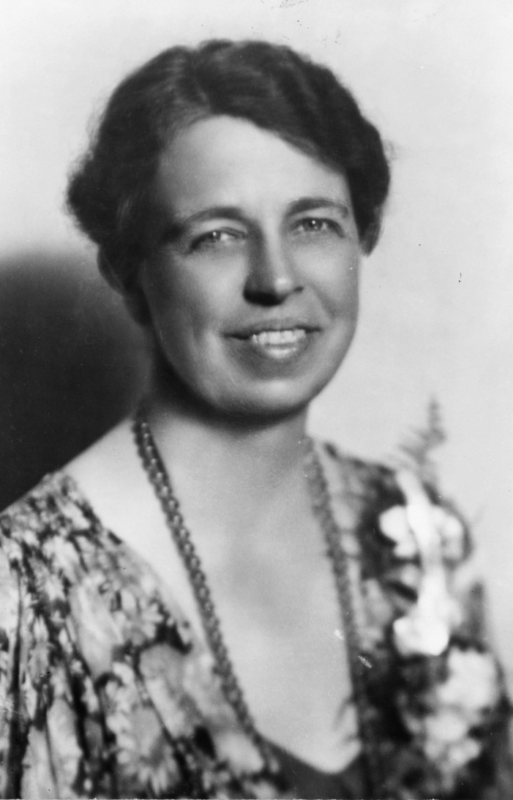
Eleanor Roosevelt
She was the best known woman in the US
She acted as her husband’s “eyes & ears”
She helped him a lot since he could not move due to being paralyzed
Eleanor campaigned for women and minorities and other humanitarian concerns

Slide 52
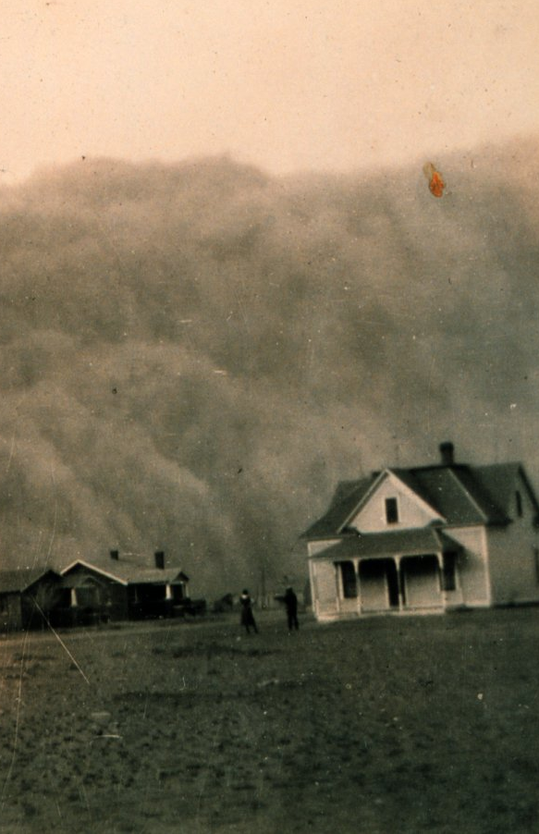
The Dust Bowl
In the 1930s the southern Great Plain suffered a major environmental disaster
Using new technologies such as tractors and disc plows, farmers cleared millions of acres of sod for wheat farming
Not knowing the roots of the grass had held the soil in place

Slide 53
The Dust Bowl
1931: a terrible drought struck and eliminated crops and the soil dried out causing strong winds to blow the soil away
1934: a strong storm carried about 300 million tons of soil, depositing some of it on ship 300 miles away in the Atlantic
Thousands of farmers went bankrupt
400,000 of them migrated to California and became migrant workers – moving from place to place to harvest fruits and vegetables

Slide 54
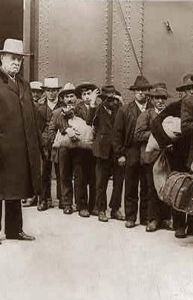
Plight of Minorities
The depression hit minorities very hard since they already had very little when they arrived
African Americans, Native Americans, and Hispanic Americans

Slide 55
African Americans
South: more than 50% of the A. American population had no jobs
400,000 of them migrated to the north to search for a better life
They did however make political gains
FDR had a group of advisors called the Black Cabinet
Robert Weave, Ralph Bunche, Mary McLeod Bethune

Slide 56
African Americans
They still continued to fight prejudice
1939: Marian Anderson (opera singer) was denied permission to sing in Constitution Hall because she was black
Mrs. Eleanor Roosevelt, however, helped arrange Marian sing at a historical moment at the Lincoln Memorial

Slide 57
Native Americans
John Collier – introduced a set of reforms known as the Indian New Deal
He stopped the sale of reservation land
Got jobs for 77,000 Native Americans in the Civilian Conservation Corps
Obtained Public Works Administration funds to build new reservation schools

Slide 58
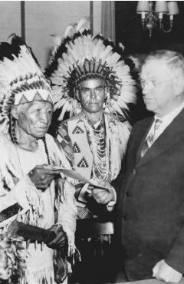
Native Americans
Collier also pushed Congress to pass the Indian Reorganization Act of 1934
This restored traditional tribal government and provided money for land purchases to enlarge some reservations

Slide 59
Hispanic Americans
About 2 million people of Hispanic descent lived in the US (California & the Southwest)
Many came from Mexico and worked as farmers, migrant workers, and laborers
However resentment grew amongst them
Politicians & labor unions demanded that they be driven out of the US

Slide 60
Radical Political Movements
These hard times helped radicals gain ground and popularity in the US
They advocated extreme and immediate change
Socialists / Communists saw the depression as the death of a failed system

Slide 61
Socialism / Communism
Communists attracted workers, minority-rights activists, and intellectuals with promises to end economic and racial injustice
However neither party became strong enough to gain political influence in the US

Slide 62
Fascism
It is a political philosophy that holds the individual second to the nation and advocates government by dictatorship
1936: Spanish Civil War began
Fascists were trying to overthrow the government in Spain
These fascists were supported by those in Germany and Italy

Slide 63
Entertainment & the Arts
Two different trends in entertainment & the arts
Escapism – light or romantic entertainment that helped people forget about their problems
Social Criticism – portraits of the injustice and suffering of Depression America

Slide 64
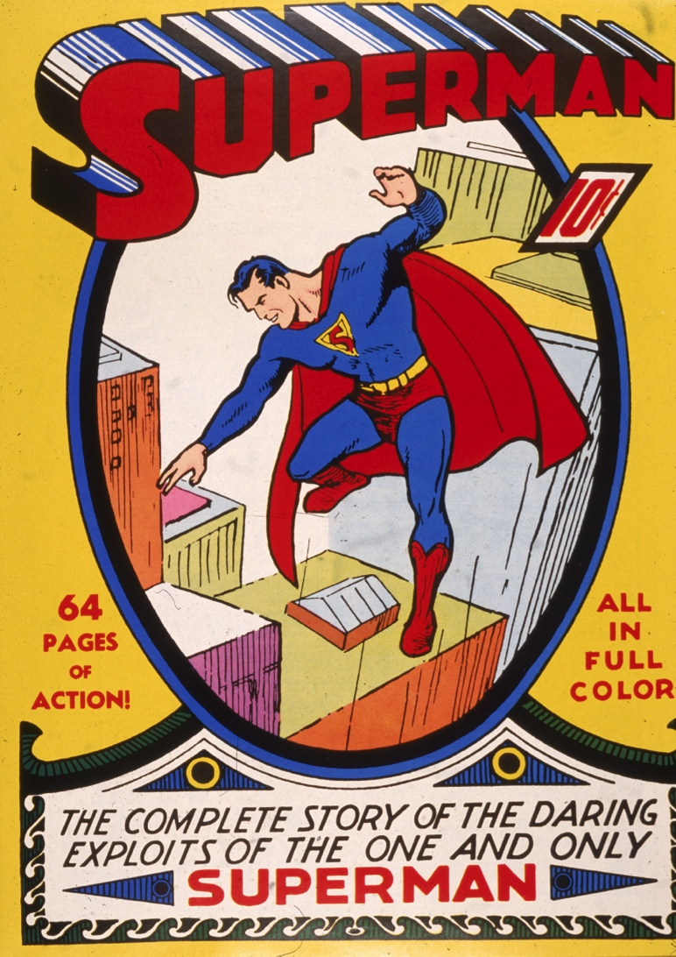
Radio
Radio also became popular
Daytime dramas were sponsored by laundry detergents and they earned the nickname “soap operas”
Adventure programs such as “Dick Tracy”, “The Lone Ranger” and “Superman” had millions of listeners

Slide 65
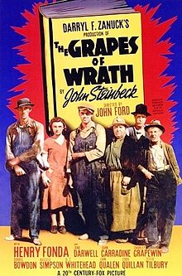
At the Movies
Every week about 85 million Americans went to the movie theaters
Some movies explored serious topics such as “The Grapes of Wrath” which was about farm families fleeing the Dust Bowl
Also “Gone with the Wind” took place in the Civil War era

Slide 66
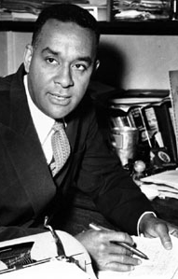
Images of the Times
Richard Wright’s novel “Native Son” told the story of an African American man growing up in Chicago

Slide 67
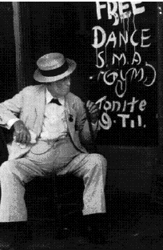
James Agee & Walker Evans
Depicted poor Southern farm families in “Let Us Now Praise Famous Men”
They used photography to do this

Slide 68
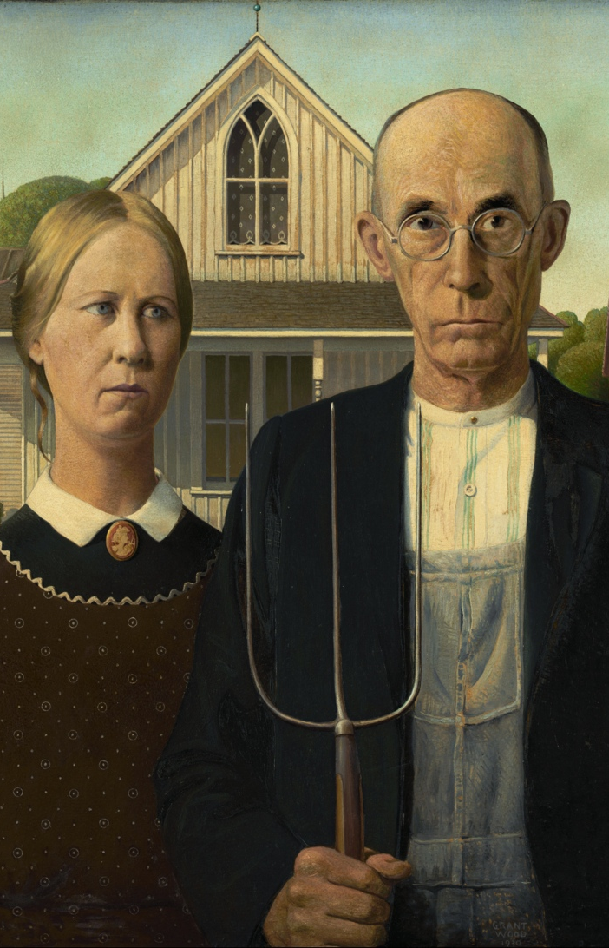
Grant Wood & Thomas Hart
Were painters who showed ordinary people confronting the hardships of Depression life

Slide 69
Effects of the New Deal
The Depression & FDR

Slide 70
New Deal Opponents
Although FDR counted on big business to support his efforts to revive the economy, they were very much opposed to the New Deal
They accused of him spending too much of government money and destroy free enterprise

Slide 71
Demanding More Reform
Liberals on the other hand, wanted a more active government
Father Charles Coughlin – a Detroit priest, once a supporter of FDR, then became one of his opponents, attacked FDR for not dealing firmly enough with big business
He also attacked Jews, bankers, Communists, and labor unions
He lost many supporters in the end because of his views

Slide 72
Demanding More Reform
Francis Townsend – California doctor, became popular because of his idea for a monthly pension – payment, for older people
Older people who quit their jobs would receive a pension
Congress didn’t pay much attention to him but it did make Americans think about their future and of the elderly poor as well as the need of retired people

Slide 73
Demanding More Reform
Huey Long – Senator from Louisiana who complained that FDR had not taken proper steps to redistribute wealth in the US
“Share Our Wealth Plan” – taxing the rich heavily then using that money to give every American a home and $2,500 a year
He gained popularity and the polls suggested he could have won on a third-party ticket
But in 1935 he was assassinated…wonder why…

Slide 74
Demanding More Reform
Revenue Act – raised taxes on wealthy people and corporations in order to bring in more government funds
1925: Second New Deal – laws passed which bought a new set of programs & reforms
They changed American life even more than the Hundred Days had done

Slide 75
Creating Jobs
20% of the workforce was still unemployed
Works Progress Administration
  gave people jobs and helped the country
  kept about 2 million people employed
  built / repaired about
    800 airports
    125,000 public buildings
    75,000 bridges
    650,000 miles of road

Slide 76
Creating Jobs
Artists, writers, and musicians who were unemployed were also given jobs:
  Painters decorated the new buildings
  Writer/photographers documented life throughout America
  Writers produced “Life in America”: 150 volumes that recorded folk-tales and songs, African American narratives, and Native American narratives

Slide 77
Help for Those in Need
1935: Congress passed the Social Security Act
  Created a tax on workers and employers
  This money provided monthly pensions for retired people
  This also helped people with disabilities, the elderly poor, and children of parents who could not support them
Unemployment Insurance – payments to people who lost their jobs

Slide 78
Labor Movement
Labor unions grew stronger
Flint, Michigan: workers at the General Motors plant planned a sit-down strike until management agreed to negotiate with them about their demands
44 days: families/friends brought them food and finally the strikers won the right to organize their union

Slide 79
Labor Movement
John L. Lewis – head of the US Mine Workers who fought to unite workers in every industry in a single union
Most unions only represented skilled workers, but Lewis fought to represent even unskilled workers – the were the largest group in the labor unions

Slide 80
Labor Movement
Congress of Industrial Organization – helped create industrial union
National Labor Relations Act (Wagner Act) – guaranteed workers the right to form union to bargain collectively with employers
Fair Labor Standards Act – banned child labor and set a minimum wage of 40 cents per hour

Slide 81
Supreme Court
Opponents of the New Deal took their issues to court
May 1935: Supreme Court ruled that the National Industrial Recovery Act was unconstitutional
The Court claimed that Congress had exceeded its lawful power to regulate interstate commerce

Slide 82
Supreme Court
January 1936: Supreme Court struck down on the Agricultural Adjustment Act
Cases were also pending for the Wagner Act, the Social Security Act, and the Tennessee Valley Authority
Some thought the Supreme Court was going to destroy the New Deal

Slide 83
Election of 1936
Presidential campaign of 1936: Did the American people support FDR and the New Deal?
FDR’s opponent was Republican Alfred M. Landon who also gained the support of many dissatisfied Democrats of FDR

Slide 84
Second Term
On election day, FDR received 61% of the popular vote which was the greatest landslide at the time
His support came from progressives, liberals, the poor and unemployed, urban workers, and African Americans
These groups would also form the nucleus of the Democratic Party for future decades

Slide 85
Roosevelt’s “Court-Packing” Plan
After reelection, FDR took action to prevent the Supreme Court from undoing the New Deal
  Asked Congress to increase the # of supreme justices from 9 to 15
  He appointed 6 new justices – those who supported him

Slide 86
The Roosevelt Recession
By 1937 the national income had nearly returned to its 1929 level
FDR thought that the Depression was over so he reduced government spending on relief and job programs in order to reduce the debt
The economy faltered immediately
Farm prices dropped, millions of people lost their jobs, hard times returned
This became to be known as the Roosevelt Recession

