Slide 1
World War II
1939-1945

Slide 2
Rise of Dictators
Dictators – leaders who control their nations by force
In the 1920s: Adolf Hitler gained much popularity in Germany
He was among many ruthless leaders who rose to power by taking advantage of people’s anger & suffering
Some Europeans resented the terms of the Treaty of Versailles after WWI
Hitler, like other leaders, promised a better life which they described with a glorious future

Slide 3
Italy
Benito Mussolini – rose to power by appealing to the resenting of many Italians who felt they had not won enough in the Versailles treaty
He introduced fascism – extreme nationalism and racism
His Fascist Party gained enough popularity to force the king out of Italy and declare him the head of government
He then went on to ban all political parties except his own

Slide 4
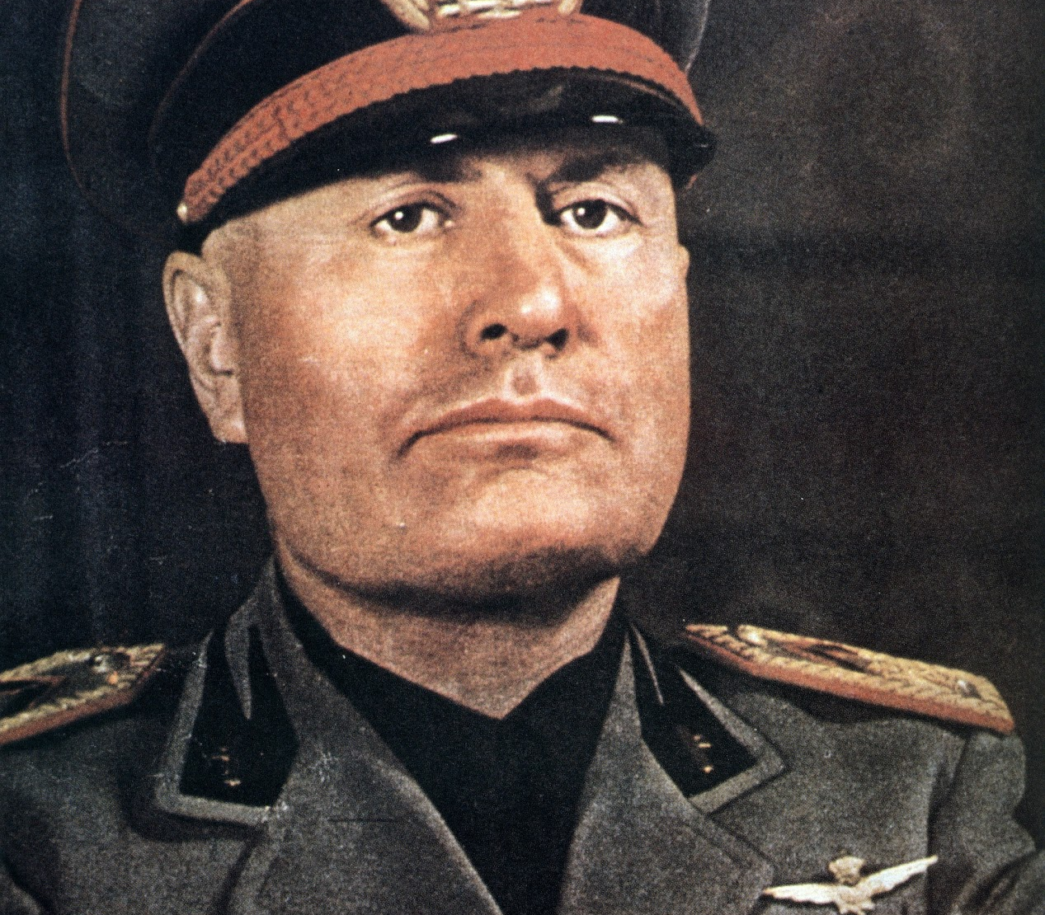
Benito Mussolini – Il Duce
Nicknamed “the leader”, he put an end to democratic rule, civil liberties, and a free press
Boys & girls were enrolled in military organizations
He vowed to recapture the glory of the Romans

Slide 5
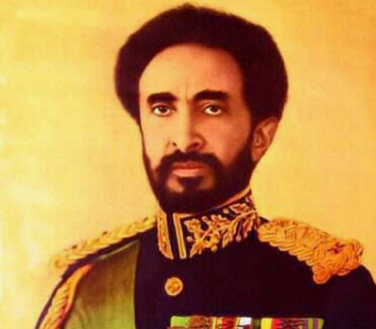
Capture of Ethiopia
1935: Mussolini sent forces to invade the African country of Ethiopia
Ethiopian emperor Haile Selassie appealed to the League of Nations
The League responded by banning trade in weapons with Italy but it lacked the power to enforce the ban
Italy withdrew from the League and continued its ways

Slide 6
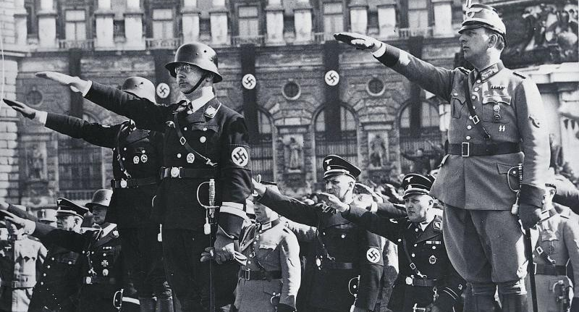
Germany
The great Depression hit Germany hard with millions of people losing their jobs and its economy nearing collapse
Germans turned to Adolf Hitler who gained popularity by exploiting people’s concern about inflation and unemployment
He also claimed that the Versailles Treaty had forced Germany to give up some of its territory & to make heavy payments

Slide 7
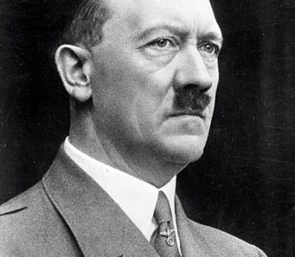
Adolf Hitler & the Nazi Party
1921: Hitler became chairman of the National Socialist German Workers’ Party (Nazi Party)
The Nazi Party were openly racist and they portrayed German people as superior to all others
Their anger was mostly directed towards Jews, whom Hitler blamed for Germany’s many problems
Anti-Semitism – hatred of the Jews

Slide 8
Adolf Hitler
After he becomes chancellor he ends all democracy & establishes totalitarian rule
  A single party and its leader suppress all opposition and control all aspects of people’s lives
He claimed that Germany had a right to expand its territory
Its neighbors watched as he rebuilt Germany’s military
To gain support he formed an alliance with Italy in 1936

Slide 9
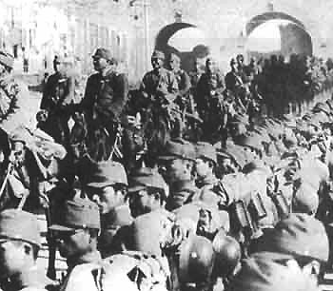
japan
The Depression also hit Japan and its people were frustrated that their government did nothing to solve the problems
The new leaders that rose to power in Japan thought they could solve its problems by expanding its territories into Asia
September 1931: Japan launched an attack on Manchuria, a province in northeastern China
While the League of Nations condemned the attack, they did nothing to stop it
1937: Japan invaded northern China and 3 years later it signed a pact of alliance known as the “Axis”, with Germany & Italy

Slide 10
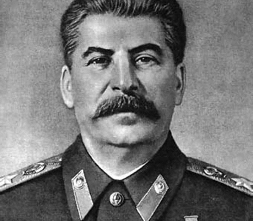
Soviet UNion
Late 1920s: Joseph Stalin rose to power as the Communist leader of the Soviet Union
He demanded complete obedience from the people he ruled
He executed his rivals, ordered the deaths of thousands suspected of supporting his rivals, and sent millions of Russians to labor camps
He also reorganized the nation’s economy, forcing millions of people onto government-owned farms

Slide 11
War Begins
September 1, 1939: Hitler sent his armies to invade Poland
  Two days later GB & France declare war on Germany
  World War II had begun
The Germans blasted holes in the Polish defense with planes and machines
  They called it a blitzkrieg – “lightning war”
Afterwards the Soviet Union moved in and occupied eastern Poland to divide the country along with Germany
Stalin also forced the Baltic countries of Latvia, Lithuania, and Estonia to be part of the Soviet Union

Slide 12
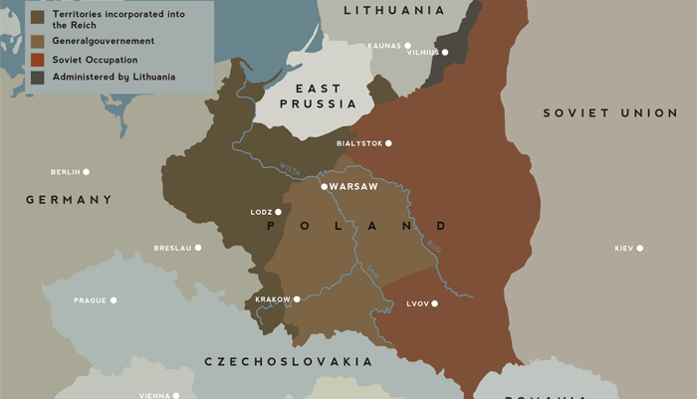
War Begins

Slide 13
The War Expands
In April, Hitler attacked Denmark & Norway and the following month moved to invade the Netherlands & Belgium
In June, Germans crossed the Somme River and continued into France
Italy then joined the war alongside Germany and attacked France from the south
Germany, Italy, and later Japan, formed the Axis Powers
June 14, 1940 the Germans march into Paris and the French surrender a week later

Slide 14
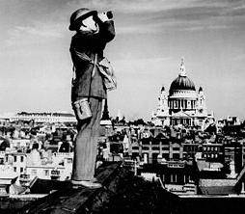
The Battle of Britain
Great Britain was the only country standing in Hitler’s way of full domination of Europe
August 1940: Germans bombed British shipyards, industries, and cities
The British were inspired by Winston Churchill words
The Battle of Britain continued until October but Germany never gained control of the island

Slide 15
American & the War
Although most American sympathized with the Allies again, they were determined to avoid war this time
America First Committee – group of isolationists who thought the US should keep out of Europe’s business
  Charles Lindbergh
  Henry Ford
Roosevelt still took precautions and preparations for the war anyway

Slide 16
1940 Election
FDR runs for a third term, breaking the tradition set by Washington
Republicans chose Wendell L. Willkie as their candidate
Willkie approve most of the New Deal and generally agreed with FDR’s foreign policy
In his campaign FDR promised Americans, “your boys are not going to be sent into any foreign wars”
  He won the victory easily

Slide 17
U.S. Involvement Grows
After the election FDR moves to support the Allies openly
Lend-Lease Act – allowed America to sell, lend or lease arms or other war supplies to any nation considered “vital to the defense of the US”
Britain was running out of cash and so they were the 1st to use this act to acquire weapons
Isolationists of course opposed this act. Why?

Slide 18
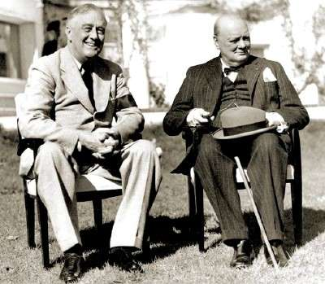
The Atlantic Charter
August 1941: FDR & Churchill met and discussed the Atlantic Charter
  The 2 nations pledged that the people of every nation would be free to choose their own form of government and live free of “fear & want”
Disarmament – giving up military weapons

Slide 19
Japanese Threat
After the fall of France, the Japanese move in and take the French colony of Indochina
They also plan to take the Dutch East Indies, British Malaya, and the American territory of the Philippines
  To acquire rubber and oil

Slide 20
US Responds
The US responds by applying economic pressure
  FDR froze all Japanese assets in American banks preventing them from obtaining money they had in the US
  He stopped the sale of oil, gasoline, and other natural resources to Japan
  This angered the Japanese

Slide 21
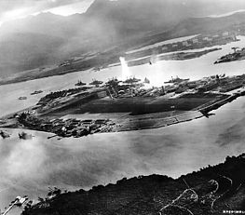
Attack on Pearl Harbor
At 7:55 on Sunday, December 7, 1941: Japanese warplanes attacked the American military base at Pearl Harbor, Hawaii
Americans were very vulnerable to this attack
  Ships were anchored in a neat row
  Airplanes were grouped together on the airfield
  They were easy targets for the Japanese

Slide 22
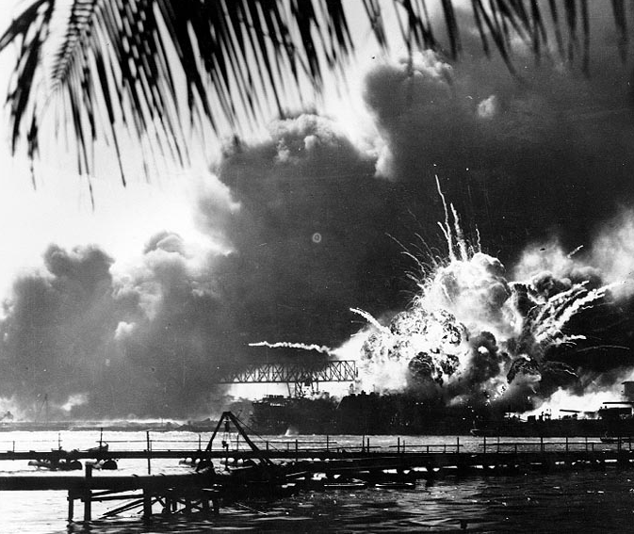
Attack on Pearl Harbor
The attack destroyed many battleships, cruisers, and other vessels
Hundreds of planes were destroyed or damaged
More than 2,300 soldiers, sailors, and civilians were killed

Slide 23
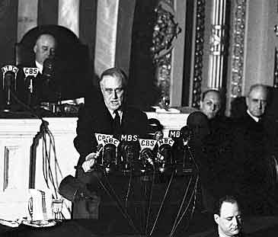
Pearl Harbor
This was the worst defeat on American soil in history
The day after the attack, FDR asked Congress for a declaration of war
December 11, the Axis Powers declared war on the US
The US joined the Allies – GB, France, China, Soviet Union

Slide 24
On the home front
World war II

Slide 25
America Prepares
Pearl Harbor united Americans to stick together and be prepared for the war
America was already preparing for the war prior to the attack with the Selective Service Acts
But now more than 15 million Americans had joined the armed forces
About 260,000 served in the WACs (Women’s Army Corps), the WAVES (Women Appointed for Volunteer Emergency) and women’s units in the marines, Coast Guard, and army

Slide 26
Financing the war
How do we raise the money for the war?
Revenue Act of 1942 – raised corporate taxes and required nearly all Americans to pay income taxes
The government also borrowed money to finance the war by selling war bonds
Movie stars and celebrities urged people to buy war bonds

Slide 27
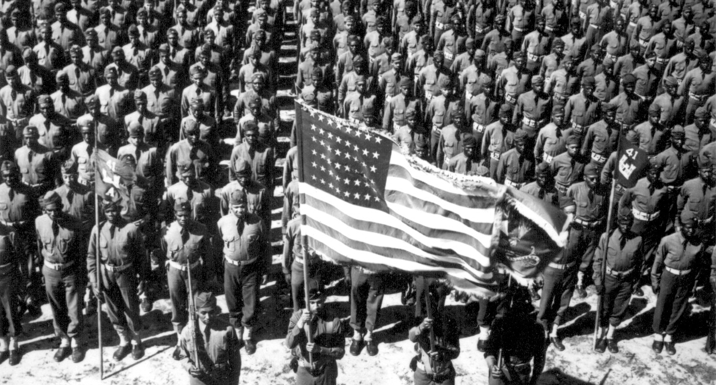
Wartime America
Industry soared during the war with factories producing more than 70,000 ships, almost 100,000 tanks and airplanes, and millions of guns
Those who stayed at home had to provide food and shelter for all those in uniform
Production helped restore prosperity to the country after years of the Depression

Slide 28
Making sacrifices
Separation from loved ones
Shortages of many consumer goods – automakers stopped making new cars and turned to making tanks, planes, and trucks
Rationing – consumers could only buy limited numbers of goods

Slide 29
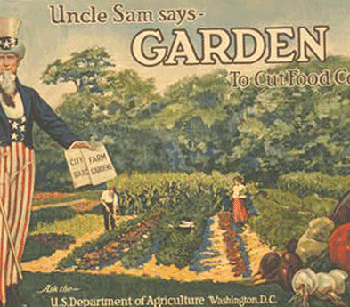
Helping the war effort
“Victory gardens” – growing vegetables instead of buying them
Children collected scrap metal for use in industry
Civil Defense – protective measures in case of attack
Office of War Information – promoted patriotism and helped keep Americans united behind the war effot

Slide 30
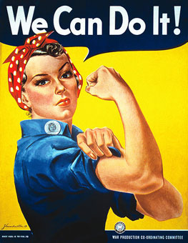
Women
More women than ever had entered the labor force since the men went on to fight in the war, again
Rosie the Riveter – an advertising campaign character who encouraged women to take factory jobs
They still earned less than men however
Most women lost their jobs after the war was over because the men had returned to reclaim their jobs

Slide 31
African Americans
About 1 million African American men & women served in the armed forces during the war
Most were given low-level assignments at first and were kept in segregated units
This changed gradually and in 1942 the army trained whites and blacks together
Tuskegee Airmen – 332nd Fight Group; shot down more than 200 enemy planes
Benjamin Davis, Jr. – became the 1st African American general in the US Air Force
A. Philip Randolph – demanded that government ban discrimination against African Americans

Slide 32
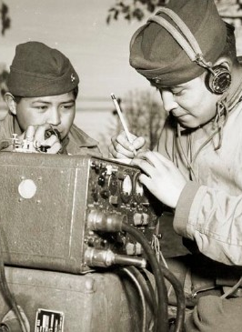
Native Americans
Many left reservations to work in defense industries
Ira Hayes – a hero in the battle for Iwo Jima in the Pacific
“Code Talkers” – Navajo group who used code language, which was based on the Navajo language, to send messages

Slide 33
Hispanic Americans
More than 250,000 Hispanic Americans served in the armed forces
The Medal of Honor was awarded to 12 Mexican Americans
Mercedes Cubria – 1st Hispanic woman officer in the WAC
Horacio Rivero – 1st Hispanic 4-star admiral since David Farragut to serve in the US Navy
Bracero – program which stimulated emigration from Mexico during the war years

Slide 34
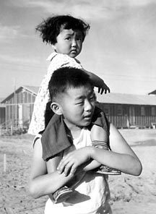
Japanese Americans
After Pearl Harbor, Japanese Americans were feared and hated by many other Americans
2/3 of Japanese Americans were Nisei – American citizens who had been born in the US; but they were still questioned by others

Slide 35
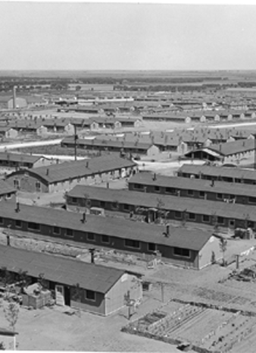
Japanese Americans
The government feared that these Japanese Americans were a danger
The President ordered the army to relocate more than 100,000 West Coast Japanese Americans to detention centers
Internment Camps – crowded and uncomfortable detention camps

Slide 36
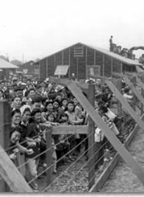
Korematsu vs United States
1944 Supreme Court case which upheld the order providing for the relocation of Japanese Americans
1988: Americans acknowledged the injustice of relocation
  Congress issued a formal apology and agreed to give each survivor $20,000 as a token of the nation’s regret

Slide 37
War in Europe & Africa
World war ii

Slide 38
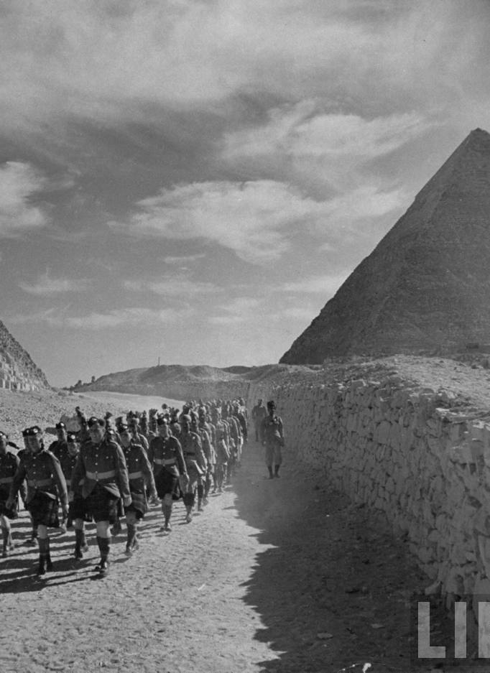
North African Campaign
January 1, 1942: the US joined Britain, the Soviet Union, and 23 other Allied nations in promising to defeat the Axis Powers
German forces occupied almost all of Europe and much of N. Africa
  If the Germans defeated the Soviets, they would be unstoppable
Although Stalin argued that attacking continental Europe would crush the Germans, Churchill claimed it would have been too difficult a task
In the end, the Allied Powers agreed to attack N. Africa

Slide 39
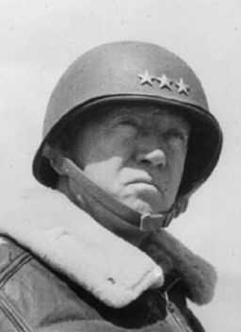
North African Campaign
November 1942, the British pushed the Germans almost entirely out of Egypt and they prevented the Germans from capturing the Suez Canal
November 8, 1942: American, British, & Canadian forces under general Dwight D. Eisenhower landed in Algeria & Morocco
Although the Americans met some defeat in Tunisia, they were backed by general George Patton who closed in on the Germans
May 1943: the Allies drove the Germans out of N. Africa

Slide 40
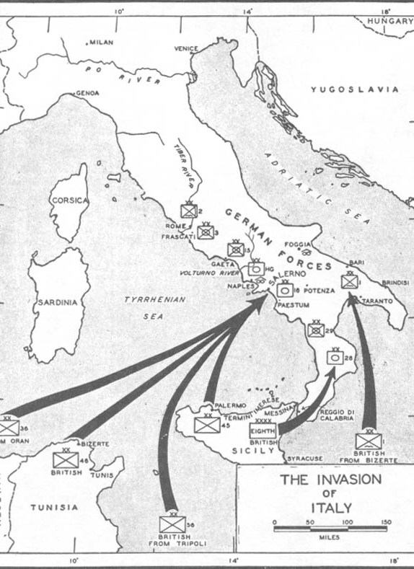
Invasion of Italy
By using bases in N. Africa, the allies could launch an attack on Italy, another Axis Power nation
Summer 1943: Sicily was under Ally control
  September: Allies were able to land in mainland Italy
The Italians saw the Allies advancing and they managed to overthrow their dictator, Benito Mussolini, and surrender
But the German forces in Italy continued to fight

Slide 41
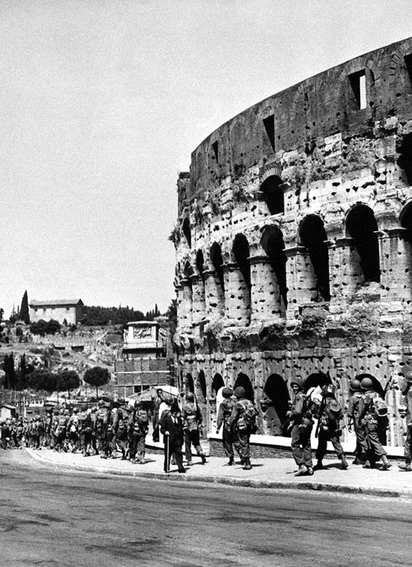
Invasion of Italy
Winter 1943: Allies meet some strong resistance in the central Italian town of Monte Cassino
January 1944: Allies land in Anzio, a seaport near Rome
May 1944: Allies finally break through the German forces and advance further into Rome
June 1944: Rome was liberated

Slide 42
Air war over Germany
Summer 1942: British & American air forces began a massive bombing campaign against Germany
Each day: American bombers bombed German factories and cities
Each night: British bombers bombed the same targets
It caused massive destruction and killed thousands of German civilians
July 1943: Hamburg was devastated after a week-long attack which killed more than 30,000 people

Slide 43
the eastern front
June 1941: Germans troops had invaded the Soviet Union and moved into the nation’s interior
September 1941: Germans surrounded the city of Leningrad and began a siege – military blockage which lasted 900 days
As food ran out, the people of Leningrad started to eat horses, cats, and dogs; thousands died
1941: Germans also attacked the capital, Moscow, and they actually reached the outskirts of the city
But the Russians somehow reversed their luck and forced the Germans’ to retreat, thanks to bad weather

Slide 44
Easter front
Spring 1942: Germany launched another attack but this time on the city of Stalingrad which was rich in oil
The Germans were able to capture Stalingrad but the Soviet surprised them by surrounding the city and cut off the German supply lines
February 1943: this brought starvation to the Germans and they finally surrendered

Slide 45
Invasion of France
Operation Overlord – invasion of France led by General Dwight D. Eisenhower
The plan was for his troops to land in Normandy on June 5th but didn’t land until June 6th because of rough seas
June 6, 1944: D-Day the troops landed on Normandy
Upon landing, the troops were met with gun fire and land mines
After a few weeks the Allies were able to gain a foothold and by August 25 French & Americans troops marched and liberated Paris

Slide 46
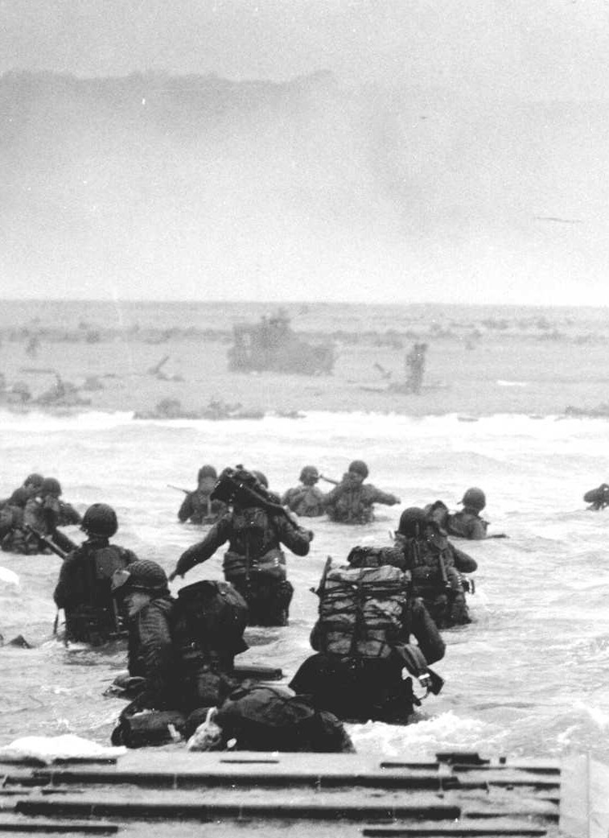
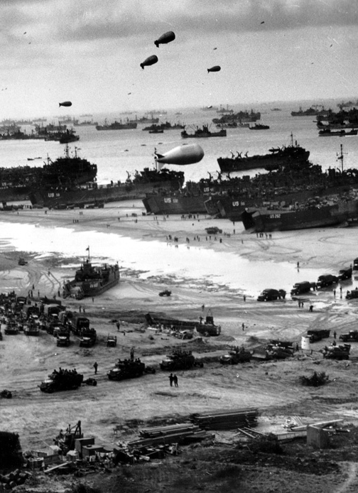
D-Day

Slide 47
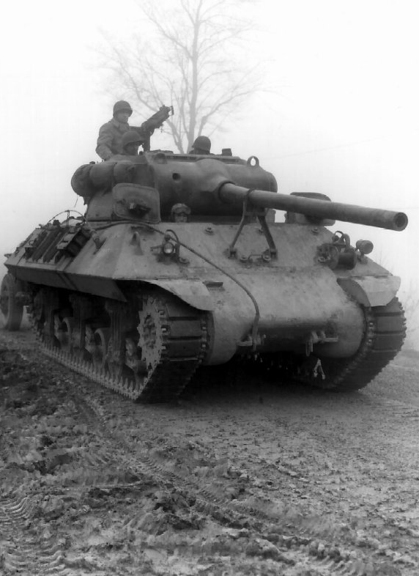
Battle of the Bulge
Germany fought on two fronts
  East: Soviets
  West: British/Americans
Battle of the Bulge - December 16, 1944: Germans launched a surprise attack along a Belgian line
  They drove troops and artillery deep into a bulge in the Allied lines
  After several battles, the Allies pushed the Germans back
  More than 100,000 soldiers died

Slide 48
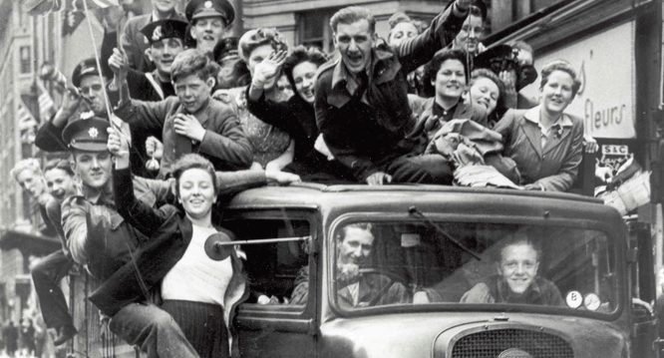
Battle of the Bulge
April 1945: marked the final phase
  Soviets surrounded Berlin (German Capital)
  April 30 - Hitler realizes the odds are against him and commits suicide
  May 7 – Germany signs an unconditional surrender
  May 8 – V-E Day “Victory in Europe Day”

Slide 49
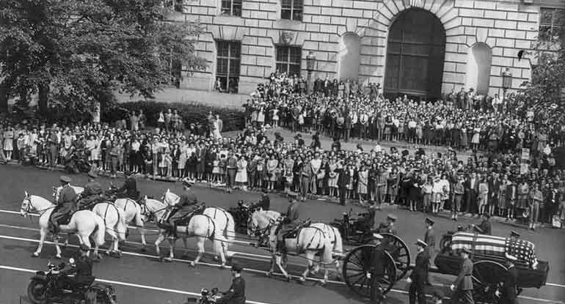
Death of a President
FDR did not share the Allied victory celebration with other leaders and Americans
April 12, 1945: he dies in Warm Springs, Georgia
Americans were devastated by the death
Vice President Harry S. Truman becomes president afterwards

Slide 50
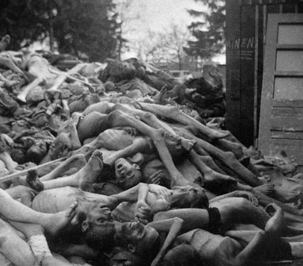
The Holocaust
After liberating the Nazi controlled areas of Europe, the Allies find horrifying scenes of Nazi brutality
The Nazis had developed, what they called, the “final solution of the Jewish question”
  They committed genocide – wiping out an entire group of people
Ever since Hitler gained power he persecuted Jews
  Jews were shot and thrown into massive graves

Slide 51
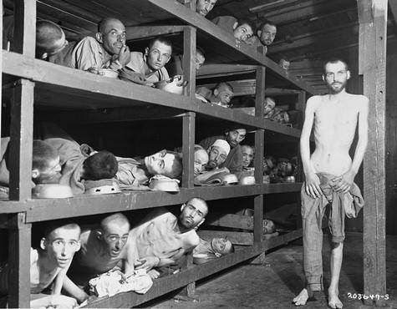
The Holocaust
Nazi troops crammed thousands of Jews into railroad cars and brought them to concentration camps – prison camps for civilians
Thousands became sick & died
“Final Solution” – Nazis built death camps where they killed thousands of people a day in gas chambers, then burned their bodies in ovens

Slide 52
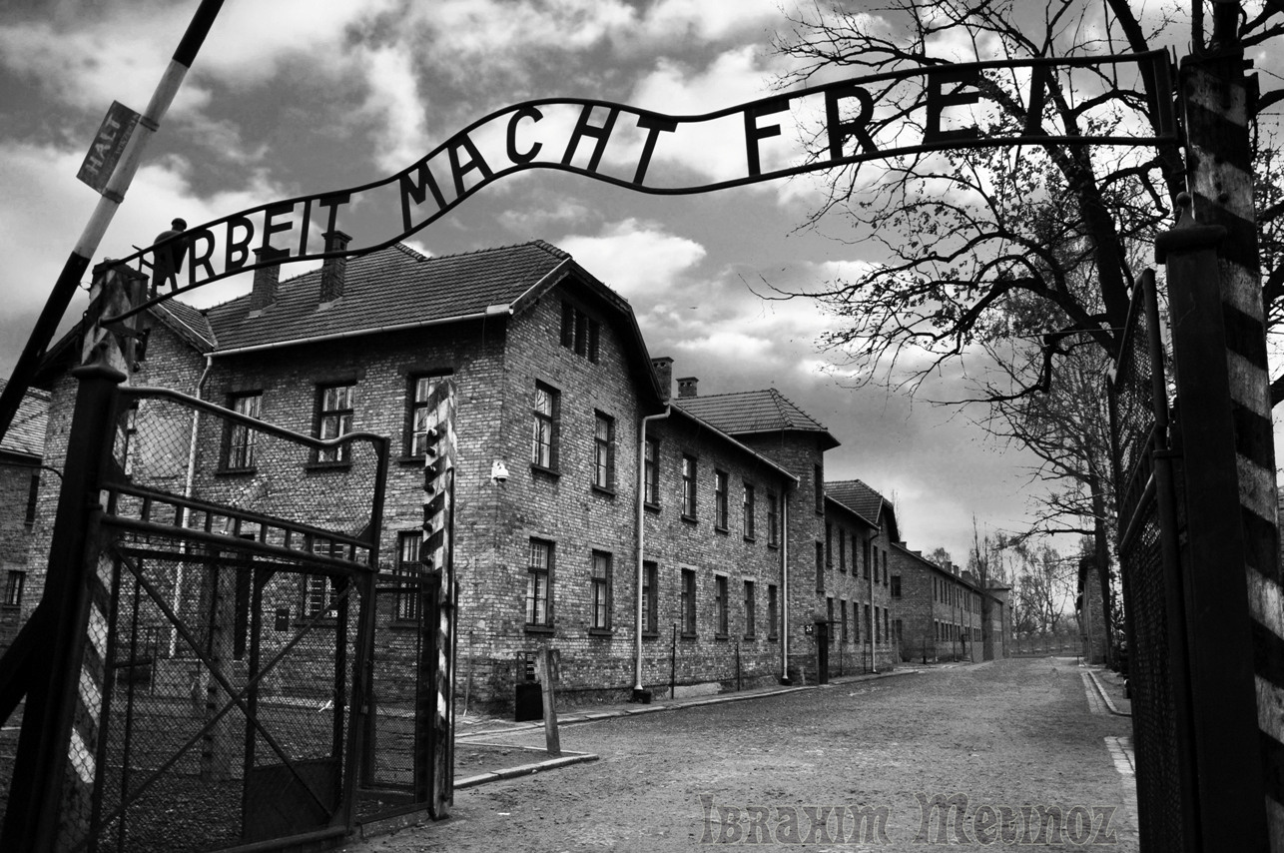
Auschwitz
This was located in Poland and was the largest concentration camp
The Nazis killed about 1-2 million people there
Non-Jews were killed too
  Polish people
  Gypsies
  People with handicaps

Slide 53
War in the Pacific
World war ii

Slide 54
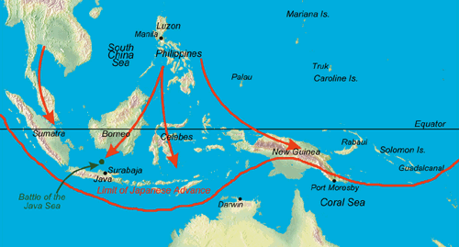
The Pacific Front
December 7, 1944: the same day the Japanese attacked Pearl Harbor, they also bombed American airfields in the Philippines and on the islands of Wake and Guam
Once they landed in the Philippines they quickly took the capital of Manila
Both Filipino and American forces were forced to retreat to the west of Manila

Slide 55
Fall of the Philippines
The Japanese were quick in taking the Philippines
April 9, 1942: tired Allied troops surrendered to the Japanese at the Bataan Peninsula
They forced many prisoners to march to a prison camp more than 60 miles away
Later on we found out what really occurred to these prisoners
If you had legs and can walk, you were forced to march
If you fell off the line, you were shot dead or bayoneted and left for dead

Slide 56
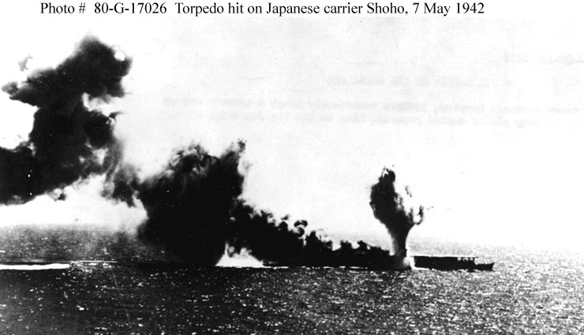
Battle of Coral Sea
April 16, 1942: 16 American bombers bombed Tokyo
  Although it did not do much in terms of military
  It did bring up American spirits about the war
Battle of Coral Sea – was a very strategic victory because it halted the Japanese advancement into Australia
American & Japanese fleets fought each other on the waters
Although the Americans suffered some damage, the Japanese were crippled with losses

Slide 57
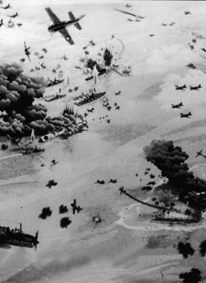
Battle of Midway
June 1942: another great victory for the Americans
American navy ship destroyed four Japanese aircraft carriers & hundreds of airplanes
It was the first major defeat of the Japanese

Slide 58
Island Hopping
American generals Douglas MacArthur and Chester Nimitz
The US began using the islands in the Pacific as bases for leapfrogging to other islands and attack the Japanese
  This became to be known as island hopping
August 1942-Februar 1943: American forces fought for control over the Guadalcanal, one of the Solomon Islands
June 1944: Americans captured Guam which provided a base for launching bombs on Japan
October 1944: American ships destroyed most of the Japanese fleet at the Battle of Leyte Gulf
It was the biggest naval battle in history where 282 ships took part in

Slide 59
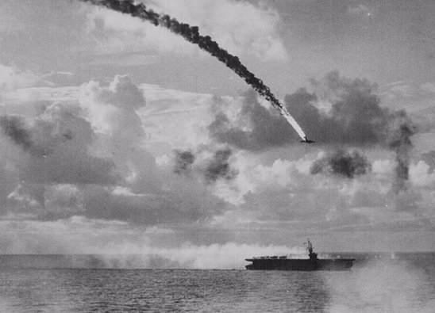
Advance on Japan
March 1945: Americans finally close in on the country of Japan
  They took the islands of Iwo Jima and Okinawa
The raids on Tokyo and other cities, thousands of civilians died and Japan’s economy was crippled
In a desperate attack, Japan unleashes a corps suicide pilots known as kamikazes
They crashed planes loaded with explosives into American ships

Slide 60
The atomic bomb
The Japanese continued to fight and refused to surrender
1939: German physicist Albert Einstein had written to FDR telling him that the Nazis might try to use the energy of the atom to build “ extremely powerful bombs”
FDR hears about this and wants to create this bomb himself so he creates a top-secret operation called the Manhattan Project
July 16, 1942: now-President Truman decides whether to use the bomb against Japan

Slide 61
The atomic bomb
Potsdam Declaration – the Allies issue this warning that if Japan did not surrender, then it face destruction
  The Japanese refuse to surrender
  Truman orders the bomb to be used
August 6, 1945: American B-29 bomber (Enola Gay) dropped an atomic bomb on the Japanese city of Hiroshima
3 days later a second bomb was dropped on Nagasaki

Slide 62
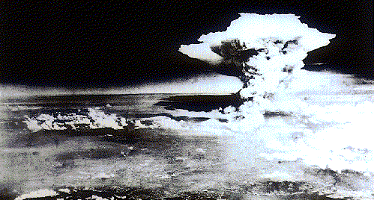
1st bomb
Leveled Hiroshima
Killed about 70,000 people

Slide 63
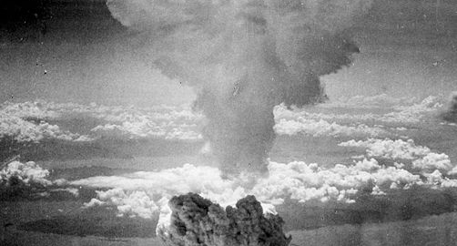
2nd bomb
Killed about 40,000 people

Slide 64
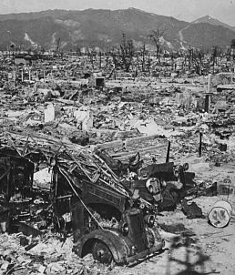
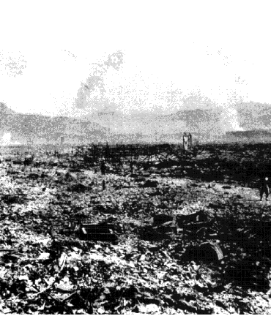
The atomic bomb
hiroshima
nagasaki

Slide 65
The war ends
After the bombings, the Japanese agreed to surrender
August 15, 1945: V-J Day was proclaimed for “Victory in Japan”
September 2: the Japanese signed a formal agreement and World War II ended
The years of the war, Nazi and Japanese officials were put on trial and accused of war crimes and crimes against humanity

Slide 66
Cost of the war
WW II was the most destructive war in history
More than 40 million people died during the war
More than 50% were civilians killed by bombing, starvation, disease, torture, and murder
American causalities
  322,000 dead
  800,000 injured
Soviet Union
  20 million deaths

