Slide 1
The Cold Era
1946 – 1954

Slide 2
Cold War Origins
Chapter 27 – Section 1

Slide 3
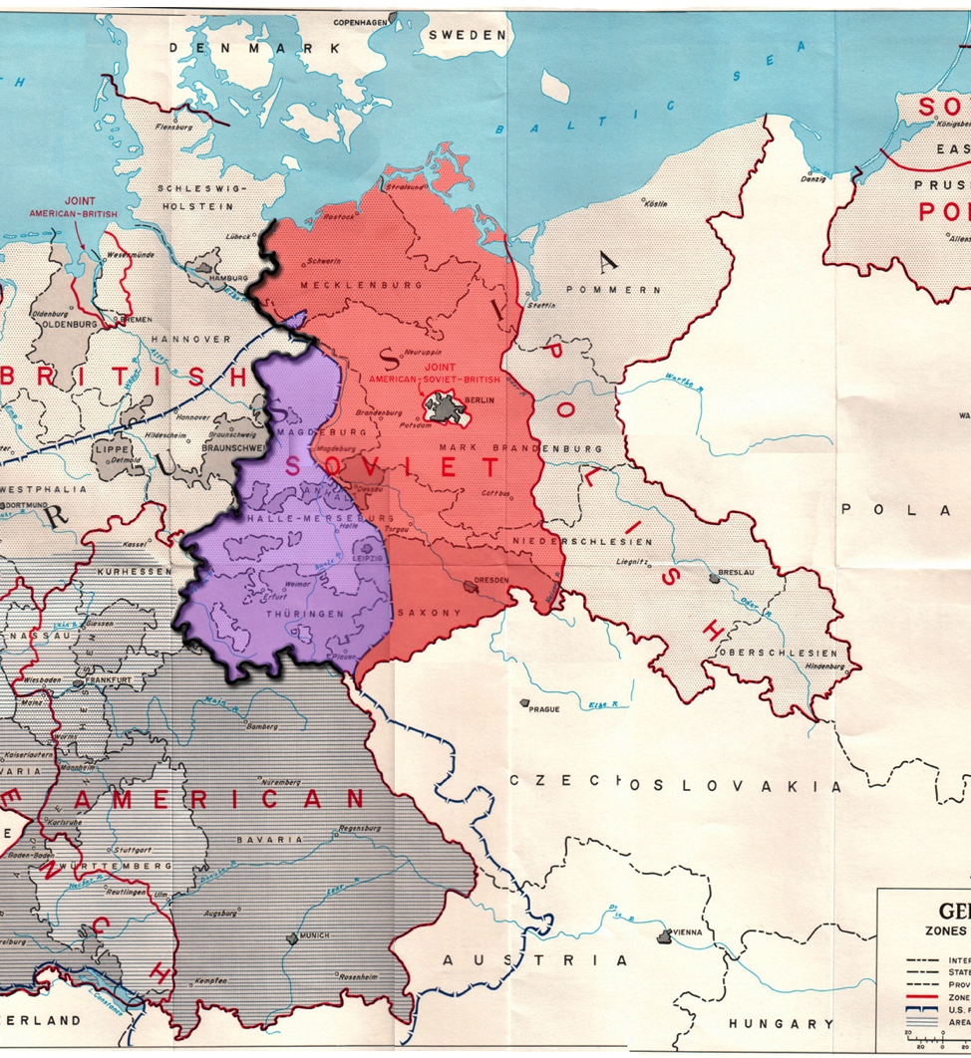
Wartime Diplomacy
Western democracies & Soviet Communists set aside their differences
However, the Soviets had already moved into the countries of Poland, Hungary, and Czechoslovakia when pushing back Germany

Slide 4
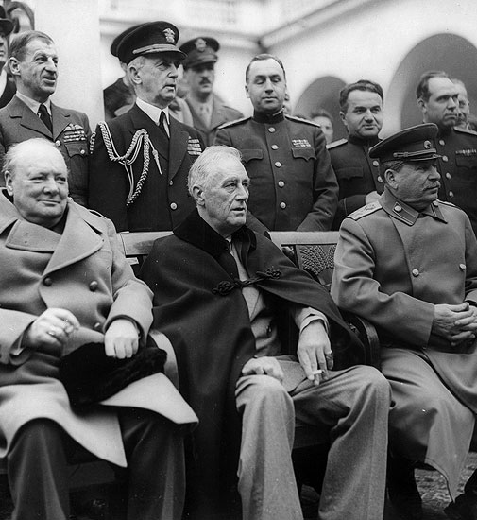
The “Big Three”
Franklin D. Roosevelt, Winston Churchill, and Joseph Stalin
They meet in Yalta to discuss issues about the postwar world
Yalta Agreement –
  The Soviet Union agreed to enter the war against Japan
  In return the Soviets received some territories in Asia

Slide 5
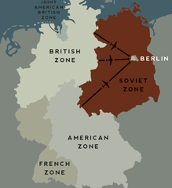
Wartime Diplomacy
Roosevelt & Churchill were worried about Stalin taking control of too many territories
They feared Soviet domination and the spread of communism in Europe and all over the world
Stalin wanted to keep a large are of land between the Soviet Union and its enemies in the west
Germany also posed a problem, being situated in the middle of this tension
So they agree to divide Germany into 4 zones until elections

Slide 6
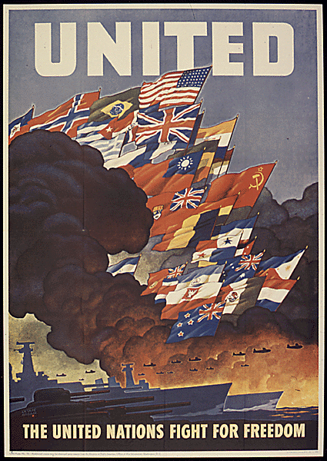
United Nations
After Roosevelt’s death, Harry Truman became president
He felt a huge sense of responsibility when he assumed the presidential office
One of his first decisions was to form a new international organization that was discussed in Yalta
June 26, 1945 (San Francisco, CA): 50 nations including the Soviet Union signed the charter creating the United Nations

Slide 7
Soviets Expand in Europe
These peacetimes did not last because Stalin did not keep his promise to hold free elections in Eastern Europe
The Soviets set up Communist governments in those countries
Other countries in Europe grew to distrust the Soviets & the Western nations
2 groups: Soviet-controlled Communist governments & the capitalist democracies

Slide 8
The Iron Curtain
Churchill delivered a speech in Missouri where he said that an “iron curtain” had descended on Europe
He meant that the Soviets had cut off Eastern Europe from the West
Behind the curtain are the countries of Eastern Europe

Slide 9
Containing the Soviets
American diplomat, George F. Kennan, argued that the US and the Soviets could not cooperate and that the US should take measures
His ideas led to containment – the US would try to “contain” Soviet expansion through limited military means and nonmilitary means

Slide 10
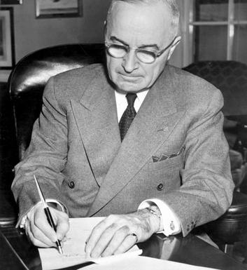
Truman Doctrine
The containment policy soon went into effect
March 1947: President Truman proposed a policy to help nations threatened by communism and Soviet expansion:
“I believe that it must be the policy of the United States to support free peoples who are resisting attempted subjugation [conquest] by armed minorities or by outside pressures”

Slide 11

The Marshall Plan
After the war, much of Europe was in ruins because bombing had destroyed houses, factories, bridges, and roads
People did not have enough food and no means of making money so they turned to communism which promised housing and employment for all
George Marshall – proposed that the best way to keep the countries of Western Europe free of communism would be to help restore their economies
Between 1948 & 1951 the Plan contributed nearly $13 million to rebuilding Western Europe

Slide 12
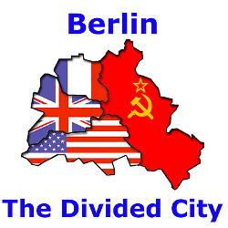
Crisis in Berlin
Germany was divided into 4 occupation zones
  East – controlled by Soviets
  West – controlled by the US, GB, and France
Berlin was located deep within Soviet-controlled East Germany it was also divided among 4 nations
Truman – “a reunited Germany was essential to the future of Europe”
Stalin – “a reunited Germany was a threat to the Soviet Union”

Slide 13
The Berlin Blockade
June 7, 1948 – the US, GB, and France agreed to unite their zones and form a West German republic and each nation’s section of Berlin would be included in the republic
Berlin blockade was Stalin’s answer to this plan
  June 24, 1948: Soviet troops rushed around the edge of West Berlin
  Almost overnight they created a blockade, stopping traffic on al highway, railroad, and water routes
  West Berlin and its citizens were cut off from supplies

Slide 14
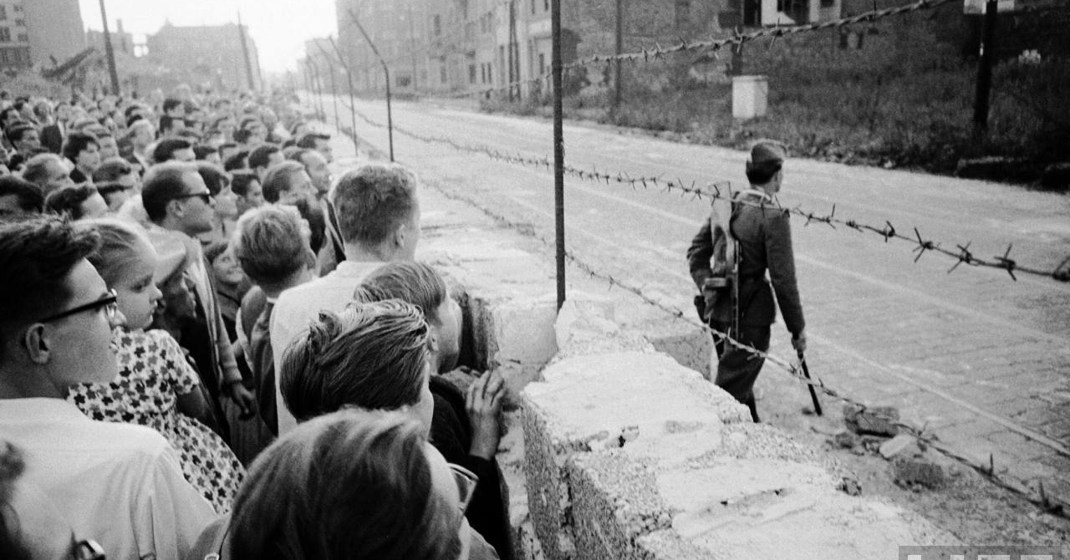
Berlin Blockade

Slide 15
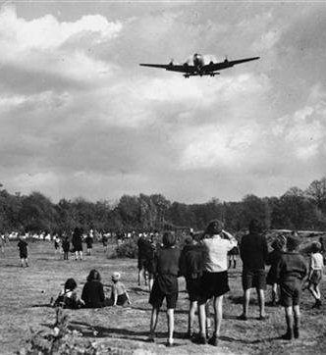
The Berlin Airlift
Instead of using military force, Truman used airplanes and organized an airlift to save the city
American & British cargo planes carried food, fuel, and other supplies into West Berlin
It continued day and night for more than 10 months delivering tons of supplies
Eventually Stalin ended the blockade but Berlin and Germany still remained divided into 2 nations
  The Federal Republic of Germany – West
  The German Democratic Republic – East

Slide 16
Armed Camps
This Berlin crisis confirmed that the US and the Soviets were locked in a cold war:
  A war in which the two enemies did not actually fight each other
  Instead they began building up its military forces and arms to intimidate the other

Slide 17
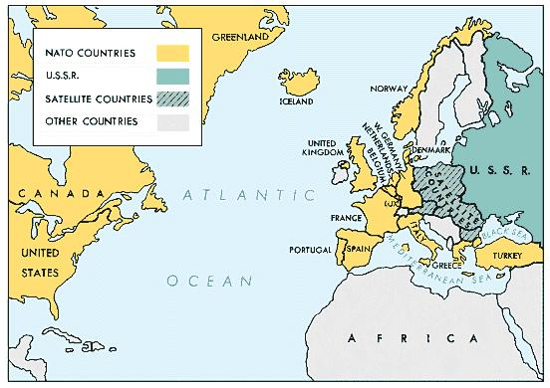
NATO
April 1949: the US, Canada, and 10 other nations signed a pact: North Atlantic Treaty Organization (NATO)
It stated that “an armed attack against one or more of the member nations shall be considered an attack against all”

Slide 18
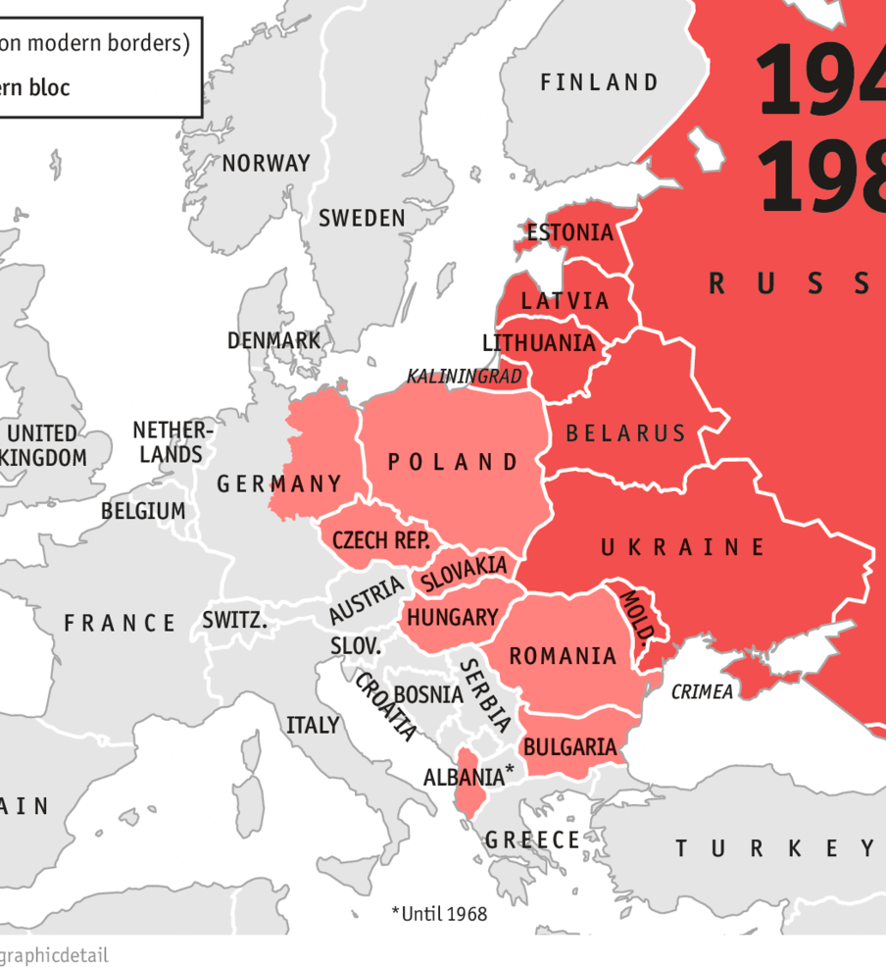
Warsaw Pact
The Soviets’ response to NATO was to create an alliance of its own with Communist governments
1955: the alliance had a military force that the Soviet Union Controlled
This further divided Europe between NATO & the Warsaw Pact countries

Slide 19
The US Rearms
President Truman’s advisers in the National Security Council argued that America could not rely on other countries to contain the Soviets
They believed the US needed to take a more active stand against communism everywhere
1950: they released a report known as NSC-68 which said that the US must actively
“foster the seeds of destruction within the Soviet Union”
The US committed itself to combating communist expansion everywhere in the world

Slide 20
Independence Movements
Many states broke free of colonial rule and established independence
Philippines from the US
India, Pakistan, and Burma from the British Empire
25 African countries from European colonial powers
Jews and Arabs both claimed the region of Palestine which was controlled by the British

Slide 21
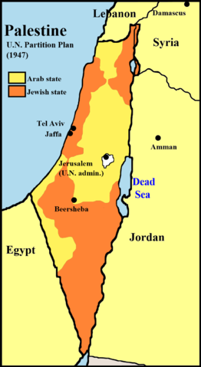
Palestine
1947: the UN agreed to divide Palestine into independent Jewish and Arab states with Jerusalem as an international city
The Jews accepted by the Arabs did not
The new Jewish state of Israel declared its independence

Slide 22
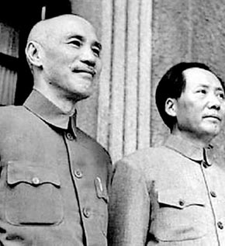
Communism in China
The most threatening change occurred in China
1949: a long civil war ended with victory of Chinese Communist forces
  Communists led by Mao Zedong
  Chinese government led by Chang Kai-shek

Slide 23
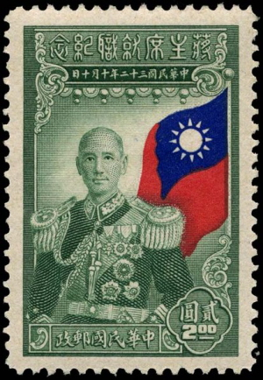
Mao Zedong
He formed a new Communist state called the People’s Republic of China
Chang Kai-Shek retreated with his forces to Taiwan which is off the southeastern coast of China
The US recognized the government in Taiwan as the legitimate government of all China
Now the Soviet Union has a powerful ally in Communist China
It seemed to many that the entire continent of Asia was in danger of becoming Communist

Slide 24
Postwar Policies
Chapter 27 – Section 2

Slide 25
Postwar Economy
Businesses and industries had to shift from producing war goods to making consumer goods
During the war the prices for consumer goods remained stable
After the war, when government removed price controls, the prices began to rise
This caused inflation
Fortunately for Americans, they had saved so much money during the war, that they were eager to spend it now

Slide 26
Workers Seek Higher Wages
Rise in prices weren’t met with a rise in wages
Wages were protected during the war but after the war companies did not raise the wages in accordance to the raise in prices
Labor unions started to call for strike, millions of steelworkers, railroad workers, and others had walked off their jobs demanding better pay and conditions

Slide 27
Truman Takes Action
President Truman pressured workers to go back to work because they were hurting the economy
May 1946: he threatened to draft them into the army
Afterwards, Truman had the government take over the mines and brought back the workers
He persuaded owners to grant the demands of the workers and pressured other workers to go back to work

Slide 28
Truman Faces the Republicans
September 1945: Truman presented Congress with a plan of domestic reforms geared at solving some of the nation’s economic problems
This was called the Fair Deal

Slide 29
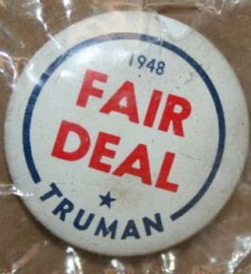
Fair Deal
Truman’s proposal:
  Raise the minimum wage
  Expand Social Security benefits
  Increase federal spending to create jobs
  Building new public housing
  Create a system of national health insurance
These proposals failed because Truman was a Democrat and the majority of Congress were Republicans (or Southern Democrats)

Slide 30
Republicans Control Congress
1946: in Congressional elections, Republicans won with the slogan “Had Enough?” pointing to Truman’s mistakes
They went on to create their own plans for the nation
  Limit government spending
  Control labor unions
  Reduce government regulation of the economy
  Reverse policies adopted under the New Deal

Slide 31
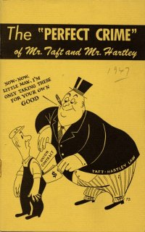
Biggest Problem
Labor unrest and growing power of labor union was the biggest problem for Republicans
Republicans favored big business, not labor unions
Spring 1947: Taft-Hartley Bill
  Limited the actions workers could take against their employers
  Outlawed the closed shop – a workplace that hires only union members
  Allowed the government to temporarily stop any strike that endangered public health or safety

Slide 32
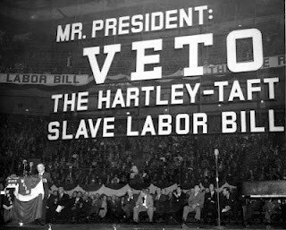
Criticism
Workers were angry and dubbed this bill a “slave labor bill”
This bill was aimed to prevent any strikes in the future similar to the ones by the mine workers

Slide 33
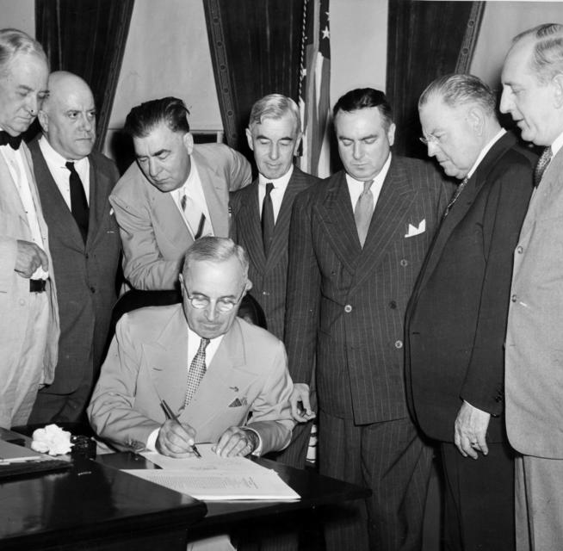
Government Reorganization
Truman introduced a commission to study ways of improving the efficiency of government (headed by former president Herbert Hoover)

Slide 34
National Security Act
It unified the army, navy, marines, and air force under the Department of Defense
Headed by: Secretary of Defense
Set up:
  Joint Chiefs of Staff – made up of the heads of each of the armed forces
  National Security Council – operated out of the White House and would advice the president on foreign and military matters

Slide 35
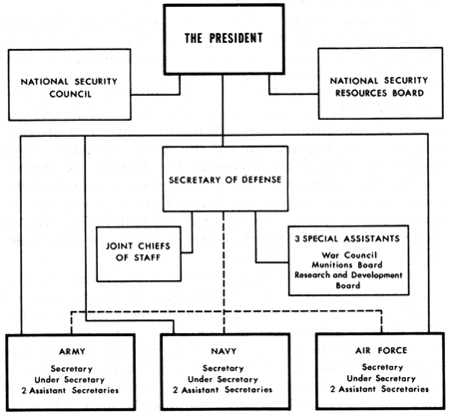
National Security Act

Slide 36
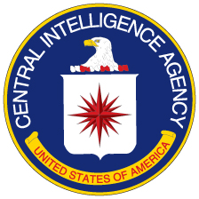
Central Intelligence Agency
The CIA aids American foreign policy by collecting information about what is going on in other countries, studying it, and passing it to the president and other foreign-policy decision makers
Use secret agents, paid informers, and governments to collect information
Many feared that the CIA would spy on American citizens but Truman promised that they would only do so on foreign lands and not bring in “police state methods”
The CIA can receive and spend money without informing Congress about it

Slide 37
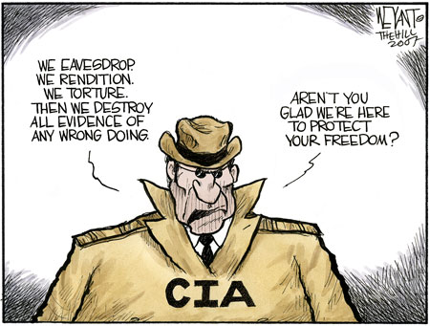
CIA

Slide 38
Election of 1948
Truman faced an uphill battle because of his unpopularity
Candidates are:
  Harry S. Truman – Democrat
  Strom Thurmond – Southern Democrat (Dixiecrat)
  Henry Wallace – Progressive
  Thomas Dewey – Republican

Slide 39
Election of 1948
Truman campaigned against that “do-nothing, good-for-nothing, worst Congress”
Dewey had been doing a great job at campaigning and many experts expected him to win
Some newspapers even claimed “Dewey defeats Truman”
When the ballots were counted, Truman edged out by more than 2 million votes
Democrats also regained control of both the House of Representatives & the Senate – Congress

Slide 40
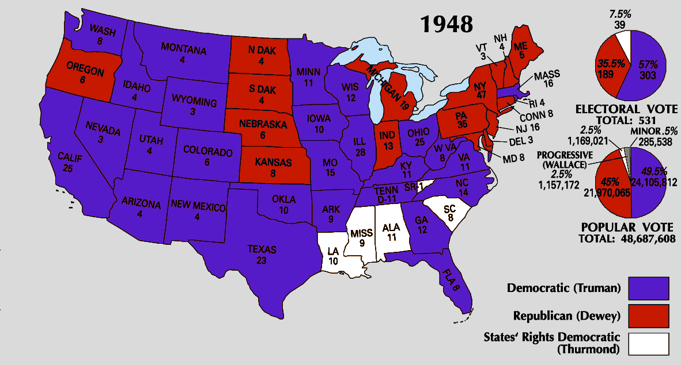
Election of 1948

Slide 41
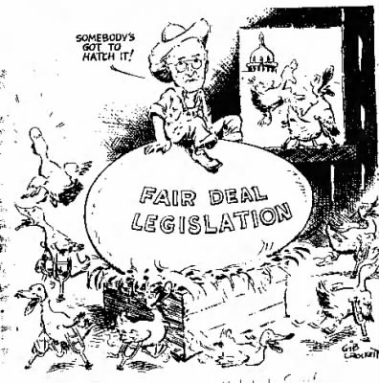
Fair Deal for Americans
After winning the election of 1948, Truman reintroduced the Fair Deal
Still, Congress defeated most of the proposals
  Did pass law to raise minimum wage
  Did expand Social Security benefits for senior citizens
  Did provide funds for housing for low-income families

Slide 42
Stand on Civil rights
“We shall not, however, finally achieve the ideals for which this nation was founded so long as any American suffers discrimination as a result of his race, or religion, or color, or the land of origin of his forefathers”
Truman wanted to end discrimination but was unable to persuade Congress to pass laws to protect voting rights of African Americans, or abolish the poll tax, or make lynching a federal crime

Slide 43
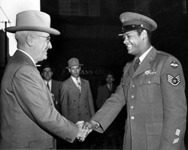
Civil Rights
He was able to
  Order federal departments and agencies to end job discrimination against African Americans
  Order the armed forces to desegregate – to end the separation of races
  Instructed the Department of Justice to enforce existing civil rights laws

Slide 44
Other Proposals
Truman also proposed:
  To end slums
  To end government-backed medical insurance
  Higher minimum wage
  More federal money for public schools

Slide 45
The Korean War
Chapter 27 – Section 3

Slide 46
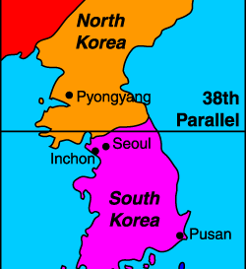
Conflict in Korea
1945: Korea was a colony of Japan
End of WWII: Korea is stripped from Japan
The US & the Soviet Union both sent troops into Korea and agreed to occupy it temporarily
38th Parallel – line of latitude at which Korea was divided on
North Korea – USSR
South Korea - US

Slide 47
Conflict in Korea
After the Soviets and the US left Korea, tensions grew immensely
North Korea invaded South Korea
President Truman came to the realization that this meant:
  The US soon would be involved in military action in Asia

Slide 48
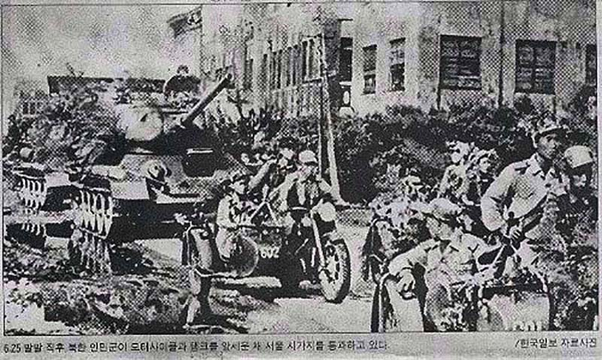
Invasion of South Korea
The North Koreans tried to unify the country by force after crossing into the 38th Parallel
They gained control over much of South Korea including its capital, Seoul
President Truman believed the the North Koreans were being supported by the Soviets
Truman orders the use of military raids on North Korea without the consent of Congress

Slide 49
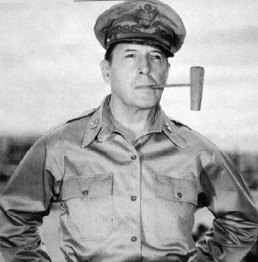
United Nations Responds
The UN agrees to send with Truman and they send in forces under the US’s direction
Truman appointed General Arthur MacArthur to command the UN forces
June 30: days after the invasion of South Korea, American troops
The goal was to push the North Koreans back across the 38th Parallel
However China intervenes in the war

Slide 50
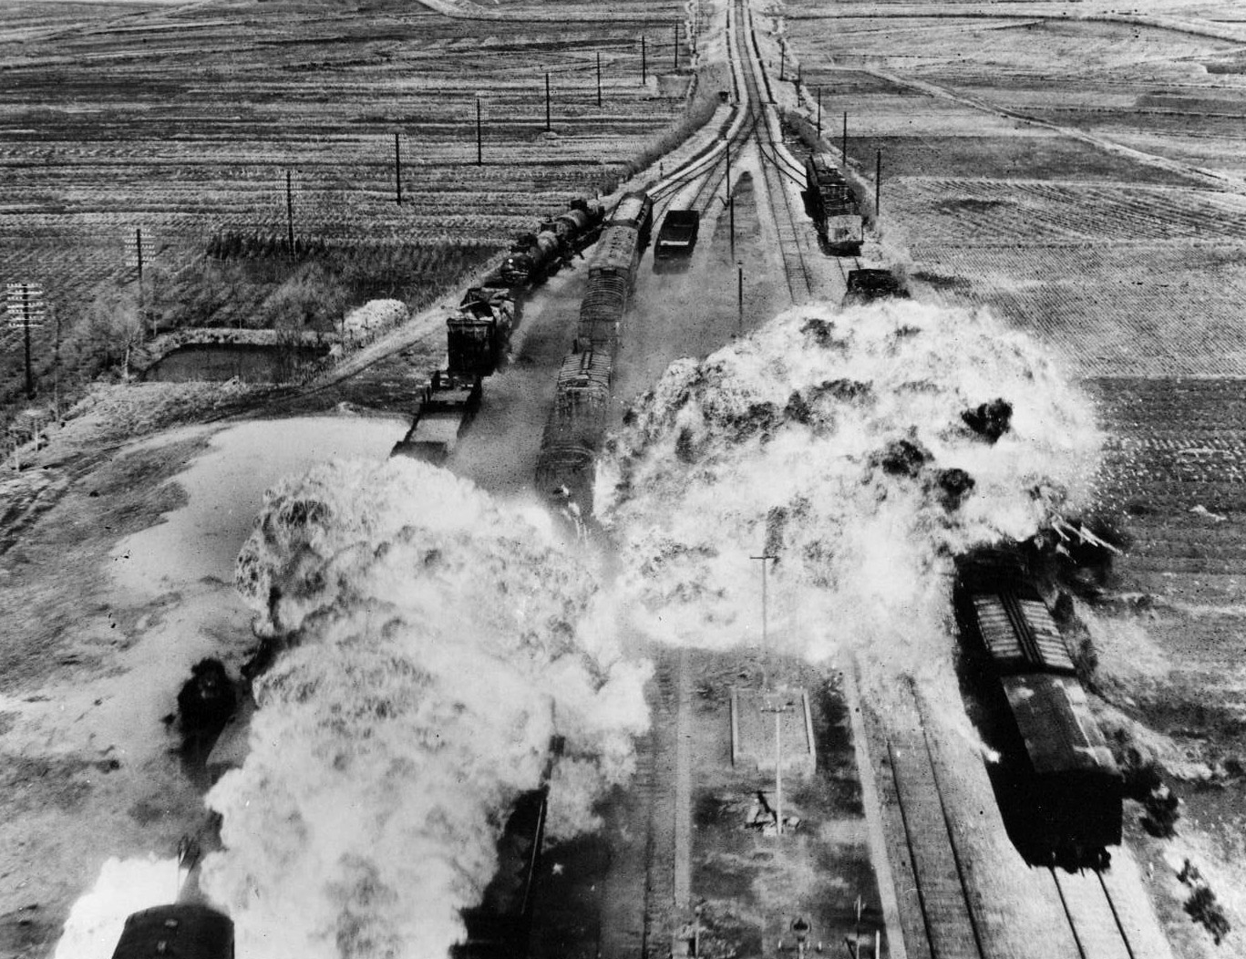
Early Phases of the War
September 1950: North Koreans had pushed to the southern tip
UN forces landed midway on the Korean Peninsula and tried to recapture Seoul
October 1: North Koreans were caught between Un forces from Seoul and Pusan
They were forced to retreat back to the 38th Parellel

Slide 51
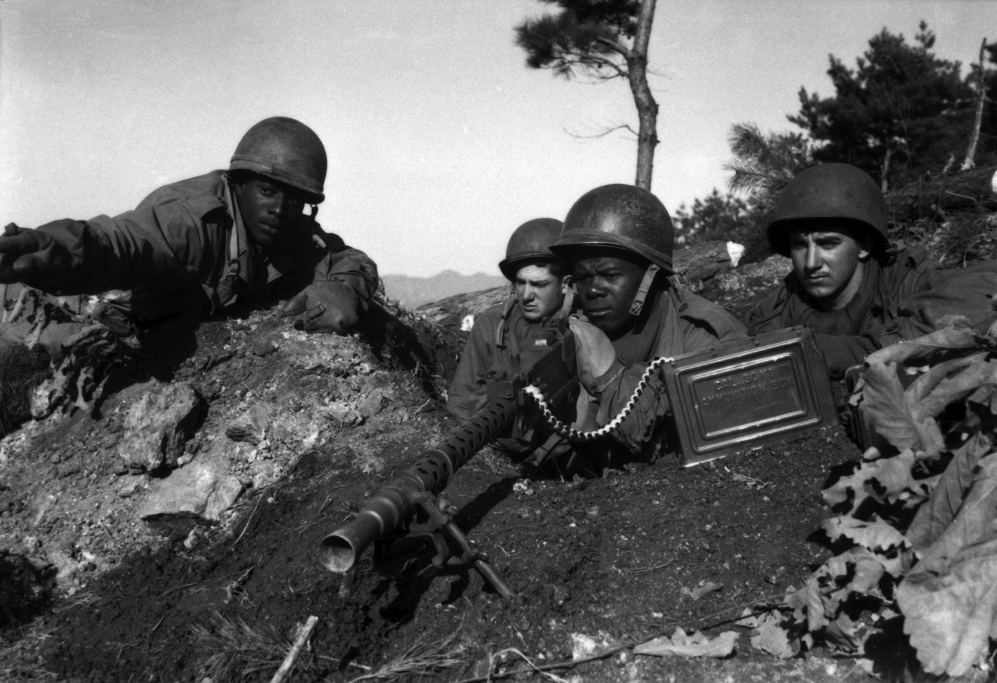
Taking the Offensive
MacArthur, encourage by this success, advises President Truman to invade North Korea
He told Truman that neither China nor the Soviet Union would enter the war to help North Korea
After receiving orders, MacArthur moved his forces northward
The UN forces captured Pyongyang (North Korean capital)

Slide 52
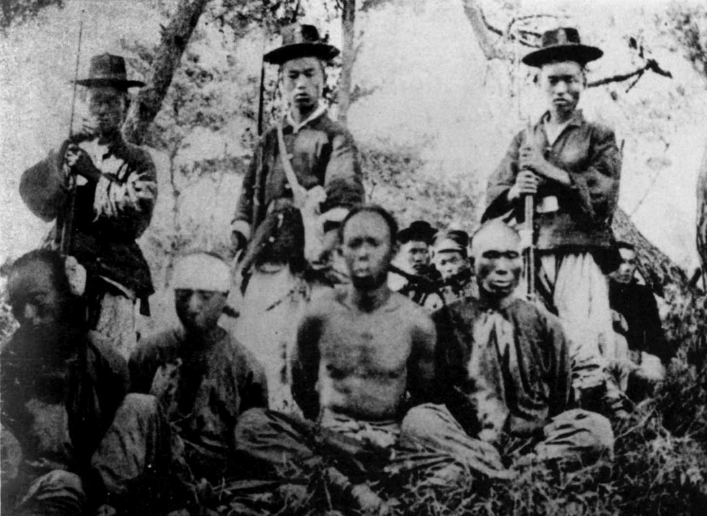
Taking the Offensive
Upon advancement, the US received warning from the Chinese
If the invasion of N. Korea didn’t end, China would send its army to support the N. Koreans
MacArthur thought the Chinese were bluffing, but they weren’t
Late October: thousands of Chinese troops began massing along the border
November 26th: Chinese troops launched an attack on UN forces forcing them to retreat south of the 38th Parallel

Slide 53
The Stalemate
January 1951: UN forces stopped their retreat
They retook Seoul and pushed the Communists back across the 38th Parallel
The war became a stalemate – neither side was able to gain much ground or achieve a victory
It lased for almost 2 years

Slide 54
American Leadership Divided
Truman
MacArthur
Began to consider negotiating an end to the fighting
Opposed MacArthur’s plan fearing it would lead to a larger war (like a world war)
April 11, 1951: Truman relieved MacArthur of his command in Korea saying, “If I allowed him to defy the civil authorities in this manner, I myself would be violating my oath to uphold and defend the Constutition”
Argued that the UN forces should now attack China by invasion or bombing Chinese troops in Korea
MacArthur complained in a letter to Congress that he was being kept from doing his job
Received a hero’s welcome on his return to the US and delivered a farewell speech, “Old soldiers never die, they just fade away”

Slide 55
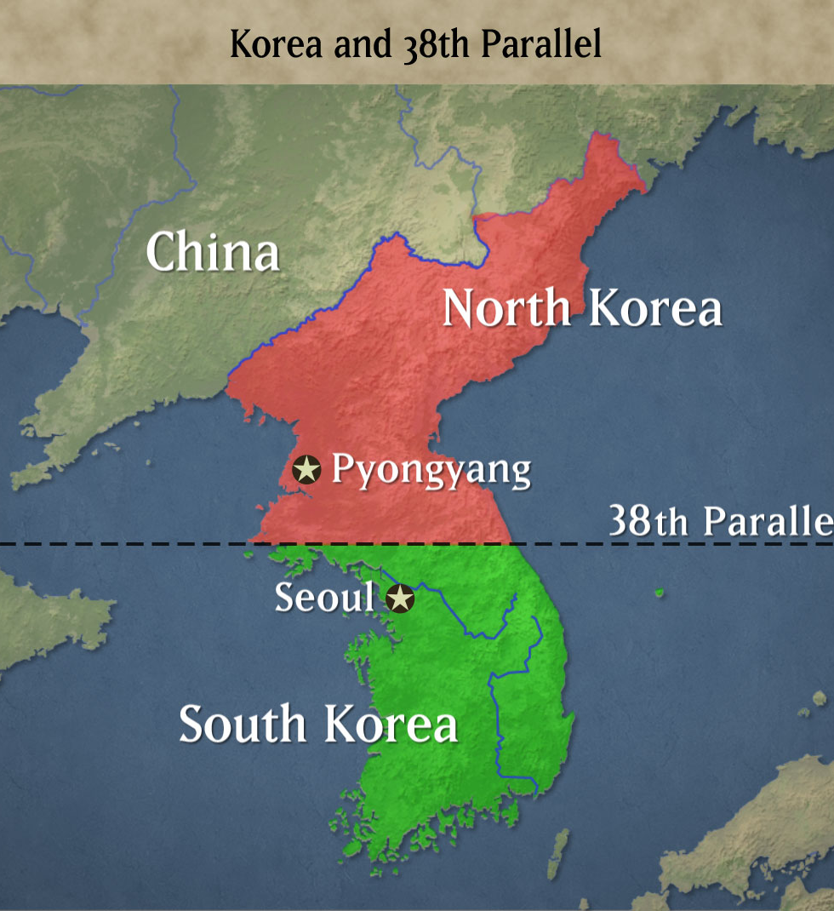
Ending the Conflict
July 1951: negotiations began between the 2 sides and lasted for 2 years
Agreement:
  Created a demilitarized zone – a region where military forces could not enter, between the 2 Koreas
  It is extended a mile and a half on either side
Neither side achieved victory and almost no change in territory

Slide 56
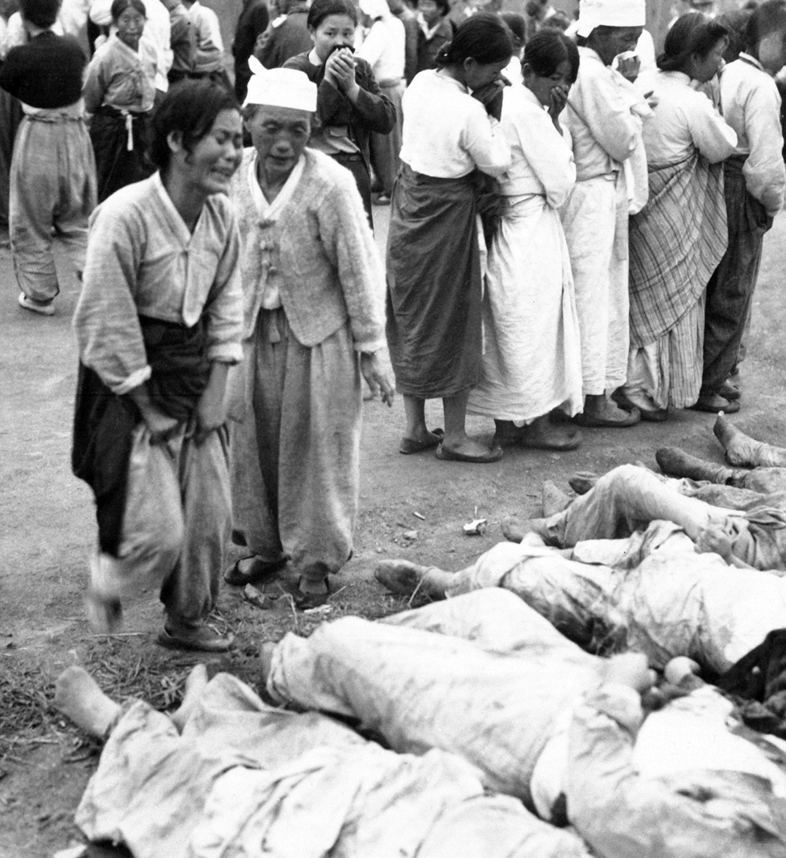
Results of the War
More than 54,000 Americans died in the war
103,000 were wounded
Nearly 2 million Koreans and Chinese lost their lives
Large portions of North & South Korea were devastated
America’s involvement sent a message to the Soviets
  US is committed to fighting Communist expansion with money, army, and even lives

