Slide 1
Three Worlds Meet
Unit 1

Slide 2
Converging Cultures
Prehistory - 1520
Chapter 1

Slide 3
Migration to America
No one knows for sure when the first people migrated to North America
Folsom discoveries tell us that people were here at least 10,000 years ago or even earlier
Examining DNA helps determine the origin of ancient people
Radiocarbon Dating – to determine how old objects are; done by measuring the radioactivity left in a special type of carbon, called carbon 14, which can be taken from bone or wood

Slide 4
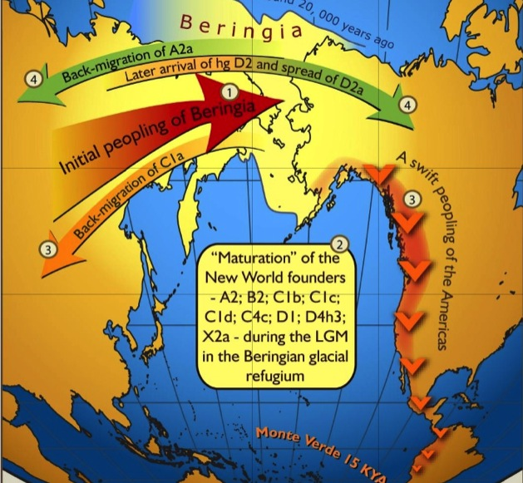
Asian Migration to America
It is believed that people from Asia crossed the Beringia from northern Asia and into Alaska
They did this because they constantly hunted for food and their adventures brought them to the American continent

Slide 5
Early Civilizations of Mesoamerica
Mesoamerica comes from the Greek work meso meaning “middle”; this was located in southern Mexico and central America
The people there learned how to plant & raise crop during the agricultural revolution (9,000-10,000 years ago)
The first crops included pumpkins, peppers, squashes, gourds, and beans

Slide 6
Early Civilizations of Mesoamerica
Maize, also known as corn, was perhaps the most important of all crops because it could be ground into flour to make bread and dried and stored for a long period of time
What happened to nomadic people during the agricultural revolution

Slide 7
The Olmec
Civilization – highly organized society marked by trade, government, the arts, science, and sometimes a written language
Anthropologists believe that the earliest civilization was the Olmec
They emerged between 1500BC-12ooBC near Veracruz, Mexico

Slide 8
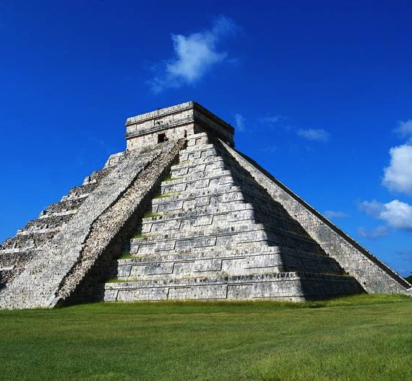
The Olmec
They had built villages, temples, and pyramids

Slide 9
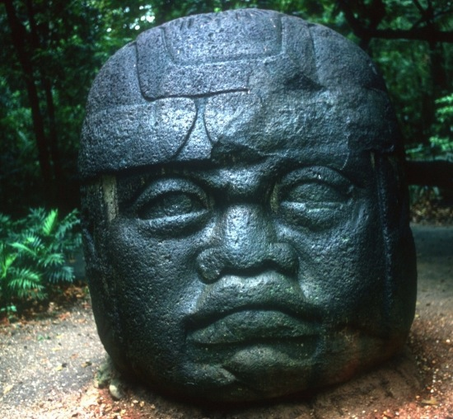
The Olmec
They also built enormous 8-foot heads

Slide 10
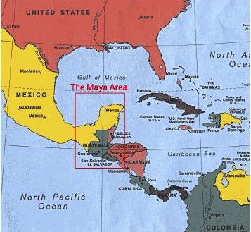
The Maya
The Maya emerged around 200AD in the Yucatan peninsula and expanded in present-day Central America and southern Mexico

Slide 11
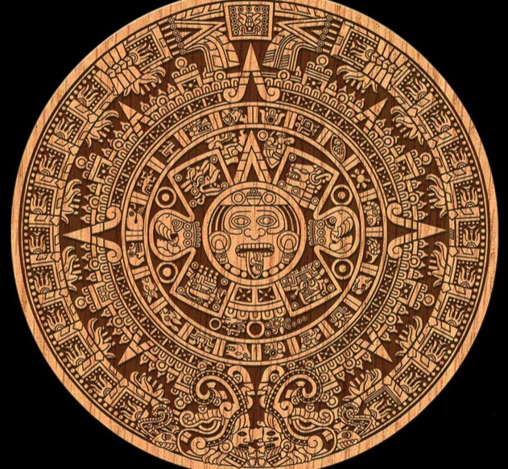
The Maya
They were very talented in mathematics & engineering which is how they developed one of the most accurate calendars of their time

Slide 12
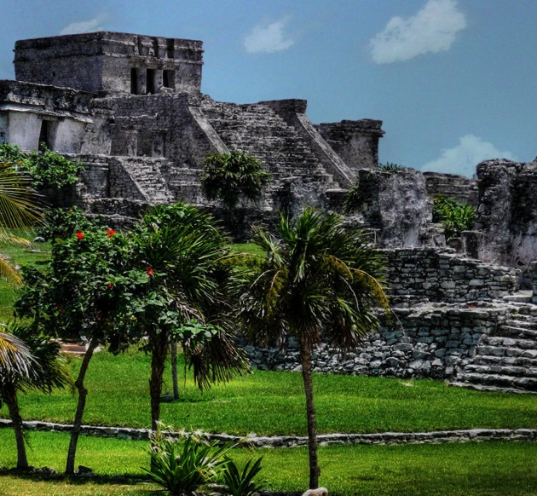
The Maya
They also built pyramids like other ancient peoples which served as temples
They were the centerpiece of the Mayan cities of Tikal & Chichen Itza
The Mayan were a great civilization but because they were not unified they usually fought wars against each other

Slide 13
The Toltec
After the Mayan civilization disappeared, a new one emerged called the Toltec
They built their city in Tula and they were master architects
They were one of the first Native Americans to use gold and copper for art and jewelry
However around 1,200AD they also fell to northern invaders called the Chichimec

Slide 14
The Aztec
One group from the Chichimec called the Mexica, built their city called Tenochtitlan in 1325
It is located in present-day Mexico City
This group however adopted the name Aztec for themselves from their original homeland: Aztlan
They created a huge empire by using military force and also controlled trade this way
They even brought some captives as human sacrifices in their religious ceremonies

Slide 15
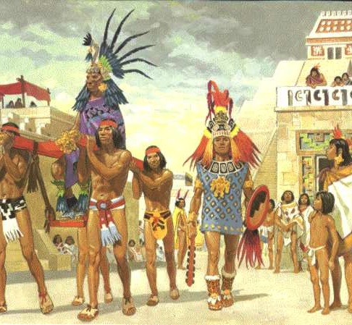
The Aztec
Ceremonies

Slide 16
The Hohokam
300AD: In central Arizona a group called the Hohokam built a civilization with an elaborate system of irrigation canals
Their canals carried water hundreds of miles away to their farms
They grew corn, cotton, beans, and squash
The Hohokam culture flourished for more than 1,000 years
1300: they began to abandon their irrigation system because of floods and by 1500 they vanished

Slide 17
The Anasazi
700AD - 900AD: the people of the Four Corners area came together to create a civilization
  Utah
  Colorado
  Arizona
  New Mexico
They were called the Anasazi – “ancient ones”
They built basins and ditches to channel rain in their harsh desert environment

Slide 18
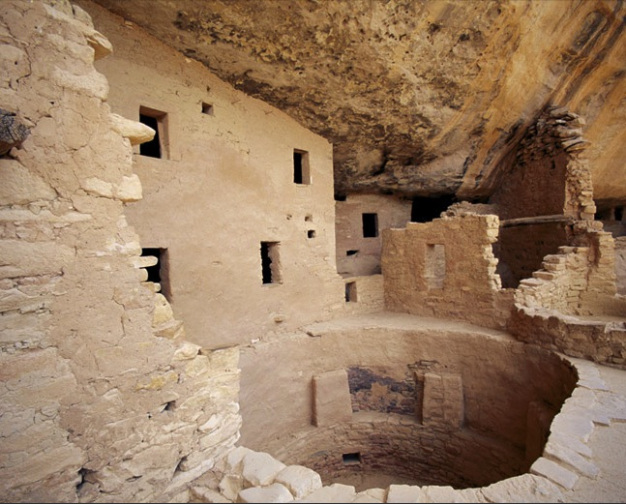
The Anasazi
850 – 1100: they built large, multi-story buildings of adobe with connecting passageways
It also included circular ceremonial rooms called kivas
Spanish explorers called these structures pueblos – Spanish for “village”

Slide 19
The Adena & Hopewell Cultures
These people of the eastern woodlands developed woodworking tools such as stone axes and gouges
They built dugout canoes and made nets to snare birds
They also made clay pots
1000BC: these people began burying their dead under massive dome-shaped mounds of dirt
The Adena lasted from 1000BC until 200BC
The Hopewell lasted from about 200BC until 400AD

Slide 20
The Mississippian Culture
700AD - 900AD: agricultural technologies began to spread through the Mississippi River
This created another new culture called the Mississippean
They were great builders who left an 8 mile stretch of remains in Missouri
Their main city was home to about 16,000 people and they also had pyramids

Slide 21
Native American Cultures
Chapter 1 – Section 2

Slide 22
The West - Southwest
By the time the Europeans arrived, Native Americans were scattered into many small groups
The Southwest inhabited the descendants of the Anaszi and the Hohokam
They included the Zuni, Hopi, and other Pueblo peoples
They depended on corn to survive

Slide 23
Southwest
When a man married, he joined the household of his bride’s mother
Men’s and women’s work was separate
  Men farmed and herded sheep and performed most ceremonies, made moccasins, and wove clothing and blankets
  Women had to take care of the house and they also crafted pottery and baskets, and hauled water, they also helped men in farming and constructing houses

Slide 24
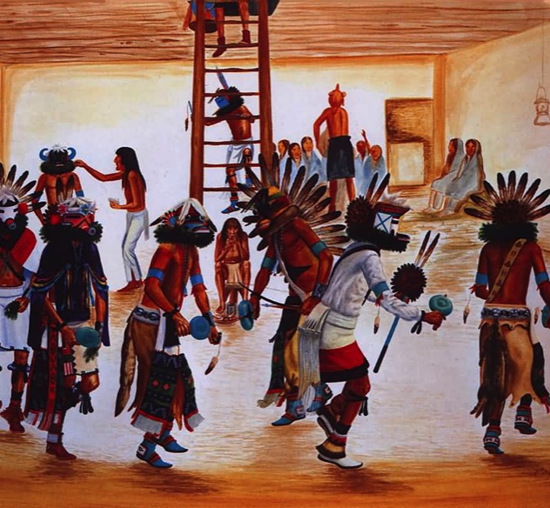
Southwest
When boys turned 6 they joined the kachina cult
  Kachina – good spirit
They believed that the kachina visit that the kachina visited their town each year with messages from the gods
These cult members wore masks symbolizing the spirits and they also danced to bring the spirits to the town

Slide 25
Southwest
The more famous groups, the Apache & Navajo, also inhabited the southwest
The Apache remained nomadic
The Navajo settled down and learned how to grow corn, beans, and squash

Slide 26
Pacific Coast
This region included many different groups such as the Tlingit, Haida, Kwakiutls, Nootkas, Chinook, and Salish peoples
They occupied the lands from present-day Alaska down to Washington state
They did not practice agriculture and luckily for them they had forests nearby for lumber
They built homes, canoes, made ceremonial masks, and totem poles

Slide 27
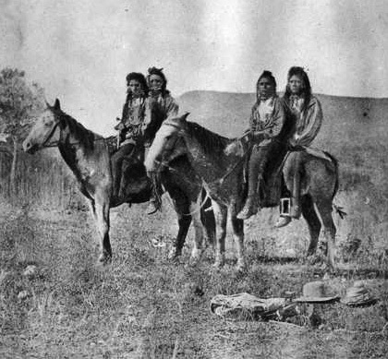
Pacific Coast
Between the Sierra Nevada & Rocky Mountains the climate was drier
These groups (the Ute and Shoshone) live a nomadic life
The land was too arid (having little or no rain) so they roamed in search for food

Slide 28
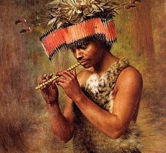
Pacific Coast
In California, there were other groups who enjoyed wildlife and a mild climate
The Pomo gathered acorns, caught fish, and snared small game and birds

Slide 29
The Great Plains
These people were influenced by Mississipean & Hopewell cultures and they lived near the Missouri and other rivers
They practiced agriculture up until the 1500s where it is believed that they began living a nomadic life
This change could have been caused by drought or war
They included the Pawnee, Kansas, and Iowa peoples

Slide 30
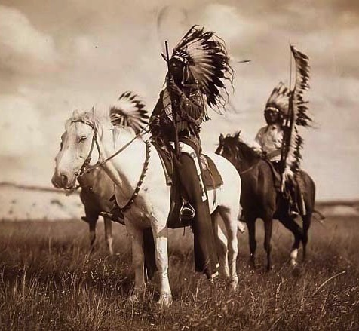
The Great Plains
The Sioux people and others changed drastically after the began taming horses
The Spanish brought horses in the 1500s and over the years horses either escaped or were stolen
The Sioux encountered and mastered these horses and in the process became some of the world’s greatest mounted hunters and warriors

Slide 31
The Great Plains
Sioux men gained achievement through bravery in hunting and war
They could gain more fame by scalping their enemies they had killed
But the greatest achievement of all was through a nonviolent act called “counting coup”

Slide 32
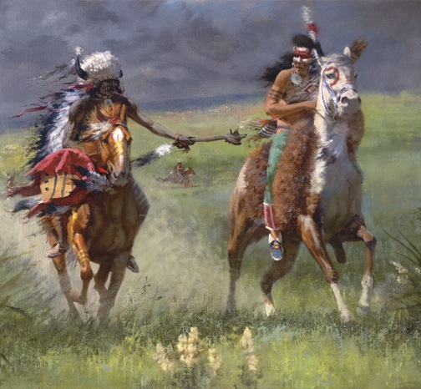
Counting Coup
This was a process where a warrior would charge into a group of the enemy
Then he would just touch one of them with a stick
This was meant to humiliate the enemy and then gallop away

Slide 33
The Far North
Inuit – were the most northern and widespread of Native Americans and their territory stretched across the Arctic from present-day Alaska to Greenland
The Aluet settled in Alaska as well
These two groups depended heavily on hunting such as seals, walruses, whales, polar bears, caribou, musk oxen, and other animals
They developed harpoons, the kayak, the dogsled, boots with spikes for walking on ice, and special goggles to prevent snow blindness

Slide 34
Eastern Woodlands
East of the Mississippi and south of the Great Lakes
Almost all of the Native Americans here provided for themselves by combining hunting and fishing with farming
They ate a lot of deer meat with corn, beans, and squash
The deer hide was also used for clothing

Slide 35
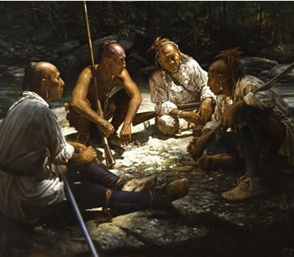
People of the Northeast
Most of the Northeast people were divided into two major language groups
Those who spoke Algonquian
Those who spoke Iroquoian

Slide 36
Peoples of the Northeast
Algonquian-speaking peoples:
  Those located in the New England territory
  Wampanoag in Massachusetts
  Narragansett in Rhode Island
  Pequot in Connecticut
  Powhatan Confederacy in Virginia
  Delaware along the Delaware River
  Shawnee in the Ohio River Valley
Some Algonquian words used in English today: hominy, moccasin, papoose, etc.

Slide 37
Peoples of the Northeast
Iroquoian-speaking people included:
  The Huron
  Neutral
  Erie
  Wenro
  Seneca
  Cayuga
  Onondaga
  Oneida
  Mohawk

Slide 38
Peoples of the Northeast
Many of these people practiced slash-and-burn agriculture by cutting down parts of forests and then burning the cleared land to make it more fertile
They used different types of houses such as longhouses and wigwams

Slide 39
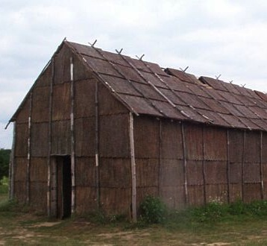
Longhouse
Barrel-shaped roofs
Large and rectangular

Slide 40
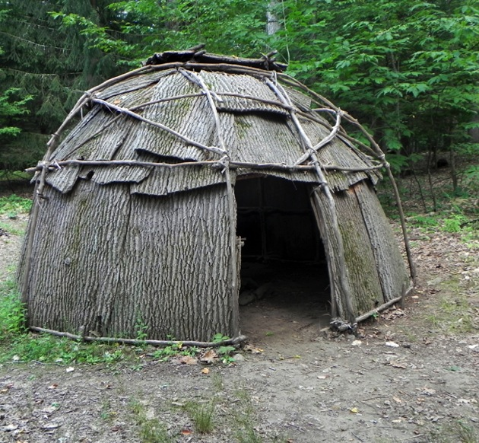
Wigwams
Either conical or dome-shaped
Were made using bent poles
Covered with hides or bark

Slide 41
Iroquois League
The Algonquian and Iroquois people shared some common traits such as decorating their belts (wampum) with white and purple shells
They both viewed land as a resource to be used for the entire group
They also believed that the land was not for one person to buy or sell

Slide 42
Iroquois League
All Iroquoian people had similar cultures and lived in large kinship groups – extended families
  This was headed by the eldest woman of the clan
  Women occupied positions of power and importance
  They were responsible for the planting and harvesting of crops
  Up to 10 related families lived together in each longhouse

Slide 43
Iroquois League
Despite their similar cultures they still fought wars against each other
5 nations in New York (Seneca, Cayuga, Onondaga, Oneida, and Mohawk) formed an alliance known as the Iroquois League
A shaman and a chief of the Mohawk founded the league because they were worried that war was tearing the five nations apart
These leaders were all men but they were all appointed by women

Slide 44
People of the Southeast
They almost all lived in towns where women did most of the farming and men hunted deer, bear, wildfowl and even alligator
They were influenced by the Mississippian culture
The Cherokee were the largest group and lived in what is today North Carolina and eastern Tennessee
They were Iroquoian speakers along with the Choctaw, Chickasaw, Natchez, and Creek

Slide 45
African Cultures
Chapter 1 – Section 3

Slide 46
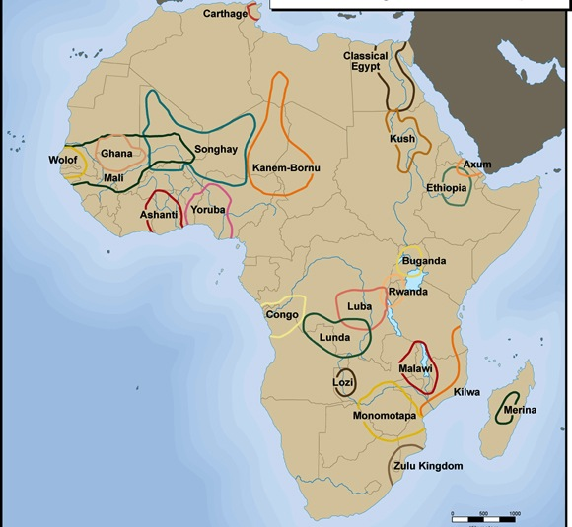
West Africa
Between the 400s & 500s there were 3 great empires that rose and fell in West Africa
  Ghana
  Mali
  Songhai

Slide 47
Lay of the Land
Africa’s geography determined where empires would thrive
Sahara – ancient Arabic word meaning desert
Savannah – regions of scrub forest and rolling grassland
The Niger River served as a path for trade and migration

Slide 48
Lay of the Land
Crossing the Sahara was risky but camels allowed merchants to open long-distance routes across the desert
Some things that became available to other parts of the world because of trade:
  Gold
  Ivory
  Ostrich
  Feathers
  Furs

Slide 49
Islam & West African Civilizations
The most significant of the ideas that traveled to West Africa were the religious ideas of Islam
By 711 Islam had spread all the way across northern African to the Atlantic Ocean
It gained massive acceptance
By the 900s nomadic traders converted to Islam and carried these ideas across the Sahara and into West Africa

Slide 50
The Lure of Gold
West Africa prospered mainly because of the gold trade
Anyone who conquered African lands quickly found out about the gold and therefore gold was in high demand
1300s: 2/3 of the gold in Europe and North Africa came from trade with West Africa

Slide 51
Empires of West Africa - Ghana
400s: Ghana was the earliest amongst the empires
It was located between the gold mines of Bambuk and the salt mines of Taghaza
The people called themselves the Soninke
After Muslims conquered North Africa, Ghana’s merchants became very rich
Muslim traders were even allowed to build a mosque in the capital of Kumbi-Saleh

Slide 52
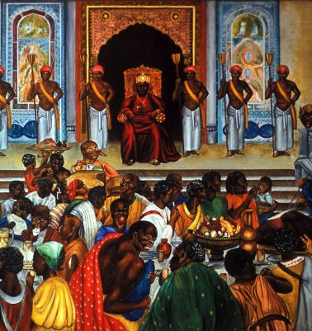
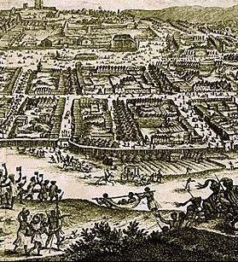
Ghana

Slide 53
Ghana
Despite this success, Ghana’s empire collapsed by the 1200s
1100s: The empire became Muslim but it was hurt by frequent wars with other Muslims of the Sahara
Also, Ghana’s land had become exhausted and its farmers could no longer feed its people
These combined factors weakened Ghana and trade routes bypassed Ghana depriving it of any wealth and success

Slide 54
Empires of the West – Mali
The Malinke people lived east of Ghana and controlled the upper Niger Valley
This allowed them to direct the gold trade
They went on to conquer the Soninke of Ghana and build the empire of Mali
1300s: their empire spread east down the Niger River past Timbuktu and west down the Senegal and Gambia Rivers

Slide 55
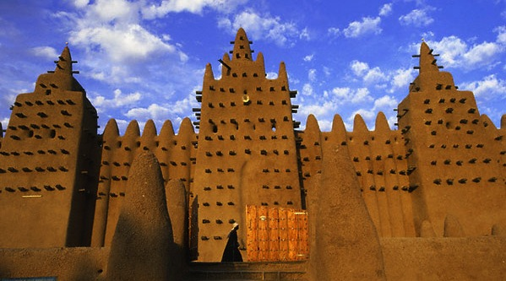
Mali

Slide 56
Mali
The ruler of Mali was called the mansa
Government: a bureaucracy of scribes and treasurers who lived in the capital city with the emperor
Bureaucracy – a system of government where important decisions are made by state officials and not elected representatives
To stay in power, leaders had to collect tribute from the farmers and send a portion to the capital

Slide 57
Mali
The mansa kept a large army ready and made army leaders important officials in his government to enforce laws
1300s: the empire reached its peak under the leadership of Mansa Musa and his brother Mansa Sulayman
But by this time the gold mines had been open to other peoples
This gave rise to Timbuktu as a center of trade and Muslim scholarship

Slide 58
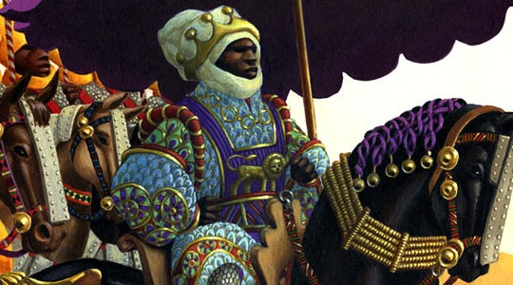
Mansa Musa

Slide 59
Songhai
The Sorko people lived along the middle Niger and built the Songhai empire
They made canoes and fished for a living
They also used their canoes to do trade and gained wealth this way
800s: they created an empire
Their ruler was Sonni Ali who used a powerful army of cavalry back by a fleet of war canoes to seize Timbuktu in 1468

Slide 60
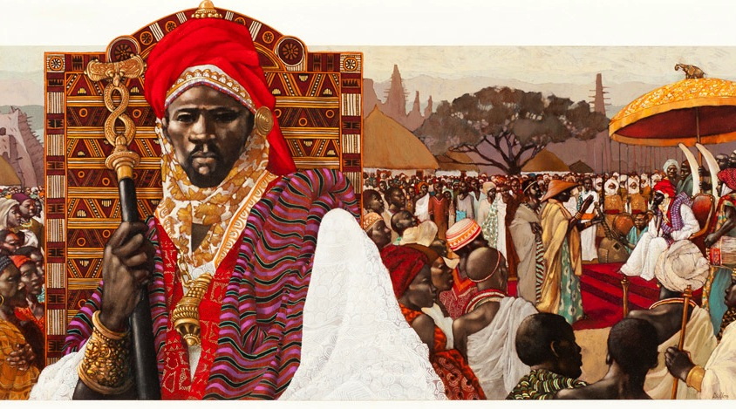
Sonni Ali

Slide 61
Songhai
After taking Timbuktu, he pushed into the Sahara and south down the Niger
He captured the town of Jenne and according to legend his army never lost a battle
His son and successor was an ineffectual ruler
He allowed Askiya Muhammad to seize the throne

Slide 62
Songhai
Askiya Muhammad:
  Was a devout Muslim
  Revived Timbuktu as a great center of learning
  Encourage more trade across the Sahara
  Centralized power in the Songhai capital of Gao
In 1591 the Songhai empire began to declined after Moroccan troops armed with guns and cannons defeated them

Slide 63
Forest Kingdoms of Guinea
The area situated in West Africa’s southern coast is called Guinea
Here we have some small states and kingdoms
The Yoruba & Edo people were a mixture of hunters, farmers, and traders
The farmland allowed farmers to produce so much food that they had a surplus – more than what was needed/used

Slide 64
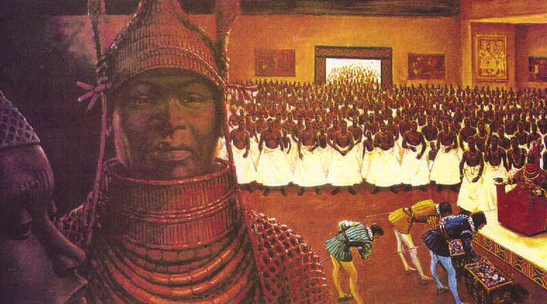
Benin

Slide 65
Forest Kingdoms of Guinea
The Edo people developed the city-state of Benin in the 11th & 12th century
By 1400: Benin was a large, walled city several miles long
Their ruler was called oba
Mid-1400s: Oba Ewuare put together a powerful army and built Benin into an empire
They sold their captives as slaves to the Portuguese and in a series of civil wars, Benin citizens also fell to slavery to the Portuguese

Slide 66
Central & Southern Africa
Many Central African villages rose becase of its location to the rivers but they also grew wheat and raised livestock
Their societies were matrilineal – tracing your lineage or descent through your mother, rather than your father
Women also played a major role in trade while the men hunted, fished, and raised livestock
Instead of inheriting power through the father, the son inherited power through the mother
  Ex: the son of the chief’s eldest sister took the post

Slide 67
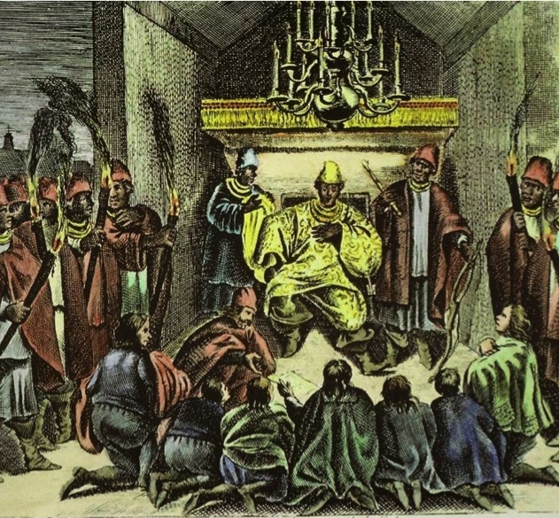
Central & Southern African
Kongo originated around 1400 along the Zaire River
The the fertile soil and abundant rainfall allowed the farmers to produce food surpluses
1500s: the Kongo king ruled over a large region from the Atlantic to the Kwango River

Slide 68
Slavery
Slavery existed in African society just like it had all over the world
Most of the people had been captives during war or some convicted criminals who served a punishment
In some rare occasions, slaves could purchase their freedom by selling produce they had grown or marry into their captor’s society

Slide 69
The Gold Trade
This also changed slavery in West Africa
The Akan people started mining gold and trading it to the Mali empire
They enquired African slaves for clearing the land and mining the gold
1420s: when the Portuguese began exploring the west coast of Africa they traded European goods for African gold, ivory, pepper, and palm oil
They also sold enslaved Africans for gold

Slide 70
Sugar & Slavery
Europeans learned about cultivation and processing sugarcane from the Muslims in the 1100s
Demand for sugar began to rise and about 20% of all calories consumed in Europe came from sugar
They set up sugar plantations on the Mediterranean islands of Cyprus and Sicily which provided the climate and soil for sugarcane growth

Slide 71
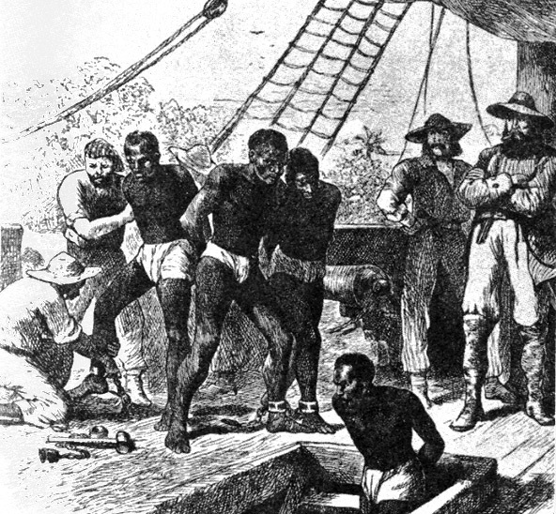
Slavery & Sugar
Cultivation required heavy manual labor
You either pay people to do the work very high wages or find a way to force people to do the work without paying them
This encouraged Europeans to use enslaved workers and enter the slave trade

Slide 72
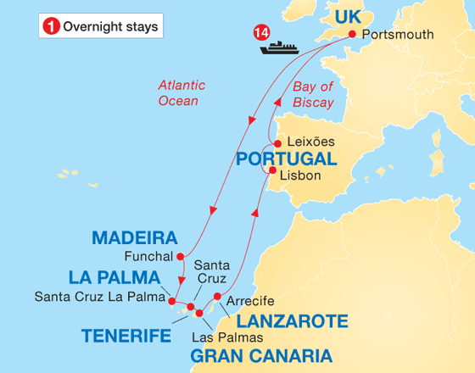
Slavery & Sugar
The enslaved people they used were Slavic and Muslim
Afterwards they started enslaving Africans to bring them to the Canary & Madeira Islands which was close to Africa
However the Europeans had very limited land for plantations; this would change with the discovery of a New World

Slide 73
European Cultures
Chapter 1 – Section 4

Slide 74
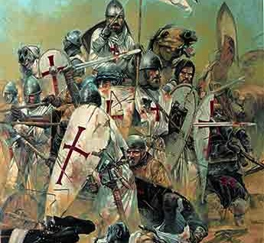
European Society
What was happening in Europe?
Pope Urban Ii had called for a holy war against the Muslims living in the Holy Land of Jerusalem
They were called the Crusades and they helped shaped European society from that point forward
It opened up the doors to another world of spices, silks, and other goods for the Europeans

Slide 75
European Society
The Roman Empire had control of most of Europe, controlling everything from private to public life
By the year 500, it had lost much of its power which isolated western Europe form the rest of the world
Trade declined, cities, bridges, and roads fell into ruin
Life did not extend beyond the tiny villages where they were born
This period is known as the Middle Ages or Medieval Ages

Slide 76
Feudalism
The central government was weakening and this gave rise to a new political system known as feudalism
Feudalism – powerful leaders gave land to nobles in exchange for pledges of loyalty and service
After time these nobles that acquired land would also acquire some powers held by the government
These nobles also raised their own armies, dispensed justice, and even minted coins (made their own money)
In return these nobles swore loyalty and promised to provide knights to the royal army

Slide 77
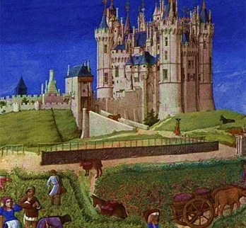
Manorial System
Since the fall of the Roman Empire, many peasants had worked for large landowners because they could not obtain their own land and for protection

Slide 78
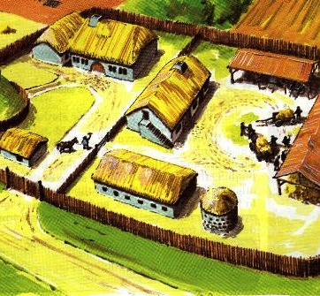
The Lord’s Manor
It included:
  The lord’s house
  Pastures for livestock
  Fields for crops
  Forest
  A peasant village
Feudalism is the political relationship between nobles
Manorialism – the economic ties between nobles

Slide 79
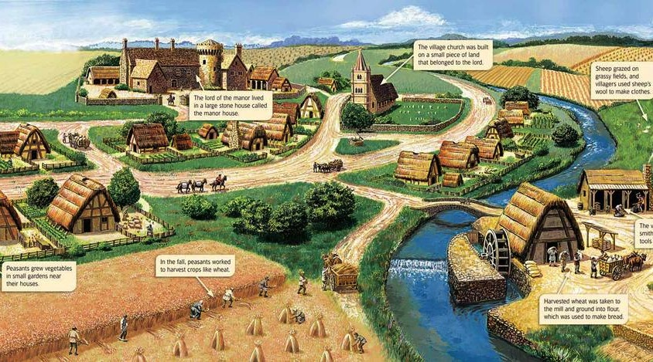
Lord’s Manor

Slide 80
Manorial System
Peasants provided services in exchange for being protected by their lord
  Farming the lord’s land
  Making various payments of goods
These peasants rarely left the manor
Serfs – people who were bound to the manor and could not leave it without permission
They were not slaves since they couldn’t be sold to someone else

Slide 81
Serf Life
They lived in
  Tiny, one-room houses
  With dirt floors
  A hole in the roof for a chimney
  One or two pieces of furniture
They ate:
  Coarse bread
  Few vegetables
  Grain for porridge

Slide 82
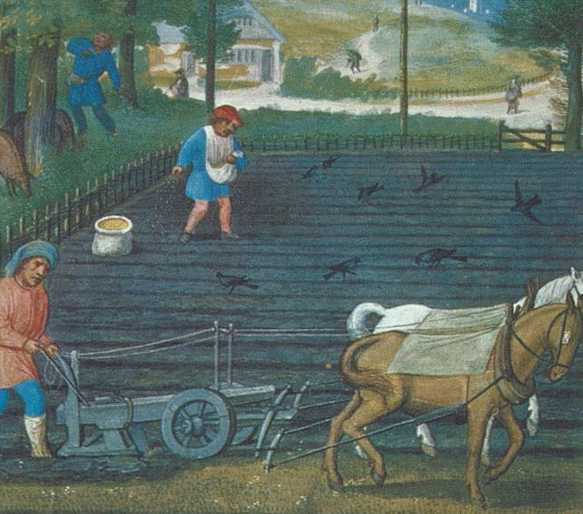
An Improving Economy
1000: the invention of a better plow allowed farmers to produce more food
The invention of the horse collar allowed farmers to use horses instead of oxen
Horses could pull a plow faster than an ox allowing farmers to grow more crops each year

Slide 83
An Improving Economy
The ability to produce a surplus of foods helped to revive trade in Europe and the growth of towns
Warfare and raids by bandits decreased
Roads were soon filled with traders carrying goods to markets

Slide 84
The Church
It had its own laws and dealt with cases related to the clergy, doctrine, marriage, and morals
Disobedience to church laws resulted in sever punishments for common persons and rulers alike
Excommunication – barred people from participating in Church rites

Slide 85
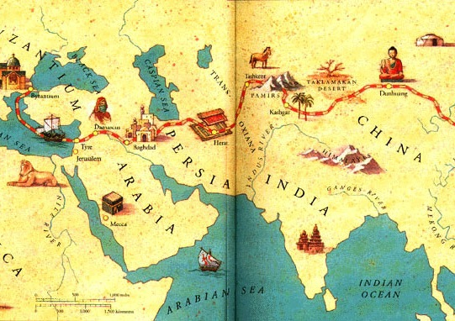
Expanding Horizons
As mentioned before, the Crusades helped open the doors to trade for western Europe
Luxury goods were in demand:
  Spices
  Sugar
  Melons
  Tapestries
  Silk

Slide 86
Business with Asia
Chinese & Indian merchants traded spices and silk with Arab merchants
Arab merchants traded these good with European merchants
European merchants noticed that Arab merchants only accepted money in payment
They needed a common medium of exchange and it led to the rise of an economy based on money
Demand for gold increased to make coins

Slide 87
The Mongols
The Mongols also helped increase the flow of goods
Mongol horsemen came from Central Asia and built one of the largest empires in world history
They integrated much of Asia’s economy
  It broke down trade barriers
  Opened borders
  Secured the roads against bandings
  Encouraged even more trade between Asia & Europe

Slide 88
Expanding Horizons
1300s: Europe was importing huge quantities of spices, silks and other goods from Asia
The Mongol empire collapsed in the 1300s and Asia began to separate into dozens of independent kingdoms and empires
Flow of goods declined
Price of spices rose higher
European merchants looked for a route to Asia that bypassed the Muslim kingdoms
If not by land, perhaps by sea

Slide 89
New States, New Technology
Europeans definitely wanted to find another route to Asia
Feudalism brought about so many wars amongst the different cities/villages that exploring became impossible
Western Europeans also didn’t have the proper technology to attempt to sail to China

Slide 90
Strong States Emerge
1400s/1500s – feudalism started to decline with the help of trade with Asia and the Crusades
Rise of towns/cities provided kings/queens with a new source of wealth they could tax
Rulers could now use their army to open up & protect trade routes
They could also set up common trade laws and a common currency within their kingdoms

Slide 91
Strong States Emerge
Money from trade meant that rulers did not have to depend on nobles for support
Mid-1400s: 4 strong states emerged
  Portugal
  Spain
  England
  France
Portugal was the earliest to set up voyages for exploration

Slide 92
The Renaissance Spurs Discoveries
An intellectual movement had sprung up around the same time these new states began to emerge
Renaissance – “rebirth”, in French
It began around 1350 and lasted until around 1600
It referred to a rebirth of interest in the classical cultures of ancient Greece & Rome

Slide 93
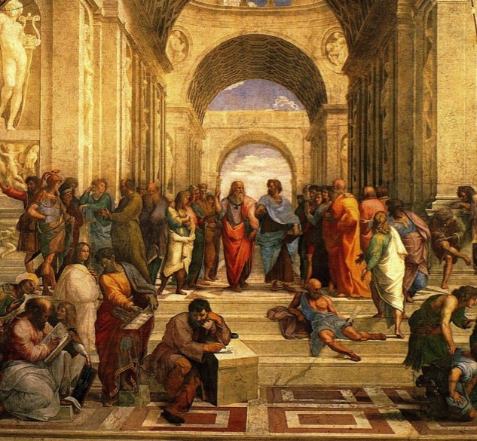
The Renaissance
Scholars rediscovered works of philosophers, geographers, and mathematicians
They began to read works by Arab scholars
It produced spectacular works of art
It also marked a renewed commitment to learning and helped to trigger a scientific revolution

Slide 94
New Technology
To find a water route to China, Europeans needed navigational instruments that would enable sailors to travel out of sigh of land and still find their way home
Astrolabe – a device invented by the ancient Greeks, refined by Arab navigators
  It uses the position of the sun to determine direction, latitude, and local time
Compass – device which showed the direction of magnetic north

Slide 95
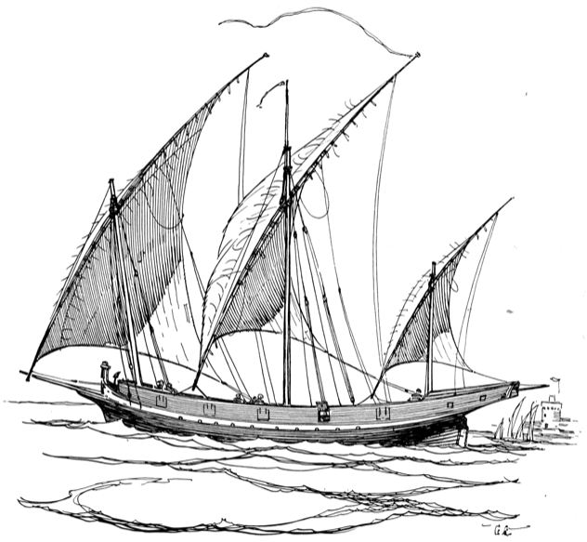
New Technology
These tools were very important in navigation but they also needed strong ships to help for smooth sailing
Lateen Sails – made it possible for ships to sail against the wind

Slide 96
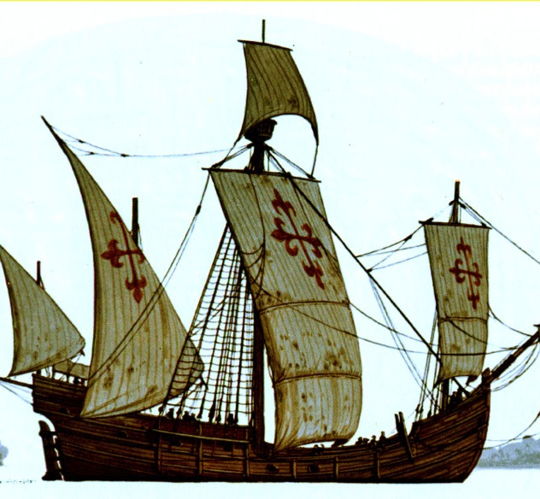
New Technology
Another great invention was the caravel
Small vessel capable of carrying about 130 tons of cargo
It required very little water to sail

Slide 97
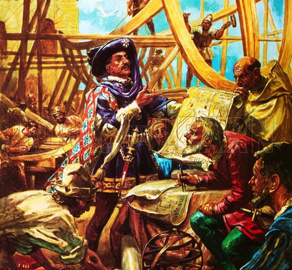
Portuguese Exploration
Portuguese explorers became the first Europeans to find a sea route to Asia
1419: Prince Henry of Portugal also known as Henry the Navigator set up a center for astronomical & geographical studies in Portugal
He invited mapmakers, astronomers, and ship-builders from around the Mediterranean world to come there to study and plan explorations

Slide 98
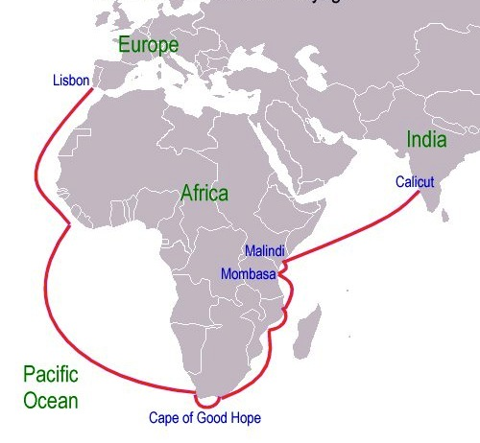
Portuguese Exploration
1420: Portuguese explorers started mapping Africa’s west coast
1488: Bartolomeu Dias, a ship commander, reached the southern tip of Africa
1429: Vasco da Gama commanded 4 ships from Portugal, around Africa, then to India
The water route had been found!

Slide 99
Europe Encounters America
Chapter 1 – Section 5

Slide 100
Vikings Arrive in America
Contrary to popular belief, Christopher Columbus was not the first European to set foot in the Americas
Vikings (people who came from Scandinavia) were a Norse group who made it here long before
Late 700s: longboats (Viking ships) ventured outward from their Norse homeland
Most of the Vikings headed south where they traded with other people, even invading them
Others crossed the Atlantic Ocean

Slide 101
Vikings Arrive in America
Sometime around 1000 BCE: Leif Ericsson and 35 men landed in Newfoundland
They tried to set up colonies there but they failed for a few reasons
The Native Americans opposed them
Vikings at this time did not have better weapons than the Natives
Europeans in later years will arrive with weapons of gunpowder

Slide 102
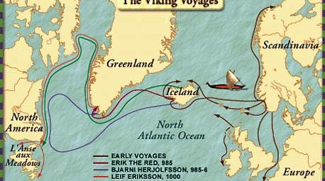
Leif Ericson

Slide 103
Spain Sends Columbus West
The Renaissance renewed the European interest in America
Many European states were eager to find a water route to Asia
Christopher Columbus, an Italian explorer, was sent on a mission by the king and queen of Spain to find this water route

Slide 104
New Geography
Around the 1400s the only labeled bodies of land on all maps were that of Africa, Europe, the Middle East, and Asia
Then a book appeared that would revolutionize European exploration
12 centuries earlier, a Greek-educated Egyptian geographer/astronomer Claudius Ptolemy had drawn maps of a round world
It was complete with 360 lines of longitude

Slide 105
Ptolemy’s Geography
It was rediscovered in 1406 and printed in 1457
European mariners also consulted the work of Arab geographer al-Idrisi who traveled widely in the Middle East
1154: he published a geographical survey of as much of the world as was then known to Europeans and Muslims

Slide 106
Columbus’s Plan
Ptolemy’s Geography had some serious understatements about the world
He made the world seem much smaller than it actually was
Columbus on the other hand thought that Spain and India were so close together that he could get there within a few days’ time

Slide 107
Columbus’s Plan
At first Columbus went to the Portuguese to get financial backing from them
They agreed to support him financially
However then news broke that Bartolomeu Dias had rounded the southern tip of Africa
The Portuguese lost all interest in supporting Columbus

Slide 108
Columbus’s Plan
So Columbus turns to his brother, Bartholomew who was a respected mapmaker in Europe
They first went to the royalty of England and France and they found no luck there
Then they turned their attention to Spain
Columbus promised King Ferdinand & Queen Isabella wealth and many converts to Catholicism
1492: the king and queen agreed to support Columbus

Slide 109
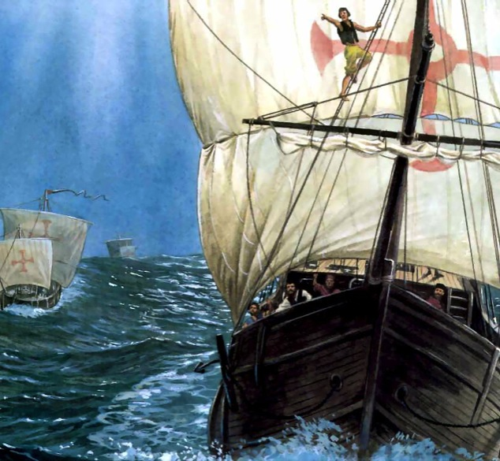
The First Voyage
August 1492: the Nina, the Pinta, and the Santa Maria set sail
First he and his men land in the Canary Islands to take fresh supplies
After battling the Atlantic Ocean they reached the Caribbean and landed in the Bahamas, one what is today San Salvador Island

Slide 110
The First Voyage
They encounter the Taino people
He called them Indians because he thought he had reached the Indies
He noticed that some of the local people had a small piece of gold “hanging from a hole which they have in their nose”
He soon learned that the gold came from “a king who had large vessels of it, and possessed much gold”

Slide 111
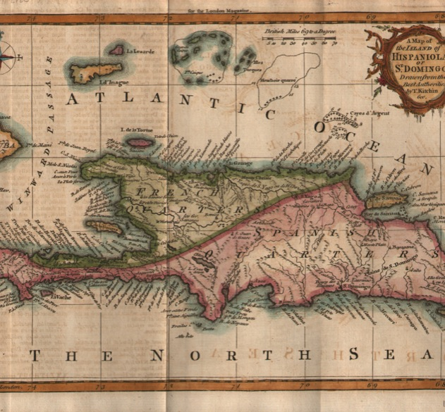
The First Voyage
He was very eager to find this gold so he kept searching for it
His search brought him to the island of Cuba and Hispaniola (Haiti & Dominican Republic)
He mistakenly concluded that Cuba was the coast of China and Hispaniola was Japan

Slide 112
Columbus’s Reaction to the Natives
Upon meeting the Natives, Columbus said that
“They are artless and generous with what they have, to such a degree as no one would believe but he who had seen it. Of anything they have, if it be asked for, they never say no, but do rather invite the person to accept it, and show as much lovingness as though they would giver their hearts”

Slide 113
Natives Reaction to Columbus
Natives were just as curious about Europeans as they were of the Natives
“The people kept coming down the beach, calling to us and giving thanks God. Some brought us water, some food; others, seeing that I did not wish to go ashore, swam out to us . . One old man climbed into the boat, and the others, men and women, kept shouting ‘Come and see the men who have come from Heaven; bring them food and drink’”

Slide 114
Columbus’s First Voyage
On Christmas Eve, the Santa Maria struck a reef off Hispaniola and broke apart
He and his crew built a small fort called a La Navidad and had 40 crew members go and look for gold
March 1493: Columbus returned to Spain with gold, parrots, spices, and Native Americans
He was awarded with titles such as “Admiral of the Ocean Sea” & “Viceroy and Governor of the Indies”
He promised the King and Queen with as much gold as they want

Slide 115
Columbus’s Later Voyages
This time he goes back with 17 ships and over 1,200 Spanish colonists
He learns that the men he left behind from his 1st voyage had been killed and their fort destroyed
Many of the colonists he brought over were nobles who wanted to get rich instantly
They did not want to work let alone do manual labor
They accused Columbus of misleading them with false promises of gold, many headed back to Spain to complain

Slide 116
Columbus’s Later Voyages
In an attempt to save his reputation, Columbus found a place that had gold they could mine
He enslaved the local Taino Natives and forced them to work for the Spanish: mining and planting crops
1496: his brother, Bartholomew, in the meantime founded a new town called Santo Domingo closer to the gold mines

Slide 117
Columbus’s Later Voyages
On his 3rd voyage he wrote: “I believe that this is a very great continent, which until today has been unknown”
1502: he made one final voyage and mapped the American coastline from Guatemala to Panama before returning back

Slide 118
Spain Claims America
Because of Columbus, Spain was able to send many explorers and settlers to the New World
They explored and inhabited the islands of Cuba, Jamaica, Hispaniola, and Puerto Rico
Eventually they made their way to the American mainland

Slide 119
Treaty of Tordesillas
Since Portugal claimed the right to control the Atlantic routes to Asia, it made things difficult for the Spanish
The Spanish then went to the pope to appeal for a decision to use the Atlantic to go to the New World and colonize

Slide 120
Treaty of Tordesillas
1493: Pope Alexander VI established the line of demarcation to prevent a war between Spain & Portugal
This is an imaginary north-to-south line running down the middle of the Atlantic
It stated that Spain would control everything to the west of this line
While Portugal would control everything to the east of this line

Slide 121
Treaty of Tordesillas
Later on both countries signed a treaty to resolve their differences on the line of demarcation
Treaty of Tordesillas stated that the line would be moved almost 1,000 miles to the west
It did 2 things:
  Confirmed Portugal’s right to control the route around Africa to India
  Confirmed Spain’s claim to the New World
  Unknowingly the line was so far out west that it cut through South America, giving Brazil to the Portuguese

Slide 122
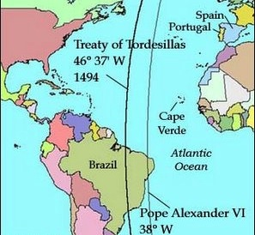
Treaty of Tordesillas

Slide 123
Naming America
1499: an Italian explorer, Amerigo Vespucci, sailed for Spain to the New World
He too took the same route as Columbus thinking he landed in Asia
1501: he sails for Portugal and lands in a different region of the continent
He comes to the conclusion that this could not be Asia and publishes a book
German scholar Martin Waldseemuller says that the land should be named after “Amerigo the discoverer”

Slide 124
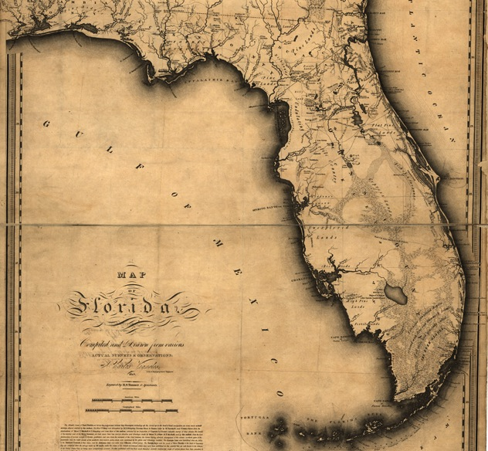
Continuing Spanish Expeditions
Juan Ponce de Leon, a Spanish governor in Puerto Rico, sailed further north
He had heard of a place where a fountain had magical abilities
These abilities were believed to have restored a person’s youth
He did discover a land full of wildflowers and named this place Florida – land of the flowers

Slide 125
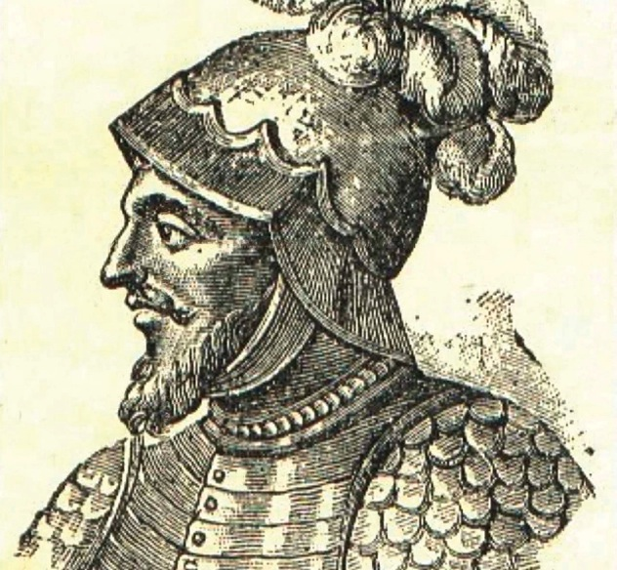
Continuing Spanish Expeditions
1510: Vasco de Balboa was a planter from Hispaniola who wanted to escape his creditors
He got on a ship and sailed south and founded a colony on the Isthmus of Panama
He heard tales of a “south sea” that led to an empire of gold
He became the first European to reach the Pacific coast of America

Slide 126
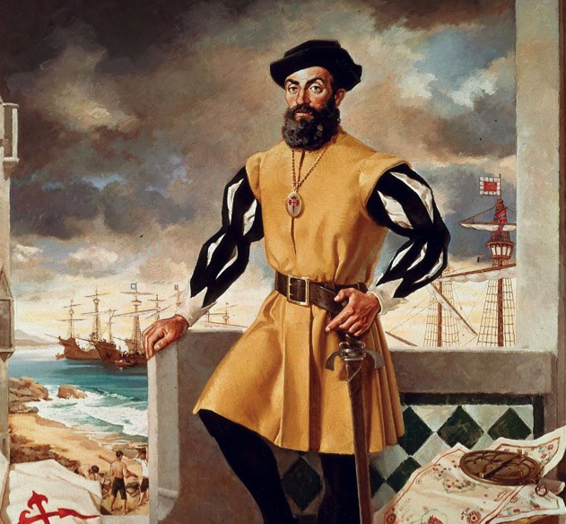
Continuing Spanish Expedition
1520: Ferdinand Magellan was a Portuguese mariner who worked for the Spanish
He later discovered a strait which was later named after him
He also sailed into the same ocean as Balboa did
The waters seemed so peaceful that he named it that, pacific
He died in the Philippine Islands but his crew eventually made it back to Spain
They became the first to circumnavigate the globe

Slide 127
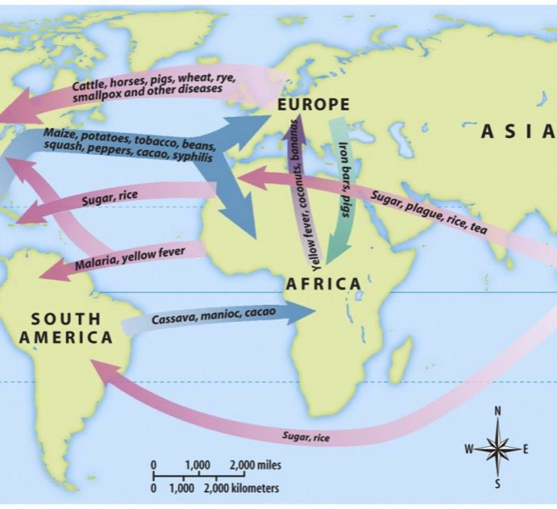
The Columbian Exchange
The interactions between Europeans and Natives changed the world forever
It was known as the Columbian Exchange

Slide 128
From America ~> Europe
Local Native Americans taught the Europeans who arrived there how to farm the local crops
Corn became essential to the Europeans and it eventually made its way back to Europe
As did other crops: pumpkins, beans, sweet potatoes, tomatoes, chili peppers, peanuts, chocolate, and squash

Slide 129
From America ~> Europe
The potato was perhaps the most important discovery for the Europeans
Instead of using rye, they could use potatoes to feed more people on the same piece of land
They also learned new devices invented by Natives
  Canoe
  Snowshoe
  Hammock
  Poncho

Slide 130
From Europe ~> America
Native Americans were introduced to wheat, oats, barley, rue, rice, coffee, dandelions, onions, bananas, and oranges
Animals included: chickens, cattle, pigs, sheep, and horses
Technologies: new types of metalworking, new techniques of shipbuilding, and new weapons (firearms)

Slide 131
For Europe ~> America
The worst import was an invisible one
Europeans brought bacteria and viruses that caused many diseases:
  Influenza
  Measles
  Chicken pox
  Mumps
  Smallpox

Slide 132
From Europe ~> America
It is unfortunate that the cons outweigh the pros
The amount of trade between the the two continents were overshadowed
Overshadowed by the amount of disease, military conquests, and slavery that devastated the Native American population

