Slide 1
The World
Unit 1

Slide 2
How Geographers Look at the World
Chapter 1

Slide 3
Exploring Geography
Chapter 1 – Section 1

Slide 4
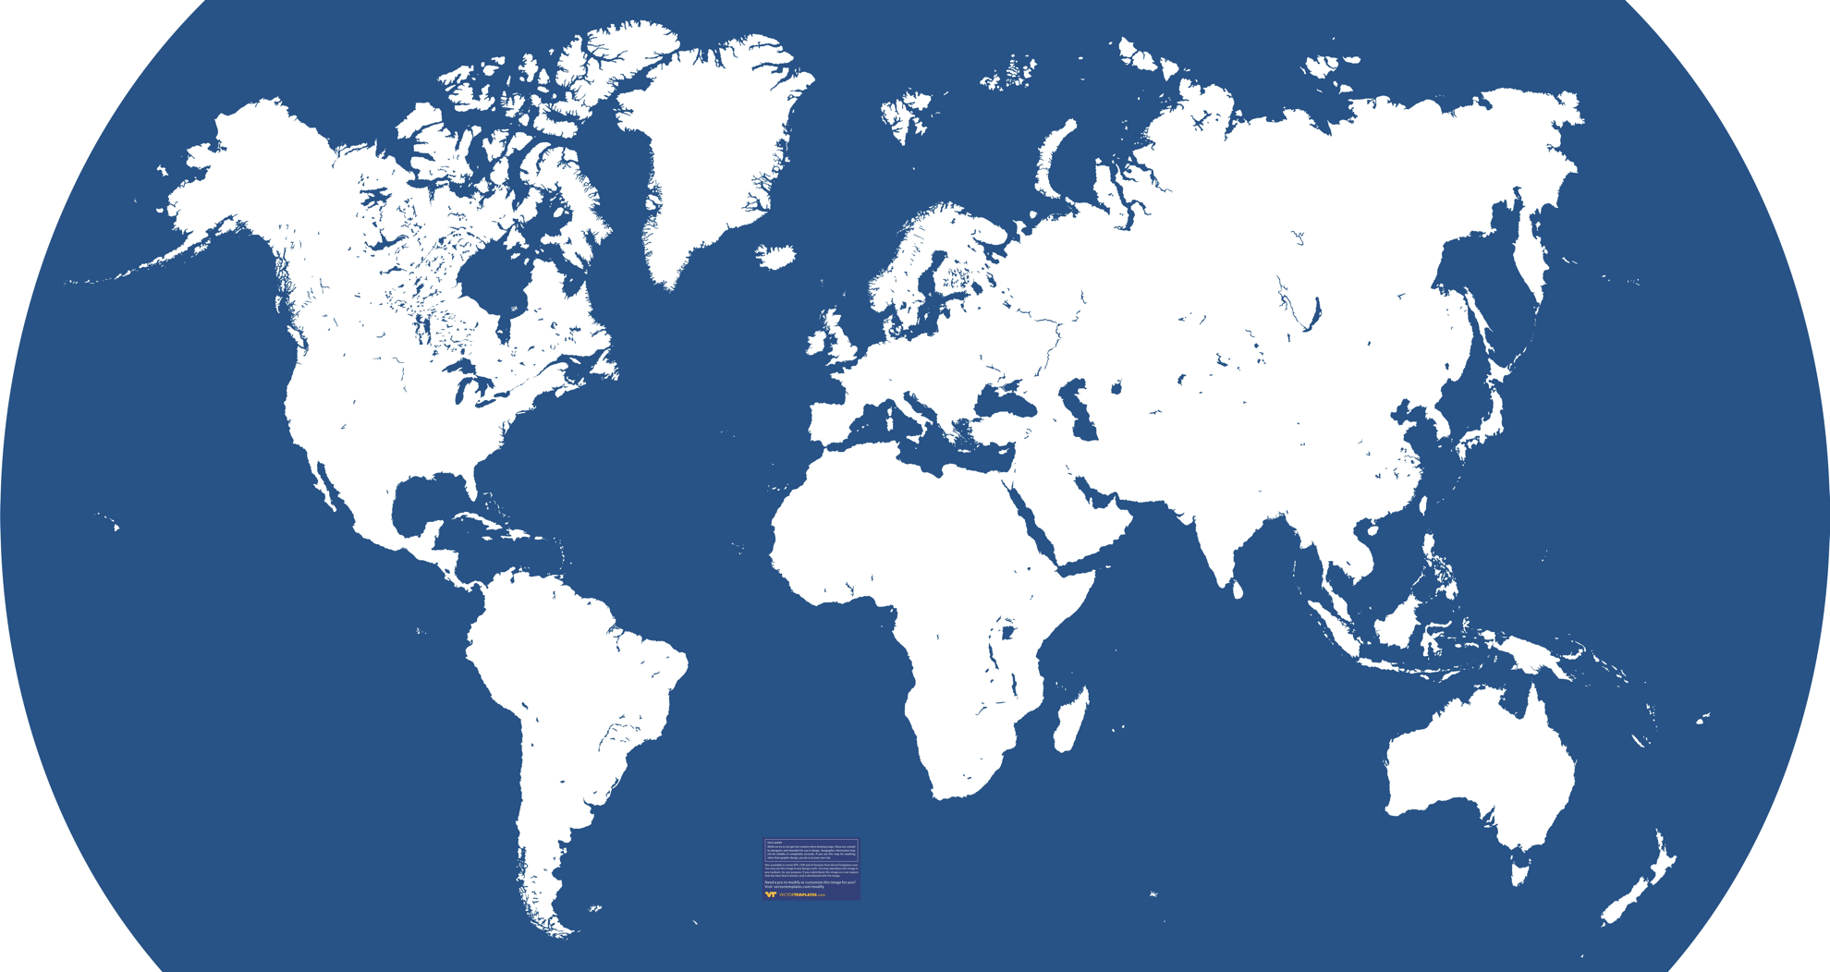
Maps
What are the names of the continents and the oceans?
What is the largest body of water on Earth?
Which continents are located entirely above the Equator?
Which large bodies of water border Asia?
On which continent is Brazil located?

Slide 5
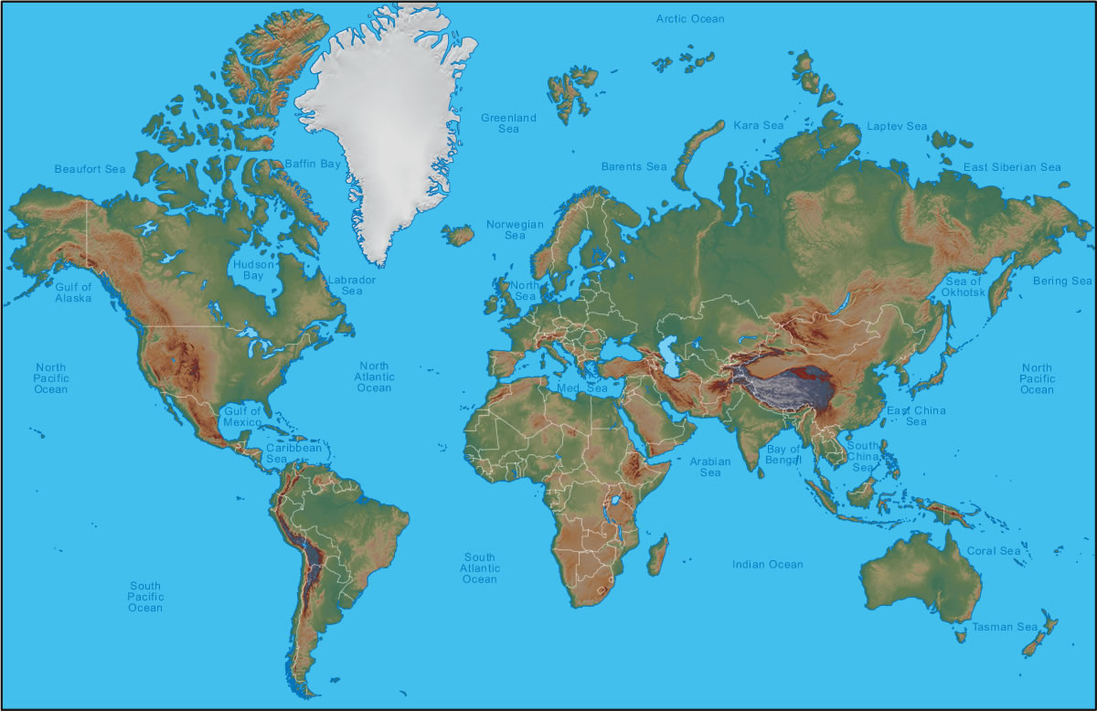
What is Geography?
It is the study of the earth’s physical features and the living things (humans, animals, and plants) that inhabit the planet
Look at where these elements are located and how they relate to one another
Why is this important?

Slide 6
Elements of Geography
Etymology (origin) of Geography:
  Greek word geographia for “earth description”
Geographers may study volcanoes and why they erupt
They may also analyze a city’s location to climate, landscape, and available transportation
Why?

Slide 7
Geographers
Take into consideration:
  The world in spatial terms (location)
  Places and regions
  Physical systems
  Human systems
  Environment and society
  The uses of geography

Slide 8
The World in Spatial Terms
Location – specific place on the earth; this is a reference point in the same way dates are reference points for historians
How do geographers use location and what is the importance of it?

Slide 9
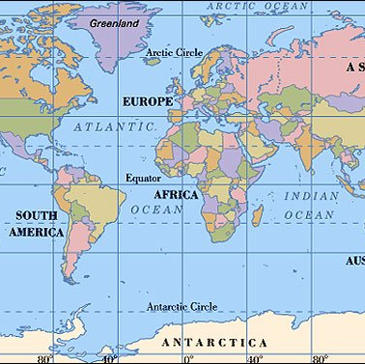
The World in Spatial Terms
Absolute Location – the exact spot at which the place is found on the globe
Tools to use: imaginary lines around the earth such as the Equator
It also divides the the earth into hemispheres (northern and southern)

Slide 10
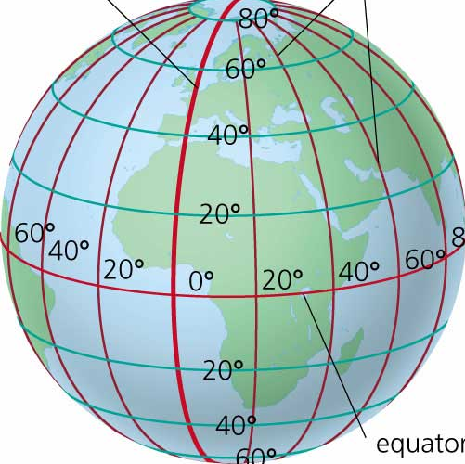
The World in Spatial Terms
Prime Meridian – it also divides the earth into hemispheres known as the eastern & western hemispheres
The Equator, Prime Meridian, and other lines of latitude/longitude create the grid system

Slide 11
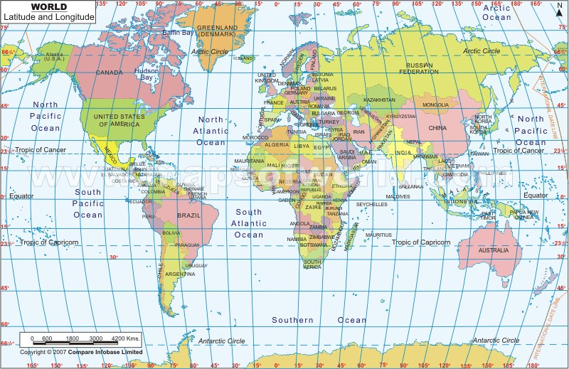
The World in Spatial Terms
What is the importance of a grid system?
How do you describe a location using grid systems?

Slide 12
The World in Spatial Terms
Relative Location – location in relation to other places
  Can you give an example?
Place – particular space with physical and human meaning; something about that location which makes it distinct
  What is an example of a place?
Regions – areas united by specific factors; geographers usually group places into regions
  What would you consider a region?

Slide 13

Places & Regions

Slide 14
3 Types of Regions
Formal – uniform; it is defined by a common characteristic, perhaps something produced there
  What are some examples?
Functional – central place and the surrounding area linked to it
  Can you think of some functional regions?
Perceptual – defined by popular feelings and images rather than objective data
  An example would be the “heartland” which is a central area where traditional values are more important

Slide 15
Physical Systems
Geographers very often analyze natural phenomena such as volcanoes, hurricanes, and floods
These all shape the earth’s surface and can have a great impact on Earth’s ecosystems
Ecosystems – a community of plants and animals that depend upon one another, and their surroundings, for survival

Slide 16
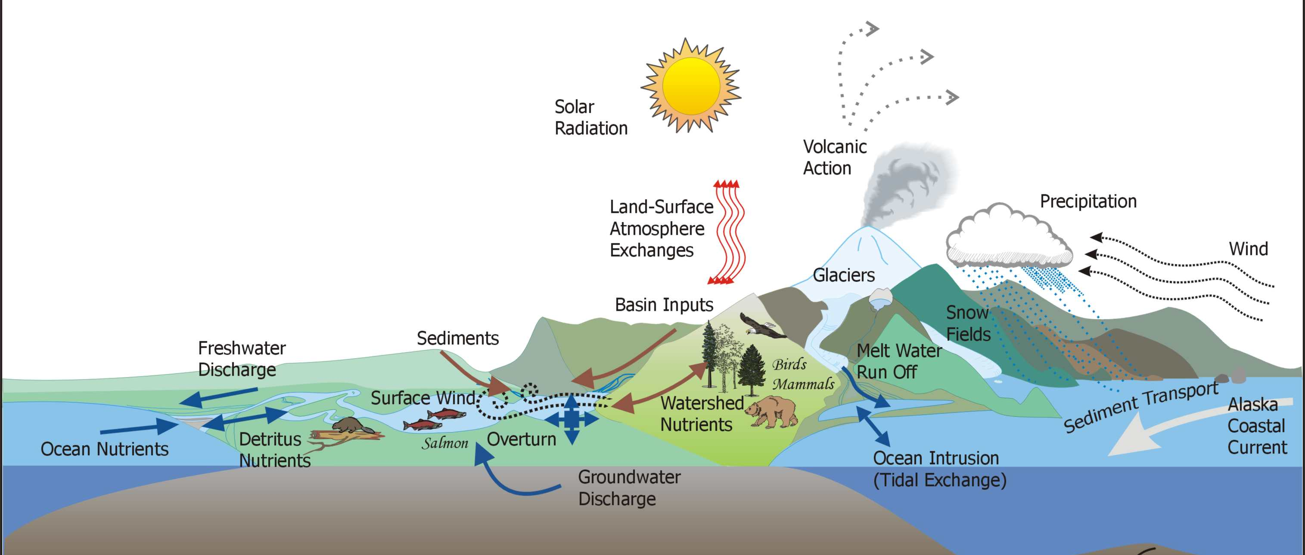
Ecosystems

Slide 17
Human Systems
Geographers also observe how people settle the earth, form societies, and create permanent features
Movement – ongoing movement of people, goods, and ideas
This can occur during migration

Slide 18
Environment & Society
Human-Environment Interaction – the study of the interrelationship between people and their physical environment
  The way people use their environment
  How and why they have changed it
  What consequences result from these changes

Slide 19
Effects
Sometimes humans can affect the environmental
  Examples:
In other cases, the environment can affect human activities
  Examples:

Slide 20
The Geographer’s Craft
Chapter 1 – Section 2

Slide 21
Branches of Geography
To make their work easier, geographers divide their subject area into different branches
Two of the major ones are: Physical Geography and Human Geography

Slide 22
Branches of Geography
Physical Geography – focuses on the study of the earth’s physical features
  Such as: climate, land, water, plants, and animal life
  In terms of their relationships to one another and to humans
Human Geography – also known as cultural geography, is the study of human activities and their relationship to the cultural and physical environments
  Such as: political, economic, and cultural factors (population density, urban development, economic production, and ethnicity)

Slide 23
Branches of Geography
Examples of how geography is further divided into smaller subject areas:
  Meteorology: the study of weather and weather forecasting
  Historical Geography: the study of places and human activities over time and the various geographic factors that have shaped them

Slide 24
Geographers at Work
Here are some methods which geographers use in their day-to-day work:
  Direct observation
  Mapping
  Interviewing
  Statistics
  Technology

Slide 25
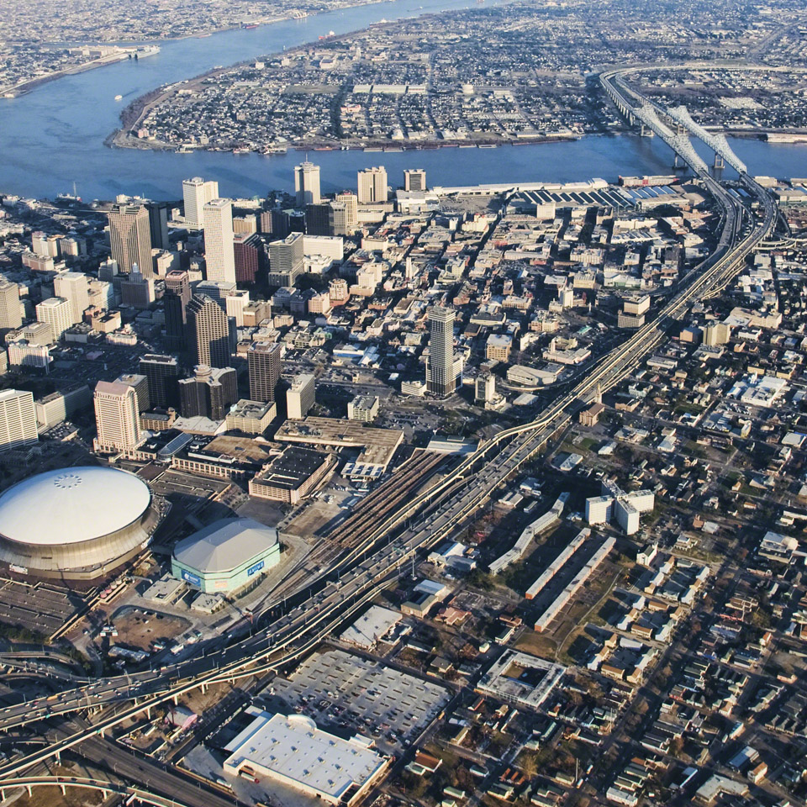
Direct Observation
This comes in handy when studying the earth and the patterns of human activities that take place on the earth’s surface
To do so, geographers can use aerial photos or satellite images to determine where the mineral deposits or freshwater sources are located
Why might these be important?

Slide 26
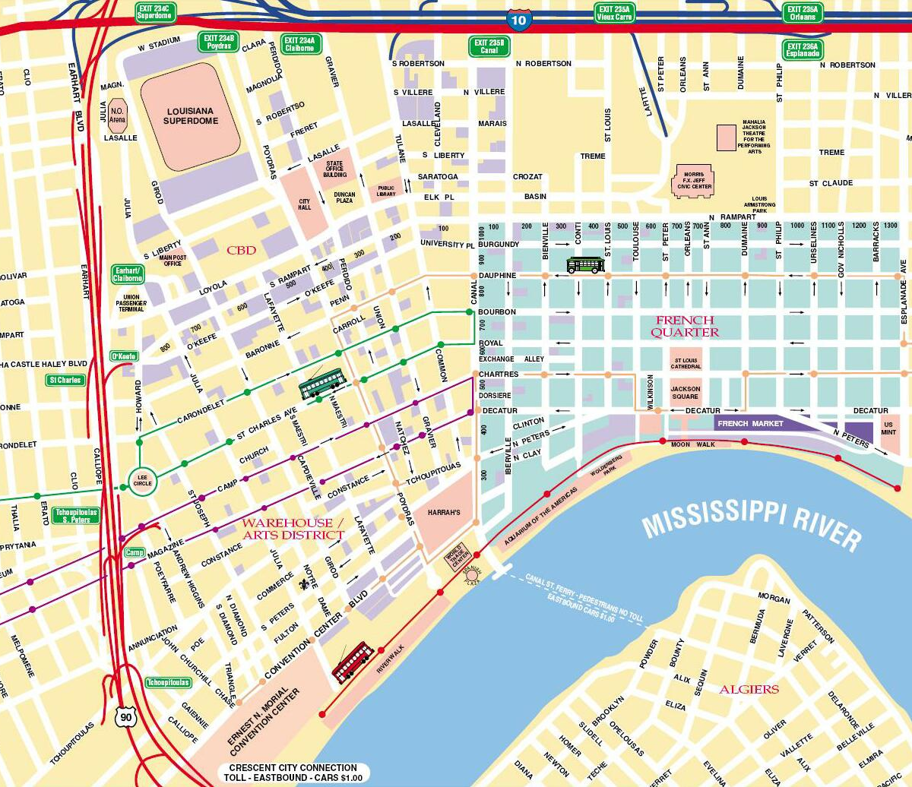
Mapping
Maps are very fundamental for geographers
Cartographer – specialists who make and design maps and also involves the studying of maps/mapmaking
Sometimes it is easier to explain research findings visually (such as on a map) than it is in written text
How can maps come in handy?

Slide 27

Interviewing
Sometimes observations aren’t enough, therefore geographers must go out and interview people
A particular group of people are chosen and only a small part of that group is interviewed to reflect the entire population

Slide 28
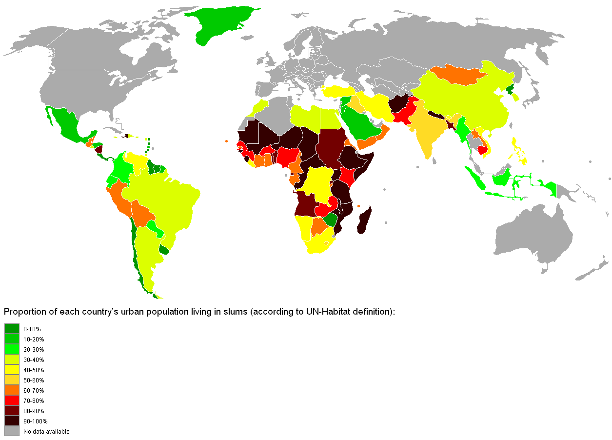
Statistics
This method helps geographers simplify complex data and present them in a way that is more easily understood
What can statistics show?

Slide 29
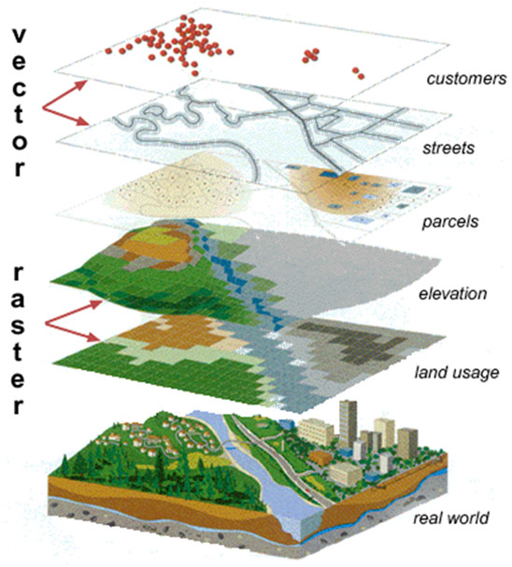
Technology
Just like any other professional, a geographer uses technology in their line of work
  Examples: satellites, computers, etc.
Geographic Information Systems (GIS) – computer tools that process and organize data and satellite images with other pieces of information

Slide 30
Technology
How has technology changed the art of mapmaking? What is being done differently today than years before?

