Slide 1
America in the 1950’s
1953 – 1960

Slide 2
Eisenhower in the White House
Chapter 28 – Section 1

Slide 3
Republican Revival
By 1952: Truman began to lose support
Many Americans were upset over the stalemated war in Korea and worried about Communist subversion
Because of all the dissatisfaction, Truman decided not to run for reelection
Democrats – Aldai E. Stevenson (P) & John J. Sparkman (VP)
Republicans – Dwight D. Eisenhower (P) & Richard M. Nixon (VP)

Slide 4
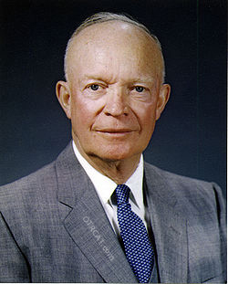
Eisenhower
Eisenhower was born in Texas but raised in Kansas
He graduated from the United States Military Academy at West Point
He became a supreme commander of the Allied forces during WWII
People trusted him and his warmth & sincerity won many voters
He promised to end the Korean War

Slide 5
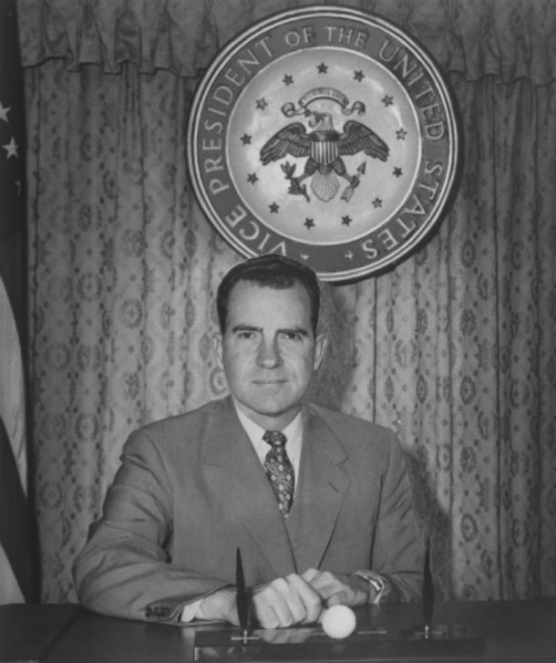
The Campaign
Unfortunately, there was a scandal in the Republican party during the presidential campaign
VP candidate, Richard Nixon, had been accused of accepting political gifts from supporters
He went on television to defend himself
These speeches won broad support for Nixon and persuaded Eisenhower to keep him as his VP candidate

Slide 6
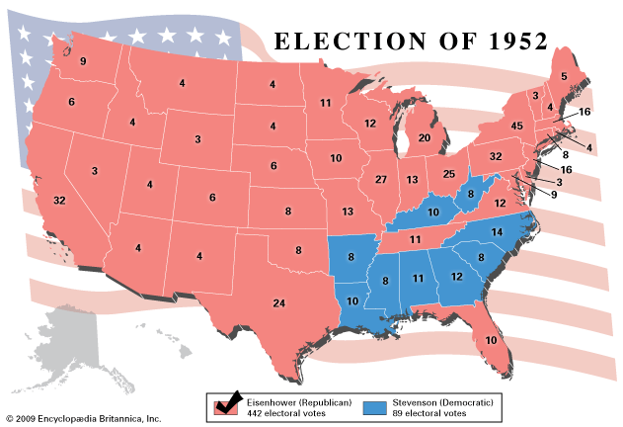
Elections
Eisenhower won by a landslide victory and 1st Republican to win since 1928
Popular votes – 6 million more than Stevenson
Electoral votes – 442 to 89
Republicans also won control of Congress

Slide 7
Domestic Policy
Eisenhower served 2 terms in office
He followed a moderate – middle of the road approach
“Conservative when it comes to money, liberal when it comes to human beings”
Wanted to make the federal government “smaller rather than bigger”
Supported economic policies to limit government spending and encouraged private enterprise
Removed the wage & price controls and managed make some cuts in government spending
When he left office the federal budget had a surplus (excess) of $300 million

Slide 8
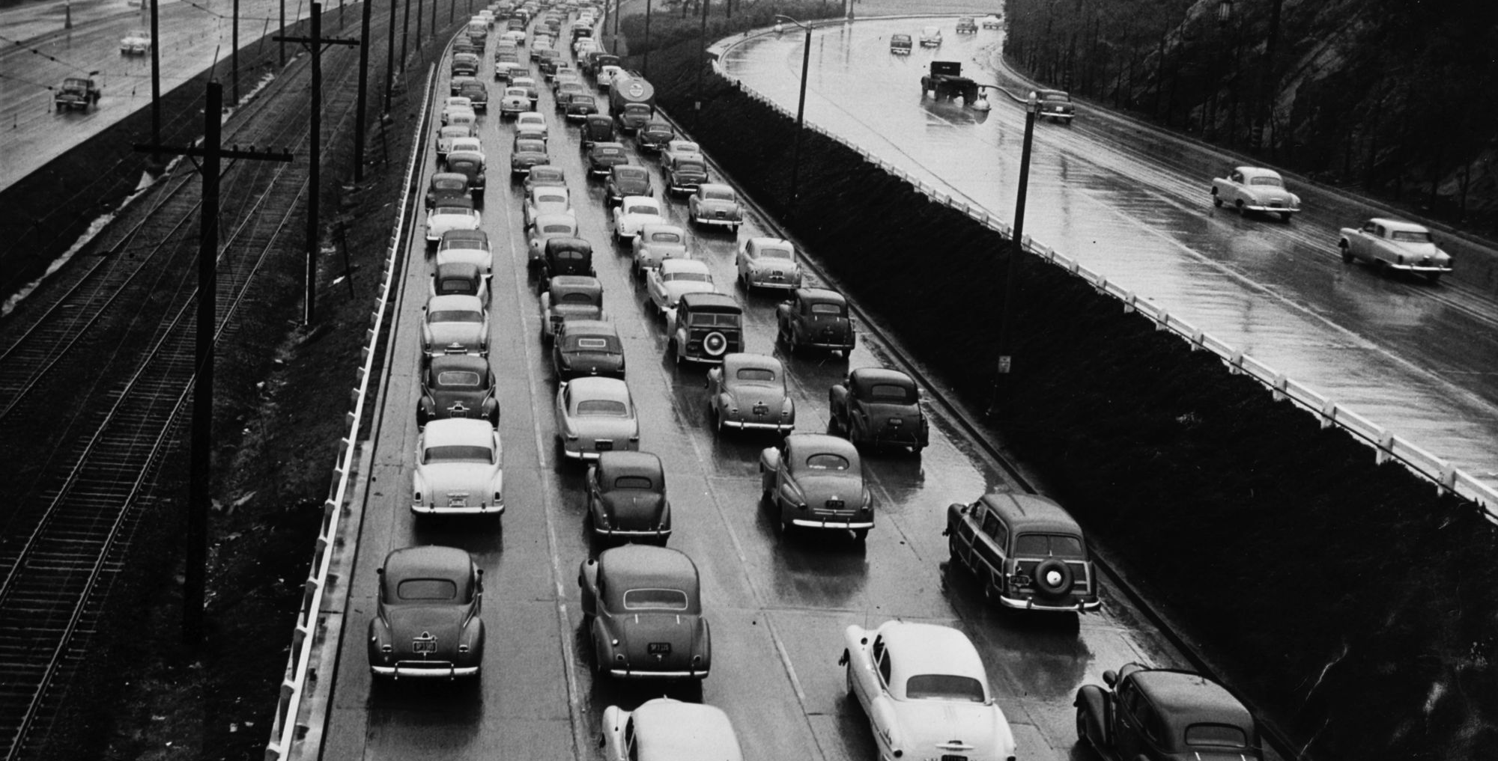
The Nation Expands
1956: Congress passed the Federal Highway Act
  Funded the construction of more than 40,000 miles of highways
This was the largest public works program in the nation’s history
It spurred growth in many areas
  Automobile
  Oil industries
  Improved military mobility in case of attack
1959: Alaska & Hawaii entered the Union

Slide 9
Social Programs
Eisenhower believed that government should protect the basic welfare of Americans
He did not want to touch Social Security and other New Deal programs
He extended Social Security benefits to 10 million more people
He also provided unemployment insurance to 4 million more
Furthermore, he approved greater funding for public housing
And agreed to increase minimum wage from $0.75 to $1.00

Slide 10
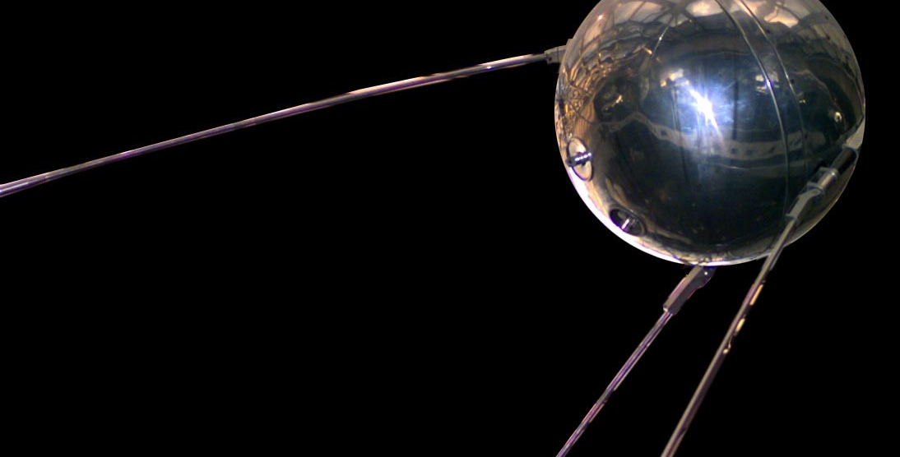
Eisenhower & the Cold War
October 4, 1957: Americans heard the news of the Soviets sending into space the first ever artificial satellite called Sputnik
Within a month the Soviets launched a second satellite
Americans were horrified and in awe
They feared that America was lagging behind and also feared that the Soviets could launch atomic weapons form space

Slide 11
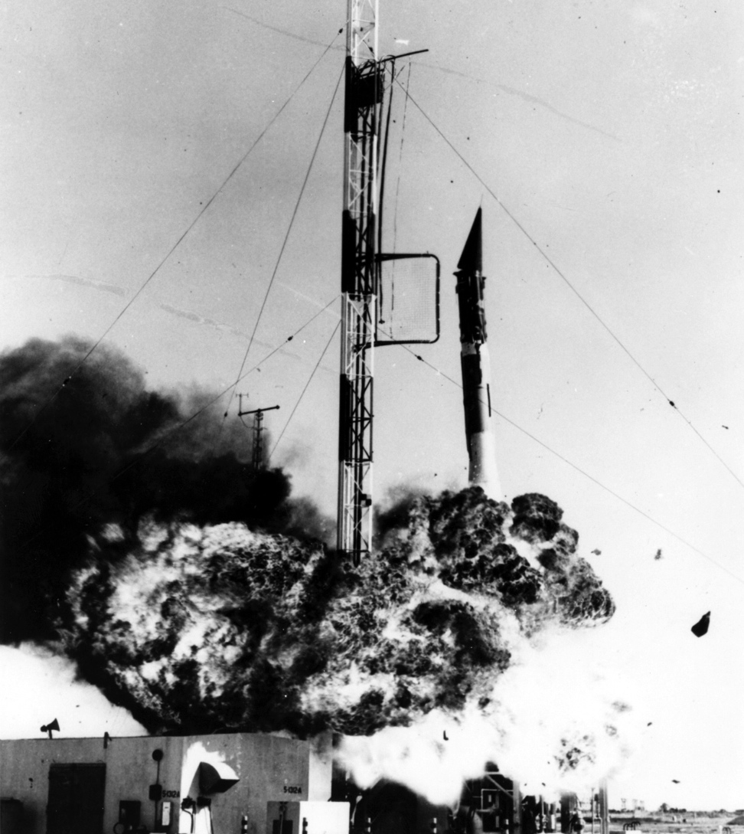
Launching Our Own Satellite
Embarrassingly, when the US launched its own space satellite – Vanguard – it exploded
Hundreds of reporters and spectators watched the rocket rise a few feet off the launching pad
The foreign press made fun of the launch
They called it “Flopnik” and “Stayupnik”

Slide 12
US – USSR Rivalry
Eisenhower continued to oppose the spread of Communism but he also tried to keep tensions from erupting into a war
Secretary of State John Foster Dulles proposed that if the USSR attacked any nation, the US would respond with a massive retaliation – instant attack using nuclear weapons
He believed that the US had to use threats to push the Soviets to the brink of war

Slide 13
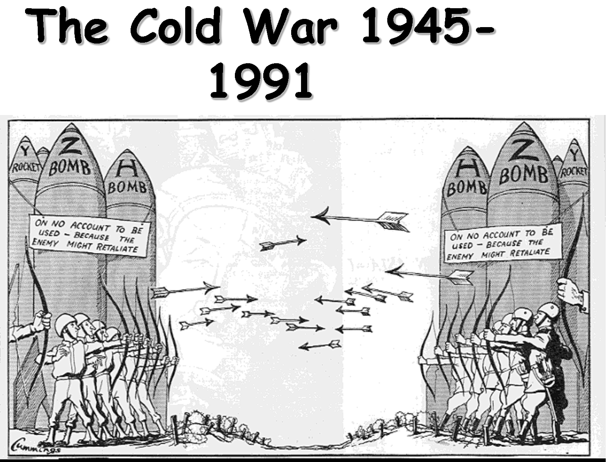
The Arms Race
This policy of massive retaliation and then the Soviet efforts to counter those retaliations produced a nuclear arms race
  Both nations raced to build more and more weapons
They both built massively destructive hydrogen bombs
  These were nuclear weapons much more powerful than atomic bombs
They developed a variety of guided missiles capable of delivering nuclear warheads

Slide 14
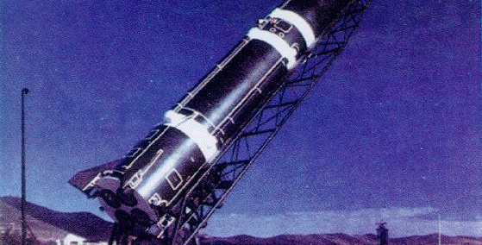
Intermediate-Range Ballistic Missile
Could reach targets up to 1,500 miles away

Slide 15
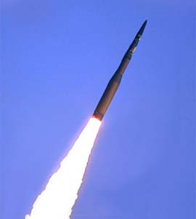
Intercontinental Ballistic Missile
Had a range of many thousands of miles

Slide 16
Civil Defense Administration
With the arms race, Americans began preparing for a nuclear war
They educated the public with pamphlets and radio and television messages
Some families built air-raid shelters in their basements or backyards
Schools held air drills
One student said: “Students lie on the floor and stick their heads under the lockers”
He said that people believed this would make them safe during a nuclear attack

Slide 17
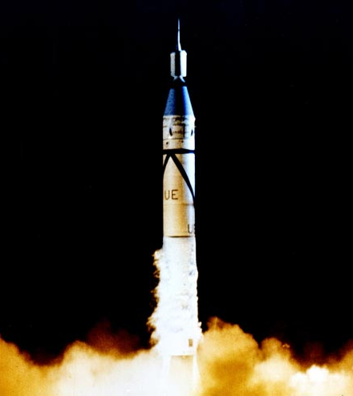
Space Race
Previous failure and embarrassment led the US to develop its own space program
Federal money went to fund the National Aeronautics and Space Administration (NASA)
  New government agency in charge of the space program
Eventually America launched its first successful rocket into space called the Explorer

Slide 18
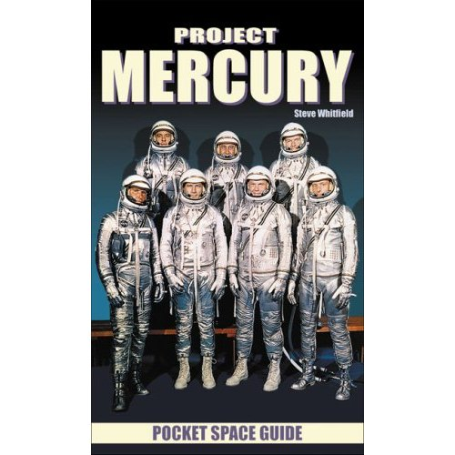
Project Mercury
With America pulling ahead in the space race, the nation launched a program to put an astronaut in space
The government also encouraged science education by providing more funds for the teaching of science and technology in the nation’s schools

Slide 19
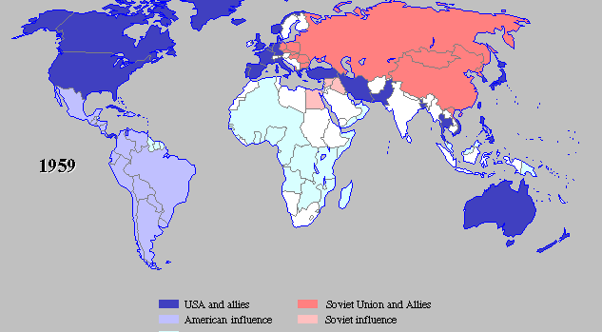
Foreign Policy Challenges

Slide 20
Crisis in the Middle East
Israel – backed by the United States
Arab States – had close ties with the Soviet Union
1948: the Arab States attacked Israel
A new conflict in the Middle East was soon on the rise
It threatened to involve the superpowers and their allies
But this wasn’t the only tension waiting to erupt

Slide 21
The Suez Canal
Egyptian President Gamal Abdel Nasser wanted to nationalized – to bring under government control – the Suez Canal
Great Britain & France feared that Nasser would close off the canal and cut off oil shipments to Europe
October 1956: they attacked Egypt
Israel also joined the fight and invaded Egypt
The Soviet Union then threatened to attack British & French cities
With all the tension, the 3 nations decided to pull out of Egypt

Slide 22
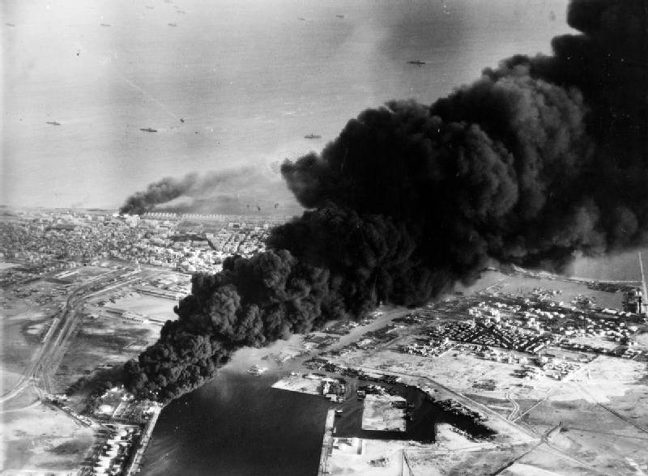
Port Said

Slide 23
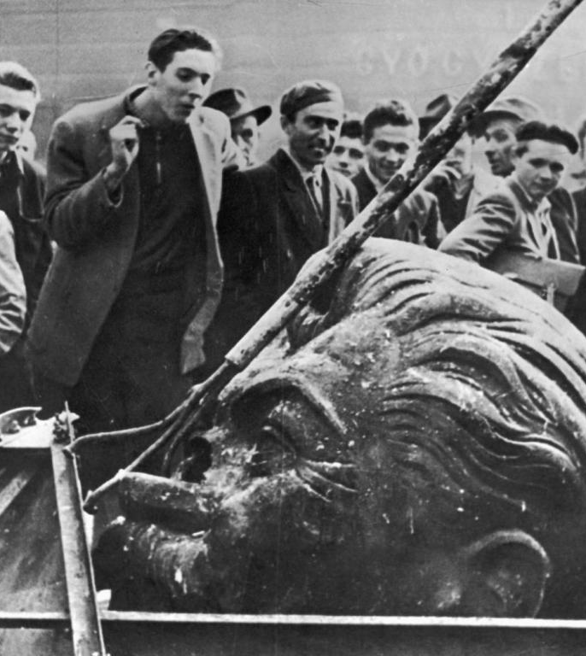
Uprising in Hungary
October 1956: students and workers demonstrated in the capital of Budapest
They wanted changes in the government
Strikes and riots spread
The new government that came demanded that the Soviets withdraw
November 1956: Soviet tanks and troops poured into Hungary and crushed the revolt
Rebels appealed to the US for help but the US did not intervene

Slide 24

Vietnam
1950s: America had given France billions of dollars to help fight the Vietminh – nationalist rebels led by Communist leader Ho Chi Minh

Slide 25
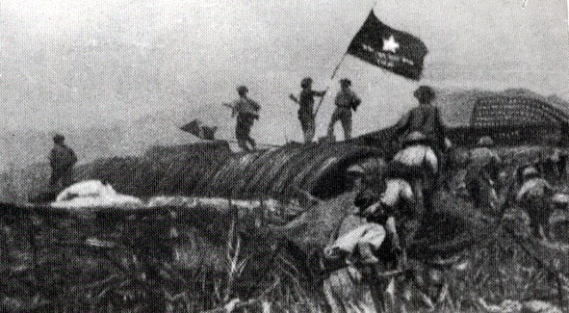
Vietnam
March 1954: Vietminh forces trapped 13,000 French troops in Dien Bien Phu
The French pleaded for help but Eisenhower refused
“I can conceive of no greater tragedy than for the United States to become engaged in all-out war in Indochina”

Slide 26
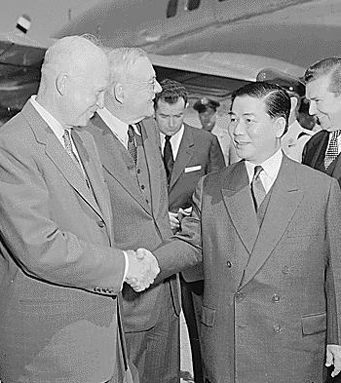
Vietnam
Without American help the French were forced to surrender
Geneva Accords – French and Vietminh representatives meet in Switzerland
  It temporarily divided Vietnam
  North – controlled by the Vietminh
  South – controlled by the Vietnamese who were friendly to the French

Slide 27
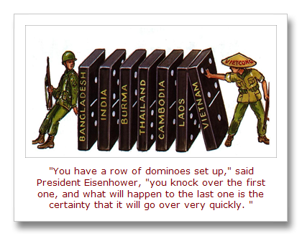
Domino Theory
Eisenhower believed that if one nation fell to Communism then other nations would also fall
To keep South Vietnam from becoming Communist:
  The US aided its anti-Communist government
  Helped create the Southeast Asia Treaty Organization (SEATO)
  It was made up of the US, Gb, FRA, NZ, AUS, the PHI, PAK, and THA

Slide 28
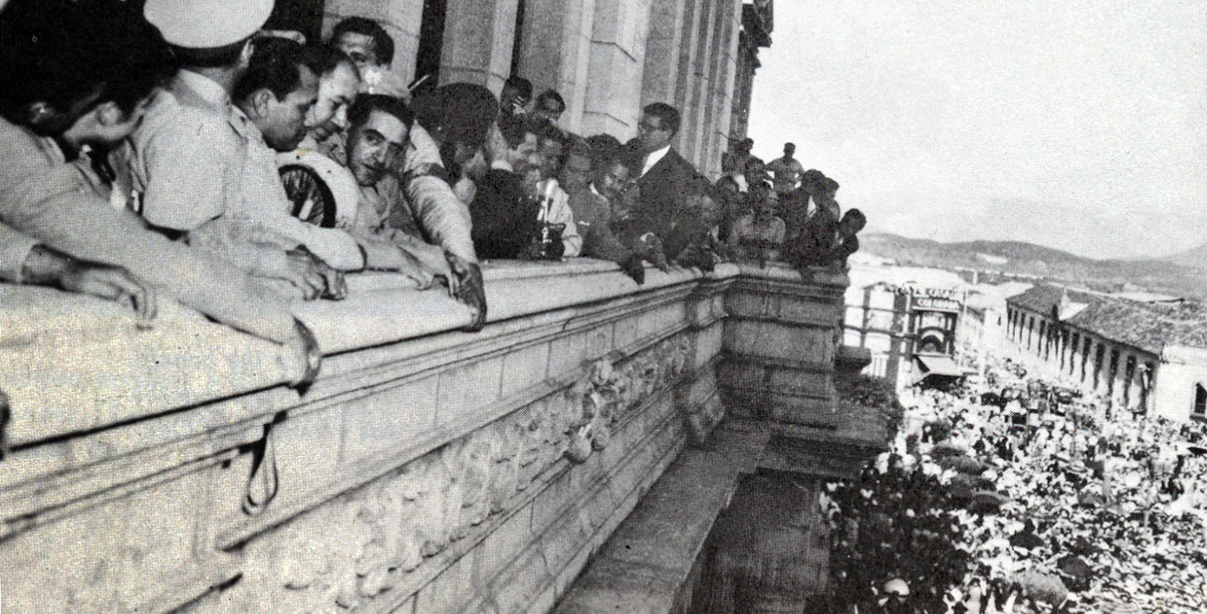
Troubles with Latin America
1954: the CIA helped overthrow the government of Guatemala because some feared it was leaning toward Communism
Many Latin American countries didn’t like our intervention

Slide 29

Cuba
Anti-American feeling became part of the revolution in Cuba
Rebel leader Fidel Castro overthrew dictator Fulgencio Batista and formed a new government
The US welcomed Castro at first because of his promise of democratic elections/reforms
But then he seized foreign-owned property
His government became a dictatorship
It also formed close ties with the Soviet Union

Slide 30
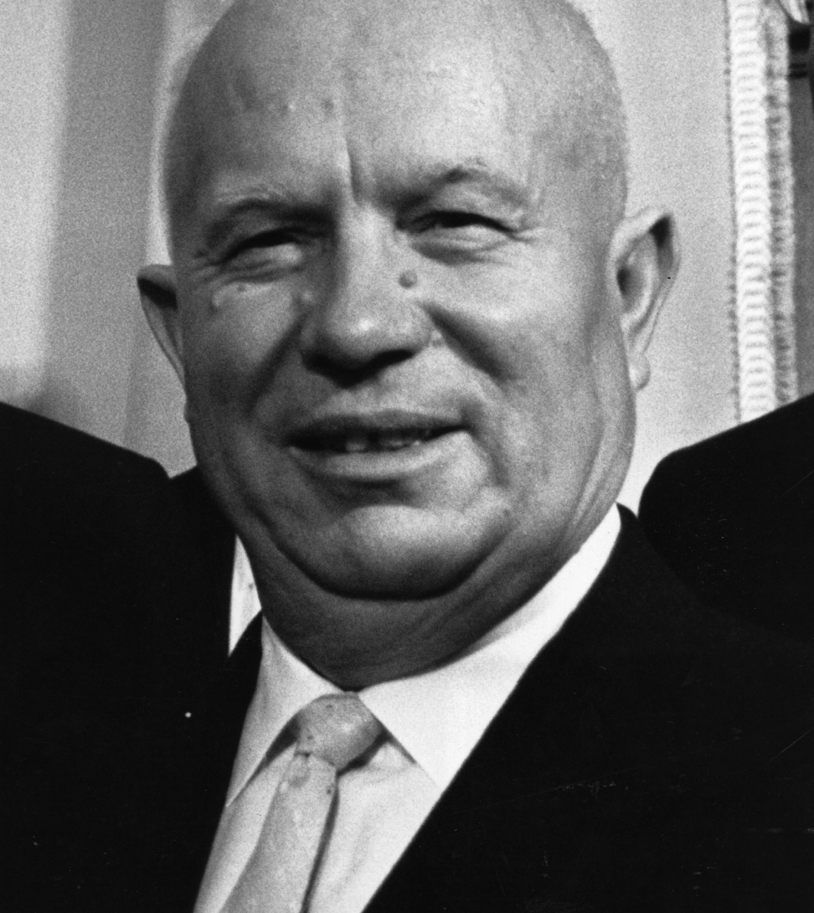
Cold War “Thaws”
1953: Joseph Stalin dies and Nikita Khrushchev takes over
1955: Eisenhower, NATO leaders, and Soviet officials met in Geneva, Switzerland for a summit – meeting of heads of government
It was a friendly atmosphere and dubbed the “Spirit of Geneva”
They talked of disarmament and German reunification

Slide 31
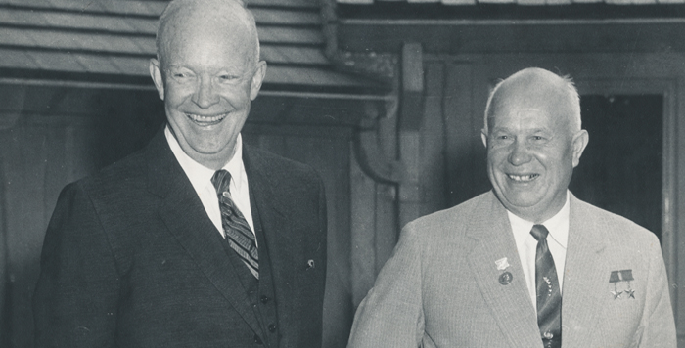
Geneva Summit
Policy of peaceful coexistence
  The two superpowers would compete with one another but avoid war
  Khrushchev even proposed to meet in another summit and Eisenhower agreed

Slide 32
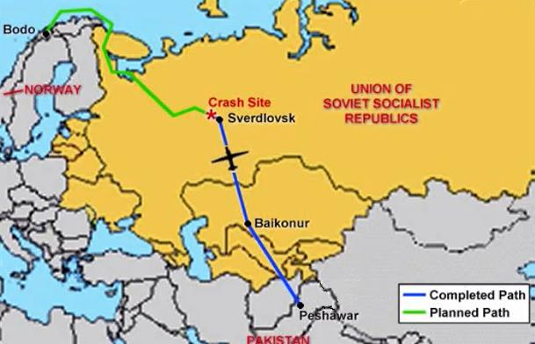
The U-2 Incident
For years Americans had been using spy planes called U-2s over Soviet territory to photograph Soviet nuclear sites and military bases
May 1, 1960: Soviets shot down one of the U-2 planes and captured its pilot Francis Gary for invading a Soviet airspace
May 16: the second summit in Paris broke up and this brief “thaw” in the Cold War ended

Slide 33
Eisenhower’s Warning
January 1961: Eisenhower delivered his Farewell Address
He issued a warning about the influence of the military
The military budget had grown dramatically and military leaders had allied with business to get bigger and more expensive weapons
He feared this alliance – military-industrial complex – heated the arms race and could “endanger our liberties or democratic processes”
He warned the nation of the close involvement of government and industry in preparing for war

Slide 34
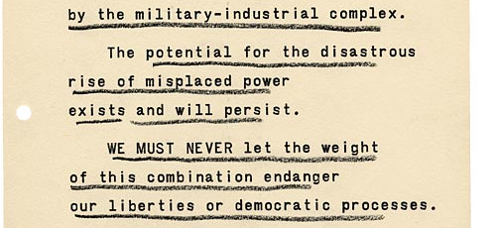
Eisenhower’s
Farewell Address

Slide 35
1950s Prosperity
Chapter 28 – Section 2

Slide 36
Booming Economy
1945-1960: total value of goods and services produced in the US increased by about 250%
Contributions to economic growth:
  Military spending during the Korean War
  Government spending on housing, schools, welfare, highways, and veteran benefits
  Technological advances
  Business, industry and agriculture adopted new technology & new methods

Slide 37
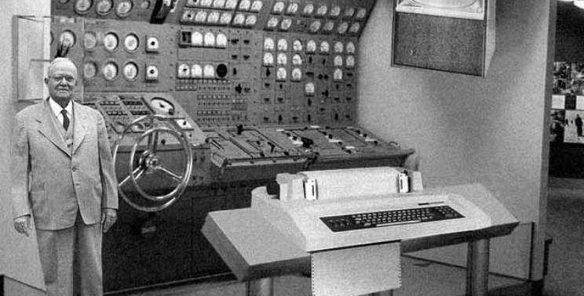
The Computer
1950s: the computer was invented
It wasn’t like the small personal computers we have today
They were large, immense, weighing tons and filling whole rooms
1955: IBM (International Business Machines) was the leader in the fields with orders for 129 of its big computers

Slide 38
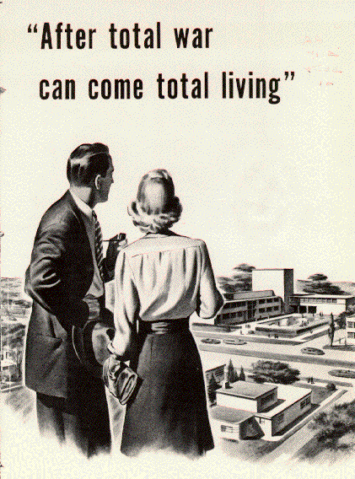
Higher Incomes
Higher standard of living – a measure of people’s overall wealth and quality of life
The personal income – the average income, earned or unearned, of every individual in the nation
  Increased from $1,223 - $2,219
  End of the ‘50s, America had the highest standard of living in the world

Slide 39
Changing Nation
Changes brought by economic growth:
  Growth in population
  Increased affluence – wealth
  Suburban expansion
  Grater demand for consumer goods

Slide 40
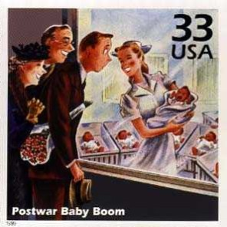
Baby Boom
1950s: nation’s population increased nearly 20%
  150 million to 179 million
This period of a soaring birthrate is called the baby boom

Slide 41
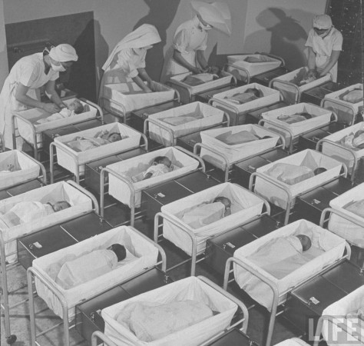
Baby Boom
Reasons for a baby boom:
  Higher incomes meant couples could afford to have more children
  Better health care, improved nutrition, and medical breakthroughs against disease reduced infant death rates

Slide 42
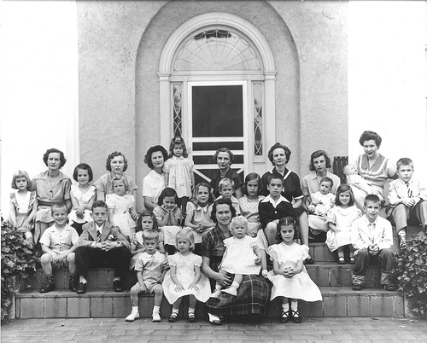
Baby Boom
Impact of the baby boom:
  Many women left the workforce to stay home and raise children
  Demand for baby products and services grew (stimulating the economy)
  School enrollment soared (putting a strain on the education system)

Slide 43
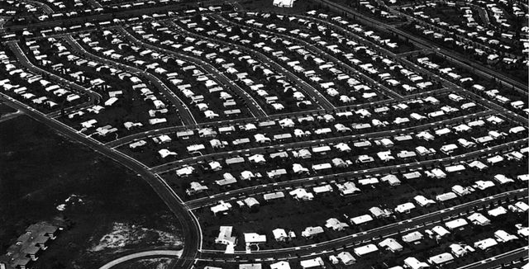
Expanding Suburb
1950s: 75% of new home construction took place in the suburbs
They were usually located on the fringes of major cities

Slide 44
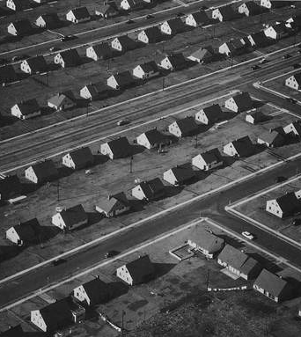
Levittown
William Levitt – introduced mass-produced housing
  He had experience building houses for the navy
  His first suburb development was known as Levittown
  1947: it was located on Long Island, NY
  It included more than 17,000 identical houses
  Built from materials precut and preassembled at a factory and then put together quickly on site

Slide 45
Suburban Housing
Provided:
  Affordable homes
  Privacy
  Isolation from urban problems
  Space for cars
  Sense of belonging to a community formed by people similar in age, social background, and race
Home ownership was not open to everyone
African Americans & Hispanic Americans were refused because they were minorities

Slide 46
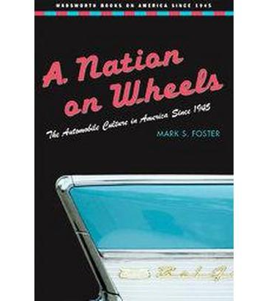
Nation on Wheels
People needed cars:
  To go to work
  To go shopping
  Run errands
  They weren’t a luxury but a necessity
Construction of new highways encouraged the spread of suburbs
Suburban America became a “car culture”

Slide 47
California
So-Cal came to symbolize suburban life and car culture
It was the drive-in capital of the nation
A person could:
  Go to the movies
  Eat fast food
  Do banking
  Even attend religious services without leaving the car
One woman said:
“I live in Garden Grove, work in Irvine, shop in Santa Ana . . . My husbands works in Long Beach, and I used to be the president of the League of Women Voters in Fullerton”

Slide 48
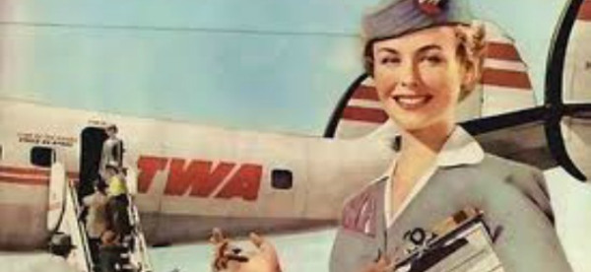
Air Travel
Travel by air was also easier now
1950s: the jet engine was perfected and the first jet-powered commercial aircraft began operation
Early 1950s: the airliner was on the way to replace the railroad train and the ocean liner as the preferred long-distance transportation

Slide 49
Consumer Society
Americans went on a buying/shopping spree
Reasons?
  Affluence
  Growing variety and quantity of products available
  Expanded advertising
It was also easier to buy goods:
  Use of credit cards
  Easy-payment plans

Slide 50
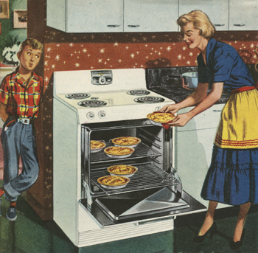
Consumer Society
What did Americans buy:
  Dishwashers
  Washing machines
  Television sets
  Stereos
  Clothes made from synthetic fabrics
Car manufactures competed to outdo one another by building bigger, faster, and flashier cars
Advertising on the TV and radio prompted Americans to engage in the new fads – hula hoops, crew cuts, poodle skirts, and pizza!

Slide 51
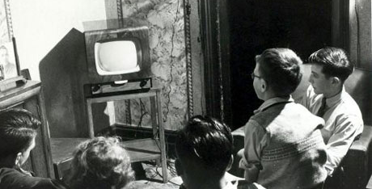
An American Culture
1949: over 900,000 households had television sets
They were large wooden cabinets with small screens that displayed grainy black-and-white images
1950s: average of 6.5 million sets were produced a year
End of the 1950s: most families had television

Slide 52
An American Culture
Television: became the main form of entertainment and an important source of news and information
Religious leaders helped spread religious messages with these new forms of communication
They had their own radio and television programs, best-selling books, and newspaper columns

Slide 53
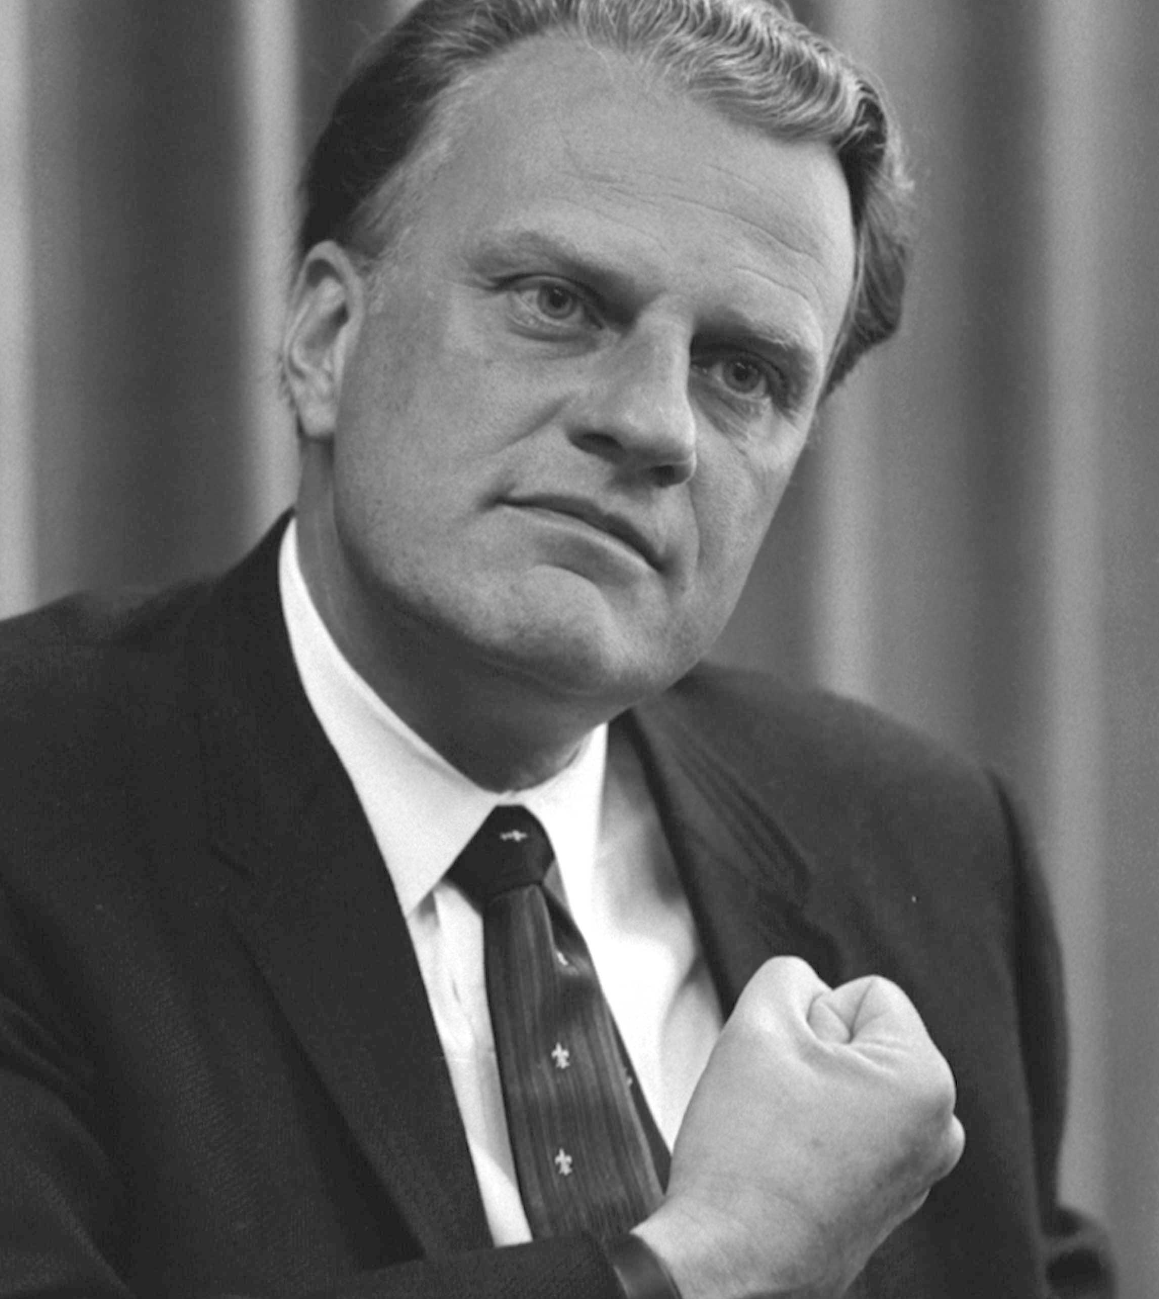
Billy Graham
Popular Protestant minister and preacher
Attracted thousands of people all over the nation and other parts of the world

Slide 54
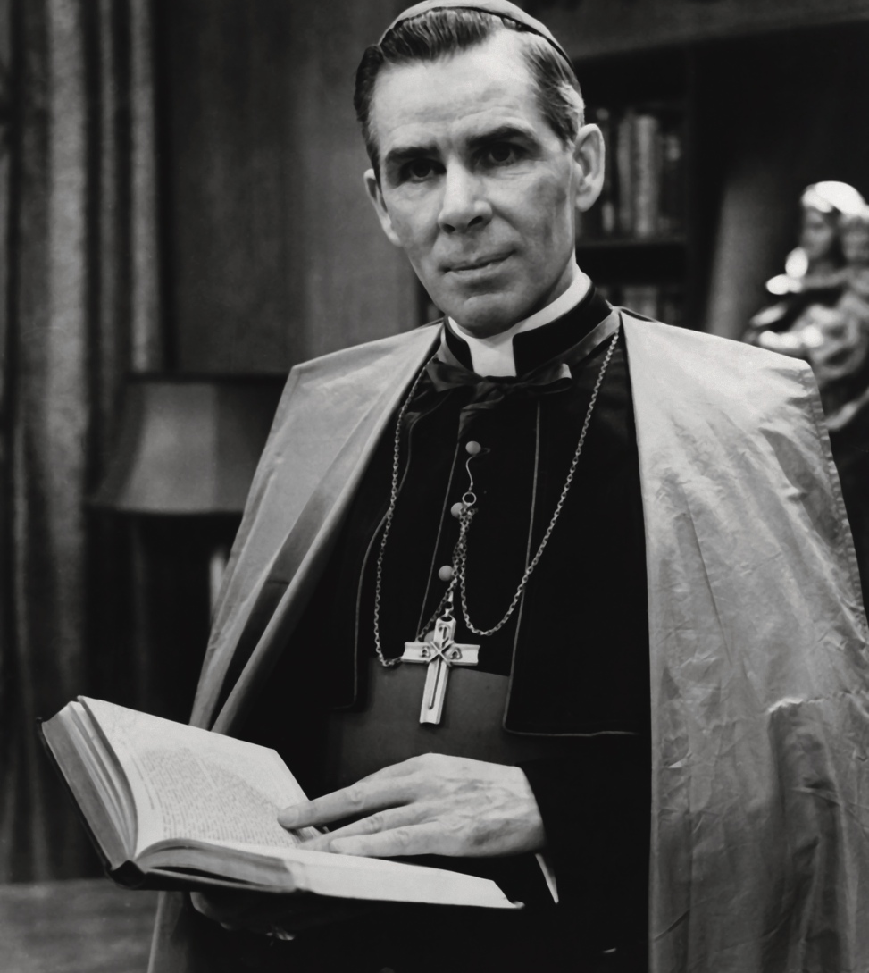
Fulton J. Sheen
Roman Catholic bishop
Became a television personality
Had weekly programs

Slide 55
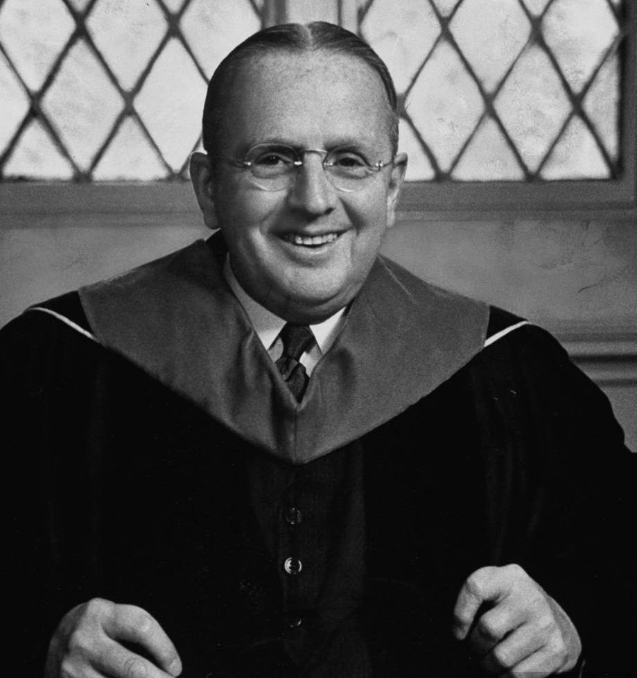
Norman Vincent Peale
Attracted many thousands of followers
Preached a message of “positive thinking”

Slide 56
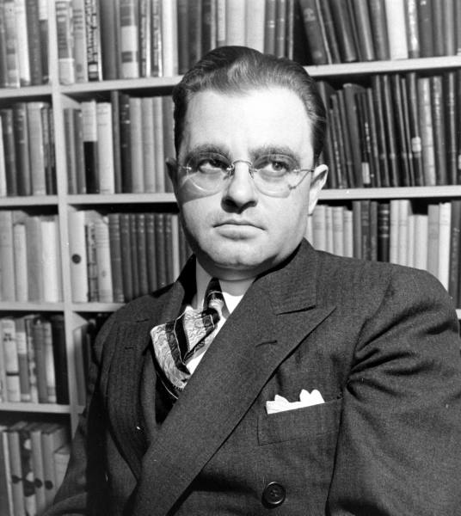
Joshua Loth Liebman
Jewish rabbi
Expressed tolerance for religious differences
“Tolerance is the positive and cordial effort to understand another’s beliefs, practices, and habits without necessarily sharing or accepting them”

Slide 57
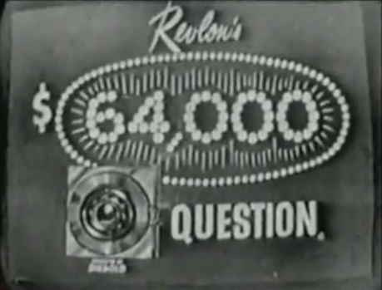
An American Culture
Americans watched the many quiz shows like The $64,000 Question

Slide 58

An American Culture
Children watched shows such as
  The Mickey Mouse Club
  Howdy Doody

Slide 59
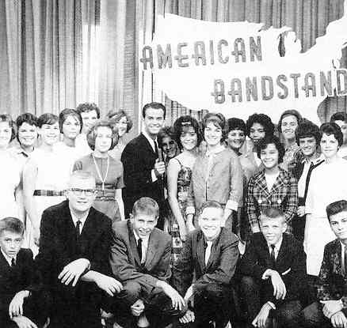
An American Culture
Teens watched the latest hit songs
  American Bandstand

Slide 60
An American Culture
Families followed weekly episodes
  I Love Lucy
  Leave it to Beaver
  Father Knows Best

Slide 61

I Love Lucy

Slide 62

Leave it to Beaver

Slide 63
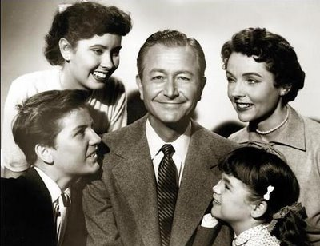
Father Knows Best

Slide 64
An American Culture
The TV shows that Americans helped shape the expectations for their own lives
Advertising helped create a big national market for new products and fashions

Slide 65

Rock-N-Roll
The new music sensation that was sweeping the nation was Rock-N-Roll
Many teens preferred this music and rejected the mellow music of their parents’ generation
They’d rather listen to heavily accented beats and simple lyrics

Slide 66
Rock-N-Roll
It grew from rhythm and blues music that African American musicians had created years before
It had some elements of country music, the tempo was quicker, and the instruments were electrically amplified

Slide 67
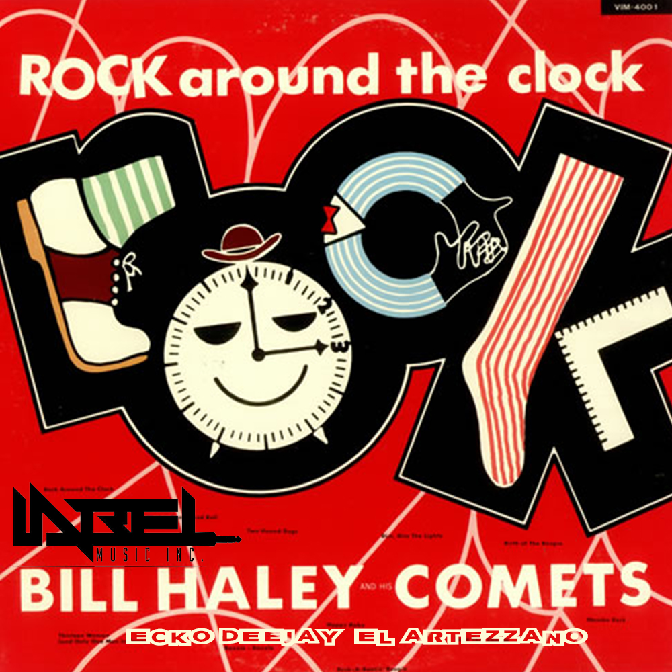
Bill Haley & the Comets
Rock Around the Clock

Slide 68
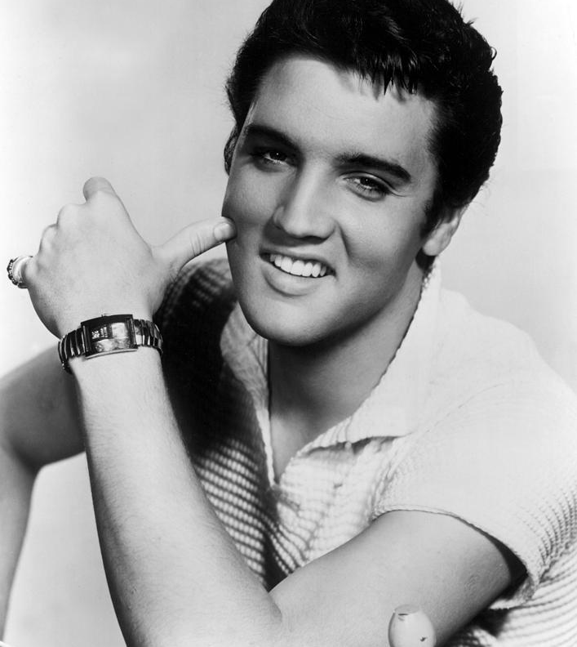
Elvis Presley
The most well-know rock-n-roll artist even to this very day
He adapted the style of African American performers such as Chuck Berry and Little Richard
He became known as the king of rock-n-roll and was an idol to millions of young Americans
Many young men copied his ducktail haircut and swaggering mannerisms

Slide 69
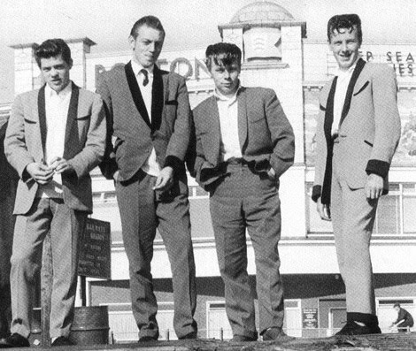
An American Culture
For teenagers, the experience of listening to the music helped forge a common identity and bond
Differing attitudes of the older and younger generations toward music and other forms of pop culture came to be known as the generation gap

Slide 70
Problems in a Time of Plenty
Chapter 28 – Section 3

Slide 71
Poverty
1950s: more than 20% of Americans lived in poverty
Many farmers did not share the wealth as others
Crop surpluses caused the prices of farm products to decline – this also caused farm income to decline
Large business enterprises bought the available farmland
They transformed this land into thriving businesses
New machines & chemicals helped produce more food for American and foreign consumers

Slide 72
Farmers Struggle
Small farmers suffered because they could not compete with large farms
They sold their land and migrated to urban areas
The thousands who remained struggled
The mechanized cotton pickers also replaced workers
Southern farmworkers lost their jobs
They also lost their land

Slide 73
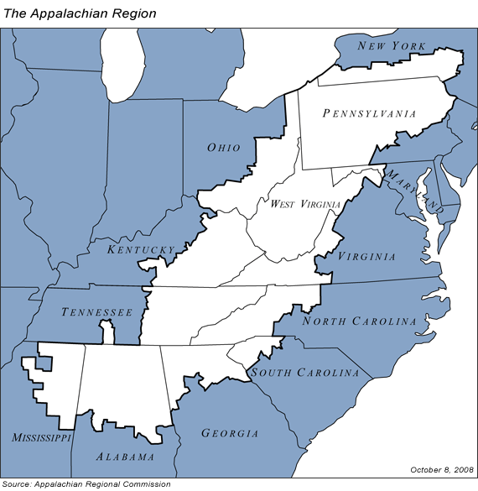
Appalachia
This is a region stretching along the Appalachian Mountains
The decline of the coal industry plunged thousands of rural mountain people into desperate poverty

Slide 74
Urban Poverty
The more middle-class Americans that left for the suburbs, the more the poor were left behind
The inner cities became islands of poverty
1940-1960: more than 3 million African Americans from the South moved to cities in the North & Midwest
  Hispanics (Puerto Ricans and Mexicans) also moved to American cities

Slide 75
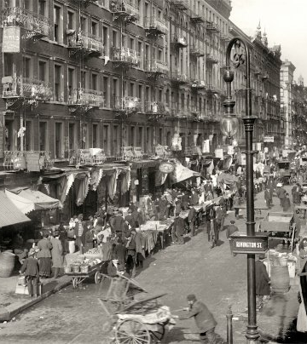
Ghettos
“White Flight” – occurred when huge exodus of whites left the cities to go to the suburbs
These cities were turned into ghettos
  Neighborhoods that were inhabited mainly by poor minority groups

Slide 76
Urban Unemployment
White fled to cities, factories and businesses also relocated into suburban areas
These cities faced a financial problems
Automation – producing goods using mechanical and electronic devices
  Reduced jobs in the industries that remained
  More and more difficult for the urban poor to rise from poverty
They also struggled with racial discrimination in
  Employment, housing, and education
  Crime and violence grew out of inner-city poverty

Slide 77
Voices of Dissent
People felt that the sameness of suburban and corporate life had a cost
  The loss of individuality
Others felt that it created materialism
  Focus on accumulating money and possessions rather than an interest in spiritual matters

Slide 78
Social Critics
Social critics examined the complicated situation of modern society
Many wrote about the effects on individual behaviors

Slide 79
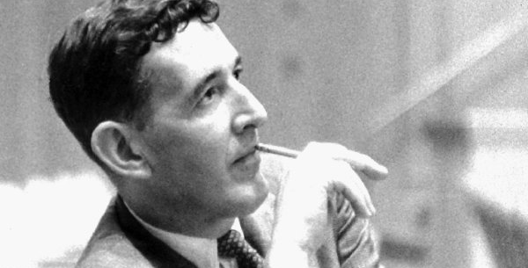
William H. Whyte, Jr.
Wrote The Organization Man
He concluded that young executives who abandoned their own views to “get along” were the most likely to succeed
“organization men have left home spiritually as well as physically”

Slide 80
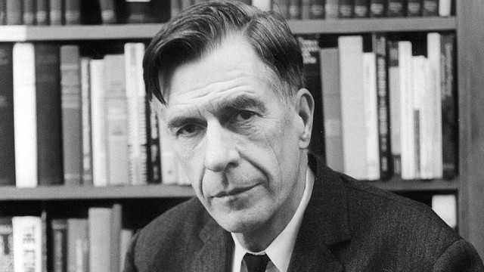
John Kenneth Galbraith
Wrote The Affluent Society
Described a suburban family, comfortably installed in an “air-conditioned, power-steered and power-braked automobile” driving “through cities that are badly paved, made hideous by litter, blighted buildings, billboards”

Slide 81
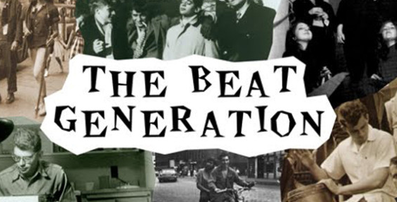
The Beat Generation
Group of writers called the Beats had sharper criticism of American society

Slide 82
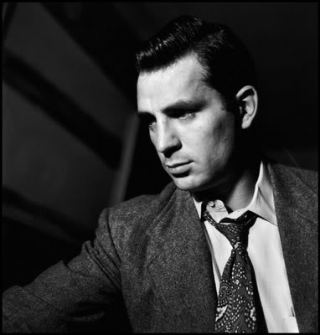
Jack Kerouac
“Beat” – weariness with all forms of the modern industrial state
Wrote On the Road which was the most influential book of the Beats
He describes the wild adventures of friends who drove aimlessly around the country
The main character was
“mad to live, mad to talk, mad to be saved, desirous of everything at the same time”

Slide 83
Questioning Roles
Women and African Americans began questioning their roles
Both groups strived to gain greater freedom and equality

Slide 84
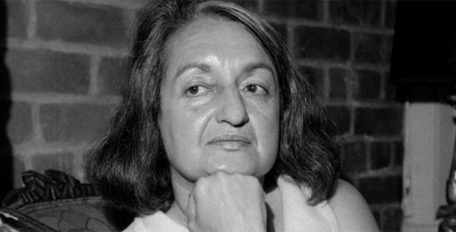
Betty Friedan
“The suburban housewife was the dream image of the young American woman. She was healthy, beautiful, educated, and concerned only about her husband, her children, and her home”

Slide 85
Women
Television, advertising, and magazines reinforced this image of women as perfect wives and mothers
It also presented the idea of suburban life as the path to a full and happy life
But many suburban housewives were dissatisfied with this role and wanted to express themselves

Slide 86
African Americans
After years of struggling for their rights, African Americans became increasingly impatient for change and less willing to accept their status as second-class citizens
They launched a campaign for full civil rights
Some events of the 50s proved to be important for African Americans

Slide 87

Brown v. Board of Education of Topeka (1954)
Declared racial segregation in public schools to be unconstitutional

Slide 88

Bus Boycotts
African Americans staged boycotts of segregated buses in Montgomery, Alabama

Slide 89

Little Rock, Arkansas
President Eisenhower sent troops to Little Rock, Arkansas to enforce a court order to integrate a high school

