Slide 1
Colonizing America
1519-1733
Chapter 2

Slide 2
The Spanish & French Build Empires
Chapter 2 – Section 1

Slide 3
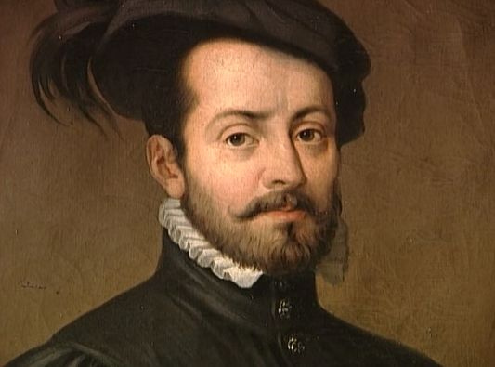
Hernan Cortes
Hernan Cortés was only 19 years old when he sailed the Atlantic in search for fortunes in the Americas
By the age of 34 he was able to overturn the Native American civilizations and change the lives of millions of people

Slide 4
Spanish Encounter the Aztec
1511: the Spanish under the leadership of Diego Velazquez conquered Cuba
Hernan Cortés was also part of this invasion
Cortés was awarded with control of some Native American villages in the area

Slide 5
Spanish Encounter the Aztec
With the introduction of smallpox, thousands of Native Americans died
This left the Spanish with very little man labor
Cortés was sent on a mission to find new people who would mine & farm in Cuba
February 18, 1519 – Cortés sails for Mexico with 11 ships, 550 men, and 16 horses

Slide 6
The Invasion Begins
Cortés lands in the Yucatan Peninsula and meets a shipwrecked sailor who also speaks the local Native American language
Even so, Cortés still has to battle thousands of warriors who charged against him and his men
It wasn’t long before the Spanish defeated the Native Americans
As a peace offering, the Natives offered Cortés 20 women

Slide 7
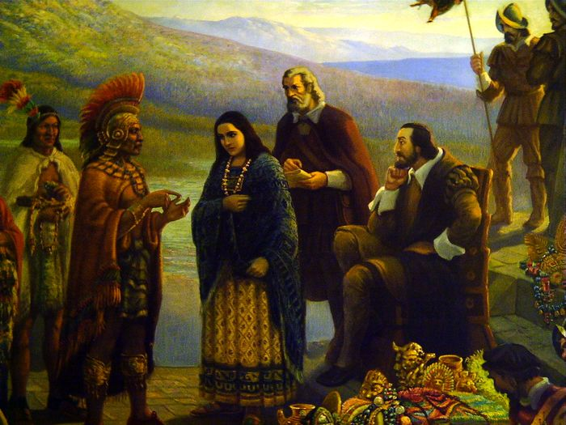
The Invasion Begins
Further up the coast, they encountered a people they did not understand
Of the 20 women was one named Malinche who helped translate the language to Cortés’ translator, who then translated it in Spanish to Cortés
Eventually Cortés had Malinche baptized and gave her the name Marina
She became one of his closest advisors

Slide 8
The Invasion Begins
Cortés gathers some information on the Aztec
He finds out that they are at war with the Tlaxcalan people
He figures if he can join forces with the Txlacalan then he can defeat the Aztec
So they continue marching, aweing people in the process because no one had seen horses before

Slide 9
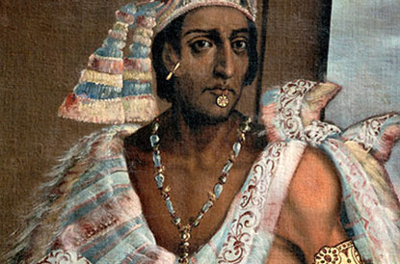
The Invasion Begins
200 miles away, a man named Montezuma hears about Cortés and the Spanish
He believed of a prophecy which stated that a god (Quetzalcoatl) would someday return from the east to conquer the Aztec
This god was also fair-skinned and bearded

Slide 10
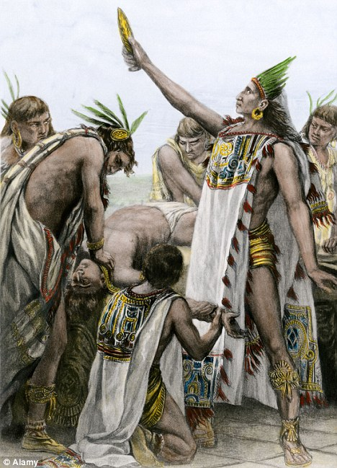
The Invasion Begins
Montezuma also sent envoys to convince the Spanish not to align with the Tlaxcalan
Furthermore Montezuma ordered the sacrifice several captives and gave their blood to the Spanish to drink
This horrified the Spanish!
It also showed Montezuma that the prophecy was true because Quetzalcoatl also hated human sacrifice

Slide 11
The Invasion Begins
Montezuma decides to ambush the Spanish however the Spanish attack first
6,000 of Montezuma’s men died
November 8, 1519 – Cortés enters the capital city of Tenochtitlan

Slide 12
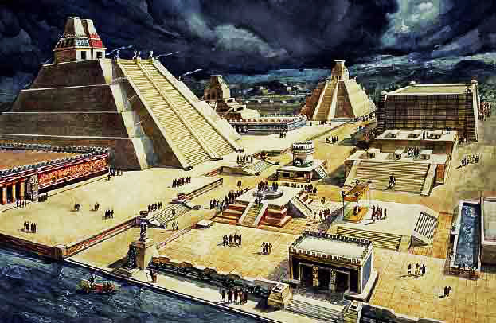
Tenochtitlan
The city amazed the Spanish because it was larger than any European city they had seen before
Its plaza had a huge double pyramid and canoes carried people along stone canals around the city

Slide 13
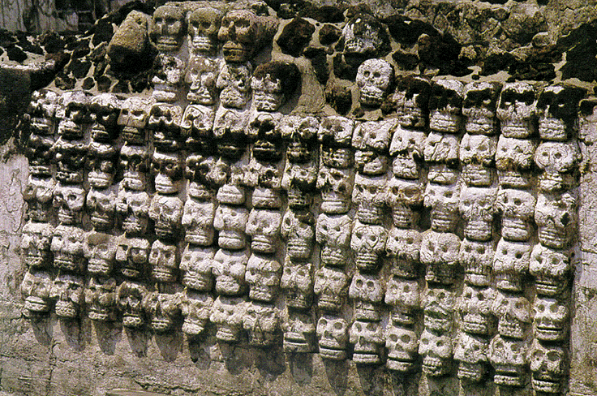
Tenochtitlan
Other things such as the tzompantli terrified them
It was a huge rack displaying thousands of human skulls
Aztec priests wore their long hair which was dried in human blood

Slide 14
Cortés Defeats the Aztec
Cortés takes Montezuma hostage and orders him to surrender
Montezuma accepts defeat and has all of the statues of their gods replaced by Christian crosses and images of the Virgin Mary
He also stops all human sacrifice

Slide 15
Noche Triste
The Aztec priests were outraged by this defeat
They soon organize a rebellion and drove the Spanish out of the city
The Spanish, however, continued to fight while retreating
450 Spaniards died while 4,000 Aztec died
This was known as the “Sad Night”

Slide 16
Defeating the Aztec Again
Cortés did not give up on his conquest of the Aztec
He soon returned with boats along the Aztec capital
At the same time, smallpox ran rampant killing tens of thousands of Native Americans
May 1521 – Cortés launches an attack
August 1521 – Cortés wins

Slide 17
New Spain
After defeating the Aztec, Cortés orders a new city be built upon the ruins of Tenochtitlan
He calls it Mexico and it becomes a colony of Spain as New Spain
The men who led these expeditions were known as conquistadors – conquerors

Slide 18
Pizarro & the Inca
Francisco Pizarro was a Spanish army captain who traveled to South America’s west coast
1526: he lands in Peru and encounters the Inca people
1531: he receives permission from the king of Spain to conquer the Inca and so he returns to Peru with a group of men

Slide 19
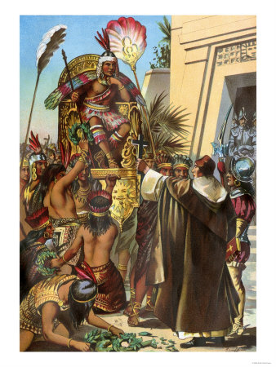
Pizarro & the Inca
He invited the Incan emperor over to meet him
While he waited he also had his cavalry & cannons hidden around the town square
Emperor Atahualpa arrives with 6,000 men and was met by a Spanish priest
The priest gives the emperor a bible, which the emperor throws to the ground
This was enough for Pizarro to attack the Inca

Slide 20
Searching for Cities of Gold
Alvar Nunez Cabeza de Vaca was part of a team who searched for gold in Florida but were unsuccessful; he eventually sailed to New Spain and died
Francsic Vasquez de Coronado went out looking for the golden city of Cibola in along the Colorado River; they found nothing but buffalo
Hernando de Soto explored today’s N. Carolina, Tennessee, Alabama, Arkansas, and Texas with nothing

Slide 21
Settling the Southwest
The Spanish continued searching for gold and in the process eventually populated some parts of Southwest America
They founded the territory of New Mexico and taking control of California
Sometimes priests adapted to the Native American cultures and even taught them Catholic beliefs
Other times priests mistreated the Natives and forced them to convert

Slide 22
Spanish American Society
Most Spaniards were hidalgos – working class tradespeople, or low-ranking nobles
They came in search for wealth and prestige
The encomienda system was created by Cortés to reward his men by giving them control over some of the towns in the Aztec empire

Slide 23
The Encomienda System
These villages were to pay their commissioner a share of the products they harvested or produced
In turn the commissioner was supposed to protect the Native Americans and try to convert them to Christianity
Unfortunately many of them abused their power

Slide 24
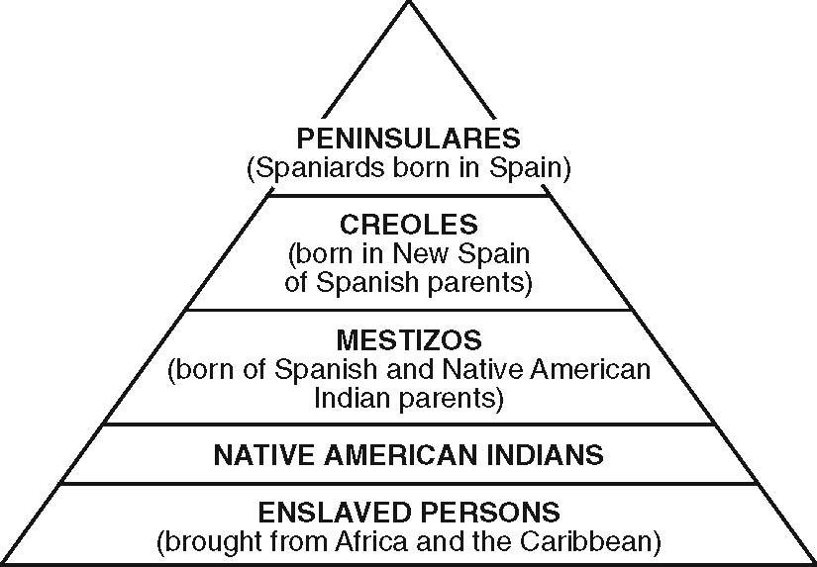
Class-Based Society
Birth, income, and education determined a person’s position
Top: peninsulares – people who had been born in Spain and who were appointed to most of the higher government and church positions
Middle Top: criollos – those born in the colonies of Spanish parents
Middle Bottom: mestizos – were mixed of Spanish & NA parents
Lowest: Native Americans, Africans, people of mixed Spanish & African or African and NA

Slide 25
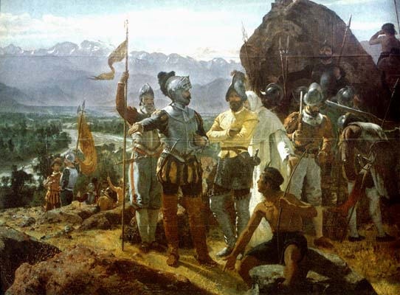
Council of the Indies
This was created to govern the huge, diverse empire in America
The council advised the king and watched over all colonial activities
The audiencia members were made to manage local affairs
The empire was split into regions called viceroyalties and a viceroy was appointed to each region

Slide 26
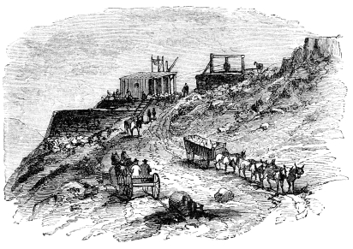
Mining
Eventually the Spanish realized that the Native Americans did not have the amount of gold they anticipated
Silver, not gold, made the Spanish rich
In Mexico they set up mining camps where Natives worked in difficult conditions
Some died from exhaustion

Slide 27
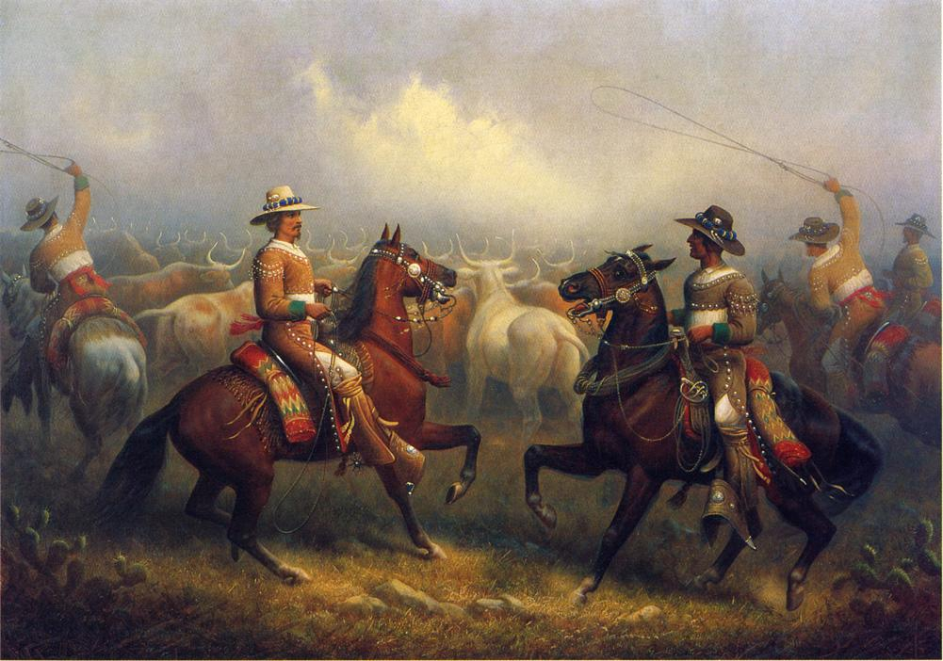
Ranching
The Spanish created large cattle ranches to help feed the residents of the town
The town could not grow crops but it could feed herds of cattle and sheep
The ranches were called haciendas
The men who herded the cattle were called vaqueros
The word lasso & corral are Spanish words

Slide 28
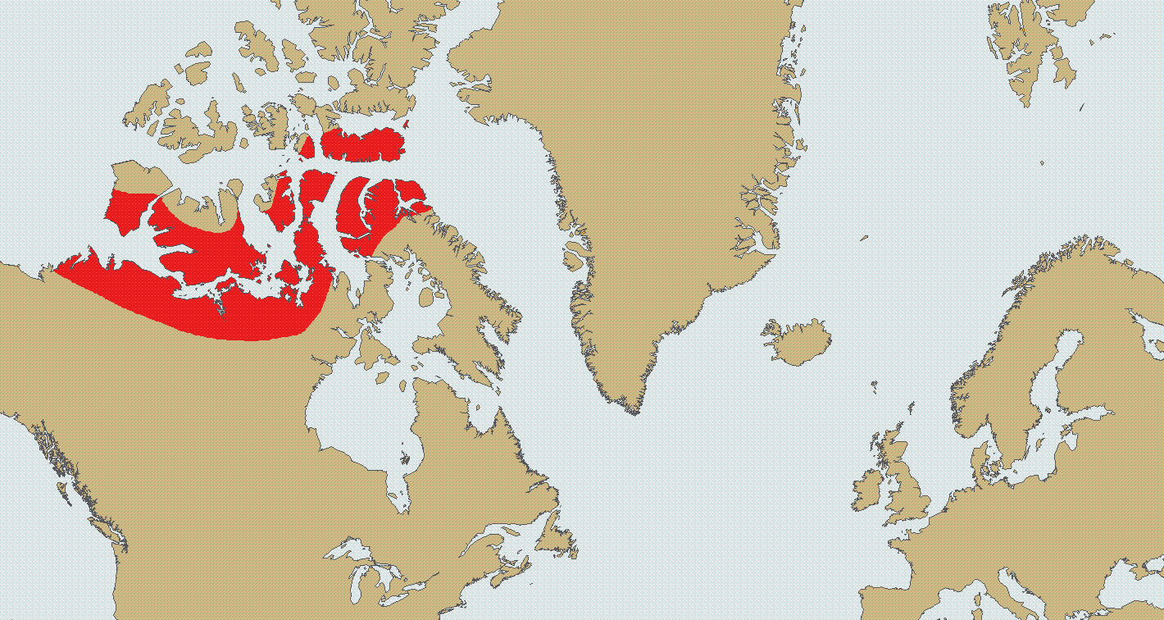
French Empire in America
1524: 3 years after Cortés conquers the Aztec, King Francis I of France sends Giovanni da Verrazano to map N. America’s coastline
They want to find the Northwest Passage
  Northern route through N. America to the Pacific Ocean

Slide 29
France Explores America
Jacques Cartier was another explorer who was sent 10 years later by the French
On his 1st two trips he discovers and maps the St. Lawrence River
On his 3rd trip he tried to start a colony but the harsh winter prevented him from doing so
For the next 60 years the French made no advancements because of sectarian troubles in their country between Catholics & Protestants

Slide 30
Founding of New France
By the 1500s, the French started fishing near N. America
The fishermen often ventured into the mainland and came in contact with the Natives
They traded things like fur
Beaver fur became very fashionable in France

Slide 31
New France
1602: King Henry IV of France authorizes a group of merchants to create colonies in N. America
Samuel de Champlain was a royal geographer who was hired to help these merchants colonize N. Amer.
1605: they establish a colony in Acadia (Nova Scotia)
1608: they founded Quebec which became the capital of the new colony of New France

Slide 32
Life in New France
Most of the settlers only wanted to make money from the fur trade
They became to be known as coureurs de bois – “runners of the woods”
They lived among the Natives and even learned their languages and customs
Some even married Native women
Missionaries also intended on communicating with the Natives

Slide 33
New France Expands
The French government soon launched a series of expansion projects since their colony was growing a lot slower than the Spanish
4,000 men and 900 women were sent over to colonize the new colony
If a man under 20 or a woman under 16 married, they received a royal wedding gift
Parents with more than 10 kids received financial bonuses
If your child did not get married you were fined

Slide 34
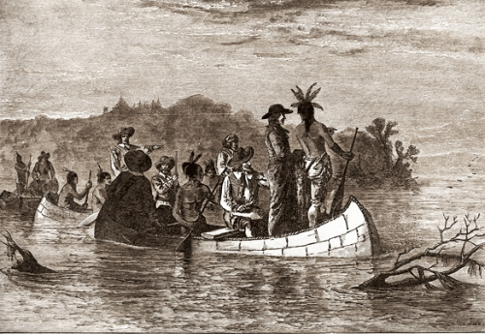
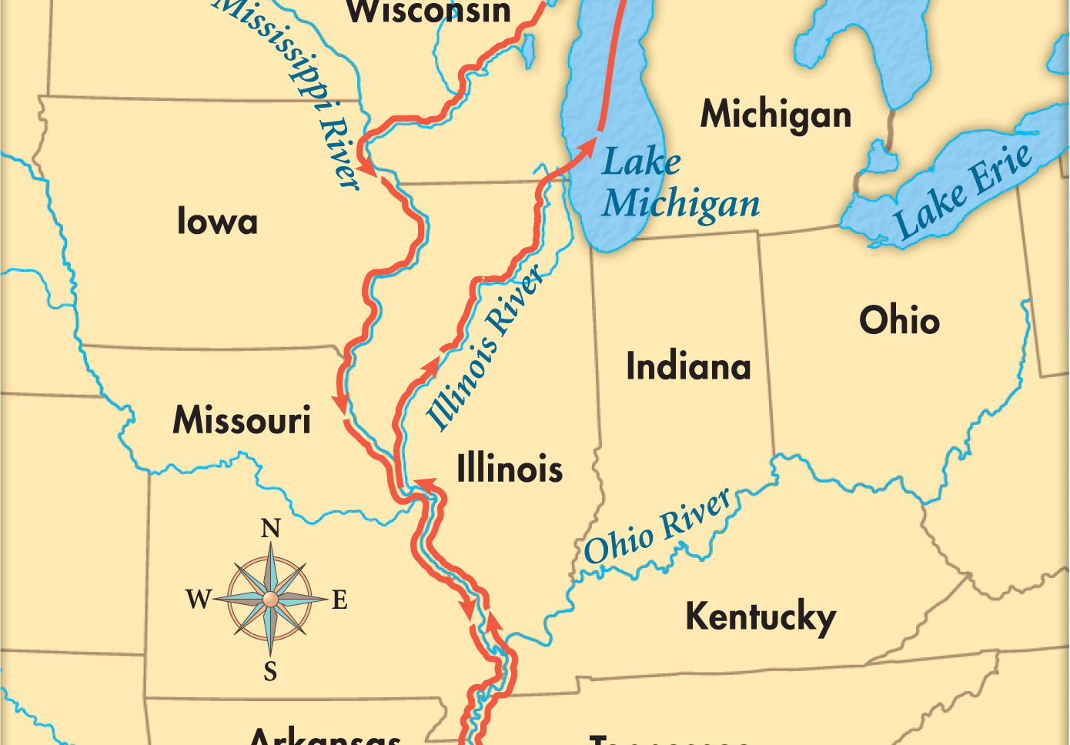
Exploring the Mississippi
1673: a fur trader (Louis Joliet) and a Jesuit (Jacques Marquette) ventured off to find a waterway that the Algonquian people called the “big river”
They eventually found the Mississippi River

Slide 35
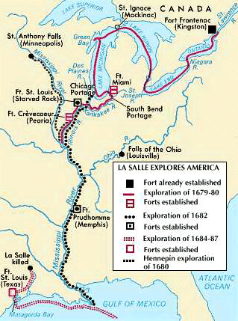
Exploring the Mississippi
Rene-Robert Cavelier de La Salle eventually followed the Mississippi all the way to the Gulf of Mexico
He then claimed the region for France and named the entire territory Louisiana in honor of King Louis XIV

Slide 36
Settling Louisiana
Count Frontenac was the governor of New France and he ventured out to find a way to ship furs through the Mississippi
Over time they realized that the crops that could be grown in Louisiana required hard manual labor
Many people did not want to do this kind of work
Eventually they enslaved people to do the work for them

Slide 37
Rivalry with Spain
The Spanish were always concerned about the French in N. America
To protect their territory they established the town of St. Augustine in Florida
1716: the Spanish start to colonize Texas even more to prevent the French from expanding
Neither one posed a threat to the other
In fact, the real threat would come from a different quarter of the continent: with the English settling in the Atlantic Coast

Slide 38
English Colonies in America
Chapter 2 – Section 2

Slide 39
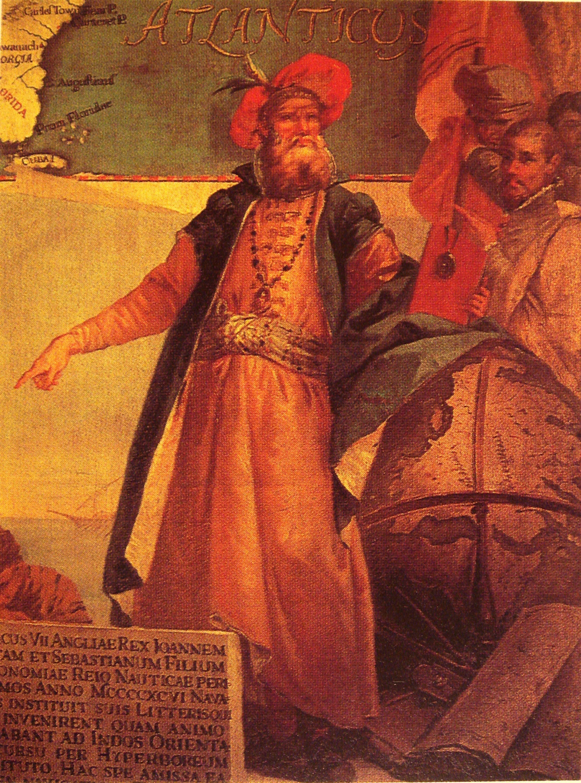
England Takes Interest
John Cabot, an Italian navigator, had sailed for the British to find lands that were unknown to Christians
He also wanted to find another route to Asia but he, too, landed near Nova Scotia
Eventually he sailed along the coasts but all he wrote is that he saw trees and woods, no people

Slide 40
England Takes Interest
England gives Cabot a pension and bonus for finding “new found land”
The next year he sails for a 2nd time and was never seen again
He did arrive 5 years after Columbus, the English did not try to colonize America until after 80 years

Slide 41
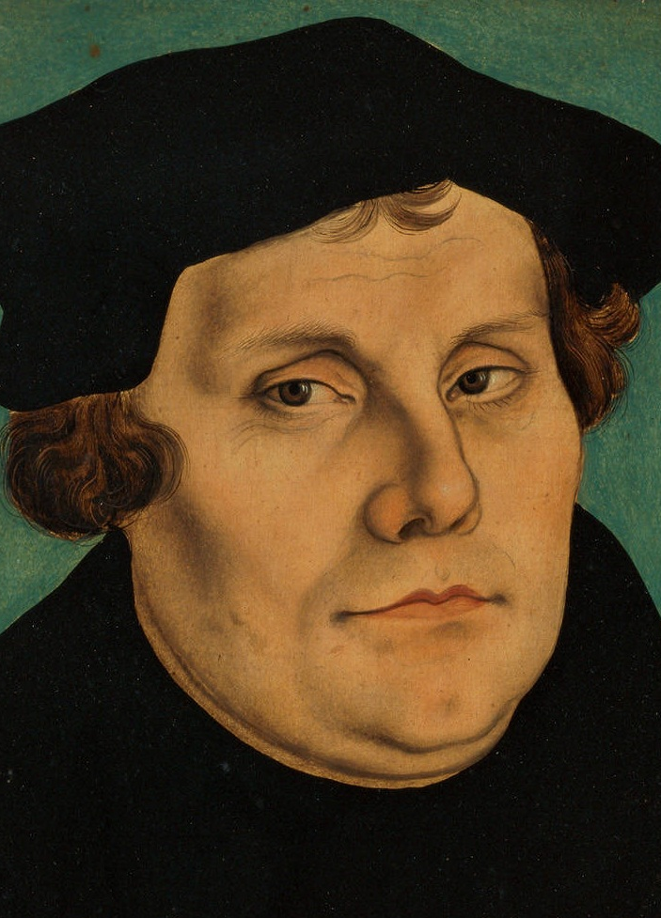
Reformation Divides England
1517: the unity within the Christian world started to diminish
A German man named Martin Luther accused the Church of corruption
This marked the beginning of the Protestant Reformation
Luther was expelled from the Catholic Church but his ideas spread like wildfire

Slide 42
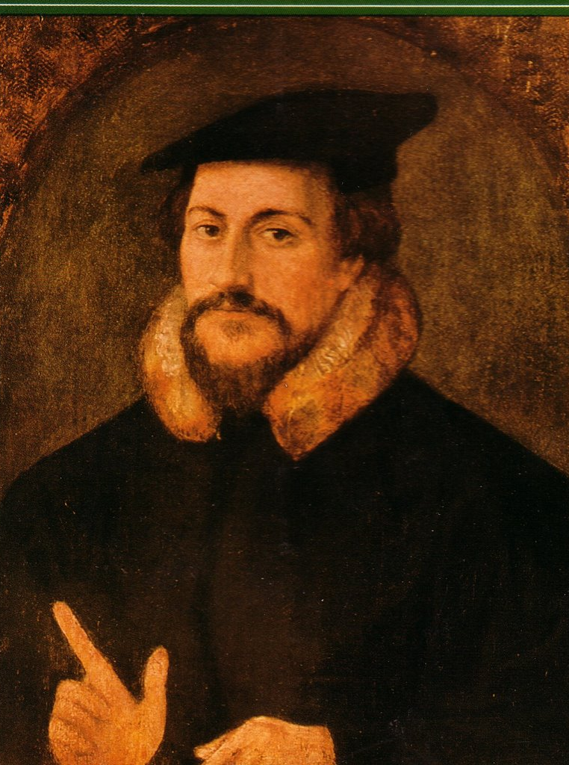
Further Division
John Calvin, in Switzerland, suggested that neither kings nor bishops should control the Church
Congregations should choose their own elders and ministers to run the Church for them
This had a profound impact on England and sparked another movement called Calvinism

Slide 43
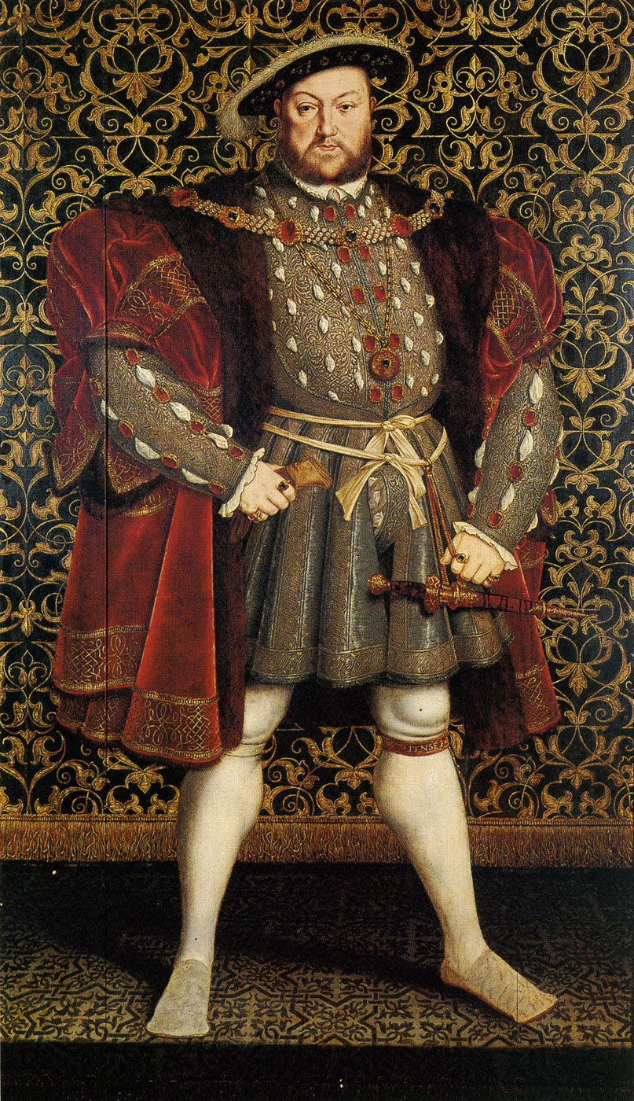
Reformation Changes England
The Reformation in England happened differently than it did throughout Europe
It started from a disagreement between the king and the pope
The King Henry VIII wanted his marriage annulled to Catherine of Aragon
Since she was the aunt of the king of Spain, the pope did not want to annul this marriage so as to not upset the Spanish king

Slide 44
King vs Pope
The pope’s delay made King Henry VIII very angry and he broke away from the Catholic Church
He also declared that he was the head of England’s church
This new church of England became to be called the Anglican Church even though it kept many Catholic doctrine and rituals

Slide 45
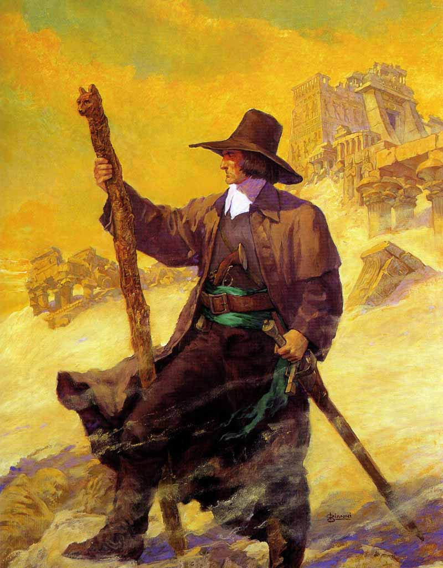
Puritans
There was another struggle in England
This time it was between people who wanted to keep the Anglican Church with its Catholic rituals and people who wanted to completely “purify” it of any Catholic influence
The second group called themselves Puritans

Slide 46
Puritans
Under Queen Elizabeth I many Puritan ideas gained acceptance within the Anglican Church
But still the most important issue was “who controlled the Church”
John Calvin’s ideas attracted Puritan leaders

Slide 47
James I
When James I became king he refused to tolerate any changes in the structure of the Anglican Church
Now that the king was also the head of the Church, he could also elect the ministers
He refused to reform the Church and made many Puritans leave England
Eventually many Puritans came to America for religious freedom

Slide 48
Economic Changes
By 1550: England was producing more wool than Europeans would buy and the price fell
Merchants needed to find new markets to sell their surplus wool to
They organized joint-stock companies who pooled the money of many investors
This allowed the company to raise large amounts of money for big projects
Now they can afford to trade and even colonize other parts of the world without government help

Slide 49
England’s Return to America
England’s interest in America increased its rivalry with Spain
England (Protestant) vs Spain (Catholic)
England made allies with the Dutch
The Dutch were under Spanish control but were Protestants
England sent privateers (privately owned ships) to aid the Dutch in revolting against the Spanish

Slide 50
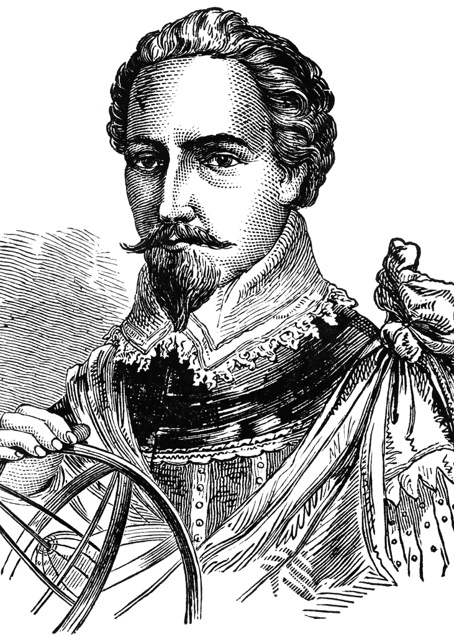
Gilbert
1578: an English soldier named Sir Humphrey Gilbert received a charter from QE I to created colony in America
He made 2 attempts to colonize but failed both times
Eventually he died at sea

Slide 51
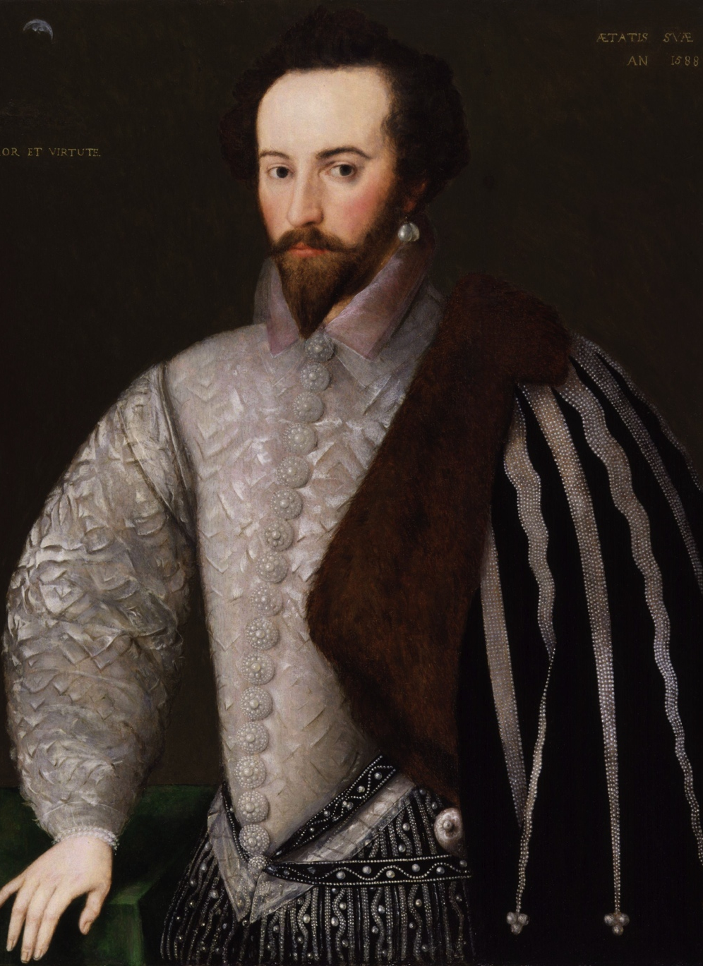
Raleigh
Walter Raleigh was the half-brother of Gilbert
He also received a charter from the Queen
His ships passed along the Outer Banks of today’s North Carolina and landed on an island the Natives called Roanoke

Slide 52
Lost Colony of Roanoke
1585: about 100 of Raleigh’s men went to settle on Roanoke many of which returned back to England
1587: he tries again with 91 men, 17 women, and 9 children
Governor John White returned to England for more supplies
He didn’t come back to Roanoke until 1590 because of the war the English and Spanish were in

Slide 53
Lost Colon of Roanoke
When John White comes back, the colony was gone
No bodies, just empty houses and the letters “CRO” carved on a post
  This referred to the Native American group the Croatoan
No one knows what happened and it still remains a mystery till this very day

Slide 54
Jamestown is Founded
1606: King James I granted a petition to investors to colonize territories in Virginia
Their company was named the Virginia Company
3 small ships called the Susan Constant, the Godspeed, and the Discovery to Virginia
These 144 men founded a settlement which they named in honor of their king, Jamestown and the river where it resides James River

Slide 55
Early Troubles
Unfortunately the colonists knew very little about living in the woods so could not make use of the fish and game around them
None of them even knew how to raise livestock or cultivate crops
Even worse: the upperclass “gentlemen” refused to do any of the manual labor
Their council argued constantly and could not make decisions

Slide 56
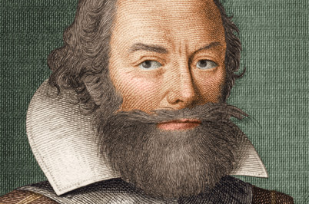
Early Troubles
This led to lawlessness, sickness, and food shortages
200 new settlers arrived and only 53 remained alive within the year
John Smith comes to the rescue

Slide 57
John Smith
He is a member of the council who also becomes a strong leader
He explored the region around Jamestown and began trading with the local Natives called the Powhatan Confederacy
Their trade helped the colony get through its first 2 winters

Slide 58
Early Troubles
To attract settlers the Virginia Company offered land to anyone who worked for the colony for 7 years
Many people arrived in the late summer
This created a crisis as there was not enough food to feed everyone which led colonists to steal from the Natives
The Natives, in return, would attack the settlers

Slide 59
Starving Times
Winter of 1609 & 1610 became known as “starving times”
Colonists succumbed to human lows as they ate “dogs, rats, snakes, toadstools”
Some even became cannibals while others dug up corpses from graves and ate them

Slide 60
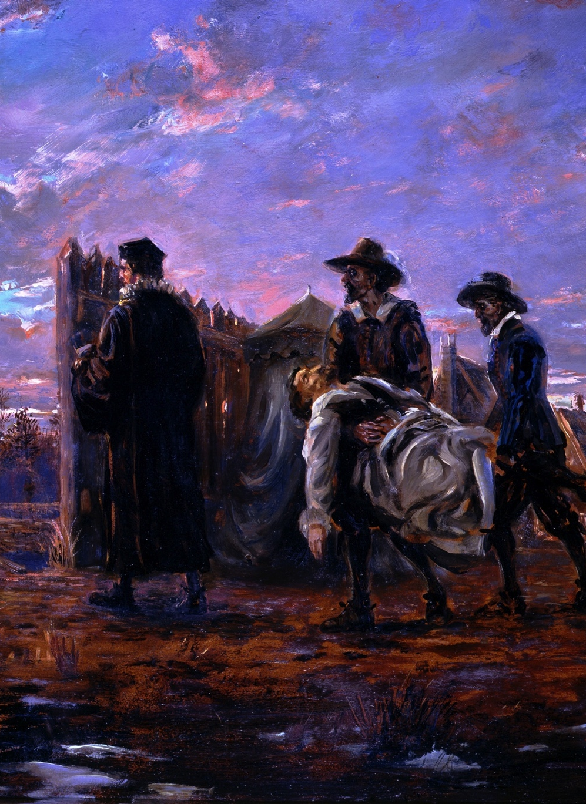
Rescue
The remaining 60 settlers left Jamestown to go downriver
They encountered other English ships with the colony’s new governor Lord De La Warr who convinced them to stay
His deputy, Thomas Dale, drafted a harsh code of laws which organized settlers into work gangs but eventually survived

Slide 61
Tobacco
Jamestown still needed a new product to sell in order to become more prosperous
They eventually discovered tobacco since it became very popular in Europe
John Rolfe began experiments using different seeds to make sure it wasn’t too bitter
This proved to be a success and the settlers began planting large quantities of tobacco

Slide 62
1st Assembly
Many reforms were introduced to attract settlers
  Giving the colony the right to elect its own assembly to propose laws
The First Assembly met in a church on July 30, 1619
It included a governor, 6 councilors, and 20 representatives
The representatives were called burgesses and the assembly was called the House of Burgesses

Slide 63
Headrights
Headrights was also another system which attracted new settlers
In this system, new settlers who bought a share in the company or paid for their passage were granted 50 acres of land
They were given 50 more for each family member over 15 years of age and for each servant they transported to VA

Slide 64
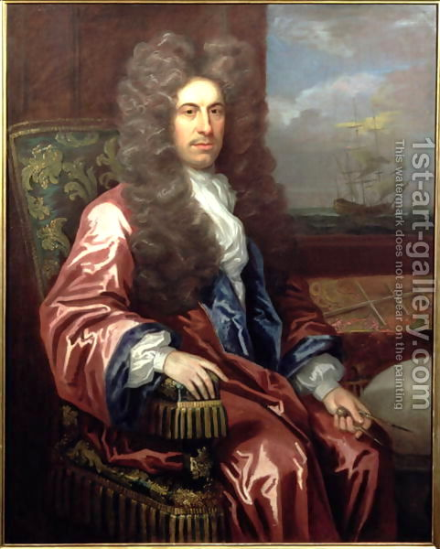
Lord Baltimore
George Calvert who was Lord Baltimore
He was a member of the English Parliament until he converted to Catholicism
This ruined his career but he remained a good friend of King James I and his son Charles I
He decided to found a colony where Catholics were accepted and could practice their religion

Slide 65
Maryland is Founded
1632: King Charles I granted him a large area of land northeast of VA
Baltimore named the new colony Maryland
It became England’s first proprietary colony since he owned the colony
He could govern any way he wished, appoint officials, coin money, impose taxes, establish courts, grant lands, and create towns

Slide 66
New England
Chapter 2 – Section 3

Slide 67
Pilgrims at Plymouth
Puritans in England were already in disagreement with the English Church
A group of Puritans called Separatists broke away from the Anglican Church to form their own congregations
King James I saw this as a challenge so he had them imprisoned
One group fled to Holland and began to call themselves Pilgrims

Slide 68
Puritans, Separatists, Pilgrims
Puritans were Christians who wanted to Purify the Anglican Church of Catholic ideas/doctrine/rituals
Separatists were Puritans who wanted to break away from the Anglican Church to form their own
Pilgrims were Separatists who fled to Holland to run away from persecution
Eventually the Pilgrims move away from Holland to America in order to preserve their English culture

Slide 69
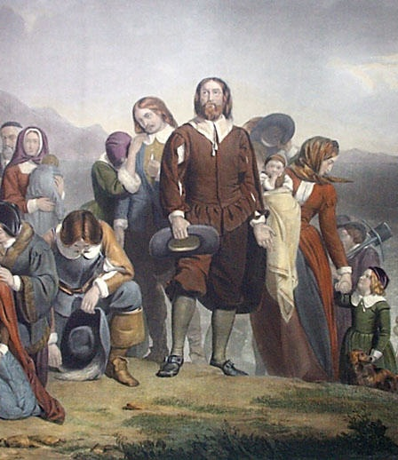
The Mayflower
These Pilgrims sailed back to England to gather with other Separatists and boarded the Mayflower
September 1620: 120 passengers set sail for America
It took about 65 days with most of the food running out and many people getting sick
Even worse: a storm blew them off course
November they finally sighted Cape Cod
Fortunately they had a copy of John Smith’s “Map of New England”
Because of this they landed in Plymouth, MA

Slide 70
Plymouth Colony
William Bradford who was one of the colony’s leaders said that the Pilgrims went to work as soon as they landed
“Idle hands are the hands of the Devil”
They began constructing homes and a common house too
Eventually a plague wiped out all but 50 settlers

Slide 71
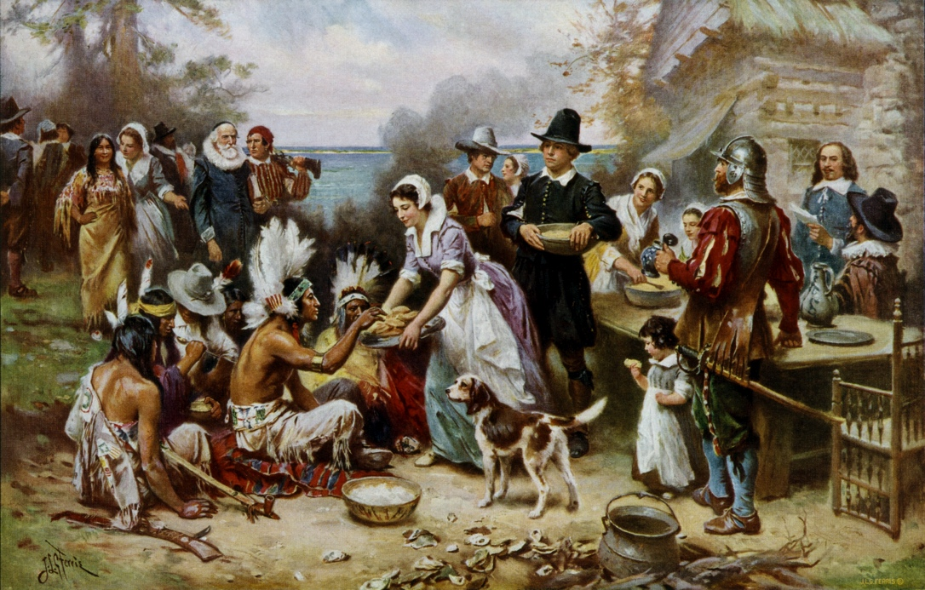
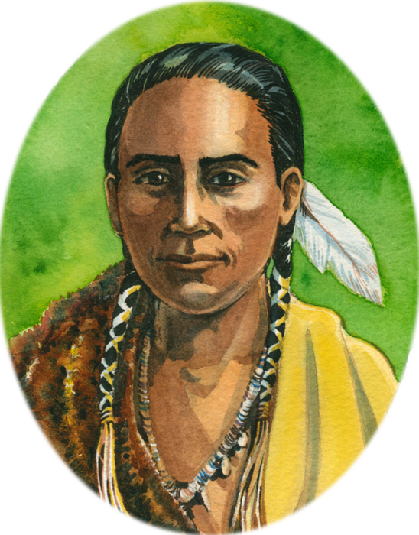
Plymouth Colony
A Native American named Squanto helped the Pilgrims understand the environment
He “directed them how to set their corn, where to take fish and how to procure other commodities”
He also helped the Pilgrims negotiate a peace treaty with the nearby Wampanoag Native Americans
Then they had a 3 day festival to celebrate the harvest and give thanks to God (Thanksgiving)

Slide 72
Founding Massachusetts
John Winthrop was a very wealthy attorney who was also a stockholder in the Massachusetts Bay Company
They receive a charter to create a colony in NE
Winthrop (a Puritan) wanted to find a safe haven for his fellow Puritans from England
So he turns his journey into a business and attracts more Puritan settlers to the NE colony

Slide 73
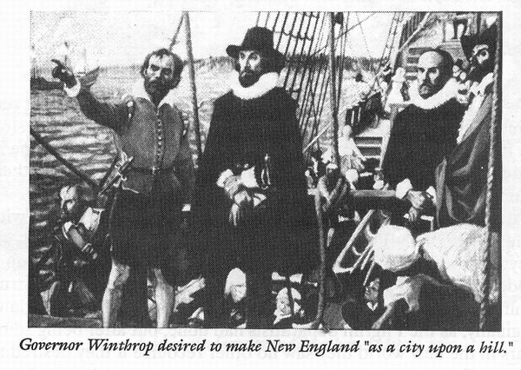
City on a Hill
Massachusetts rapidly expanded with several towns already founded, such as Boston
More and more people began to leave England as conditions became worse
This was called the Great Migration
1643: nearly 20,000 settlers had arrived in NE

Slide 74
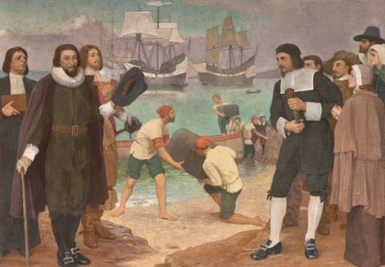
Church & State
People who owned stock in the company were called “freemen”
All of them together were called the General Court
They made laws and elected the governor
John Winthrop was chosen to be the first governor
He abused his power by telling the people only he could make laws but since he always hid the charter in a chest, no one really knew the truth

Slide 75
Church & State
Eventually the people of the colony grew tired of how very little voice they had
They demanded to see the charter and when they did they reorganized the government
Elections would be held each year now
Laws were passed requiring everyone to attend church

Slide 76
Other Laws
Gambling, blasphemy, adultery, and drunkenness were all illegal and punished severely
They tried to prevent religious ideas that differed from Puritan beliefs
If anyone challenged these ideas they could be charged with heresy and banished
Heretics were considered a threat to the community

Slide 77
Rhode Island & Dissent
Just like the intolerance of the Puritans by the Anglican Church led to the creation of Massachusetts
The Puritan intolerance of dissenters lead to the creation of other colonies in NE

Slide 78
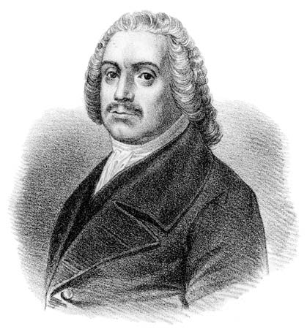
Roger Williams
He was a teacher who was offered to teach in Boston but he refused
He refused to teach anyone who aligned themselves with the Anglican Church, he was a strict Separatist
He then becomes a teacher in Salem where he is more accepted
His constant condemnation of the Puritans made people angry

Slide 79
Rogers Williams
Williams then moves away from Salem to Plymouth
Even here he declared that the land belonged to the Native Americans and that the king did not have the right to give it away
Winthrop feared that Williams would ruin any chance the Puritans had of practicing their religion far away from English rule

Slide 80
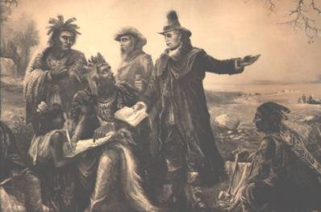
Rhode Island
Williams was ordered to leave Massachusetts because of his radical ideas
He purchases some land from the Narragansett people and founded the town of Providence in Rhode Island
Here the government had no authority in religious matters
Other beliefs were tolerated instead of suppressed

Slide 81
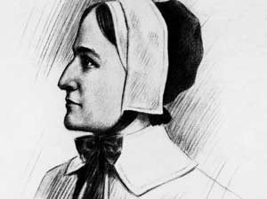
Anne Hutchinson
She was an intelligent, charismatic, and widely admired woman who arrived in Boston
The began to hold prayer meetings in her home where groups discussed sermons and compared ministers
Eventually she began to claim to know which ministers had salvation from God and which did not

Slide 82
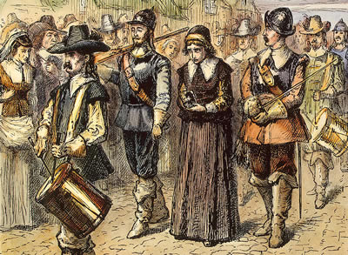
Anne Hutchinson
She was attacking the authority of ministers which then the General Court called her before them
She was questioned by the court but she did not confess nor repent only claiming that God spoke to her “by an immediate revelation”
This contradicted Puritan belief that God only spoke through the Bible
They banished her for heresy
Her and her followers settled on an island later known as Portsmouth

Slide 83
Colony of Rhode Island
More dissenting Puritans were banished from Massachusetts
They headed south and founded the towns of Newport and Warwick
They eventually joined together to become the colony of Rhode Island and Providence Plantations

Slide 84
River Towns of Connecticut
Thomas Hooker was a reverend who ask the General Court of Massachusetts to move his entire congregation to the Connecticut River Valley
He claimed that they did not have enough land near their town to raise cattle
However another reason for moving was religious freedom and his dislike of the Massachusetts political system

Slide 85
River Towns of Connecticut
Eventually more and more people began migrate and found other towns such as Hartford, Windsor, and Wethersfield
These towns joined together and created their own General Court with their own constitution known as the Fundamental Orders of Connecticut
They allowed all adult men, not just church members, to elect the governor and the General Court

Slide 86
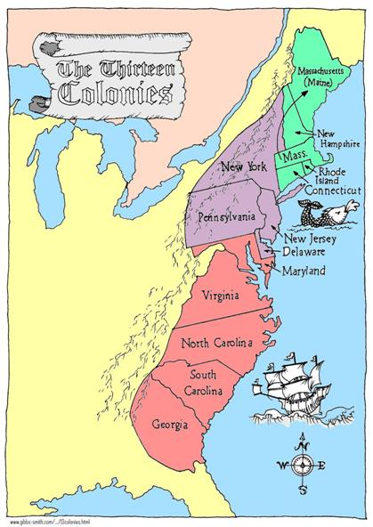
New Hampshire & Maine
Not everyone who left Mass headed for Rhode Island or Connecticut
Much of the territory had been granted to 2 men named Sir Fernando Gorges and Captain John Mason who split it in half
Gorges calls his territory Maine
Mason calls his territory New Hampshire

Slide 87
King Philip’s War
The fur trade began to decline in the 1670s which kept the peace between the settlers & Natives
Furthermore the settlers demanded that Natives follow English customs and laws
This angered the Natives because they felt the English were trying to destroy their way of life

Slide 88
King Philip’s War
1675: the Plymouth Colony arrested, tried, and execute 3 Wampanoag for a murder
Wampanoag warriors then attacked the town of Swansea which marked the start of King Philip’s War
It was named after the Wampanoag leader Metacomet but the English called him King Philip
The settlers won the war and it was a turning point for for the New England colonies

Slide 89
Middle & Southern Colonies
Chapter 2 – Section 4

Slide 90
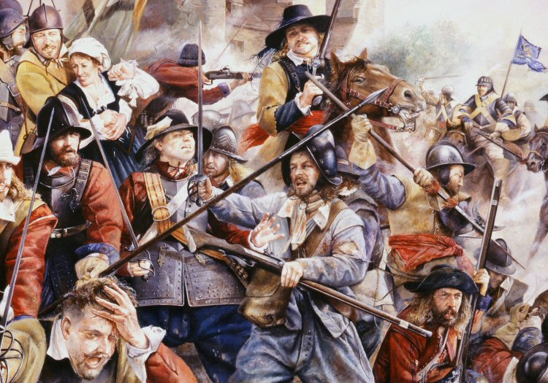
English Civil War
It began in 1642 when King Charles I sent troops into the English Parliament to arrest Puritan leaders
Parliament was dominated by Puritans and they responded by organizing their own army
1646: Parliament’s army defeated the King’s troops and captured King Charles I
2 ½ years later they tried the king and condemned him to death
Oliver Cromwell then dissolved Parliament and seized power giving himself the title “Lord Protector of England”

Slide 91
Colonies Choose Sides
Colonies had to choose whether to support Parliament or the King
Virginia: the governor & house of burgesses supported the king until 1652 when a Parliament fleet forced them to change sides

Slide 92
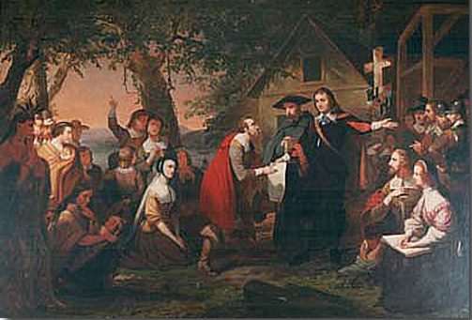
Maryland’s Civil War
Lord Baltimore supported the king
1644: Protestants in Maryland rebelled and in order to calm things down, Lord Baltimore appointed a Protestant as governor
He also introduced the Maryland Toleration Act which granted religious toleration to all Christians in Maryland and protected Catholic minority from the Protestants

Slide 93
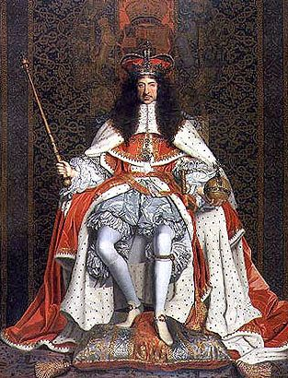
Restoring the Monarchy
After Oliver Cromwell’s death, no one stepped up
Therefore England’s leaders decided to restore the monarchy
1660: they appoint Charles II, the son of Charles I
This became known as the Restoration
From this point forward the English government took the lead in promoting colonization

Slide 94
New Netherland /
New York
The English had set up shop in Virginia and in Massachusetts
They now wanted to acquire the land between the two colonies
Unfortunately it was occupied by the Dutch
The English would have to take it from them

Slide 95
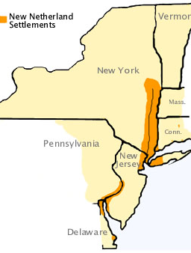
New Netherland
The Dutch hired an English navigator named Henry Hudson to help find a water route to the Pacific from N. America
He instead found a river which was later named the Hudson River
He also told of how rich in fur these territories were
1614: therefore the Dutch claimed this region and called it New Netherland

Slide 96
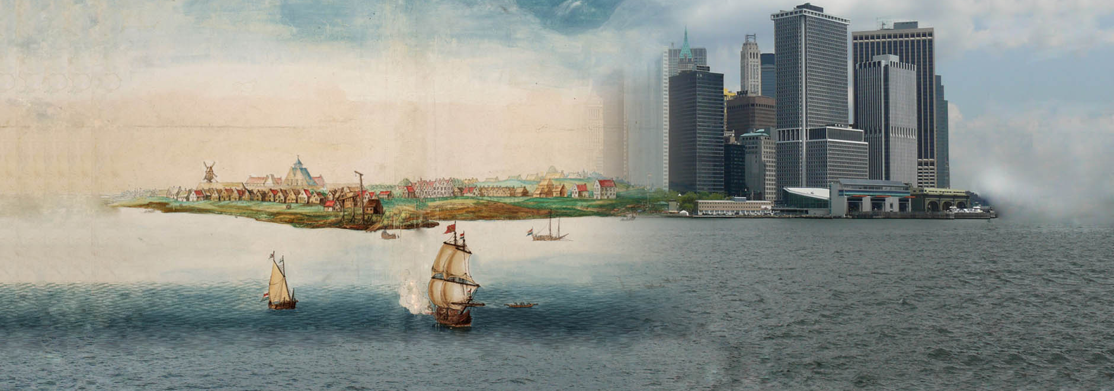
New Netherland
Their major settlement was called New Amsterdam and it was located on Manhattan Island
According to tradition: the Dutch bought the land from the Natives for only $24 worth of goods
1646: New Netherland had only 1,500 people compared to the 25,000 in New England
To increase population the Dutch offered land to anyone who had money
An influx of French, German, Polish, Spanish, Italian, and even Portuguese Jews came to America

Slide 97
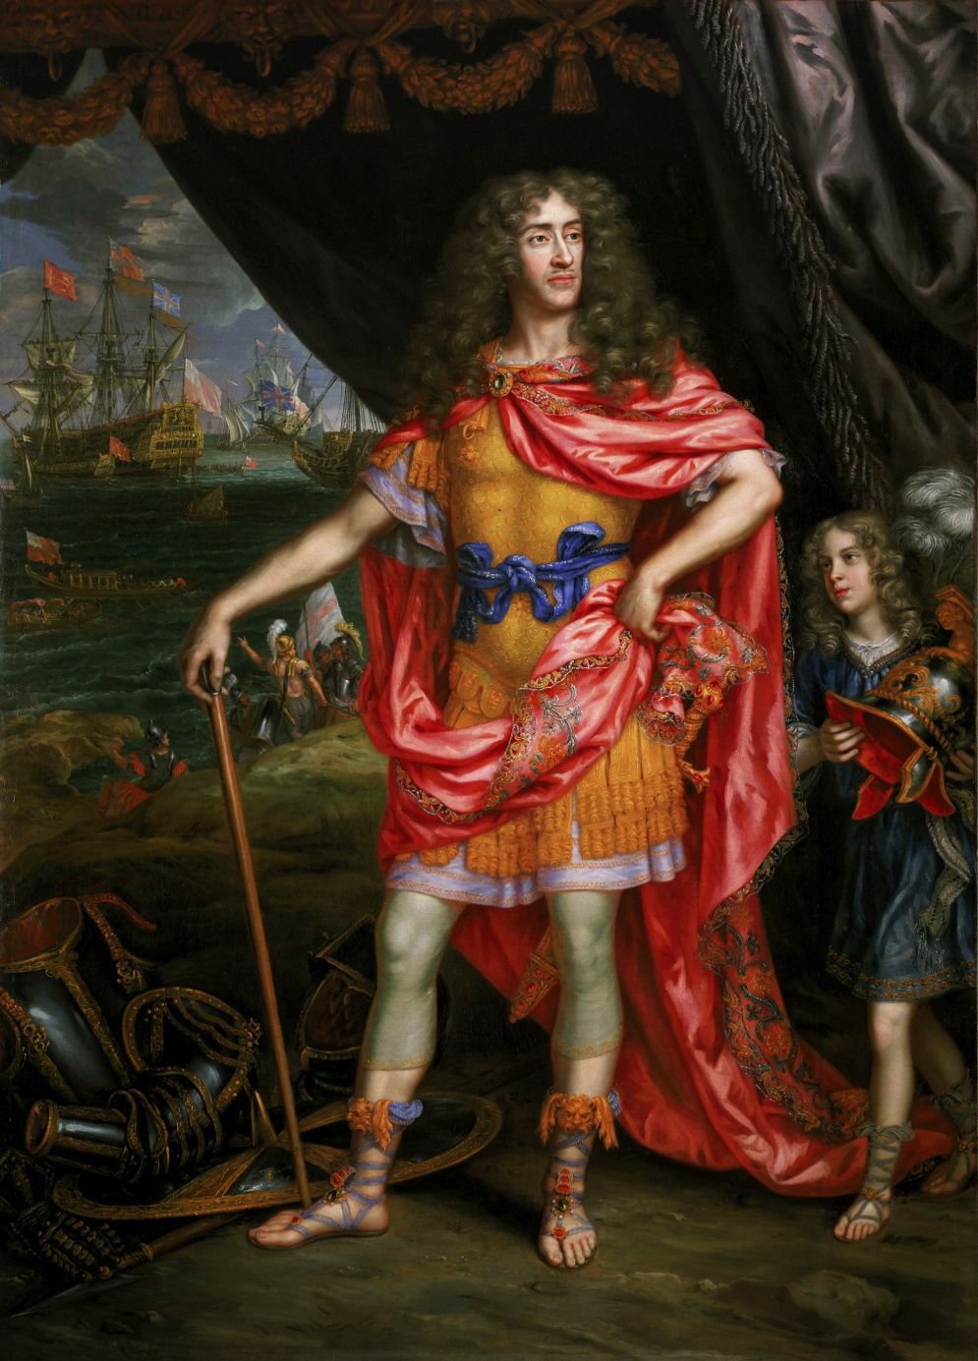
New York
In 1664: King Charles II decided it was time to seize New Netherlands from the Dutch
He granted all the land from the Delaware Bay to the Connecticut River to his brother James
James was the Duke of York and he sent 4 ships to New Netherland
He seized it and called the place New York

Slide 98
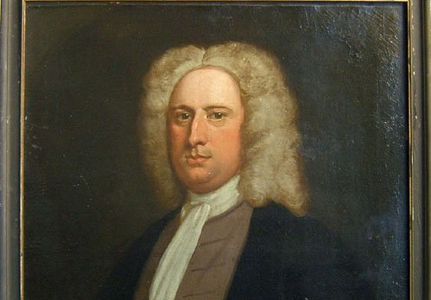
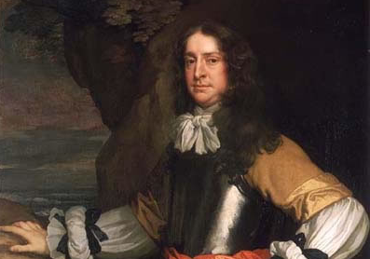
New Jersey
Afterwards, James decided to grant a large portion of his land to two of the king’s closest advisors – Sir George Carteret & Lord John Berkeley
James decided to name the colony New Jersey in honor of Sir George Carteret who was from the island of Jersey
To attract settlers they offered land grants, religious freedom, and the right to elect a legislative assembly

Slide 99
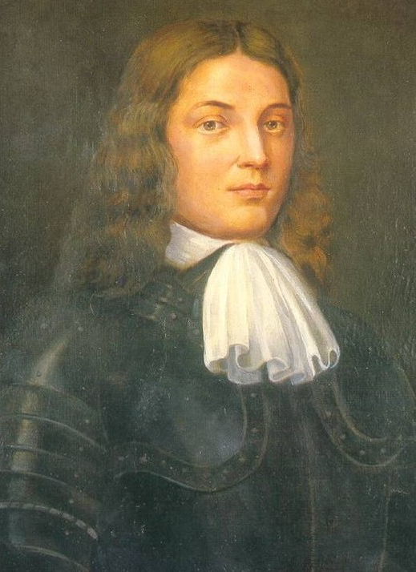
William Penn
Admiral William Penn was another close friend of King Charles II who loaned ships and money to the king but died before the king could pay him back
Oddly enough, he had a son who was also named William Penn
William Penn (Jr) inherited his father’s estate and the money owed to his father by the king
He asked the king to pay him back by granting him land in America but the king was a bit hesitant since Penn was a Quaker and the king didn’t like Quakers

Slide 100
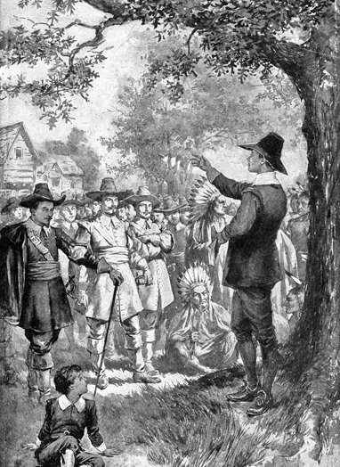
Quakers
They believed that everyone had their own “inner light” from God and no need for a church or ministers
They objected to all political and religious authority including forcing people to pay taxes or serve in the military
Quakers advocated pacifism – opposition to war or violence
Often they clashed with the government and other religions and many fled to America
They were persecuted in every colony so they wanted their own colony

Slide 101
Pennsylvania
Penn and other Quakers bought New Jersey from Berkeley & Carteret
Many Quakers moved to Jersey but Penn thought this wasn’t the best move
There were a lot of Puritans in NJ and they’d be very hostile towards the Quakers
So Penn asks the king for a charter of land west of the Delaware River
The king agrees but tells him to name the colony Pennsylvania (Penn’s Woods)

Slide 102
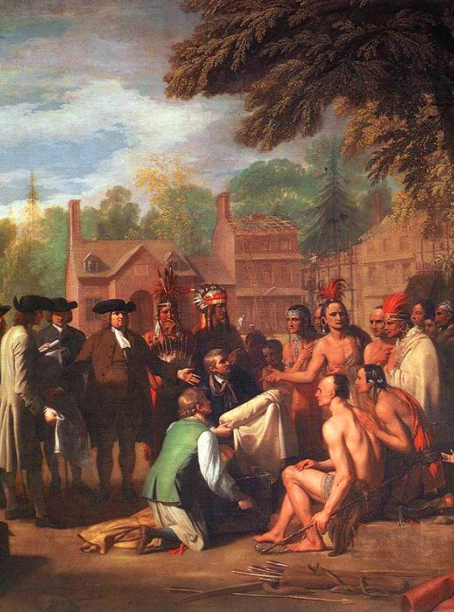
Pennsylvania
Pennsylvania was regarded as a “holy experiment” where complete political and religious freedom would be practiced
He believed that Native Americans were treated unjustly so he tried to patch things up and win the friendship of those who lived in PA
1862: Penn signed the Treaty of Shackamaxon which the Lenni Lenape ceded land to the colonists
This marked a 70 year peace between the Natives and Quakers in PA
He built the capital of Philadelphia – “the city of brotherly love”

Slide 103
Penn’s Constitution
Penn also prepared a constitution (frame of government) for his colony
At first it allowed anyone who owned land or paid taxes to vote
Later he issued a new charter establishing a legislative assembly elected directly by the voters
The governor was appointed by the proprietor
The right to vote was given to all colonists who owned 50 acres of land and professed a faith in Jesus Christ but still allowed everyone to practice their own religion

Slide 104
Delaware
Land was also made ready for settlers
There were many English Quakers but a large number of Germans and Scots-Irish migrated too
1648: there were nearly 7,000 colonists
Penn eventually bought 3 counties from the Duke of York in the south of Pennsylvania
They went on to become the colony of Delaware

Slide 105
Southern Colonies
King Charles II was very interested in the lands south of Virginia
He awarded the large territory there to 8 of his other friends and political allies
As a matter of fact: Carolina was named in honor of King Charles

Slide 106
North Carolina
N. Carolina was home to a small and scattered population
Most people were farmers who came from Virginia
It did not have a good harbor and the coastline made it hard for ships to teach it
This resulted in the colony growing very slowly
Eventually the people began growing tobacco and they also exported naval supplies like tar, pitch, and turpentine

Slide 107
South Carolina
This land was believed to be suitable for growing sugarcane and richer than N. Carolina
Unusually sugarcane did not grow well here
The first product they exported was deerskin which became popular for leather in England
The colony began to capture NA and ship them to the Caribbean for slavery

Slide 108
Georgia
1720’s General James Oglethorpe finds out that many people in England were in prison because they could not pay their debts
He was a wealthy member of Parliament and the English government saw the southern colonies as an advantage
Therefore King George II grants Oglethorpe and 19 other trustees permission to settle in the region between the Savannah & Atlanta Rivers

Slide 109
Georgia
The new colony was named Georgia in honor of the king
The trustees banned slavery, rum, and brandy and limited land grants to 500 acres
It did attract settlers from all over Europe including Scots, Welsh, Germans, Swiss, Italians, and Portuguese
Initially settlers objected to these rules so the trustees lifted the bans

Slide 110
England’s American Colonies
1775: the English colonies were growing roughly to 2.5 million people
Despite Jamestown, the English were successful in building other prosperous towns
Its success became its downfall
Allowing people to self-organize their governments will lead to people resenting the Royal Crown and planted the seeds for rebellion

