Slide 1
Colonial Ways of Life
1607 - 1763
Chapter 3

Slide 2
The Southern Colonies
Chapter 3 – Section 1

Slide 3
Southern Economy
Economy based on commercial agriculture
Jamestown made tobacco the main cash crop – crop grown primarily for market
Tobacco – Virginia & Maryland, and North Carolina
Rice & Indigo – South Carolina
Plantations – large commercial estates where many laborers lived on the land and cultivated the crops for landowners

Slide 4
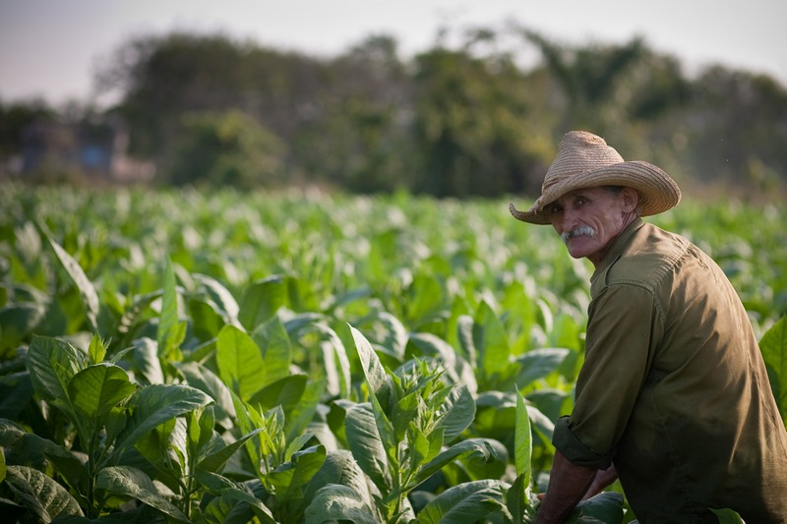
Tobacco & the Chesapeake
Whoever could grow tobacco became very wealthy since it was in high demand
Since it required a lot of labor, a farmer needed a large work force to cultivate a large crop

Slide 5
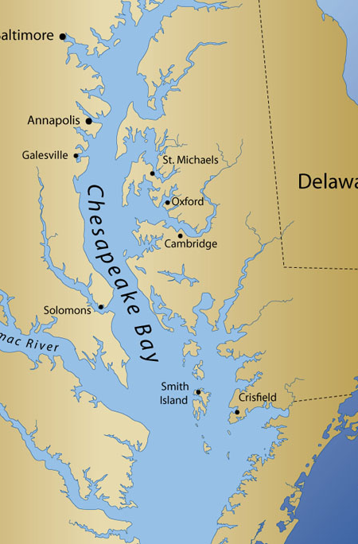
The Chesapeake Bay
The geography of this region was perfect for tobacco farming
It acted like a wide road with so many navigable rivers connected to the bay
If farmers could locate their farms next to a river, they could ship their crop anywhere

Slide 6
Indentured Servants
These were people who were hired to work on the farms for certain amount of years and then set free
In America, there was more than enough land but not enough people to work the fields
In England, there wasn’t enough land so it created a high unemployment
These unemployed people agreed to become indentured servants
Colonists in America paid for their passage and promised to feed, clothe, and shelter them

Slide 7
Southern Society
Many people came to the south hoping to become wealthy, very few did
Planters that could afford to bring in slaves and servants received large land grants
They could now produce a much larger crop
With the money the earned they could acquire more workers and more land
The wealthy elite controlled most of the land and relied up on the labor of others to work it for them

Slide 8
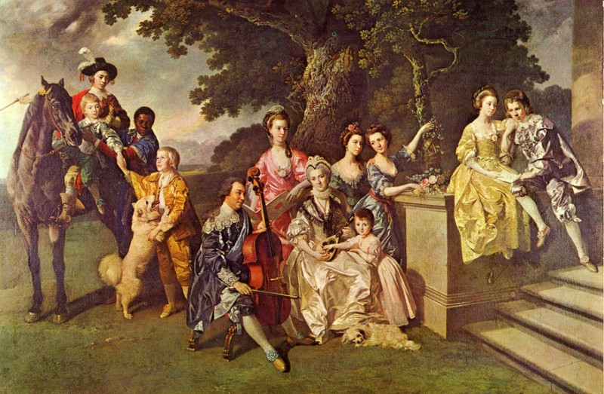
Planter Elite
Gentry – wealth landowners, planter elite
They represented their communities in the governing councils and assemblies, commanded the local militias, and served as county judges

Slide 9
Southern Communities
Residents lived near each other in a group of buildings
  The planter’s great house
  Stables and barns
  The workers’ cabins
Other facilities:
  Schools and chapels
  Workshops for blacksmiths
  Carpenters
  Weavers
  Coopers (barrel makers
  Leather workers

Slide 10
Gentry Plantations
1600 – indentured servitude
1700 - slavery
Gentry plantations were small
Planters and servants worked side-by-side
Rarely exceeded 30 people
The Great House were small (4-7 rooms)
Plantation sizes grew
Large brick mansions with elaborate gardens
Copied fashions & lifestyle of England’s upper class
Planters no longer worked on the field with their workers
Gentry enjoyed leisure time: hunting, fishing, gambling, reading, practicing music

Slide 11
Backcountry Farmers
Half of the servants that came from England died
Of those that were set free, less than half of them received their own land
They had to pay for the deed, land survey, tools, seeds, and livestock
Many couldn’t afford this, so they became tenant farmers, working lands they rented from the planter elite

Slide 12
Backcountry Farmers
The wealthy elite owned the lands near the rivers, while the former servants mostly lived farther inland in the “backcountry”
They were also called yeomen
They worked small plots of land, lived in 1 or 2 room houses
They practiced subsistence farming – farming only enough crops to feed their own families
  Corn, beans, potatoes, barley, and rye

Slide 13
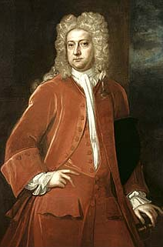
Sir William Berkeley
He was the governor of Virginia who controlled the legislature through the people he appointed in office
Once he assembled a majority of supporters in the House of Burgesses, he exempted himself and his councilors from taxation
He then went on to restrict voting only to those who owned property
This angered backcountry & tenant farmers
He also made some harsh Native American policies

Slide 14
Crisis Over Land
The most important issue for colonists was to acquire land
However most of the land at the time was owned by the NA
The wealthy elite lived near the coast & didn’t care about the backcountry farmers nor did they want war with the NA
1675: a war broke out between the backcountry farmers and the Susquehannock

Slide 15
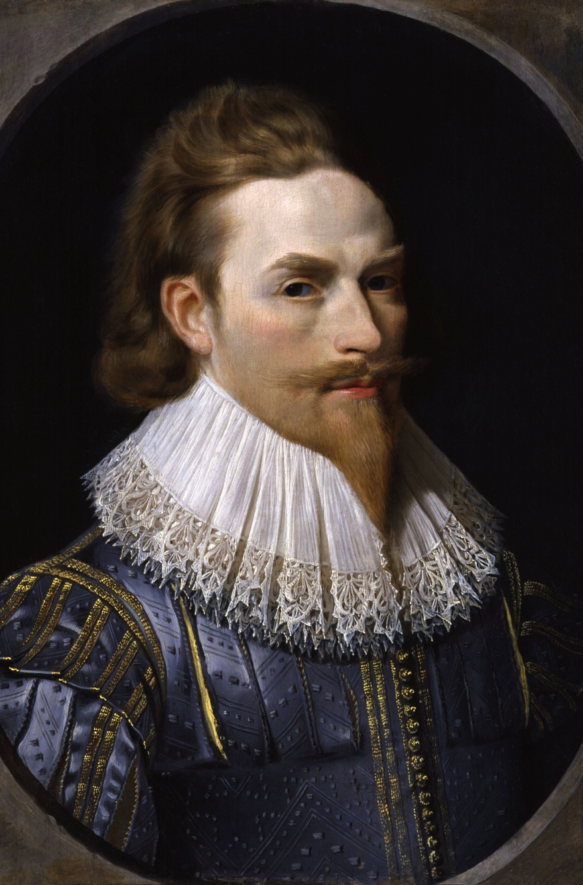
Nathanial Bacon’s Revolt
Nathanial Bacon was a member of the governor’s council who took the side of the backcountry farmers
He owned some land near the frontier and his plantation was attacked by NA so he wanted to do something about it
Bacon organizes his own militia backed by the newly elected House of Burgesses and attacks the NA
The HOB then restores the vote to all free men and took away the tax exemptions Berkeley had grant to his supporters

Slide 16
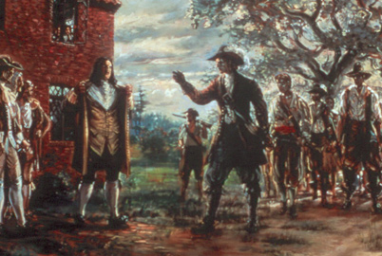
Bacon’s Rebellion
Bacon still wasn’t satisfied so he returns to Jamestown with several hundred of his men to charger Berkeley on corruption
Berkeley flees and raises his own army
Both sides battle it out until Bacon, who was hiding in a swamp, became sick and died
His army disintegrated due to lack of leadership

Slide 17
Slavery Increases
After Bacon’s Rebellion, the government generally supported expanding the colony westward, not caring about the NA
It also increased a trend – the use of slavery instead of servants
There were many reasons to switch to slavery
1672: King Charles II grants a charter to the Royal African Company to engage in the slave trade to make it easier for colonies to acquire slaves

Slide 18
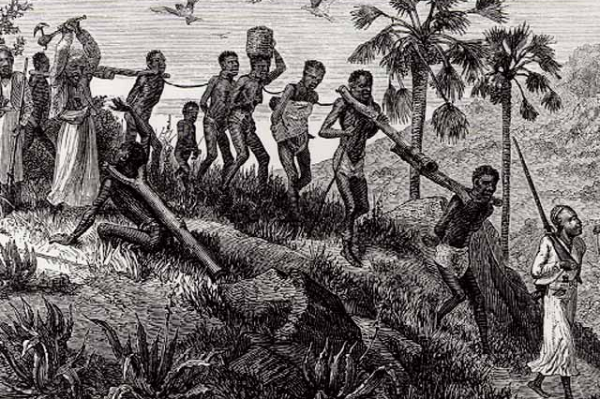
A Slave’s Voyage
Voyage to America was terrible
Africans were tied together with ropes around their necks and hands, traded to Europeans, branded, and forced aboard a ship
Roughly between 10-12 million Africans were forcibly transported
Nearly 2 million died at sea

Slide 19
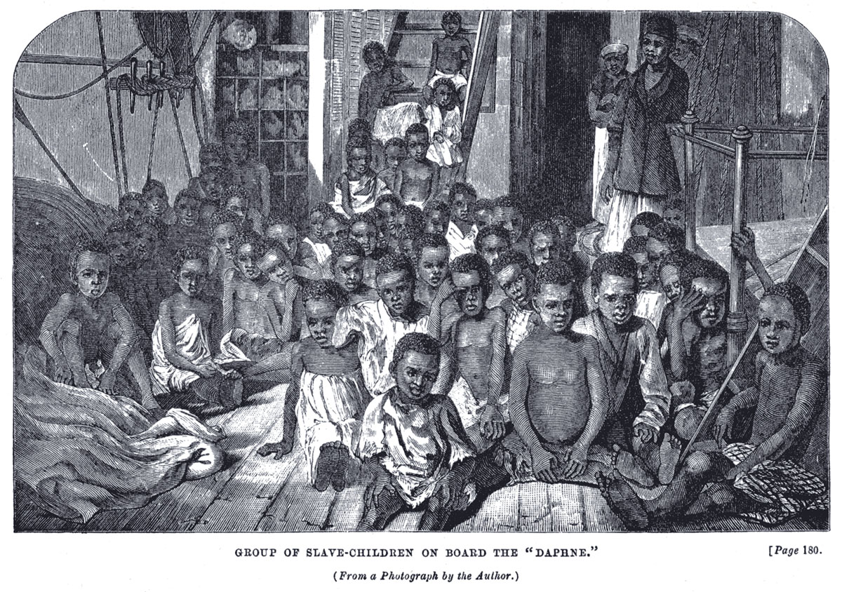
A Slave’s Voyage
Slaves were chained and crammed into the ships’ filthy holds for more than a month
Prisoners could hardly sit or stand and were given minimal food and drink
Those who died or became sick were thrown overboard
Those who refused to eat were whipped

Slide 20
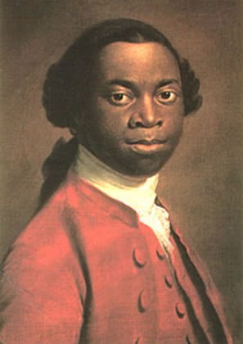
Olaudah Equiano
He was also known as Gustavus Vassa
He was kidnapped from his home by other Africans
He was then traded to Europeans and shipped America
After winning his freedom he wrote a memoir describing his terrible journey across the Atlantic
This was also known as the Middle Passage

Slide 21
Where Did the Slaves Go?
Brazil – 3.5 million
Spanish Colonies – 1.5 million
British, French, & Dutch Colonies – 4 million
Before the slave trade was over – 500,000 to N. America

Slide 22
Early Slavery
English law did not recognize chattel slavery – one human being is said to be owned by another
Therefore when the first slaves came to Virginia & Maryland, they were treated in a manner similar to indentured servants
Children born to Africans weren’t always considered enslaved

Slide 23
Early Slavery
Some enslaved Africans obtained their freedom by converting to Christianity
In the early days, enslaving Africans was acceptable not because of their race, but because they weren’t Christians
However over time the laws changed
1638: Maryland began to deny Africans the same rights as English citizens
1660s: new laws in Virginia & Maryland lowered the status of all Africans regardless of religion

Slide 24
Slave Codes
These were a set of laws that formally regulated slavery and defined the relationship between enslaved Africans and free people
Africans were denied the right to own property or to testify against a white person in court
They were forbidden to assemble in large numbers

Slide 25
New England & the Middle Colonies
Chapter 3 – Section 2

Slide 26
New England’s Economy
Fishing made a lot of New Englanders rich & provided a way of living for many people too
However none of their crops were in demand in other places
Instead of plantations, New Englanders farmers practiced subsistence farming
The main crop that they grew was corn, since the soil was too poor, and a fungus called black rust

Slide 27
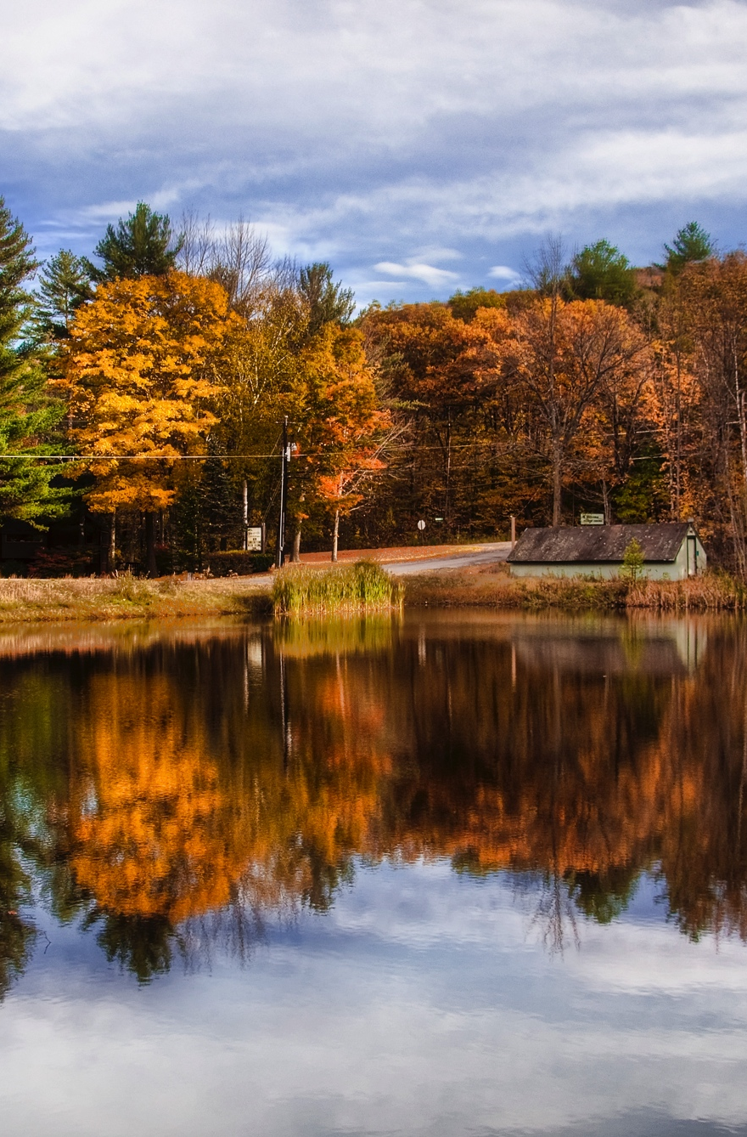
New England’s Economy
As New England became more settled, farmers began to grow barley, oats, and rye
They also grew vegetables like beans, peas, pumpkins, squash, and turnips
Farmers also included orchards, apple trees were common, berries like cranberries, blackberries, and strawberries
They also raised livestock like oxen, horses, cattle, sheep, and pigs

Slide 28
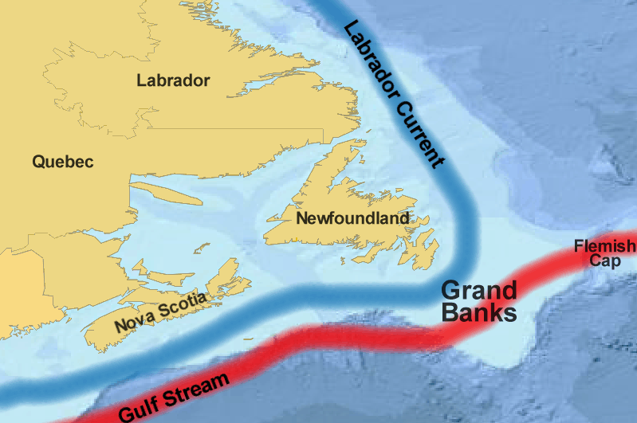
Fishing
Fishing was a major industry in New England
Northeast of NE was the Grand Banks which supplied the environment with plankton – an important food supply for many types of fish and whales
This brought many fish like cod, mackerel, halibut, and herring

Slide 29
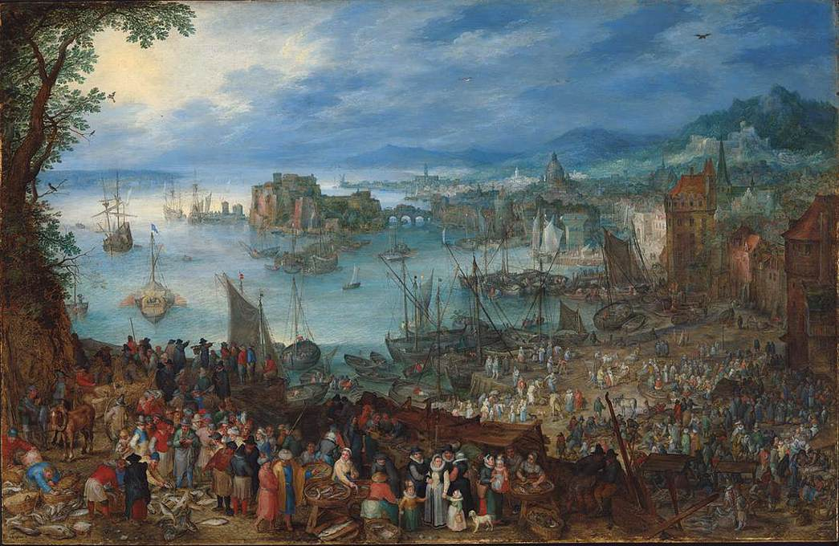
Fishing
There was a great demand for fish
It brought prosperity since every coastal town had a fishing fleet
Nearly 4,000 to 5,000 people in NE made their living by fishing

Slide 30
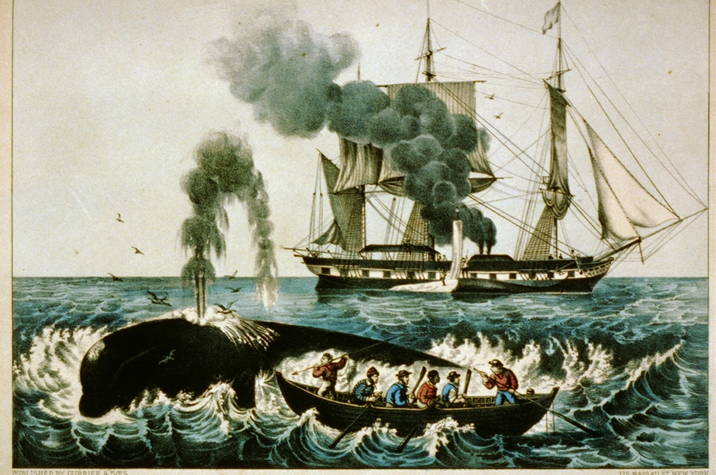
Whaling
Whalers were after whales for their blubber
Their blubber was used to make candles and lamp oil
They also sought after ambergris which is a waxy intestinal substance used to make perfume
Finally they used their bones for buttons and combs

Slide 31
Lumbering
Since the New England colonies were located in the northeast, there was an abundance of forests
They provided the conditions necessary for the development of a lumber industry
The fall line is the area where rivers descend from a high elevation to a lower one, causing waterfalls
They were used to power sawmills which cut the lumber that were transported downriver and shipped to other colonies

Slide 32
Lumbering
Every colony needed lumber
They wanted walnut, maple, and sycamore wood for furniture
They used cedar for doorframes and windowsills
Maple was made into spinning wheels
Oak and pine were materials for boards, shingles, and barrel staves

Slide 33
Shipbuilding
Ships were quickly built and built cheap because of the forests and sawmills
Ships were in demand because of the large growing fishing industry
These ships were built 30%-50% cheaper in America than in England so English merchants definitely showed interest
1770: 1 out of every 3 English ship was made in America

Slide 34
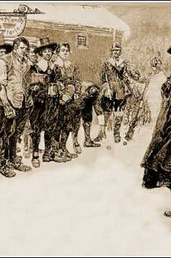
Life in New England Towns
It was centered around Puritan belief who were very much committed to the church
Unlike other colonies who granted land to individual people, the general court in NE granted land to groups of people
These groups became the town proprietors who were members of the congregation that wanted to establish a new community
The town was at the heart of the residents

Slide 35
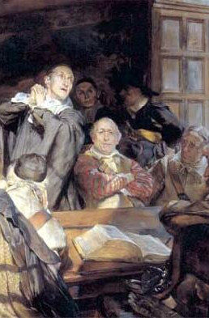
Town Meetings
Residents met to discuss local problems/issues
They also elected leaders and chose deputies
Town Meetings developed into the local town government
Anyone could go to these meetings but only freed men who owned land could vote
Selectmen were men who were chosen to manage the town’s affairs and were elected annually

Slide 36
Role of the Selectmen
They appointed officials the town needed such as:
  Clerks
  Constables
  justices

Slide 37
Puritan Society
Houses were located close to the church and were called meetinghouses
Therefore people could never use distance as an excuse for not going to church for Sunday worship, sermons, and Thursday night religious lectures

Slide 38
Puritan Society
Puritan law banned: “The infamous Games of Cards and Dice because of the lottery which is in them”
What does this mean?
They also frowned up “Stage-Players and Mixed Dancing”
Puritans also felt a responsibility for the moral welfare of their neighbors; watching over them was very important

Slide 39
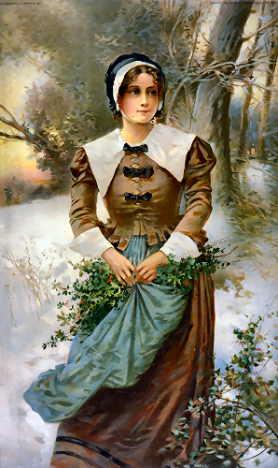
Puritan Society
People usually regard Puritans as being intolerant and strict but they weren’t displeased with all fun and pleasurable activities
They drank rum, enjoyed music, and liked to wear brightly colored clothing which indicated their social status
Their artists and architects produced beautiful and elegant works
“God had made the world, and the things in it were to be enjoyed by people.”

Slide 40
Trade & Rise of Cities
New England only produced a few goods & crops that England wanted
But England produced many items that settlers wanted
  Hardware & various mechanical instruments
  Fine cloth
  Linens
  Ceramic plates

Slide 41
Triangular Trade
New England had to trade some of their goods to other places in order to acquire other goods that England wanted
The sugar plantations in the Caribbean wanted New England’s fish, lumber, and meat
To pay for these things, the Caribbean sugar planters either traded raw sugar with New England or gave them bills of exchange
These were credit slips English merchants gave the planters in exchange for their sugar, they’d take the bills and sugar back home and use them to buy English goods

Slide 42
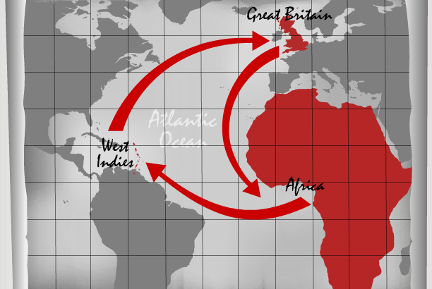
Triangular Trade
This 3-way trade New England merchants established with the Caribbean colonies and England is an example of triangular trade
Others existed as well:
  NE would trade rum to the British, who then traded rum to West Africans in exchange for slaves, who were transported across to the Caribbean and traded for sugar

Slide 43
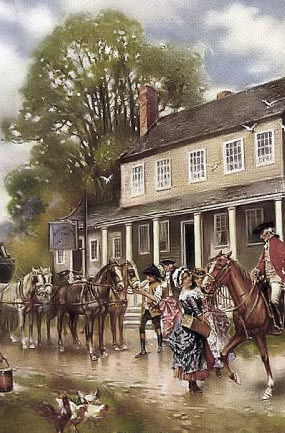
New Urban Society
Several ports grew rapidly into the first cities of America
Top: a small group of wealthy merchants who controlled the city’s trade
They were similar to the wealthy planters in the south and fashioned themselves after the British upper class
  Elegant imported clothing
  Built luxurious mansions surrounded by gardens/servants
  Rode through the crowded city streets in fancy carriages

Slide 44
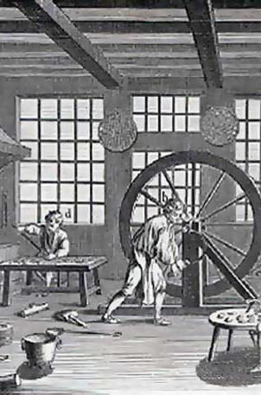
New Urban Society
Middle: were the artisans and their families
Artisans were skilled workers who knew how to manufacture various goods
  Carpenters
  Masons
  Coopers
  Iron and silversmiths
  Glass makers
  Bakers
  Seamstresses
  Shoemakers

Slide 45
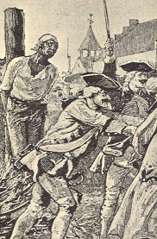
New Urban Society
Bottom: people without skill or property
Many were employed at the harbor where they loaded and serviced ships
Others were servants, indentured servants, and enslaved Africans

Slide 46
Society in the Middle Colonies
These were the colonies of Pennsylvania, New York, New Jersey, and Delaware
They contained some of the most fertile farmland in N. America
They were also able produce a surplus of their crops which could be sold
Crops: rye, oats, barley, potatoes, but wheat was the most important

Slide 47
Growth of the Middle Colonies
Middle colonies benefited from their geography because they had 3 wide rivers – Hudson, Delaware, and Susquehanna
They made it easier for the farmers to move their goods to the coast for shipping
Towns located where the rivers emptied into the Atlantic rapidly grew into major cities
New York City & Philadelphia became the two largest cities in the British colonies

Slide 48
The Wheat Boom
As diseases began to decline the population exploded with also a flood of new immigrants into America
Population increase also created a huge demand for wheat
Farmers became very wealthy by hiring poor immigrants to work on their farms for wages
Other colonists became entrepreneurs – businesspeople who risked their money by buying land, equipment, and supplies and then selling them to the new immigrants for a profit

Slide 49
The Wheat Boom
The British government limited manufacturing in the colonies so they had few industries and had to import so many manufactured goods from England
But the wheat boom created a new group of capitalists – people who had money to invest in new businesses
They built large gristmills new NYC and Philadelphia that produced tens of thousands of barrels of flour for export

Slide 50
The Wheat Boom
The limited technology prevented farmers from becoming very wealthy, although they still prospered because of wheat
All of the wheat had to be cut by hand using a sickle
Threshing – separating the grain from the chaff – also had to be done by hand by beating the grain with a wooden flail

Slide 51
Distinct Classes
Top: wealthy entrepreneurs who owned large farms and other businesses
Middle: many farmers who owned only a few acres and could generate a small surplus from their land
Bottom: landless workers who either rented land from large landowners or worked for wages

Slide 52
The Imperial System
Chapter 3 – Section 3

Slide 53
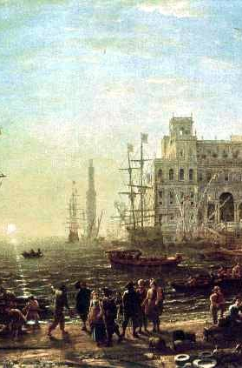
Mercantilism
Mercantilism is a set of ideas about the world economy and how it works
Mercantilists believed that to become wealthy and powerful, a country had to accumulate gold and silver
A country could do this by selling more goods to other countries than it bought from them
They argued that a country should be self-sufficient in raw materials
However this system prevented colonies from selling foods to other nations, even if they could get a better price

Slide 54
The Navigation Acts
The English government tried to encourage exports and restrict imports and little attention was paid to the colonies and how they fit into England’s economic system
King Charles II and his advisers wanted to generate wealth for England by regulating trade and expanding the colonies in America
1660: He asked Parliament to pass a navigation act

Slide 55
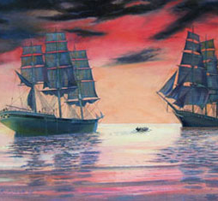
The Navigation Acts
It required all goods imported or exported from the colonies to be carried on English ships
It also stated that at least ¾ of the crew on each ship had to be English
Furthermore it listed specific raw materials that could be sold only to England or other English colonies
  Sugar, tobacco, lumber, cotton, wool, and indigo
  These were the major products that earned money for the colonies

Slide 56
Reaction to Navigation Acts
Colonists were angry, especially tobacco planters
They complained that it forced them to deal with English merchants who charged such high prices for shipping that the planters were robbed of their profit

Slide 57
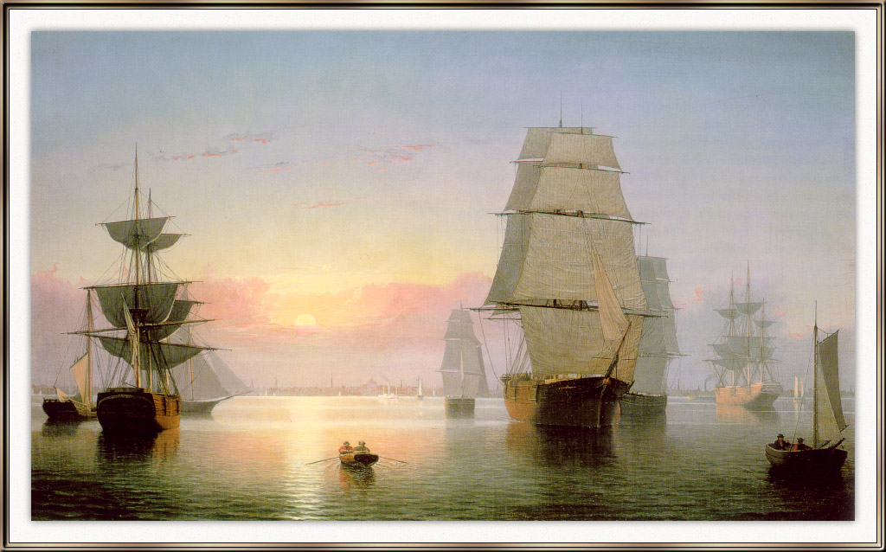
The Staple Act
1663: Parliament passed another navigation act called the Staple Act
This act required everything the colonies imported to come through England
All merchants bringing European goods to the colonies had to stop in England, pay taxes, and then ship the goods out again on English ships
This generated money for England but also increased the price of goods in the colonies

Slide 58
Reaction to the Staple Act
These acts encourage colonial merchants to break the new laws
But to enforce them, Parliament authorized the appointment of customs inspectors
They would report directly to the English government

Slide 59
Problems with Enforcement
1675: the Lords Commissioners of Trade and Plantations were appointed to oversee colonial trade and advise the king about problems
It was discovered that the Dutch and other foreign ships crowded Boston Harbor and the Massachusetts merchants ignored the Navigation Acts
They even smuggled goods to Europe, the Caribbean, and Africa
The Massachusetts governor even told the king they would not obey these laws

Slide 60
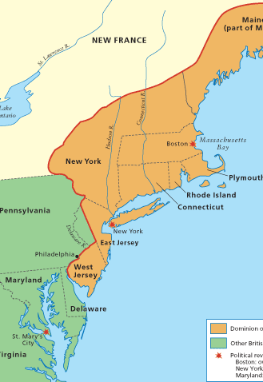
Dominion of New England
When James II assumed the throne, he went even further in his authority and increasing his punishment of the merchants
1686: the English government merged Massachusetts, Plymouth, and Rhode Island together and created a new royal province called the Dominion of New England
1687: Connecticut and New Jersey were forced to join
1688: New York was added too

Slide 61
Dominion of New England
The Dominion was run by a governor-general and councilors appointed directly by the king
  Colonial assemblies were abolished
Governor-general and his council would have the power to make laws, impose taxes, administer justice, and confirm or deny all existing land grants
Sir Edmund Andros was appointed as governor-general

Slide 62
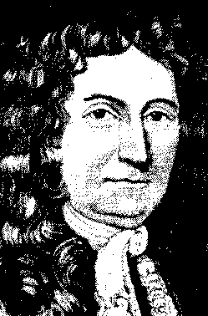
Sir Edmund Andros
he declared all deeds and land titles issued under the Massachusetts charter to be worthless
He insisted that anyone who wanted a new deed would have to pay an annual tax to the government
He also rigorously enforced the Navigation Acts
Andros went on to undermine the Puritan Church and declared that only marriages performed in Anglican churches were legal
He demanded that Puritan meeting halls be made available for Anglican services every other Sunday and that no one was to teach school without permission

Slide 63
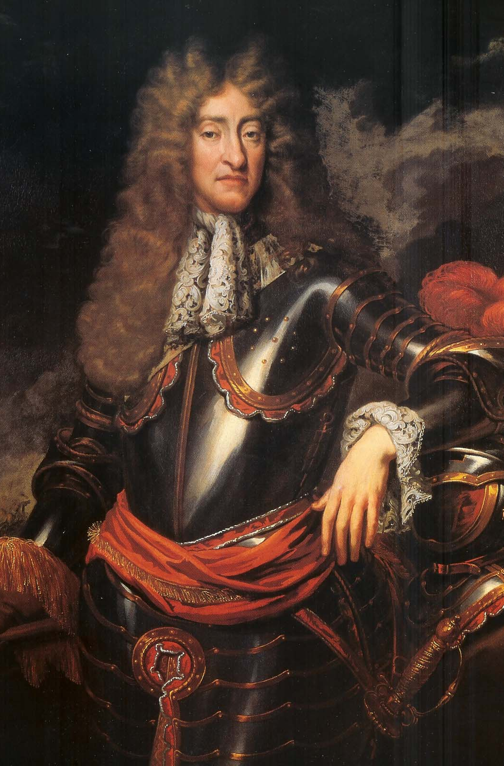
Suspicions of King James II
Colonists in America hated James II for his treatment of them
The English in England also grew suspicious of him because of his constant rejection of Parliament’s advice, revocation of charters for English towns, and his open practice of Catholicism
He prosecuted Anglican bishops and people were worried that if this continued, he might lead the country into another civil war

Slide 64
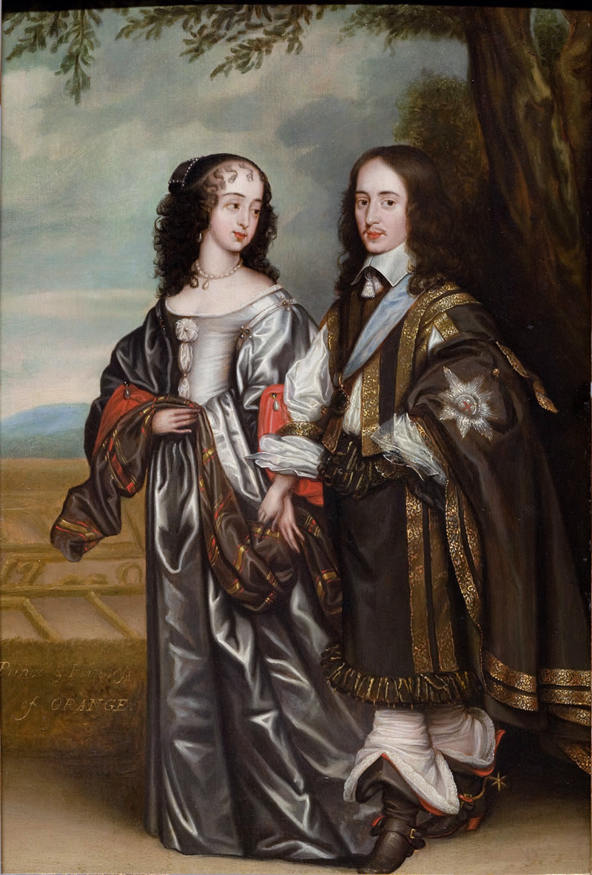
Tolerating James II
Most members of Parliament still tolerated James II mainly because of his daughter Mary
She was Protestant and so was her Dutch husband William of Orange
They were expected so succeed James II to the throne
1688: hopes were shattered when James II & his second wife gave birth to a son…
The son was now the heir to the throne and would be raised Catholic

Slide 65
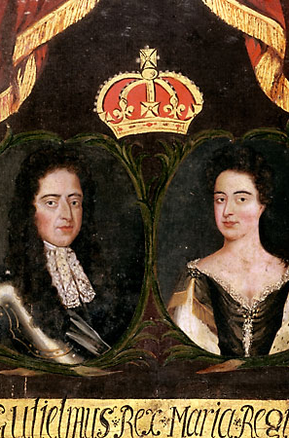
Glorious Revolution
Immediately protests were triggered by the birth of this son
Members of Parliament went even as far as inviting Mary and her husband William to take the throne of England
When William arrived, James fled
This bloodless change of power became known as the Glorious Revolution

Slide 66

English Bill of Rights
William and Mary stepped to the throne and swore that they would obey the laws of the Parliament and afterwards were read their Bill of Rights
The English Bill of Rights abolished the king’s absolute power to suspend laws and create his own courts

Slide 67
English Bill of Rights
Illegal for the king to impose taxes
Illegal for the king to raise an army without the consent of Parliament
Guaranteed freedom of speech within Parliament
Banned excessive bail and cruel and unusual punishments
Every English subject was guaranteed the right to petition the king and the right to a fair and impartial jury
The Toleration Act granted freedom of worship to nearly all Protestants but not to Catholics and Jews

Slide 68
The Glorious Revolution in America
As soon as news reached America of James’ dethronement, and uprising occurred in Boston
Colonists seized and imprisoned Governor-General Andros and his councilors
They were returned to England and the Dominion of New England slowly died out
Connecticut & Rhode Island were allowed to go back to their previous form of government
Massachusetts, Maine, and Plymouth were all part of the royal colony of Massachusetts

Slide 69
New Charter of Mass.
People were given the right to elect an assembly
The assembly was given the right to elect the governor’s councilors
But the governor had to be appointed by the king (William)
Voters had to own property but they did not have to be members of a Puritan congregation
It also granted freedom of worship to Anglicans

Slide 70
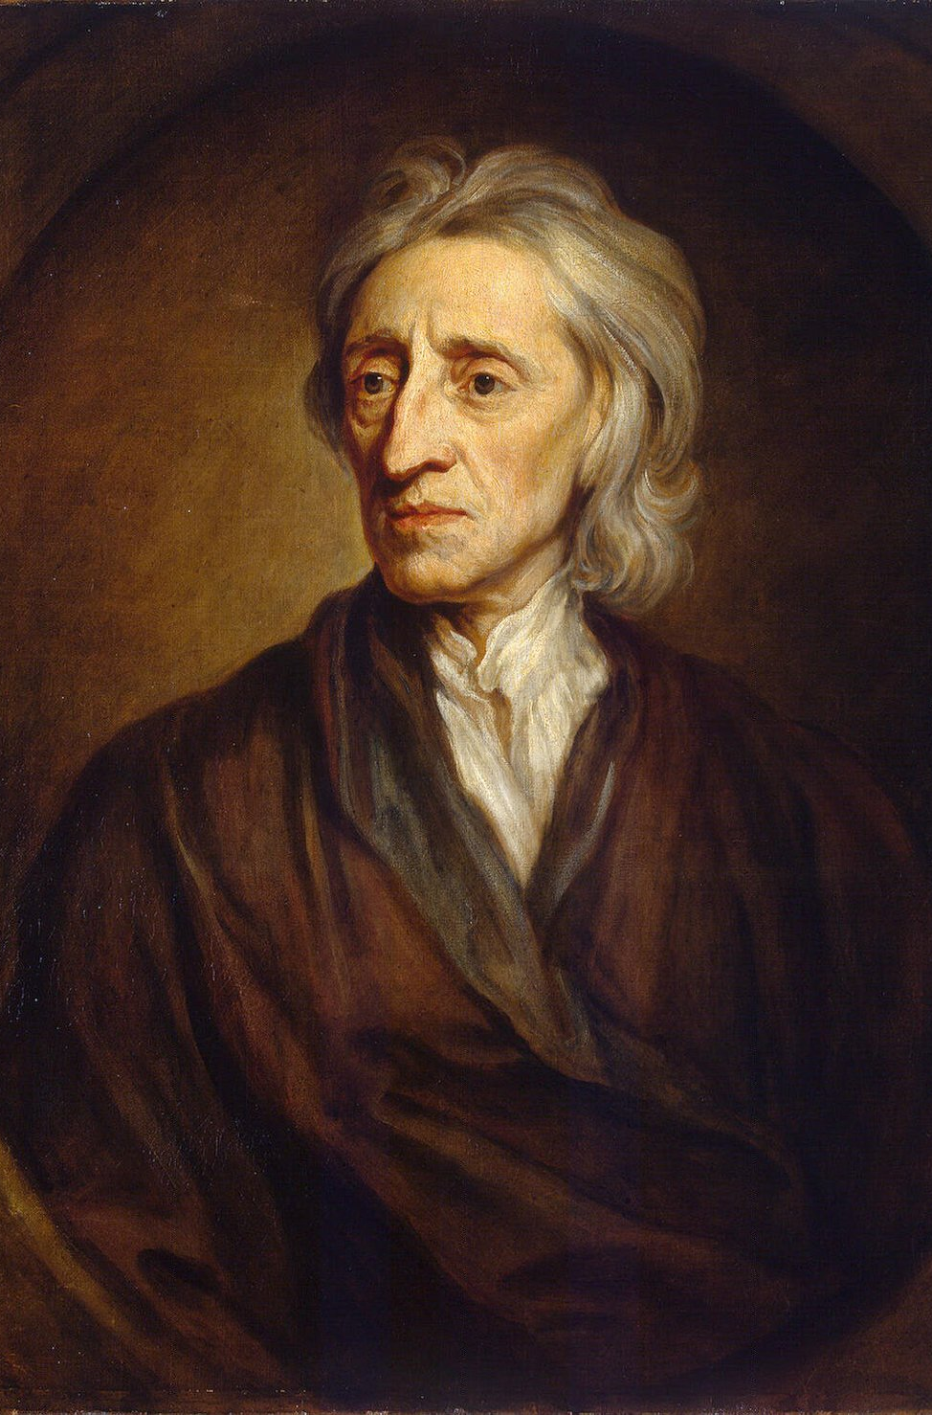
John Locke’s Legacy
John Locke was a political philosopher who wrote a booked called The Treatises of Government
It explains the basis of political obligation and it justified revolution
He argued that a monarch’s right to rule came from the people
All people are born with certain natural rights

Slide 71
John Locke: Natural Rights
These included the right to:
  Life
  Liberty
  Property
Before governments were created, people lived in a “state of nature” where their rights were not safe
To protect their rights, people had come together and mutually agreed to create a government

Slide 72
John Locke: Natural Rights
People formed a contract that they agreed to obey the government’s laws and the government agreed to uphold their rights in return
Furthermore, monarchs were parties to this contract and if they violated the people’s rights, the people were justified in overthrowing the monarch and changing their system of government

Slide 73
Impact on American Colonists
Locke’s ideas ideas had a profound impact on colonists in America
They understood the “natural rights” to be the rights of English citizens and were referred to in documents such as the Magna Carta and the English Bill of Rights

Slide 74
A Diverse Society
Chapter 3 – Section 4

Slide 75
Family Life in Colonial America
People had large families
Benjamin Franklin, for example, was 1 of 17 children
People were also migrating to America
Mostly from Europe and from Africa
Some moved willingly, while others came forcibly

Slide 76
Population Growth
1700s: Most women married while in their early 20s to men who were in their mid 20s
On average, they gave birth to 7 children
1640 – 1700: the population increased from 25,000 to more than 250,000 in the colonies
1750s: more than 1 million colonists lived in America
American Revolution: we have nearly 2.5 million people

Slide 77
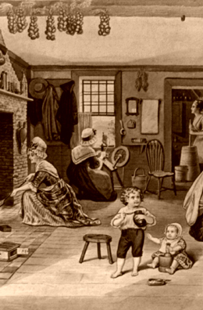
Women in Colonial Society
They had less authority than men in politics and in the household
Married women had no legal status and she could not own anything, all of the property she brought into the marriage became her husband’s
Women weren’t allowed to make a contract, be party to a lawsuit, or make a will
Singly/widowed women could actually own and manage property, file lawsuits, and run businesses

Slide 78
Women in Colonial Society
1700s: conditions improved for married women
Husbands could not sell or mortgage their land without their wife’s signature
Married women began engaging in business
They worked outside of their homes
They even operated taverns and shops, managed plantations, ran print shops, and published newspapers

Slide 79
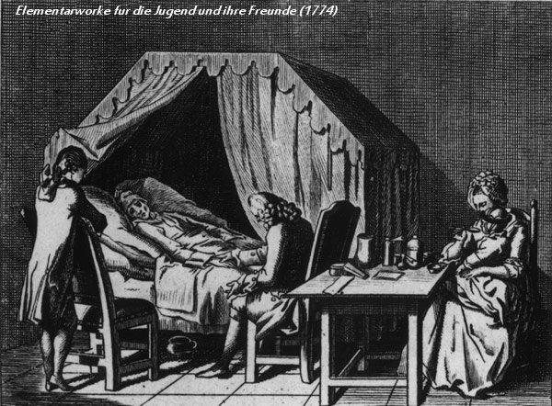
Health & Disease
People suffered from fever, tuberculosis, cholera, diphtheria, diarrhea, influenza, and scarlet fever

Slide 80
Immigrants in Colonial America
1700 – 1750: hundreds of thousands of free white immigrants arrived and settled throughout the colonies
Traders brought large numbers of enslaved Africans to America, mostly to the southern colonies

Slide 81
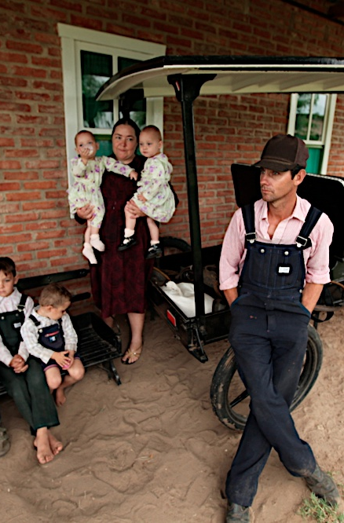
Germans in Pennsylvania
The first large group of German immigrants came to PA looking for religious freedom
The first were a group of Mennonites who founded Germantown
By 1775: more than 100,000 Germans had arrived in PA
They were known as the Pennsylvania Dutch and became some of the colony’s most prosperous farmers

Slide 82
The Scotch-Irish
These were descendants of the Scots who had helped England claim control of Northern Ireland
1717 – 1776: nearly 150,000 Scotch-Irish immigrants arrived
Most headed to PA but many migrated west where they occupied vacant land
They even went south into the backcountry of the southern colonies

Slide 83
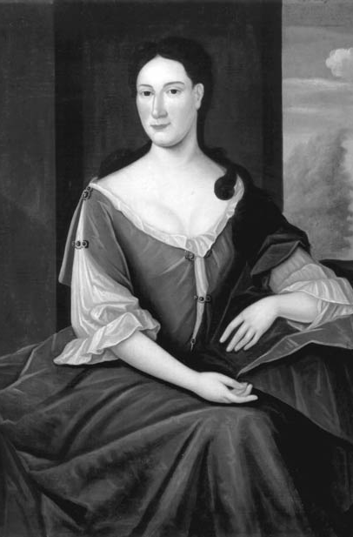
Colonial America’s Jewish Community
A small group of Jews fled from Brazil seeking religious freedom and arrived in New Amsterdam ~> NYC
They mostly lived in NYC, Philadelphia, Charles Town, Savannah, and Newport where they were allowed to practice their religion freely
They made a living as artisans and merchants
Here in America, Jews lived and worked alongside Christians

Slide 84
Africans in Colonial America
They came from many different parts of West Africa
They tried to maintain their specific languages and traditions
However white planters intentionally bought slaves from different regions
They did this so that the slaves could not communicate with each other and stage a rebellion

Slide 85
Africans Build a New Culture
In SC, Africans worked and lived in larger groups than in other southern colonies
They were isolated from white planters and this resulted in a more independent African culture
They developed their own language called Gullah
It was a combination of England and African words
Their traditional beliefs became mixed with the Christian faith
Their rhythms became a part of new musical forms

Slide 86
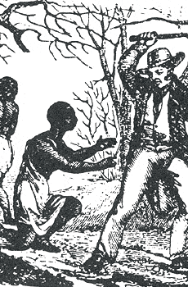
Oppression & Resistance
Authority was maintained through very harsh means of punishment
Whippings and beatings were common
Disobedient workers were branded
Some would have their noses slit or fingers/toes amputated
To leave the plantations, Africans needed passes
The planters organized night patrols to watch for rebellion and runaways

Slide 87
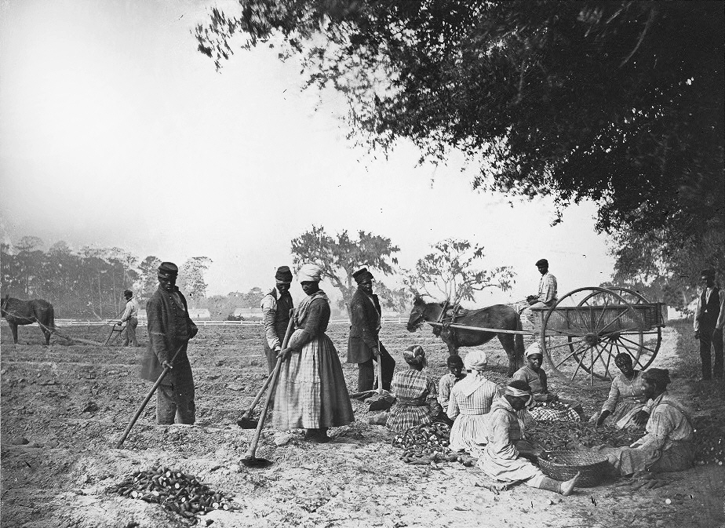
Oppression & Resistance
VA: work was less tiring because the slave population was smaller
Planters did use punishments but also tolerated persuasion
  Ex: promising slaves extra food or a day off for completing a particular job
Africans, however, found ways of combatting slavery

Slide 88
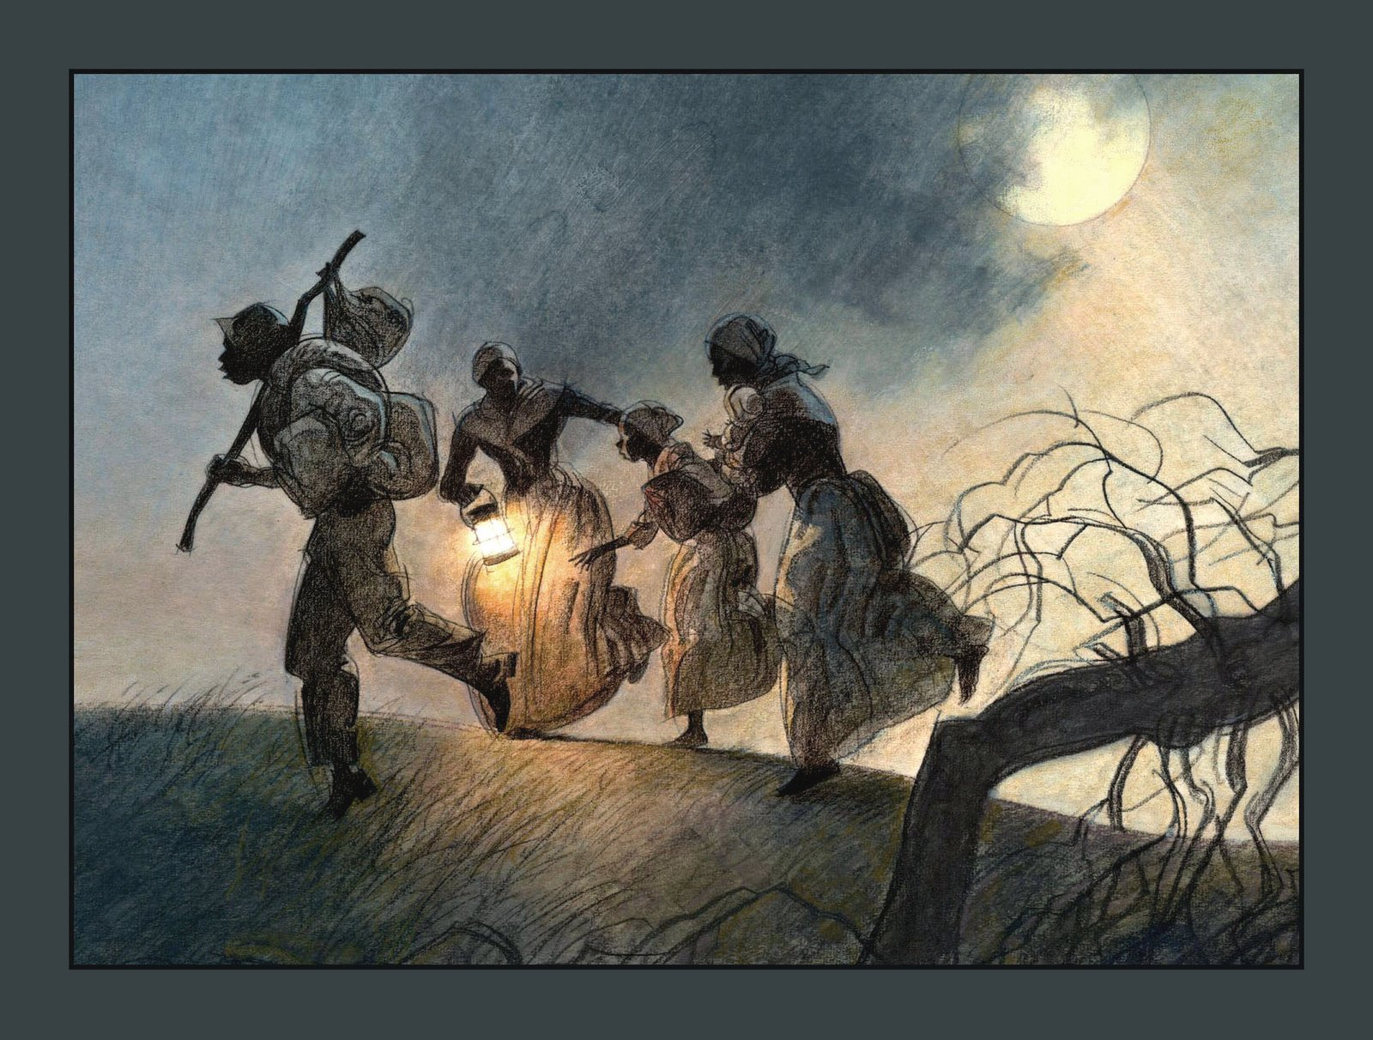
Fighting Slavery
Some slaves used passive resistance: stage deliberate work slowdowns, or lose or break tools, or simply refuse to work hard
A few gained freedom by escaping
Others purchased their freedom with the money earned on their own
While others were set free by their slaveholders

Slide 89
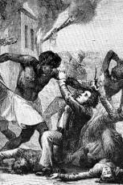
Stono Rebellion
A Spanish governor in Florida promised Africans their freedom if they escaped to Florida
1739: 75 Africans met near the Stono River, attacked their white overseers, stole their guns, and raced toward Florida
A local militia eventually ended the Stono Rebellion
Between 30 – 40 Africans were killed

Slide 90
Enlightenment & Great Awakening
1700s: America came under the influence of 2 great European cultural movements:
  The Enlightenment – challenged the authority of the church in science and philosophy while elevating the power of human reason
  The Great Awakening – stressed dependence on God and gained wide appeal among farmers, workers, and enslaved people

Slide 91
Enlightenment
These thinkers believed that natural laws applied to social, political, and economic relationships
This was known as rationalism – emphasis on logic & reasoning
John Locke was a very famous Enlightenment writer
He used reason to discover natural laws that applied to politics and society
Famous work: Two Treatises of Government

Slide 92
Enlightenment – J. Locke
His “Essay on Human Understanding” argued that people were not born sinful
Instead their minds were blank slates that could be shaped by society and education
These ideas completely contradicted Church beliefs
They also became the core beliefs in American society

Slide 93
Enlightenment – J.J. Rousseau
Jean Jacques Rousseau was a French thinker who argued:
  That a government should be formed by the consent of the people
  Government would make laws for the good of the people
Famous work: The Social Contract

Slide 94
Enlightenment – B. Montesquieu
Baron Montesquieu suggested that there were 3 types of political power:
  Executive
  Legislative
  Judicial
These powers need to be separated into different branches of government to protect the liberty of the people
They would also provide checks and balances against each other and prevent the government from abusing its authority
Montesquieu’s ideas definitely influenced the writers of the American Constitution

Slide 95
Great Awakening
Many Americans embraced a movement called pietism
It stressed an individual’s piety (devoutness) and an emotion union with God
All around the colonies, ministers spread pietism through revivals – large public meetings for preaching and prayer
This was known as the Great Awakening

Slide 96
Great Awakening – J. Edwards
He was a Massachusetts preacher and philosopher who aimed to restore New England’s spiritual intensity
His sermons terrified people because of his images of humanity dangling on the brink of damnation, suspended only by the “forbearance of an incensed angry God”
He argued that a person had to repent and convert to be “born again”

Slide 97
Great Awakening – G. Whitefield
He was an Anglican minister who arrived in Philadelphia in 1739
Powerful and an emotional speaker, he attracted large crowds everywhere he preached
He warned the dangers of listening to ministers who had not been “born again”

Slide 98
Great Awakening
During this movement, New England churches split into factions called the New Lights and the Old Lights

