Slide 1
The American Revolution
1754-1783

Slide 2
Key People
George Washington
Thomas Jefferson
Benjamin Franklin
John Adams
Benedict Arnold
General Edward Braddock
Charles Townshend
Sam Adams
William Pitt
James Wolfe
Native Americans
The French
King George
George Grenville
John Hancock
Molly Pitcher

Slide 3
Key Events
French & Indian War
First Skirmish
Albany Conference
Albany Plan of Union
Treaty of Paris
Royal Proclamation of 1763
Sugar Act
Currency Act of 1764
Quartering Act
Stamp Act
Townshend Act
Revenue Act of 1767
Virginia Resolves
Boston Massacre
Gaspee Affair
Boston Tea Party
Tea Act of 1773
Coercive Acts
Quebec Act
Intolerable Act

Slide 4
Key Events
First Continental Congress (1774)
Declaration of Rights and Grievances
Revolution
Lexington & Concord
Second Continental Congress (1775)
Battle of Bunker Hill
Olive Branch Petition
Common Sense
Declaration of Independence
Northern Campaign
Crossing the Delaware
French Interference
Saratoga
War in the West
War at Sea
Southern Campaign
War is Won
Treaty of Paris

Slide 5
Key Events
New State Constitutions
Voting Rights
Freedom of Religion
Women
African Americans

Slide 6
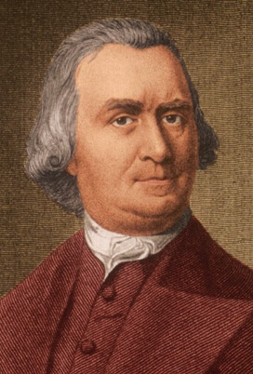
Samuel Adams
Born in Boston, MA
Labeled the most dangerous man in MA by the loyalists
Was in the Boston Tea Party
Rebel in the Revolutionary War
Cousin of John Adams
Why did he get involved in the war?
He wanted freedom from the British
His friends got arrested and evicted from their place of business

Slide 7
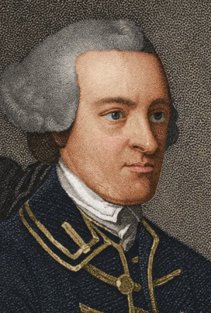
John Hancock
Made a fortune in the sugar trade
Boycotted the British taxes
Smuggled in goods to the colony
Signed the Declaration of Independence
Why did he get involved in the war?
Got involved in the war because he did not want to pay taxes on trade

Slide 8
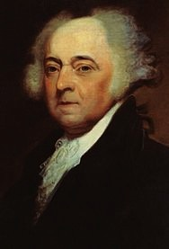
John Adams
Samuel Adams’ cousin
John Hancock’s lawyer
Argued with Parliament about laws/rules/regulations
Eventually becomes 2nd president of the United States of America
Why did he get involved in the war?
Wanted a change in government; laws were unfair

Slide 9
The French & Indian War
This war was mainly between the French and the British
They had been fighting for dominance in Europe for quite some time and this power struggle carried into the Americas
There were previous battles between the two in the years of 1689, 1748, and 1754

Slide 10
The First Encounter
French
English
Both the French and the British became interested in the Ohio River valley
This was geographically important because of access to water
The French had discovered by crossing from Lake Ontario to the Ohio River they could follow the river south to the Mississippi
Benefits: this allowed them to travel from New France to Louisiana easily
The British fur traders entered the region
Land speculators also became interested in the Ohio River valley
They bought empty land hoping to sell it to settlers for a profit
This caused tensions between the British and the French

Slide 11
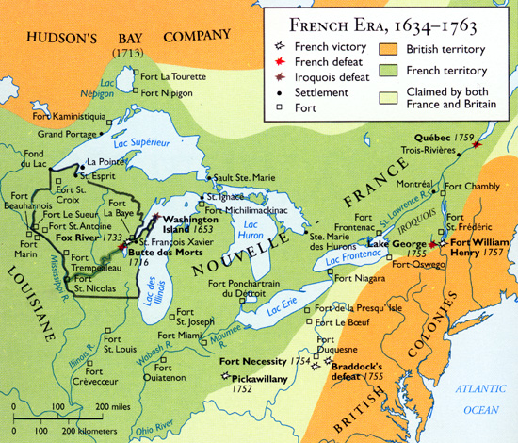

Slide 12
The First Encounter
French
English
New France’s governor ordered a chain of French fort to be built from Lake Ontario to the Ohio River in order to block British claims to that region
Governor: Marquis Duquesne
Governor of Virginia took action at once
He ordered a British fort built in western Pennsylvania
However before the fort was complete, it as seized by the French and built Fort Duquesne on that site
Governor: Robert Dinwiddie

Slide 13
The First Encounter
French
English
The French met Washington’s troops during a small battle near Great Meadows
They fought Washington and made him retreat
The British needed some reinforcement so they turn to George Washington
Washington’s troops marched toward the Ohio River in the spring of 1754

Slide 14
Washington’s Battle Against the French
Washington retreated with his troops and built a stockade named Fort Necessity
Over a month later a large French force arrived and forced Washington to surrender
Washington was later released and returned to Virginia
That was is; the French had gained control over the Ohio River Valley
Washington, however, became a hero to the colonists for his resistance against the French

Slide 15
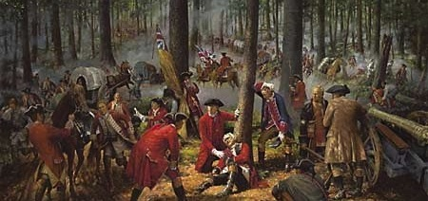
Washington Surrenders Fort Necessity

Slide 16
The Albany Conference
The British government suggested that the colonies negotiate an alliance with the Iroquois Native Americans
The Iroquois controlled western New York which was a territory the French needed to pass through in order to reach the Ohio River
Response: 7 colonies sent representatives to meet with the 150 Iroquois leaders at Albany, New York

Slide 17
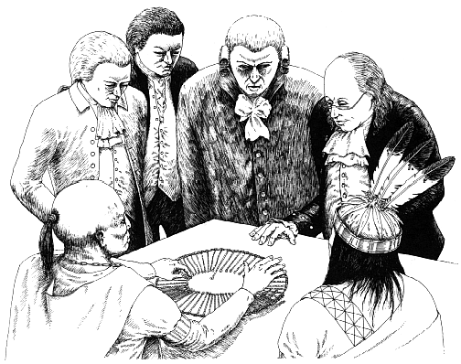
The Albany Conference

Slide 18
The Albany Conference
The Iroquois refused an alliance with the British however they did agree to remain neutral
Albany Plan of Union
  A scheme developed by a committee led by Benjamin Franklin
  It proposed that the colonies unite to form a federal government
  This effort showed that many colonial leaders had begun to think about joining their colonies together for their common defense.
  However the colonies still rejected the Plan of Union

Slide 19
The British Triumph
New British commander in chief, General Edward Braddock, arrived in Virginia with 1,400 troops and he linked up with Washington’s 450 local militia in order to attack Fort Duquesne
Braddock was not at all worried about the Huron Native Americans who were allies of the French

Slide 20
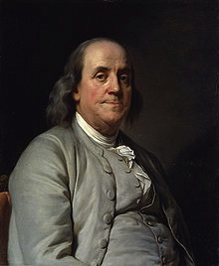
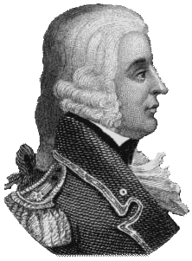
General Edward Braddock
“These savages (Native Americans) may indeed be a formidable enemy to your raw American militia. Upon the King’s regular and disciplined troops, it is impossible they should make any impression”
Benjamin Franklin

Slide 21
But What Happens Next?
French and Native American forces actually did make an impression as they ambushed Braddock’s troops
Braddock was shot and later died
If it wasn’t for Washington’s leadership the rest of Braddock’s inexperienced troops would have suffered a greater defeat, perhaps death.
Washington organized yet another retreat

Slide 22
Unexpected Participants
The Delaware people of western Pennsylvania saw how weakened the British had become
They realized that the British could be beaten
They began attacking the British settlers in their territory

Slide 23
1756
By 1756 the fighting between these two superpowers spilled to Europe, where it was called the Seven Years’ War
The British decided it was best to send troops to North America and India to defeat the French and seize their empire
Britain quickly cut of French supplies to North America
The Iroquois saw that the tides had turned and convinced the Delaware Natives to stop attacking the British
The French saw that they were badly outnumbered

Slide 24
Return to Fort Duquesne
New British General John Forbes sent troops to attack the badly outnumbered French fort
The French realize this, they burn down the fort and retreat before being confronted by the British
The British rebuild the fort and name it Fort Pitt, after the prime minister
Fort Pitt eventually became the city of Pittsburgh

Slide 25
Fatal Meeting / The Path
1759 British fleet commander James Wolfe sailed up the St. Lawrence River to Quebec City
He discovered a path from the river up the steep cliffs that protected the city
Sept. 12, 1759 – the French attacked but they lost their General Louis Joseph Montcalm and the British lost James Wolfe

Slide 26
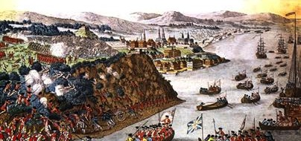
St. Lawrence Rive at Quebec City

Slide 27
Turning Point
The French and British continued fighting in other parts of the world however the victory at Quebec was the turning point
Spain decided to enter the war by aiding the French
This prompts Britain to seize Spain’s colonies in Cuba and the Philippines

Slide 28
Treaty of Paris
This was the treaty ended the war in 1763
It eliminated French power in North America
New France became part of the British Empire as well as Louisiana east of the Mississippi except for New Orleans
Spain wanted to get Cuba and the Philippines back but in order to do this they had to give up Florida to Britain
The French signed a separate treaty giving Spain control of New Orleans and all of Louisiana land west of the Mississippi in order to compensate Spain for its losses

Slide 29
Colonies Grow Discontented
The British government had borrowed a large amount of money to achieve its victory in 1763
It was now deeply in debt
The British, therefore, thought that the colonies must pay a part of the war
The policies Britain adopted a policy to solve its financial problems angered the colonists

Slide 30
The Proclamation Act of 1763
It declared that colonists could not settle west of the line that ran north to south along the Appalachian Mountains without the British government’s permission
Prior to this proclamation, colonists were settling in Native American lands which were declared illegal for colonists.
To not disturb the fur trade between the Natives and to avoid another costly war, the British decided to come up with a better solution to this problem
It, however, angered the colonists nonetheless

Slide 31
Custom Reforms
Newly appointed prime minister and first lord of Treasury, George Grenville was scheming of a way to reduce Britain’s financial debt
He found out that customs agents in America were collecting very little money due to the large smuggling of goods into and out of the colonies without paying the customs duties
Customs Duty – taxes on imports and exports

Slide 32
Customs Reforms
He convinced the English Parliament to pass a law to send these smugglers to a different court (Halifax, Nova Scotia)
The courts there were run by naval officers and had no juries and did not follow British common law
Therefore they violated the right to a jury of peers
Also, moving these smugglers to Nova Scotia violated their right to a speedy trial

Slide 33
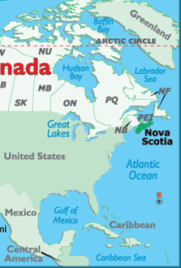
Nova Scotia
Here’s a map that shows how far Nova Scotia is from the colonies

Slide 34
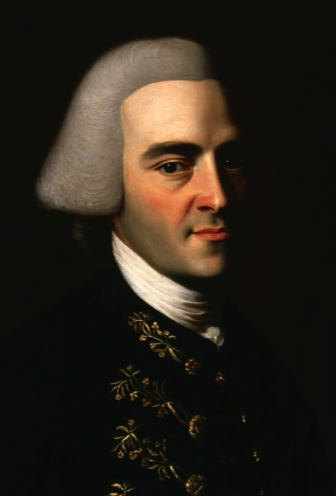
Some People that were Arrested
John Hancock – he had made a fortune in the sugar trade, smuggling molasses from French colonies in the Caribbean
His lawyer was John Adams who argued that the use of the Nova Scotia courts denied colonists their rights as British citizens

Slide 35
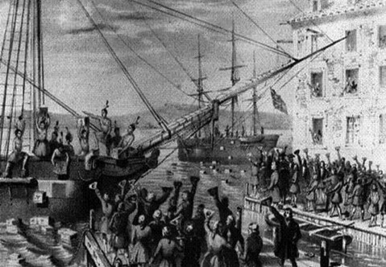
Sugar Act
This was also known as the Revenue Act of 1764
It changed the tax rates on raw sugar & molasses being imported from foreign colonies
It also taxed silk, wine, coffee, pimento, and indigo

Slide 36
Reaction to the Sugar Act
Colonists were angry! So they complained!
Not only were they angry at the tax but the consequence of it too
Anyone caught smuggling were presumed guilty until proven innocent! <~VIOLATION OF RIGHTS!!!
It also allowed British officials to seize goods without due process (proper court procedures) & prevent lawsuits by merchants whose goods had been seized

Slide 37
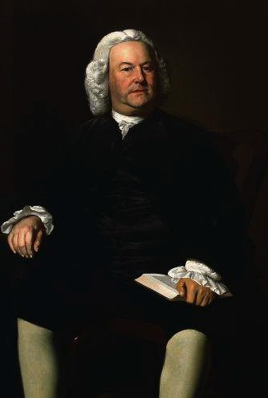
James Otis
He argued that because the colonists had no representatives in Parliament, they could not be taxed for the purpose of raising money
This is where the popular expression, “No taxation without representation” comes from

Slide 38
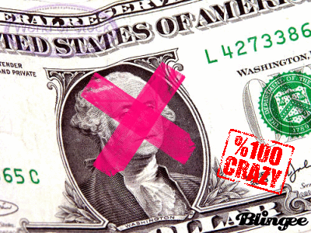
The Currency Act of 1764
In order to slow down inflation (when money loses its value), Parliament passes this new law
It banned the use of paper money in the colonies, because it tended to lose its value very quickly

Slide 39
Reaction to the Currency Act
This, too, angered colonists! Especially farmers & artisans
They liked paper money because it lost its value
They could use paper money to pay back loans
Since the money was not worth as much as when they first borrowed it, these loans were paid back quickly
Wiseguys!

Slide 40
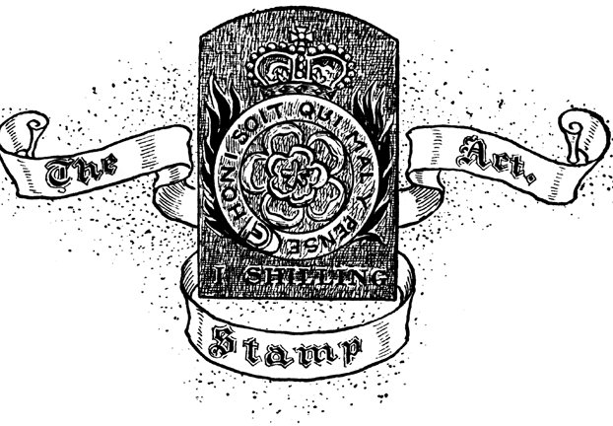
Stamp Act
This required stamps to be placed on most printed materials such as newspapers, pamphlets, posters, wills, mortgages, deeds, licenses, and even diplomas, dice, and play cards
This was different from other taxes because it was directed only towards the colonists and not on the trade between the colonies and others

Slide 41
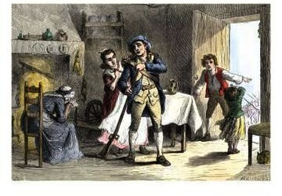
Quartering Act
This forced the colonies to pay more for the defense
If the colonies did not provide barracks for British troops, then the troops could stay in taverns, inns, vacant buildings, barns, and the colonies had to pay their rent!

Slide 42
Reaction to the Stamp Act
Huge debates took place!
Editorials, pamphlets, speeches, and resolutions against the tax swept through the colonies
Virginia: the House of Burgesses passed some resolutions declaring that Virginians were entitled to the rights of British people and could only be taxed by their own representatives
Other colonies did the same thing

Slide 43

Reaction to the Stamp Act
Connecticut: Isaac Sears organizes a group called the Sons of Liberty
They organized outdoor meetings and demonstrations
They intimidated stamp distributors
They even hung an effigy of Boston’s stamp distributor from a tree, pulled his house apart, and burned the wood the house was made from

Slide 44
Stamp Act Congress
9 colonies meet together and issue the Declaration of Rights & Grievances
It argued that only the colonists’ political representatives and not Parliament had he right to tax the colonies

Slide 45
After the Stamp Act was Passed
Colonists ignored the Stamp Act
They began boycotting all British goods and used substitutes instead
In NY, 200 merchants signed a nonimportation agreement which was a pledge to not buy any British goods until Parliament repealed the Stamp Act

Slide 46
Effects of the Boycott
Thousands of workers lost their jobs
British merchants could not collect money
This forced British lawmakers to repeal the act but to show their authority over the colonists they pass another law

Slide 47
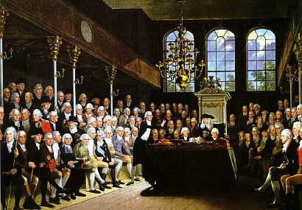
Declaratory Act
This act stated that Parliament had the power to make laws for the colonies

Slide 48
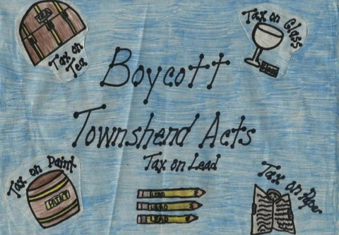
Townshend Acts
This included the Revenue Act of 1767 which put new customs duties on glass, lead, paper, paint, and tea imported into the colonies
Violators were guilty until proven innocent and their goods could be seized without due process

Slide 49
Enforcing the Townshend Acts
The use of writs of assistance was legalized
These were search warrants that enabled customs officers to enter any location to look for evidence of smuggling

Slide 50
Reaction to the Townshend Acts
What do you think?
Essays and pamphlets by John Dickinson were published that reasserted that only assemblies elected by the colonists had the right to tax them
The call for colonies to become “firmly bound together” to “form one body politic” to resist the Townshend Acts

Slide 51
Reaction to the Townshend Acts
The Massachusetts assembly began to organize resistance
Sam Adams was one of the leaders, he was the cousin of John Adams
James Otis also helped out by drafting a “circular letter” to go around to other colonies

Slide 52
Result?
British officials ordered the assembly to withdraw the letter but the assembly refused
This angered the British who then ordered the Massachusetts assembly to dissolve
Boston & NY responded by signing nonimportation agreements

Slide 53
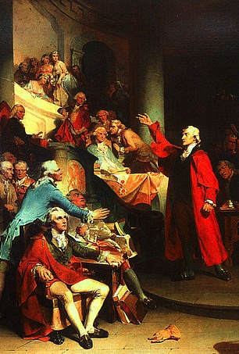
Result?
Virginia’s House of Burgesses passed the Virginia Resolve which stated that only the House had the right to tax Virginians
Britain then orders Virginia’s governor to dissolve the HOB
The leaders of the House (George Washington, Patrick Henry, and Thomas Jefferson) called members to a convention
They also passed nonimportation agreements

Slide 54
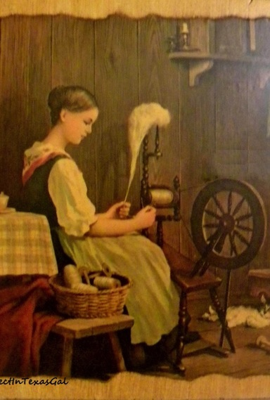
Daughters of Liberty
The nonimportation agreements went to another level when women began spinning their own cloth instead of buying it from the British
Wearing this “homespun” became a sign of patriotism

Slide 55
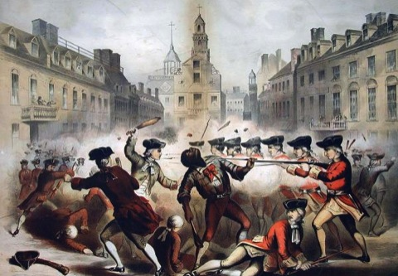
The Boston Massacre
Violence against customs officers in Boston increased so Britain send about 1,000 troops to maintain order
Bostonians called the British troops “lobster backs” because of their red coats
People constantly heckled and harassed the troops
On march 5, 1770 a crowd of colonists start throwing snowballs at a British soldier, he calls for backup

Slide 56
The Boston Massacre
In the midst of it all , the troops began firing into the crowd and according to accounts, the first colonist to die was an African/Native American man known as Michael Johnson/Crispus Attucks
When the smoke cleared, 3 people were dead, 2 died later that day, 6 were wounded
This was the massacre that the newspapers were reporting
This could have set off a revolution but weeks later the British repealed almost all of the Townshend Acts, all except a tax on tea

Slide 57
The Revolution Begins
1772

Slide 58
Massachusetts Defies Britain
The Boston Massacre dealt a blow to the relationship between the colonists and Britain
However for 2 years there remained a time of peace between the two parties
Britain would soon end those peaceful times by introducing new laws and policies to control the colonists

Slide 59
The Gaspee Affair
The Gaspee was a ship which was sent to intercept smugglers off the North American waters
There was a commander on board which was very much hated by the colonists of Rhode Island
He would search ships without a warrant and order troops to seize food without paying for it
In June 1772 colonists boarded the Gaspee and burned it

Slide 60
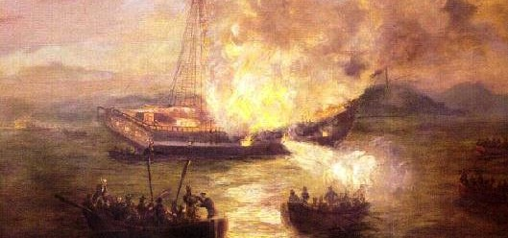
Burning of the Gaspee

Slide 61
The Gaspee Affair
Of course this made Britain very angry so they sent a commission to investigate the incident
It ordered that any suspect be sent to England for trial
This made the colonists very angry because they argued it wasn’t fair since they weren’t going to be tried by their peers
Rhode Island asked for help from its other colonies

Slide 62
The Gaspee Affair
March 1773: Thomas Jefferson suggests each colony create a committee of commission
This committee was to communicate with other colonies about British activities
It also helped unify the colonies against their common opponent at the time

Slide 63
The Boston Tea Party
In May of 1773, England’s new prime minister, Lord North, decides to help the British East India Company which was nearly bankrupt
The EIC had a corrupt management and the wars in India cost the company a lot of money
Because of the taxes on tea, merchants were also smuggling cheaper tea from the Dutch
This resulted in 17 million pounds of tea just sitting in the British warehouses
Parliament passes the Tea Act of 1773

Slide 64
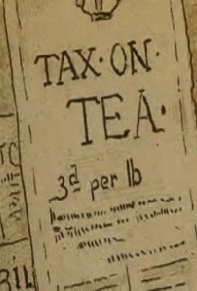
What does this mean?
East India Company tea could now be sold for a cheaper price than smuggled Dutch tea
It also allowed the EIC to sell directly to shopkeepers, bypassing American merchants who normally distributed the tea
This act made the colonial merchants angry because they feared it was the first step by the British to squeeze them out of business

Slide 65
The Boston Tea Party
EIC sent more than 1,253 chests of tea to Boston (and other cities) in October 1773
The committees of commission were informed of this news
They decided that the tea must not be allowed to land
So they devise a plan to prevent this from happening

Slide 66
The Boston Tea Party
The most dramatic showdown occurred on December 1773 when the ships arrived on the Boston harbor
The night before, however, customs officials planned to bring the tea ashore
150 men boarded the ship with several thousand people on shore cheering them on as they dumped 342 chests of tea into the harbor
This became to be known as the Boston Tea Party

Slide 67
The Coercive Acts
Spring of 1774 Parliament passed a series of 4 laws which became to be known as the Coercive Acts
They were intended to punish Massachusetts and end colonial challenges to British authority

Slide 68
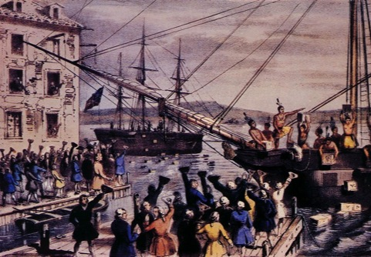
Coercive Acts
1st Act
  Shut down Boston’s port until the city paid for the tea that had been destroyed.

Slide 69
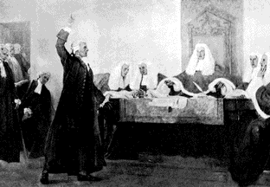
Coercive Acts
2nd Act
Required all council members, judges, and sheriffs in Massachusetts to be appointed by the governor instead of being elected
It also banned most town meetings

Slide 70
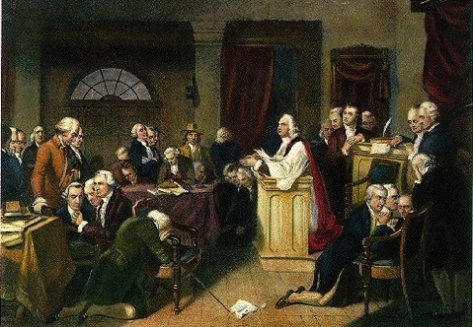
Coercive Acts
3rd Act
Allowed the governor to transfer trials of British soldiers and officials to England to protect them from American juries

Slide 71
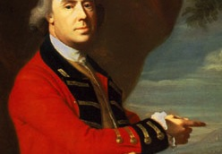
Coercive Acts
4th Act
Required local officials to provide lodging for British soldiers at the scene of a disturbance (in private homes if necessary)
To enforce these acts the British moved 2,000 troops to New England and appointed General Thomas Gage as the new governor of Massachusetts

Slide 72
British Violations
These acts violated many British rights which the colonists were entitled to:
  The right to trial by a jury of one’s peers
  The right not to have troops quartered in one’s home
The King was also not supposed to maintain a standing army in peacetime without the consent of Parliament

Slide 73
Quebec Act
A month after the last Coercive Act became law, the British introduced the Quebec Act
It had nothing to do with the events in the American colonies
It stated that the government and council appointed by the king would run Quebec
It gave more territory to Quebec including much of today’s Ohio, Illinois, Michigan, Indiana, and Wisconsin
If colonists moved west they would have to live in territory where they had no elected assembly
Intolerable Acts: The Coercive & Quebec Act

Slide 74
First Continental Congress
May 1774 The Virginia House of Burgesses called for a day of fasting and prayer to protest the arrival of British troops in Boston
Patrick Henry
“I know not what course others may take, but as for me, give me liberty or give me death”

Slide 75
First Continental Congress
After the House of Burgesses was dissolved by the Virginian governor, they went to a nearby tavern to come up with a resolution
They urged colonies to suspend trade with Britain and to send delegates to a colonial congress
In New York and Rhode Island, similar calls for a congress had already been made

Slide 76
First Continental Congress
September 5, 1774 the First Continental Congress met in Philadelphia
55 delegates represented 12 of Britain’s North American colonies
Florida, Georgia, Nova Scotia, and Quebec did not attend however

Slide 77
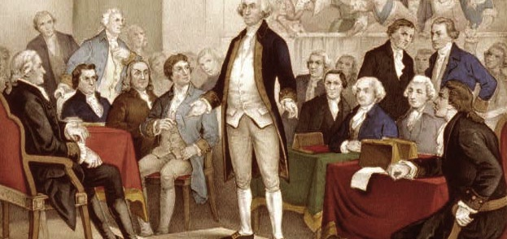
First Continental Congress

Slide 78
First Continental Congress
There were many proposals at this meeting
Some argued that a compromise was possible
Others were more radical and believed that time had come to fight

Slide 79
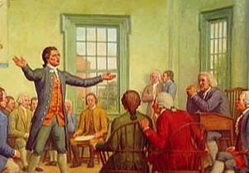
Decision
Joseph Galloway, a moderate, proposed a federal government for the colonies similar to the one outlined in the Albany Plan of Union
Radicals argued that this plan would not protect the Americans, so the colonies voted to put it off

Slide 80
Aftermath
The British had suspended the Massachusetts assembly
When the Congress found out about this, they responded with the Declaration of Rights and Grievances
  It expressed loyalty to the king but condemned the Coercive Acts
  It also announced that the colonies were forming a nonimportation association
Days later the delegates approved the Continental Association
  A plan for every county and town to form committees to enforce a boycott of British goods

Slide 81
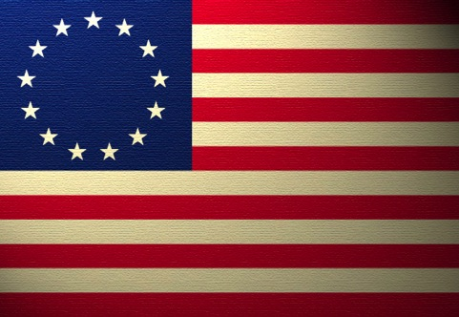
The Revolution Begins

Slide 82
The Revolution Begins
In October of 1774 the Massachusetts assembly defied General Gage and organized the Massachusetts Provincial Congress
They formed the Committee of Safety and chose John Hancock as their rival governor to General Gage
They also gave Hancock the power to call up the militia

Slide 83
The Revolution Begins
The rebellion was underway
Militias began military drills and shooting practice with men who were trained to “stand at a minute’s warning in case of alarm”
They were called minutemen
Throughout the summer and fall of 1774, British control weakened as colonists created these provincial congresses and militias raiding military depots

Slide 84
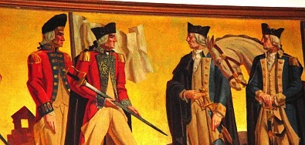
Loyalists vs Patriots

Slide 85
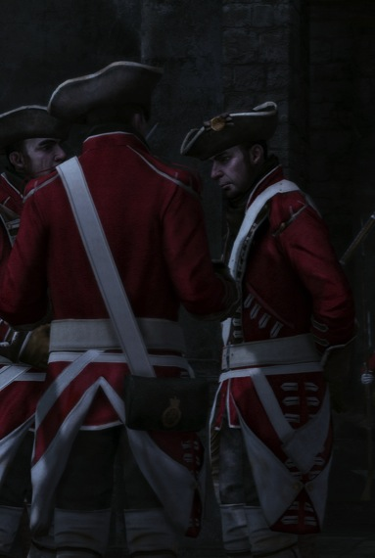
Loyalists
Loyalists (Tories)
  Were Americans who backed Britain and felt a strong sense of loyalty towards the king
They were government officials or Anglican ministers, prominent merchants and landowners, some backcountry famers
Most of them lived in Georgia, the Carolinas, and New York

Slide 86
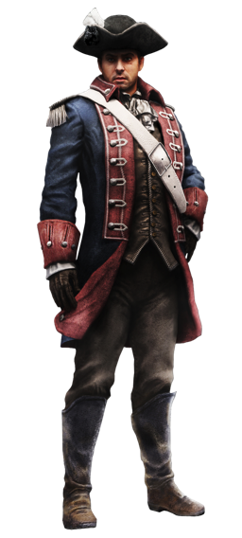
Loyalists vs Patriots
Patriots (Whigs)
  Those who believed the British had become tyrants
They were artisans, famers, merchants, planters, lawyers, and urban workers
They were strong in NE and Virginia

Slide 87
Loyalists vs Patriots
The American Revolution was much more than what people expected
It divided communities and even split families
It eventually became a civil war between Patriots and Loyalists
Caught between the two were many Americans who did not favor either side and would support whomever won

Slide 88
Lexington & Concord
April 1755: General Gage was ordered to arrest the Massachusetts Provincial Congress
General Gage didn’t know where the Congress was located so he decided to capture the military’s supply at Concord
April 18, 1755: about 700 British troops march towards Concord on a road that took them past the town of Lexington

Slide 89
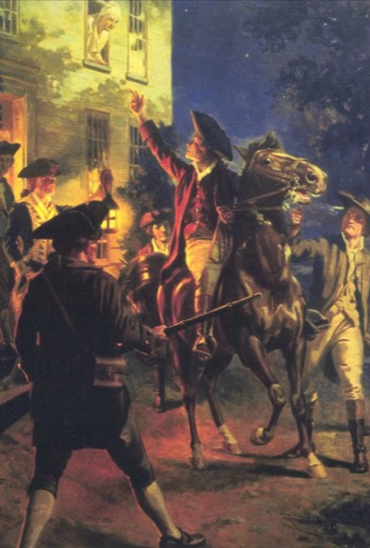
Lexington & Concord
Paul Revere & William Dawes (of the Patriots) were sent to spread the news of the British troops’ arrival
Paul Revere reached Lexington by midnight and warned the people there that the British were coming
A 3rd man, Dr. Samuel Prescott, joined them and set out for Concord
Unfortunately they were stopped by a British patrol but Prescott got through just in time to warn Concord

Slide 90
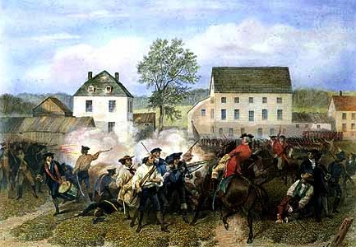
Lexington & Concord
April 19, 1775: the British troops arrived in Lexington and were met with some 70 minutemen
The British ordered the minutemen to disperse and the minutemen slowly began to back away
Then a shot was fired…
Already nervous, the British fired at the minutemen killing 8 and wounding 10

Slide 91
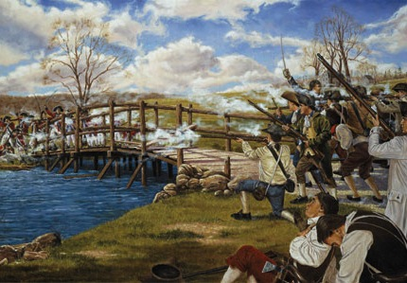
Lexington & Concord
The British leave Lexington and go to Concord
They notice that most of the military supplies had been removed
Then they head for the North Bridge on the far side of town but were met with some 400 colonial militia
A fight broke out and the British were forced to retreat

Slide 92
Lexington & Concord
The British felt that they needed to return to Boston
However on their way back farmers and militia fired at them from behind trees, stone walls, barns, and houses
By this time they lost 99 men and another 174 of them were wounded
The colonial militia lost 49 and another 46 were wounded
1775: news had spread and the militia troops had surrounded Boston trapping the British inside

Slide 93
The War for Independence
The American Revolution

Slide 94
The Opposing Sides
Valley Forge brought a lot of uncertainty for the patriots
They did not know if they were strong enough to defeat the British
On the same day that the Continental Congress voted for independence, the British landed troops in New York
  Some 32,000 men were reported to have landed

Slide 95
The Opposing Sides
British
Patriots
Were also called “redcoats” because of their uniform
Were disciplined, well trained, and well equipped
They were the Continental Army
Were inexperienced and poorly equipped
  Many of them were not paid their wages
  Many returned back home or did not reenlist once their term was up

Slide 96
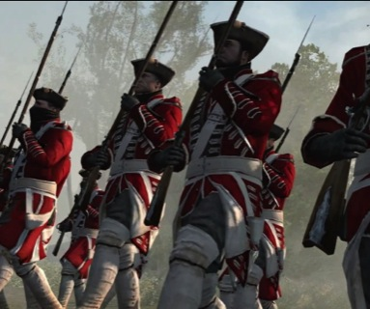
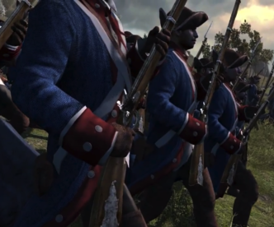
The Opposing Sides
British – Redcoats
Patriots – Bluecoats

Slide 97
Robert Morris
It was very difficult to raise money for the war since the Continental Congress could not tax its people
Therefore they issued paperback currency called “Continentals” however these paperbacks were not backed by gold or silver so became worthless very quickly
Robert Morris (wealthy Pennsylvania banker) pledged a large amount of his own money for the war
He was also able to obtain loans from foreign nations as well as convinced the Congress to create the Bank of North America

Slide 98
The Opposing Sides
The British had to fight the Continental Army on one side as well as local militia
The local militia were poorly trained but had their own fighting tactics
Guerilla Warfare – hiding behind trees or walls and ambushing your opponent
This kind of fighting can be very useful and difficult to defeat

Slide 99
The Opposing Sides
Colonial Advantage | British Advantage
Colonial Disadvantage | British Disadvantage

Slide 100
Questions to Answer
Using your chart answer the following questions
  Why was fighting for their rights and freedoms an advantage for the colonists?
  What is the biggest advantage the colonists have over the British?
  What is the biggest advantage the British have over the colonists?

Slide 101
Northwest Passage
The British knew they had to end the war as fast as possible since they had other problems on the European continent
They also wanted to make it safe for the Americans to surrender

Slide 102
The Two Part Solution
General William Howe’s strategy had a two part solution:
1st Part: Military
  He began a massive buildup in New York hoping to intimidate the Americans and capture New York City
  This would separate New England from the Southern colonies to show the Americans they could not win
2nd Part: Diplomatic
  He invited delegates from the Continental Congress to a peace conference
  Franklin, Adams, and Rutledge attended the meeting
  They realized Howe wanted to trick them into surrendering so they refused to talk further

Slide 103
Opening Moves
The Continental Congress realized that they had to put up a fight for New York City otherwise if it fell to the British then the American morale would be destroyed
General George Washington agrees to move most of his militia to Long Island and Manhattan Island
The inexperience of his men became very noticeable when many of them fled while 1,500 of them became casualties
The survivors of Washington’s army moved to Manhattan Island join the remainder of the troops

Slide 104
Opening Moves
The British were very slow in their movement towards the Americans
This left the Patriots with a lot of time to continue relocating and gaining some strength
Washington and his men were able to make it to the northern end of Manhattan while the British captured the New York and used it as their headquarters for the rest of the war

Slide 105
Crossing the Delaware
Washington had to retreat a number of times to save his army from complete defeat
At the Battle of White Plains in October 1776 Washington and his troops retreated again
Washington was caught off guard thinking that the British were coming after his Continental Army
Instead the British headed towards Philadelphia where the Continental Congress was meeting
Washington had to move fast to get there before the British

Slide 106
Crossing the Delaware
While all of this was happening, Thomas Paine wrote another pamphlet to help boost the morale within Americans
It was called The American Crisis
He reminded Americans that “the harder the conflict, the more glorious the triumph”

Slide 107
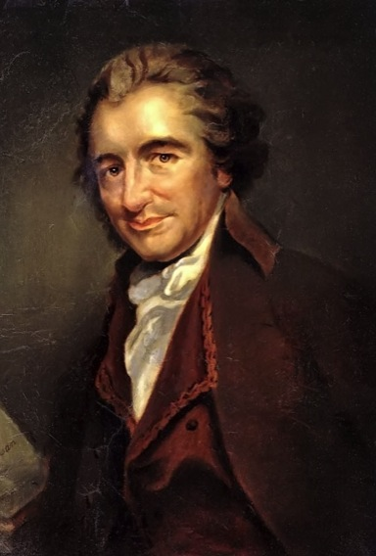
The American Crisis
“These are the times that try men’s souls. The summer soldier and the sunshine patriot will in this crisis shrink from the service of their country; but he that stands it now deserves the love and thanks of man and woman”

Slide 108
Crossing the Delaware
Winter had come by the time Washington reached Pennsylvania
The British stopped their advancement and scattered in New Jersey
In the 1700s armies did not fight because of the weather conditions and the availability of food supplies

Slide 109
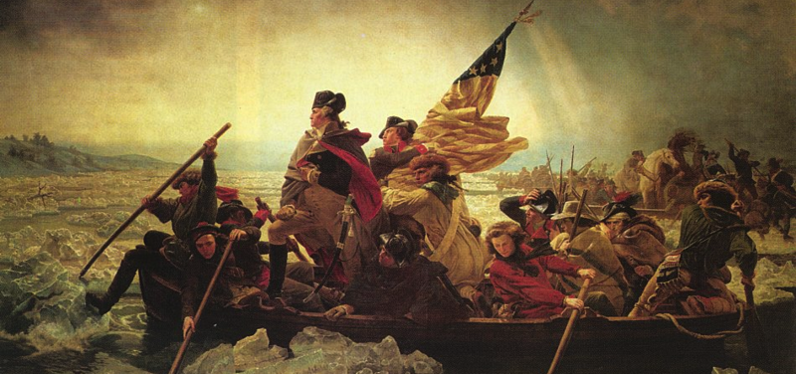
Crossing the Delaware

Slide 110
Crossing the Delaware
Washington did the most daring thing any man could do at that time: he planned a winter attack!
December 25, 1776 was the day Washington led nearly 2,400 men across the Delaware River
The men attacked a group of Hessians at Trenton in the middle of a sleet storm
They killed or captured almost 1,000 men and several days later in Princeton, Washington’s men scattered three British regiments
He was able to achieve two small victories and then he headed into the hills of northern New Jersey for the winter

Slide 111
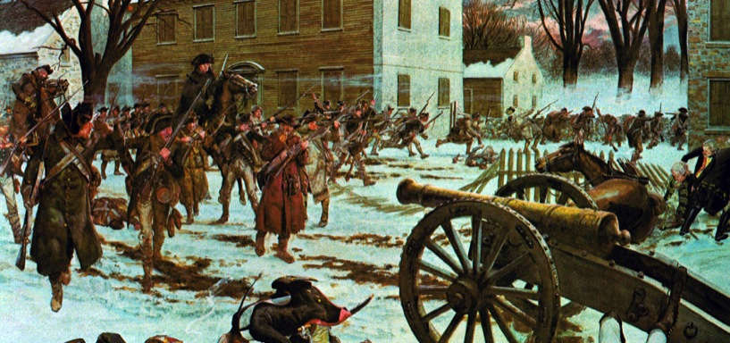
Battle of Trenton

Slide 112
Philadelphia Falls
March of 1777 King George III approved a plan to isolate New England from the other colonies
General John Burgoyne proposed a three-pronged attack

Slide 113
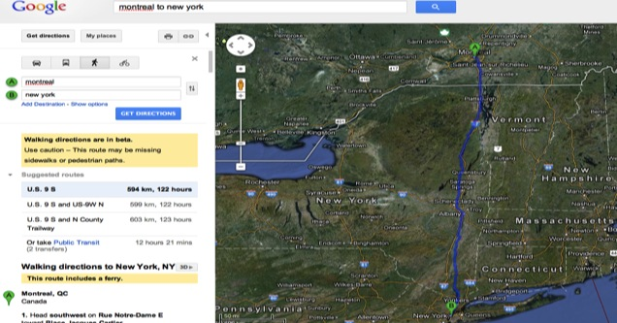
1st Attack
Take a large group of soldiers from Montreal to New York

Slide 114
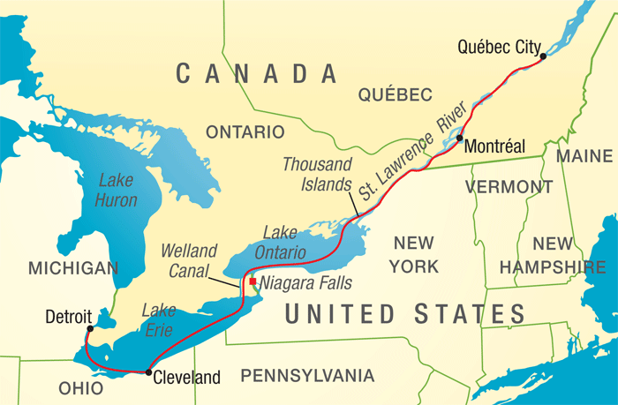
2nd Attack
Another force would move from Montreal up the St. Lawrence River to Lake Ontario then head east into New York

Slide 115
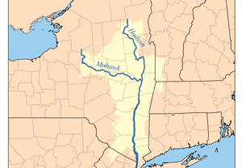
3rd Attack
This force would be led by General William Howe and would march north from New York City up the Hudson River valley

Slide 116
Things Don’t Go As Planned
Unfortunately for the British, their plan fell apart
General Howe made his own plans when he loaded about 13,000 men onto ships and moved them to Maryland
From there he wanted to attack Philadelphia from the south
He believed that by capturing Philadelphia and the Continental Congress, the Revolution would be crippled

Slide 117
Philadelphia Falls
On September 11, 1777 General Howe defeated Washington at the Battle of Brandywine Creek and captured Philadelphia
Although he captured Philly, he wasn’t able to get the Continental Congress
He failed to destroy the Continental Army ~> who took up winter quarters at Valley Forge

Slide 118
Good News/Bad News
Because of the bitter cold, nearly 2,500 of Washington’s men died
Fortunately for him he was able to gain some training services for the remainder of his men from two European military officers:
  Marquis de Lafayette of France
  Baron Friedrich von Steuben of Prussia
They helped Washington improve discipline and boost morale among his troops

Slide 119
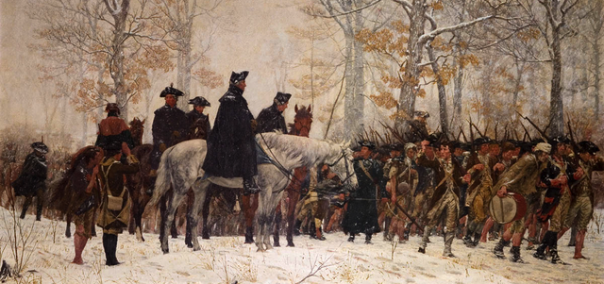
March at Valley Forge

Slide 120
The Turning Point
British General Burgoyne did not know that General Howe had made a detour
In June 1777 he and his troops of 8,000 marched south from Quebec
Along the way he picked up a group of allies - Iroquois Native Americans

Slide 121
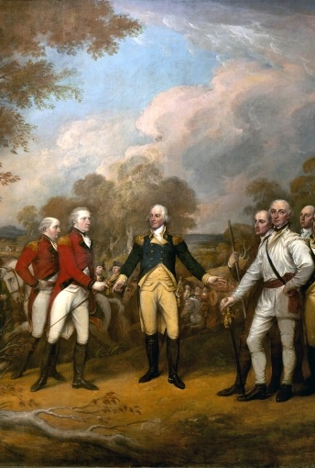
The Turning Point
The British and Iroquois who were marching from Quebec were ambushed by militia with the leadership of General Benedict Arnold
Burgoyne’s men could not drive off the militia
With his supplies dwindling he surrendered at Saratoga, New York

Slide 122
The Turning Point
This surrender helped improve American morale in the war and also convinced the French to enter the War
The French decide to send troops to help the American cause
France and Spain had been secretly sending supplies to the colonists

Slide 123
France Enters the War
Although the US was appreciative of the aid they received from France, they also wanted troops
Congress sent Benjamin Franklin, Arthur Lee, and Silas Deane to France to ask for more troops
The French decline at first because they felt the risk was too high unless they saw that the Americans could win
The Battle of Saratoga was the turning point and the convincing the French needed

Slide 124
France Enters the War
February 6, 1778 the US signed its first two treaties
1st Treaty: France became the first country to recognize the US as an independent nation
2nd Treaty: was an alliance between the US and France
Spain also joined the war but only as an ally of France and not the US

Slide 125
Other Wars
The Revolutionary War wasn’t only fought in the east; it was also fought:
  In the West
  At Sea
  In the South

Slide 126
War in the West
1778: Patriot George Rogers Clark captured several town down the Ohio River Valley
February 1779: the British had surrendered that region
July 1778: British & Iroquois troops stormed western Pennsylvania burning the towns they encountered
Summer 1779: Americans defeated the British/Iroquois in western New York

Slide 127
War at Sea
Americans attacked British merchant ships and to disrupt trade Congress issued letters of marque (licenses) to private ships to attack British merchant ships
By the end of the war, millions of dollars of cargo had been seized from the British by the Americans

Slide 128
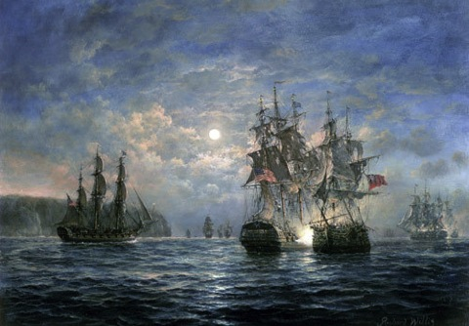
Famous Naval Battle
American naval officer John Paul Jones
He was actually sailing near Britain where he encountered British ships and began attacking them
He sank one but wasn’t strong enough for the other bigger ship
When told to surrender, his reply was “I have not yet begun to fight”
He eventually made the British surrender

Slide 129
Southern Campaign
The British felt they should advance in the south because there were more Loyalists there
There was also a big supply of rice and tobacco, two very valuable resources

Slide 130
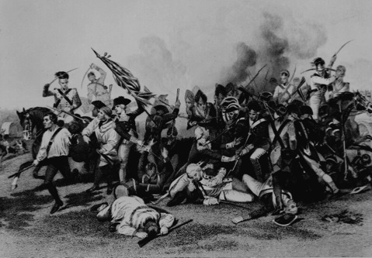
Fall of Savannah
December 1778: 3,500 British troops seized and captured Savannah, Georgia
They seized Georgia’s backcountry
They also returned the British royal governor to power

Slide 131
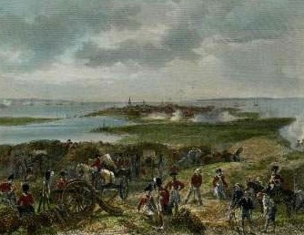
Fall of Charles Town
After the fall of Savannah, the British marched towards South Carolina
14,000 British troops surrounded American forces
May 12, 1780: the Americans surrendered
This was the greatest American defeat in the war
5,500 American troops were take as prisoners of war

Slide 132
Patriots Rally
At first everything went well for the British in the south
Many settlers were Loyalists so they fought for Britain
However one of the British officers took it too far when he decided to capture the region of the Appalachian Mountains
The people there were so angry with him that they put together their own militia and attacked

Slide 133
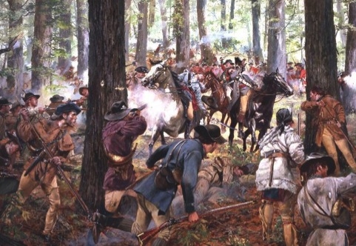
The Battle of Kings Mountain
This battle was the turning point in the south for the Americans

Slide 134
The War is Won!
Spring of 1781, British general Cornwallis decides to invade Virginia
He believed that as long as Americans controlled Virginia new troops and supplies could keep coming south
More French troops were coming to America so the British knew they had very little time left to win the war

Slide 135
Battle of Yorktown
Late April of 1781 Cornwallis marched into Virginia and linked up with former American general Benedict Arnold
B. Arnold was an American commander early in the war but decided to sell military information to the British
After his treason was discovered, he ran away to the British-controlled New York City and was given command of the British troops

Slide 136
Battle of Yorktown
As they began their conquest of Virginia, they met very little resistance from Americans
However in June 1781 they encountered an American force led by General Anthony Wayne
Realizing he was outnumbered, Cornwallis and his troops retreated back but were caught by Americans and the French

Slide 137
Battle of Yorktown
The Americans had a lot of help from the French with nearly 6,000 men arriving in New York City
Washington decided to march to NYC
French general Rochambeau learned that a fleet commander, Admiral Francois de Grasse, commanded a fleet to sail north from the Caribbean
Washington learned of this and decided to redirect his forces to Yorktown instead, to help the Virginians

Slide 138
Battle of Yorktown
Washington and Rochambeau led their troops to Yorktown
Admiral de Grasse moves towards Chesapeake Bay near Yorktown
Cornwallis was now trapped because he could not escape by sea or receive any supplies

Slide 139
Battle of Yorktown
September 28, 1781, American and French forces surrounded Yorktown and began bombarding
October 14, 1781, Alexander Hamilton (Washington’s aid) led an attack that captured key British defenses
October 17, 1781, Cornwallis began negotiations to surrender
October 19, 1781, nearly 8,000 British troops marched out of Yorktown and surrendered

Slide 140

Battle of Yorktown
During the surrender the British military band played “The World Turn’d Upside Down”

Slide 141
Treaty of Paris of 1783
It was signed on September 3, 1783
What did it mean?
  The British recognized the United States of America as a new nation with the Mississippi River as its western border
  Britain also gave Florida back to Spain
  France received colonies in Africa and the Caribbean that the British had seized from them in 1763
  November 24, 1783, the last British troops left NYC

Slide 142

Treaty of Paris of 1783

Slide 143
Homework
Section 3 Assessment Questions page 145 (#1-5)

Slide 144
The War Changes American Society
The American Revolution

Slide 145
New Political Ideas
By declaring independence, the political leaders at the time knew they were creating something new
They wanted to establish a republic – a form of government where power resides with a body of citizens entitled to vote
Americans believed that a republican society could be better than other societies; unlike the ones in Europe

Slide 146
New Political Ideas
An ideal republic:
  All citizens are equal under the law, regardless of their wealth or social class
  The government derives its authority from the people
This conflicted with traditional ideas about slavery, idea about women voting or owning property, and idea that wealthy people were “better” than others

Slide 147
New State Constitutions
Each state’s constitution should be written down and should limit the government’s power over the people
The War and the republic ideas convinced people that the best form of government is a constitutional republic
John Adams actually worried that a democracy could hurt a republic government

Slide 148
John Adams’ Proposals
John Adams proposed:
  that government needed “checks and balances” to prevent any group in society from becoming strong enough to take away the rights of the minority
  Executive, Judicial, Legislative branches should all be separate
  Legislature should have 2 houses:
    Senate: to represent people of property
    Assembly: to protect the rights of the common people

Slide 149
Virginia’s Constitution
Virginia borrowed Adams’ ideas of a proper constitution and incorporated them into their own
Virginia’s Declaration of Rights guaranteed all Virginians:
  Freedom of speech
  Freedom of religion
  Right to bear arms
  Right to trial by jury
  State could not take away property without proper court proceedings
  State could not search someone’s home without a warrant

Slide 150
Voting Rights Expanded
The experience of fighting side by side with people of different social classes increased people’s belief in equality, mostly for white men though
Everyone fought for the same cause; if everyone was equal, they all had the right to vote
The War showed many lower class people that they were equal to the upper class

Slide 151
Voting Rights Expanded
In almost every state, the new constitutions made it easier to gain the right to vote, for nearly everyone
Although a person still needed to own some land in order to vote, it was still much less than before the Revolution
These new rights saw an increase in voting demographics within the lower class

Slide 152
Freedom of Religion
Many of the Revolutionary leaders opposed “ecclesiastical tyranny” – the power of a church, backed by the government, to make people worship in a certain way
After the War, it was more common for governments to not aid churches
This idea came from Virginia where the Baptists led a movement to abolish tax collection to support the Anglican Church

Slide 153
Freedom of Religion
1786 Thomas Jefferson pushed the legislature to pass the Virginia Statute of Religious Freedom:
  Declared that Virginia no longer had an official church and that the state could not collect taxes for churches

Slide 154

Thomas Jefferson
  “Our civil rights have no dependence on our religious opinions, any more than our opinions in physics or geometry; . . . therefore . . . Proscribing any citizen as unworthy the public confidence . . . unless he profess or renounce this or that religious opinion, is depriving him injuriously of those privileges and advantages to which in common with his fellow citizens he has a natural right”

Slide 155
Women at War
Women played an important role during the Revolutionary War
They contributed both at home and the battlefront
They took over running the family farm
Others traveled with the army – cooking, washing, and nursing the wounded
Surprisingly they also served spies and couriers

Slide 156

Mary Ludwig Hays
She was known as Molly Pitcher
She carried water to Patriot gunners during the Battle of Monmouth

Slide 157

Margaret Corbin
Accompanied her husband to battle
After his death she took his place at his cannon and held the position until the battle ended

Slide 158

Judith Sargent Murray
In 1779 she wrote an essay entitled “On the Equality of the Sexes”
She argued that women were as intelligent as men but lacked education
After the War many schools for girls were founded and the number of literate women increased

Slide 159

African Americans
Many African Americans fought during the War and many gained their freedom afterwards
During the War, the British wanted to hurt the Southern economy by freeing thousands of slaves
They took the slaves and shipped them to British colonies in the Caribbean

Slide 160
African Americans
Many planters offered their slaves freedom if they fought against the British
Washington permitted African Americans to join the Continental Army instead of the joining the British
He urged states to admit African Americans into the militia and also offer freedom for those who served
Nearly 5,000 African Americans fought for the cause

Slide 161
African Americans
As African Americans began to gain their freedom after the War, American leaders realized that slavery no longer fit in well with their new idea of liberty and equality
Opposition to slavery began to grow especially in the northern and middle colonies
Emancipation – freedom from slavery

Slide 162
African Americans
Vermont banned slavery in 1777
In 1780, Pennsylvania freed all children born enslaved when they reached age 28
In 1784, Rhode Island decreed that enslaved men born thereafter would be free when they turned 21 and women when they turned 18
1799 New York freed enslaved men born that year or later when they reached age 28, women 25

Slide 163
Trouble Continues for African Americans
They still faced discrimination after the War and after gaining their freedom
Many of them were skilled and whites did not want blacks taking their jobs
  They had to take jobs such as sweeping, digging, or carrying loads
They were also restricted from voting, faced segregation, and possible kidnapping and transportation to the south where they could be enslaved again

Slide 164
African Americans
They began building their own distinct culture
Religion was a strong element of their culture
They created their own style of worship and formed their first denomination
African Methodist Episcopal (AME) Church

Slide 165
African Americans in the South
Southerners showed little interest in abolishing slavery
Only Virginia took steps toward ending slavery
1782, Virginia passed a law encouraging manumission – the voluntary freeing of enslaved persons, especially for those who had fought in the Revolution
About 10,000 slaves obtained their freedom this way

Slide 166
Homework
Assessment Questions #1-4, #6 (Page 152)
Finish Study Guide for Test
Study for Chapter 4 – Section 3 & 4 Test

