Slide 1
Creating a Constitution
1781-1789

Slide 2
The Confederation
November 1777 the Continental Congress adopted the Articles of Confederation and Perpetual Union
  This was a plan for a loose union of the states under the authority of the Congress

Slide 3
Articles of Confederation
They established a very weak central government
Under these articles, once a year each state would select a delegation to send to the capital city
This group was referred to as the Confederation Congress and was the entire government
There were no separate executive and judicial branches
It had the right to declare war, raise armies, and sign treaties but was not able to impose taxes and it was denied the power to regulate trade

Slide 4
Western Policies
The only way for the Confederation Congress to raise money to pay its debts and finance its operations was to sell the land it controlled west of the Appalachian Mountains
Land Ordinance of 1785 – established a method for surveying the western lands and arranged the land into townships six miles square; each township was divided into 36 sections, one mile square

Slide 5
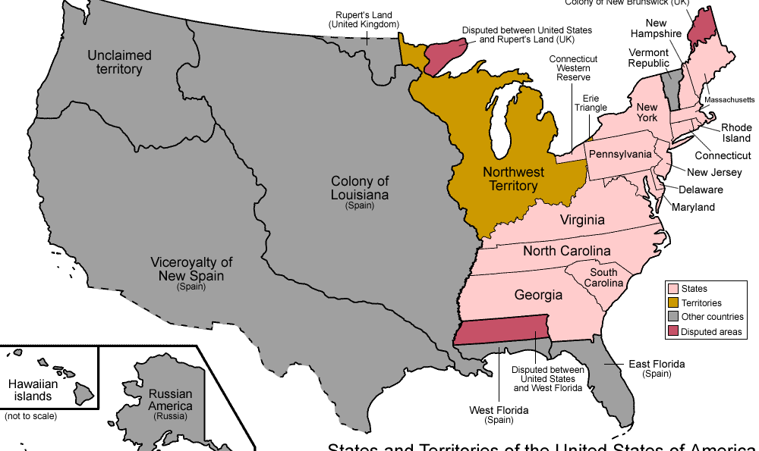
Northwest Ordinance

Slide 6
Northwest Ordinance
Was passed in 1787 and it provided the basis for governing much of the western territory
It created a new territory north of the Ohio River and east of the Mississippi
5,000 adult male citizens meant that they could elect a territorial legislature
60,000 people meant that the territory could apply to become a state “on an equal footing with original states”

Slide 7
Northwest Ordinance
It guaranteed certain rights for individuals
  Freedom of religion
  Property rights
  Right to trial by jury
“There would be neither slavery nor involuntary servitude in the said territory”

Slide 8
Problems With Diplomacy
Before the Revolutionary War many merchants and planters had borrowed money from British lenders
In the peace treaty the US had agreed that the states should allow these lenders to recover their prewar debts by suing in American courts
The problem was that Congress could not force the state to do this and many states restricted Britain’s ability to collect its debts
US also agreed to return the property that had been confiscated from Loyalists during the war

Slide 9
Diplomacy Problems
The British refused to evacuate from American soil as specified in the treaty because they wanted their debts to be paid
They occupied some frontier posts south of the Great Lakes
Congress could not solve these problems easily, it could not impose taxes so it could not raise money to pay for any debts

Slide 10
Diplomacy Problems
Dealing with Spain also showed the weakness of the Confederation Congress
There was a major dispute with Spain which involved the border between Spanish territory and the state of Georgia
The Spanish stopped Americans from depositing their goods on the Spanish territory at the mouth of the Mississippi River
This closed the river to American farmers who used it to ship their goods to market

Slide 11
Diplomacy Problems
The Congress had no power to pressure the Spanish and their dispute remained unsolved
The limited powers of the Congress had prevented any diplomatic solution from being worked out

Slide 12
Economic Crisis
The end of the War and any economic activity with Britain brought the US into a recession – economic slowdown
Farmers were most effected because they had to keep borrowing to get tier next crop in the ground and also made less money as they once did
The War left Congress and the states in debt
To pay for the war many states had issued bonds as a way to borrow money from wealthy merchants and planters

Slide 13
Economic Crisis
Pay off the debts, states could raise taxes but people in debt urged the state governments to issue paper money instead
Paper money would not be backed by gold or silver and people did not trust it; this would cause inflation
But debtors would be able to pay their debts using this paper money that was worth less than the value printed on it
It would allow them to pay off their debts more easily
Lenders would definitely opposed this because they would not be receiving the true amount they were owed

Slide 14
Economic Crisis
By 1785, seven states began issuing paper money
Paper money in Rhode Island became so worthless that merchants refused to accept it in payment for debts
After merchants were attacked by an angry mob, the state’s assembly passed a law forcing people to accept paper money as its states value

Slide 15
Shays’ Rebellion
It erupted in Massachusetts in 1786
It all started when the government of Massachusetts decided to raise taxes instead of issuing paper money to pay off its debts
Taxes fell most heavily on farmers, especially the poor ones in the western part of the state
Many found it impossible to pay their taxes as well as their mortgages and other debts
Those who could not pay faced the loss of their farms

Slide 16
Shays’ Rebellion
August 1786, angry farmers rebelled
They closed down several county courthouses to prevent farm foreclosures, and marched to the supreme court
Daniel Shays – former captain in the Continental Army and was now a bankrupt farmer; he emerged as one of the rebellion’s leaders

Slide 17
Shays’ Rebellion
January 1787, Shays and about 1,200 farmers headed to a state arsenal intending to seize weapons before marching to Boston
The governance sent more than 4,000 volunteers to defend the arsenal under the command of Benjamin Lincoln
Shays attacked before they arrived and the militia defending the arsenal opened fire
Four farmers died in the fight, the rest scattered

Slide 18
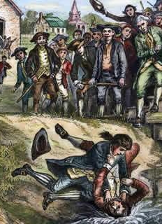
Shays’ Rebellion
The next day Lincoln’s troops arrived and ended the rebellion
The fears the rebellion caused were harder to disperse

Slide 19
Call for Change
People saw that the republic itself was at risk
They feared that as state legislatures became more democratic and responsive to poor people, they would weaken property rights and vote to take property from the wealthy
The concerns were an important reason why many people began to argue for a stronger central government
Congress called on states to correct “such defects as may be discovered to exist” in the present government

Slide 20
A New Constitution
The Constitutional Convention

Slide 21
The Convention
Nationalists – people who supported a stronger central government
They included: George Washington, John Adams, Benjamin Franklin, Alexander Hamilton, and Robert Morris
The weakness of the Confederation Congress worried many leaders who believed the nation would not survive without a strong central government

Slide 22
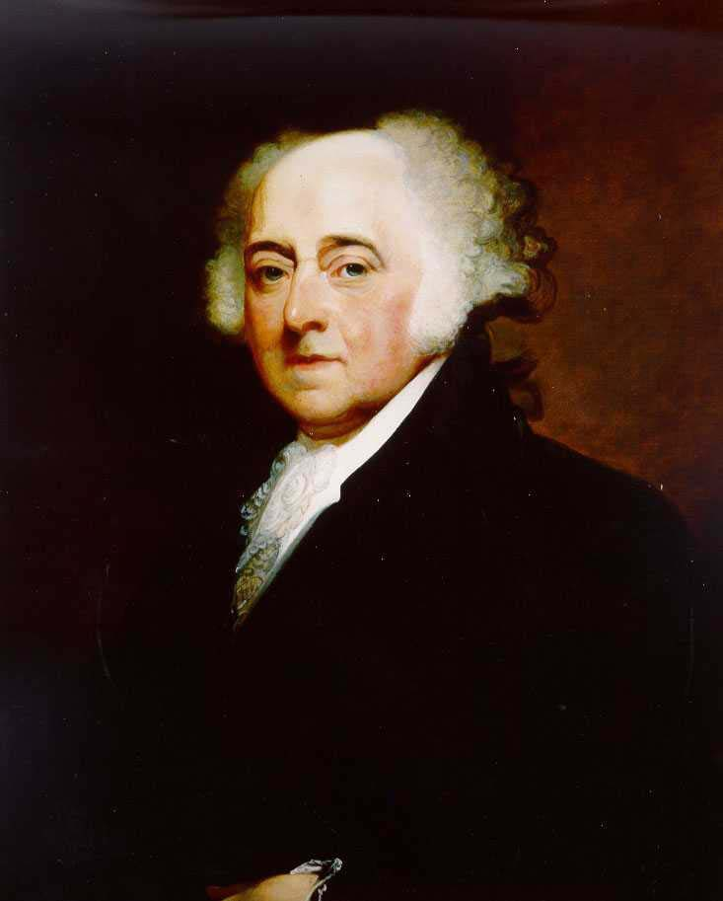
James Madison
One of the most influential nationalists and was a member of the Virginia Assembly and head of its commerce committee
He was well aware of Virginia’s trade problems with other states and Britain
He believed that a stronger national government was needed

Slide 23
James Madison
1786: Madison convinced Virginia’s assembly to call a convention of all the states to discuss trade and taxation problems
At this convention many of the delegates discussed the weakness of the Articles of Confederation and expressed interest in modifying them

Slide 24
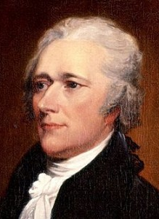
Alexander Hamilton
Was a New York delegate who recommended that the Congress itself call for another convention to be held in Philadelphia
Every states except Rhode Island sent delegates to what became known as the Constitutional Convention

Slide 25
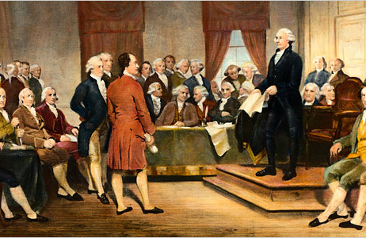
The Founders

Slide 26
The Founders
The 55 delegates who attended the convention in Philadelphia included some distinguished leaders in the US
Majority were lawyers and more of the other were planters and merchants
Most had experience in colonial, state, or national government while 7of them had served as state governors
39 had been members of the Confederation Congress while 8 had signed the Declaration of Independence

Slide 27
The Founders
At this convention the delegates chose George Washington of Virginia as presiding officer because of his stern and proper character
Other notable delegates included Alexander Hamilton and Roger Sherman
James Madison kept a record of the debates and they provided the best source of information about what went on in the sessions

Slide 28
The Virginia Plan
It was introduced by governor of Virginia, Edmund Randolph
It proposed scrapping the Articles of Confederation altogether and creating a new national government with the power to make laws binding upon the states and to raise its own money through taxes
Legislature will be divided into 2 houses, the voters in each state would elect members of the first house while members of the second house would be nominated by the state governments but actually elected by the first house

Slide 29
The Virginia Plan
It would benefit large states like Virginia, New York, Massachusetts which had more votes than the smaller states
Delegates accepted the idea of dividing the government into executive, legislative, and judicial branches
The smaller states strongly opposed any changes that would decrease their influence by basing representation on population

Slide 30
The New Jersey Plan
It was proposed by a delegate from NJ named William Paterson
It did not want to abandon the Articles of Confederation but instead to modify it them to make the central government stronger
Congress would have a single house in which each state was equally represented but would also have the power to raise taxes and regulate trade

Slide 31
The Choice
A decision had to be made on which plan they would accept
On June 19 they voted to proceed with the Virginia Plan
They decided to go beyond their original purpose of revising the Articles of Confederation
They began work on a completely new constitution for the United States

Slide 32
Aftermath?
This caused some tension amongst the delegates
The small states demanded changes that would protect them against the voting power of the big states
Northern and southern states were divided over how to treat slavery in the new constitution
There must be a compromise

Slide 33
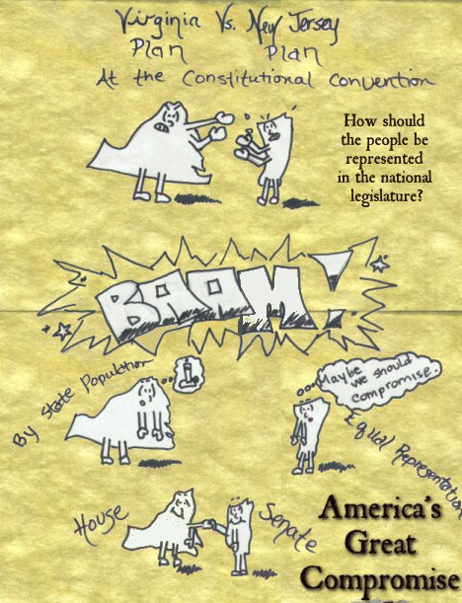
The Connecticut Compromise

Slide 34
Connecticut Compromise
By early July 1787 the convention had reached a turning point
The convention appointed a special committee to resolve the differences between the large and small states; those who were strongly committed to one side or the other were left off the committee
Benjamin Franklin was chosen to chair the proceedings

Slide 35
Connecticut Compromise
It was proposed by a Connecticut man named Roger Sherman but other historians refer to it as the Great Compromise
The committee proposed that in one house of Congress – the House of Representatives – the states would be represented according to the size of their populations
In the other house – the Senate – each state would have equal representation

Slide 36
Compromise Over Slavery
The committee proposed that each state could elect one member of the House of Representatives for every 40,000 people in the state
This caused a split between northern and southern delegates
Southern delegates wanted to count enslaved people when determining how many representatives they could elect
North delegates objected, pointing out that enslaved people could not vote

Slide 37
What to Do With Slavery
Northern delegates suggested that if slaves were going to be counted for representation, they should be counted for purposes of taxation as well
Final Decision:
  Three-Fifths Compromise – every five enslaved people in a state would count as three free persons for determining both representation
Southerners feared that a strong national government with the power to regulate trade might impose taxes on the export of farm products or ban the import of enslaved Africans

Slide 38
What to Do With Slavery
Southerners wanted the new constitution to forbid interference with the slave trade and limit Congress’s power to regulate trade
There needed to be another compromise and the delegates agreed that the new Congress could not tax imports
They also agreed that it could not ban the slave trade until 1808 or impose high taxes on the import of enslaved person

Slide 39
Moving On
By mid-September the delegates had completed their task
They believed that a vast improvement had been made with the new Constitution
September 20th they sent the new Constitution to the Confederation Congress
8 days later the Congress voted to submit the Constitution to the states for approval
9 of the 13 states had to ratify the Constitution for it take effect

Slide 40
Framework
Popular Sovereignty – rule by the people
  This was selected instead of a direct democracy
The Constitution created a system of government known as federalism
It also divided government power between the federal government (national) and the state governments

Slide 41
Separation of Powers
Legislative Branch – the two houses of Congress who makes up the laws
Executive Branch – headed by a president and would implement and enforce the laws passed by Congress
Judicial Branch – system of federal courts who would interpret federal laws and render judgment in cases involving those laws
No one in one branch could serve in either of the other branches at the same time

Slide 42
Checks & Balances
They are to prevent any one of the three branches from becoming too powerful
Each branch of government had the ability to limit the power of the other branches

Slide 43
Executive
President –
  could propose legislation
  appoint judges
  put down rebellions
  veto (reject) acts of Congress
  also be the commander in chief of the armed forces

Slide 44
Legislative
Could override the veto with a two-thirds vote in both houses
Senate – had to approve or reject presidential appointments to the executive branch and any treaties the president negotiated
Impeach – formally accuse of misconduct and then remove the president or any other high official in the executive or judicial branch

Slide 45
Judicial
They can hear all cases arising under federal law and the Constitution
Their powers are balanced by the other two branches
The president could nominate members of the judiciary but the Senate had to confirm or reject such nomination
Once appointed, federal judges can serve for life

Slide 46
Amending the Const.
The delegate recognized the Constitution might need to be amended (changed) over time
They created a clear system for making amendments – changes to the Constitution
It is a two-step process – proposal and ratification

Slide 47
How to Amend
A vote of two-thirds of the members of borth houses of Congress
Two-thirds of the states could call a constitutional convention to propose new amendments
To become effective, the proposed amendment has to be ratified by three-fourths of the state legislatures or by conventions in three-fourths of the states

Slide 48
Ratification
Creating a Constitution

Slide 49
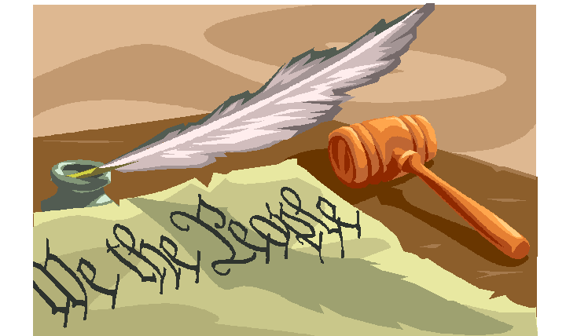
A Great Debate

Slide 50
A Great Debate
The moment the Philadelphia Convention closed its doors, the delegates rushed to their homes to begin the campaign for ratification
9 states had to vote in favor of the Constitution to pit it into effect
As soon as news broke about the new Constitution, debates began over whether it should be ratified
The debates took place in the state legislature, in mass meetings, in the columns of newspapers, and in everyday conversations

Slide 51
Federalist
Federalists – supporters of the Constitution
This name was chosen because it emphasized that the Constitution would create a federal system and that power would be divided between a central government and regional governments
The supporters included larger landowners who wanted the property protection a strong central government could provide
Merchants and artisans were also supporters of the Constitution because they wanted a strong central government to regulate trade and impose taxes on imports
Farmers also supported the Constitution because some farmers depended on trade for their livelihood and had been angry with the different tariffs and duties the states impose

Slide 52
Antifederalist
Antifederalists – opponents of the Constitution but not against federalism
They accepted the need for a national government but were more concerned whether the national government or the state governments would be supreme
Sam Adams opposed the Const. because he believed it endangered the independence of the states
Prominent supporters included: John Hancock, Patrick Henry, Richard Henry Lee, George Clinton, Edmund Rudolph, and George Mason
Many were western farmers who considered themselves self-sufficient and were suspicious of the wealthy and powerful
Many were deeply in debt and thought the Const. was a way for wealthy creditors to get rid of paper money

Slide 53
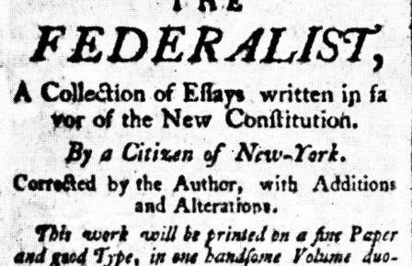
The Federalists
Many influential Americans opposed the new Constitution but several factors worked against the Antifederalists

Slide 54
The Federalists
1st: their campaign was a negative one
  Federalists presented a definite program to meet the nation’s problems
  Antifederalists didn’t have solution
2nd: they weren’t as organized
  Most of the nation’s newspapers supported Federalists
  Federalists were able to present a convincing case in their speeches, pamphlets, and debates in state conventions

Slide 55
The Federalist
Federalists’ arguments for ratification was summed up in The Federalists – collection of essays written by James Madison, Alexander Hamilton, and John Jay
They wrote under the joint pen name of Publius
The essays explained how the new Constitution worked and why it was needed
Even today judges, lawyers, legislators, and historians rely upon The Federalists to help them interpret the Constitution and understand what the original framers intended

Slide 56
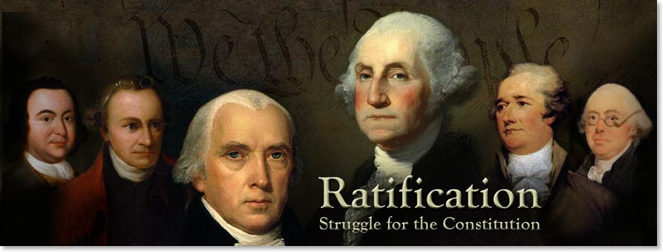
Fight for Ratification
The first state conventions took place in December 1787 and January 1788
Delaware, Pennsylvania, New Jersey, Georgia, and Connecticut ratified the Constitution very quickly

Slide 57
Ratification: Massachusetts
In Massachusetts: opponents of the Constitution held a clear majority when the convention met in January 1788
They promised to attach a bill of rights to the Constitution once it was ratified
Also agreed to support an amendment that would reserve for the states all powers not specifically granted to the federal government
This persuaded Samuel Adams to vote for ratification

Slide 58
Ratification: Massachusetts
The final vote: 187 members of the convention voted in favor of the Constitution while 168 voted against it
End of June 1788: Maryland, South Carolina, and New Hampshire had ratified the Constitution
Thus Federalists reached the minimum number of states required to put the new Constitution into effect, but Virginia and New York still had not ratified
Without these two large states, many feared the new government would not succeed

Slide 59
Virginia & New York
G. Washington and J. Madison presented arguments for ratification to the Virginia convention
Patrick Henry, Richard Henry Lee, and other Antifederalists made arguments against it
In the end: Madison’s promise to add a bill of rights won the day for the Federalists

Slide 60
Virginia & New York
Federalists were led by Alexander Hamilton and John Jay
They managed to delay the final vote until news arrived that New Hampshire and Virginia had both ratified the Constitution
The new federal government was now in effect

Slide 61
Virginia & New York
If NY refused to ratify it would be in a very awkward position since the other states had already ratified it
It would also mean the it would have to operate independently of all of the surrounding states
This argument convinced Antifederalists to change sides
Final vote: 30 to 27; the Federalists won

Slide 62
Rhode Island & N. Carolina
1788: all of the states except Rhode Island and North Carolina had ratified the Constitution
However the government could still be launched without them since it only required 9 states out of the 13 to ratify the Constitution
1788 (mid-September): Congress set a timetable for the election of the new government
March 4th, 1789 was the date for the first meeting of the new Congress

Slide 63
Rhode Island & N. Carolina
The two states finally ratified the Constitution after the new government was in place
1789 (November): North Carolina waited until a bill of rights had actually been proposed
1790 (May): Rhode Island finally ratified the Constitution with a very close (34 to 32)

Slide 64
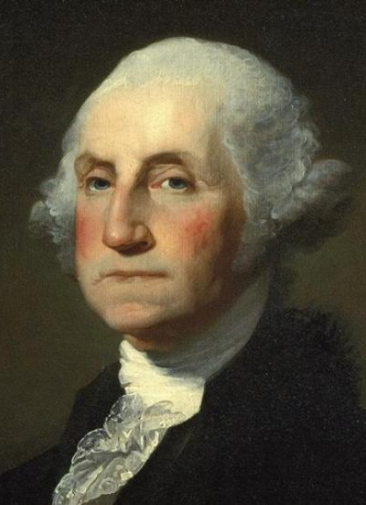
A New Government
The US finally has a new government and the new Constitution would be better than the Articles of Confederation
The American people waited for their new government to begin
Many people expressed great confidence because George Washington had been chosen to become the first president under the new Constitution

