Slide 1
Federalists & Republicans
1789-1816

Slide 2
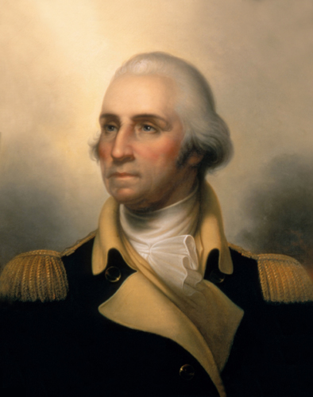
Washington & Congress
The Philadelphia Convention had given the nation a new Constitution
Washington’s task was to take the words of the Constitution and help create an effective government for the US

Slide 3
Institutions of Power
1789: Congress created the Department of State, the Department of the Treasury, the Department of War, and the Office of the Attorney General
Washington wanted men who were capable of handling such positions in office and not solely thinking about their own states while in power
To Washington, the nation matter more than the states

Slide 4
Institutions of Power
Washington appoints the following men:
  Treasury Department: Alexander Hamilton
  Secretary of War; General Henry Knox
  Attorney General: Edmund Randolph
These men became known as the cabinet – a group of advisers to the president; and Washington met with them regularly

Slide 5
Bill of Rights
This was one of the most important acts Congress introduced and it was the focal point during the ratification of the Constitution
James Madison was one of the leaders in Congress who made the Bill of Rights his top priority
He relied on the Virginia Declaration of Rights which George Mason had prepared in 1776 and the Virginia Statute of Religious Freedom that Thomas Jefferson had written in 1786

Slide 6
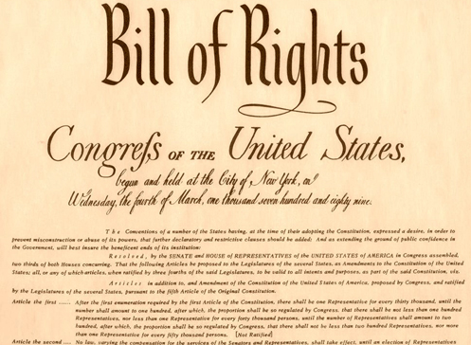
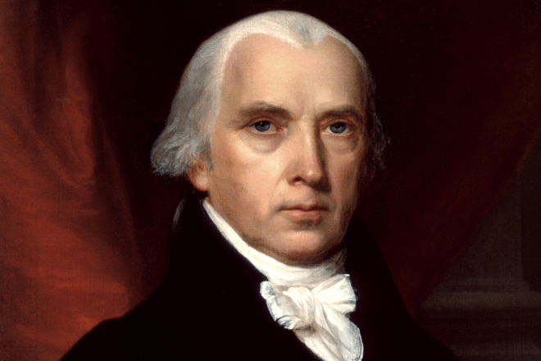
Bill of Rights
Late September of 1789, Congress had agreed on 12 constitutional amendments
All 12 were sent to the states for ratification but only 10 of them were approved
Those 10 went into effect in 1791 and they were generally referred to as the Bill of Rights
9th Amendment: states that the people have other rights not listed
10th Amendment: states that any powers not specifically given to the federal government are reserved for the states

Slide 7
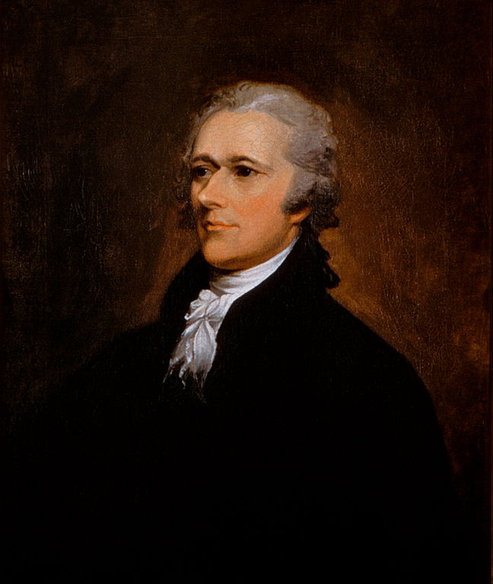
Financing the Government
Now that the government was up and running, they needed some source of revenue
Without money the government could not operate
James Madison and Alexander Hamilton responded to this need with different plans for financing the government

Slide 8
Tariff of 1789
James Madison suggested that the government raise most of its money by taxing imports from other countries
Tariff of 1789 – required importers to pay a percentage of the value of their cargo when they landed it in the United States
  Shippers had to pay a tonnage – tax based on how much their ships carried

Slide 9
Tariff of 1789
These tariffs and tonnages of course angered Southern planters because they would be charged higher rates to ship their rice and tobacco to Europe
Because of this many Southern planters thought that the new federal government was opposed to their region’s interests

Slide 10
Hamilton’s Financial Program
Hamilton supported the Tariff of 1789 but also believed that the government needed the ability to borrow money
He asked Congress to accept the debts of the Continental Congress at full value
In order to fund the War (at the time) the government had issued bonds – paper notes promising to repay money after a certain amount of time with interest
By 1789 the US owed about $40 million to American citizens and $11.7 million to France, Spain, and the Netherlands

Slide 11
Opposition to Hamilton’s Plan
The opposition was led by James Madison and Hamilton’s critics; they argued this plan was unfair to the original purchasers of the bonds
These original purchasers had sold their bonds to speculators – people willing to take a risk in hopes of a future financial gain
The purchases sold them because of fear that they would never be paid back

Slide 12
Opposition to Hamilton’s Plan
Speculators who had purchased these bonds for as little as $10 could now receive as much as $100 for their bonds at full value
This angered James Madison as well as southerners because
  Northerners owned most of the bonds
  Much of the tax money that would be used to pay off the bonds would come from the south
Madison also worried that creditors would eventually dominate American society and endanger liberty

Slide 13
There Must Be a Solution
July 1790: Hamilton, Madison, and Jefferson struck a deal
Madison and Jefferson would use their influence to convince southerners in Congress to vote for Hamilton’s plan
The capital would be moved from New York to a section of land along the Potomac River and will be called the District of Columbia

Slide 14
Bank of the United States
Hamilton asked Congress to create a national bank and he argued that the government needed the bank to manage its debts and interest payments
The bank would issue bank notes – paper money; these notes would provide a national currency that would promote trade, encourage investment, and stimulate economic growth

Slide 15
Opposition to the Bank
Of course Madison again disagreed with this notion of a national bank
He argued that Congress could not establish a bank because it was not among the federal government’s enumerated powers – powers specifically mentioned in the Constitution

Slide 16
Bank of the United States
Congress passed the bill anyways and Washington realized that his decision to sign the bill or to veto it would set an important precedent
Hamilton argued that in Article I, Section 8, the Constitution gave the federal government the power “to make all laws which shall be necessary and proper”
“necessary and proper” created implied powers – powers not explicitly listed by the Constitution but necessary for the government to do its job

Slide 17
Hamilton’s Argument
Hamilton again argued that a national bank could collect taxes, regulate trade, and provide for the common defense
Washington, after reviewing Hamilton’s plan, agreed to sign the bill
1791: Bank of the United States was established for a 20 year period

Slide 18
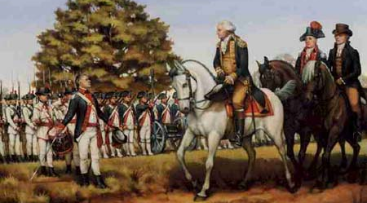
Whiskey Rebellion

Slide 19
Whiskey Rebellion
Hamilton believed that the government had to establish its right to impose direct taxes on the people
1791: Congress imposed a tax on the manufacture of whiskey
This angered many western farmers who did not use bank notes or coins as a medium of exchange, but instead used whiskey

Slide 20
Whiskey Rebellion
Western Pennsylvania: farmers terrorized tax collectors, stopped court proceedings, robbed the mail, and destroyed the whiskey-making stills of those who paid the tax
Hamilton again urged Washington to do something about this
Washington took 15,000 troops to crush the rebellion; but the rebels dispersed without a fight

Slide 21
Rise of Political Parties
Hamilton’s financial program had split Congress into two factions and they became the nation’s first political parties
Federalists – supporters of Hamilton
Republicans (Democratic-Republicans) – opponents of Hamilton such as James Madison and Thomas Jefferson

Slide 22
Hamilton and the Federalists
Hamilton favored a strong national government and believed that democracy was dangerous to liberty and stated that “the people are turbulent and changing; they seldom judge or determine right”
This pretty much led him to believe that only the “rich, well born, and able” should have a hand in government
He also believed that manufacturing and trade were the basis of national wealth and power
Supporters included: artisans, merchants, manufacturers, and bankers

Slide 23
Jefferson and the Republicans
Jefferson believed that the strength of the US was its independent farmers and his ideas were often referred to as agrarianism
He argued that owning land enabled people to be independent and as long as most people owned their own land, they would fight to preserve the Republic
He feared that too much of an emphasis on commerce would lead to a society divided between the rich (those who owned everything) and the poor (those who worked for wages)

Slide 24
Jefferson and the Republicans
Jefferson believed that the wealthy would corrupt the government and threaten the rights and liberties of ordinary people
The Democratic-Republicans became the party that stood for the rights of the states against the power of the federal government
These first two political parties divided the country regionally

Slide 25
Split of the Nation
Rural south and west tended to support the Republicans
More urban northeast tended to support the Federalists
Future events in Europe would deepen the divisions between the political parties and create new crises for the young Republic

Slide 26
Partisan Politics
Federalists & Republicans

Slide 27
Revolution in France
The French Revolution soon began after Washington’s inauguration into office
At first Americans sympathized with the revolutionaries because they seemed to be fighting for the same rights as Americans did not too long ago
However a new group from those revolutionaries took power and they executed thousands of people while stripping aristocrats of their property as well as killing the king and queen

Slide 28
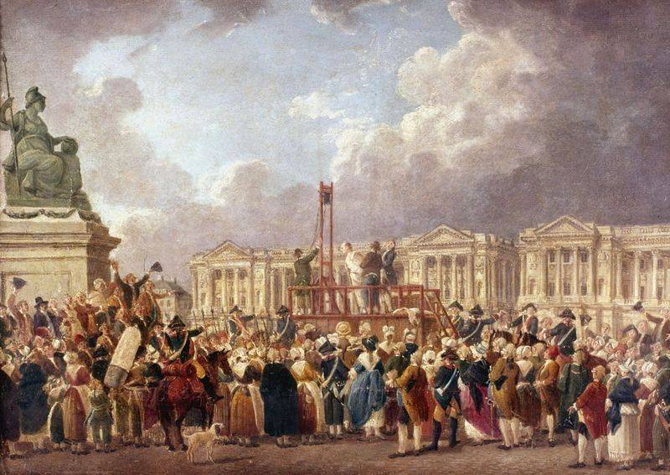
Radical Revolutionaries
Soon after executing the king, the radicals declared war on Britain
Since America traded with both Britain and France, America was caught in this European conflict

Slide 29
American Response
Americans were divided
Federalists: horrified by the violence and chaos and oppose it
Republicans: supported it because they admired the fight for liberty, despite the bloodshed

Slide 30
American Response
The war between Franc/Britain put Washington in a difficult position
Treaty of 1778: required the US to help defend France’s colonies in the Caribbean
  Abiding to this agreement might mean war with GB
April 22, 1793: Washington issues a proclamation declaring the US to be “friendly and impartial” toward both warring nations

Slide 31
Not So Neutral
Despite the declaration, the British began intercepting all neutral ships carrying goods to French ports
On the other hand, Americans found out that the British (in North American lands) were inciting Native Americans to attack western settlers
This pushed Congress to the brink of war in 1794

Slide 32
Jay’s Treaty
Washington sent John Jay to Britain to seek a solution
The British were too busy fighting the French and they did not want to fight the United States but they also knew the US was trading with France

Slide 33
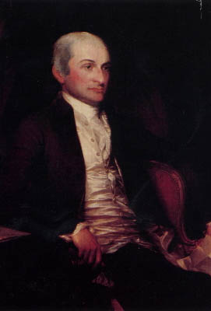
Jay’s Treaty
They finally came to an agreement with Jay’s Treaty
  Britain had the right to seize cargoes bound for French ports
  America could not get compensation for American merchants
  British agreed to submit the issue to international arbitration – a hearing by neutral third countries

Slide 34
Jay’s Treaty
In return:
  British gave the US most-favored nation status which meant that American merchants would not be discriminated against when they traded
Senators were shocked by the terms and tired to keep them secret
However they eventually ratified the treaty and news leaked to the public

Slide 35
Response?
Republicans: immediately attacked the treaty, accusing the Federalists of being pro-British
Across the nation meetings were held to discuss this treaty and after a prolong deliberation, Washington agreed to implement the treaty
This prevented war with GB and protected the fragile American economy

Slide 36
Pinckney’s Treaty
1795: Spain joined France against Britain
Jay’s Treaty brought fear in Spain that the British and Americans might join forces to seize Spain’s North American holdings
Spain quickly offers to negotiate all outstanding issues with the US
Washington sends Thomas Pinckney to negotiate

Slide 37
Pinckney’s Treaty
1795: Spanish signed the of San Lorenzo / Pinckney’s Treaty
  It granted the US the right to navigate the Mississippi and to deposit goods at the port of New Orleans
  It won broad acceptance especially by western farers who wanted to use the river to get crops to market

Slide 38
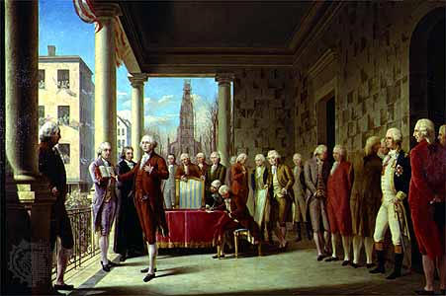
Washington Leaves Office
By the end of his second term Washington grew tired of party politics and people attacking his character so he decided to retire
However before leaving office he issues his final speech which is known as Washington’s Farewell Address where he warned Americans of sectionalism – avoid dividing the country into North and South or East and West

Slide 39
Washington’s Farewell Address
“Let me now…warn you in the most solemn manner against the baneful effects of the spirit of party…The disorders and miseries, which result, gradually incline the minds of men to seek security and response in the absolute power of an individual”
“The great rule of conduct for us, in regard to foreign nations is in extending our commercial relations to have with them as little political connection as possible…’Tis our true policy to steer clear of permanent alliances with any portion of the foreign world”

Slide 40
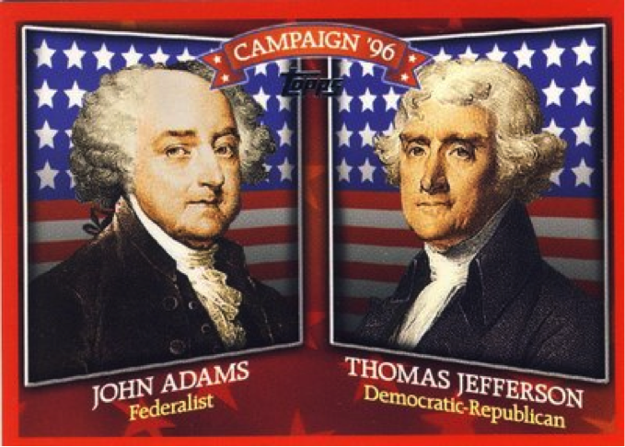
Election of 1796
Washington steps down and the nation witnesses its first real elections
Federalists: line up John Adams
Republicans: nominate Thomas Jefferson
In the end John Adams beat Jefferson 71 to 68 and became the second president of the US

Slide 41
Quasi-War With France
Adams faced troubling times at home and abroad
The French were very angry about Jay’s Treaty and began stopping American ships and seizing their goods if they were going to Britain
This angered the Federalists who wanted to go to war with France
However, like Washington, Adams decides it’s best to not get involved in a major war

Slide 42
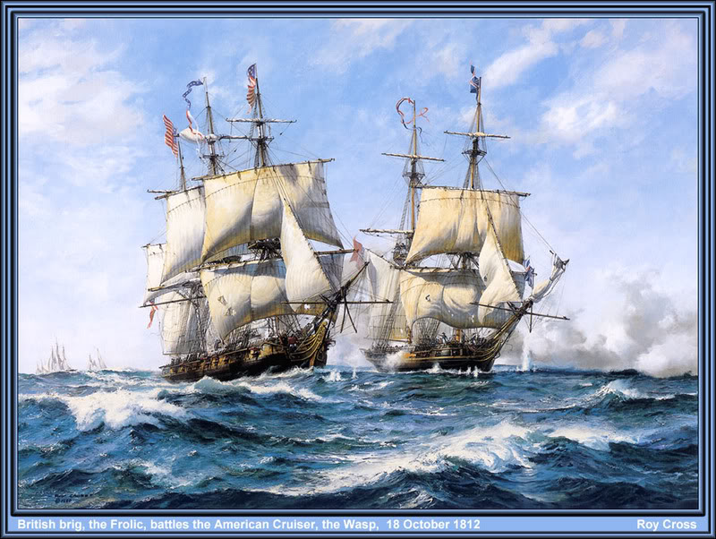
Quasi-War With France
Adams sends: Charles Pinckney, Elbridge Gerry, and John Marshall to negotiate with France
June 1798: Congress suspended trade with France and directed the navy to capture armed French ships
Soon enough both nations were fighting an undeclared war at sea which was called the Quasi-War

Slide 43
Quasi-War With France
Fall of 1798: France proposed new negotiations
September 1800: the two countries signed the Convention of 1800
  The US gave up all claims against France for damages to American shipping
  France released the US from the Treaty of 1778
  The war came to an end

Slide 44
Alien and Sedition Acts
federalists: pushed 4 laws through Congress which became known as the Alien and Sedition Acts
  1st Law – required immigrants to wait 14 years before becoming citizens, this weakened Republican support
  2nd & 3rd Laws – gave the president the power to deport without trial any alien deemed dangerous to the US
  4th Law – made it a federal crime to utter or print anything “false, scandalous, and malicious” against the federal government or any officer of the government
  The first 3 laws were aimed at aliens – people living in the country who were not citizens while the last law prevented sedition – incitement to rebellion

Slide 45
Virginia & Kentucky Resolutions
Between 1798 and 1799 Jefferson and Madison were secretly criticizing the Alien and Sedition Acts
Virginia Resolution
  Introduced the theory of interposition
  If the federal government did something unconstitutional, the state could interpose between the federal government and the people and stop theillegal action

Slide 46
Virginia & Kentucky Resolutions
Kentucky Resolution:
  Advanced the theory of nullification
  If the federal government passed an unconstitutional law, the states had the right to nullify the law, or declare it invalid

Slide 47
Election of 1800
Federalists: John Adams hoped to win this election but the Alien and Sedition Acts and a new tax which the Federalists introduced on houses, land, and enslaved Africans made Americans very angry
Republicans: nominated Thomas Jefferson for president and Aaron Burr for vice president
  They campaigned against the new taxes, the national bank, and they accused the Federalists of favoring monarchy and of discouraging political participation

Slide 48
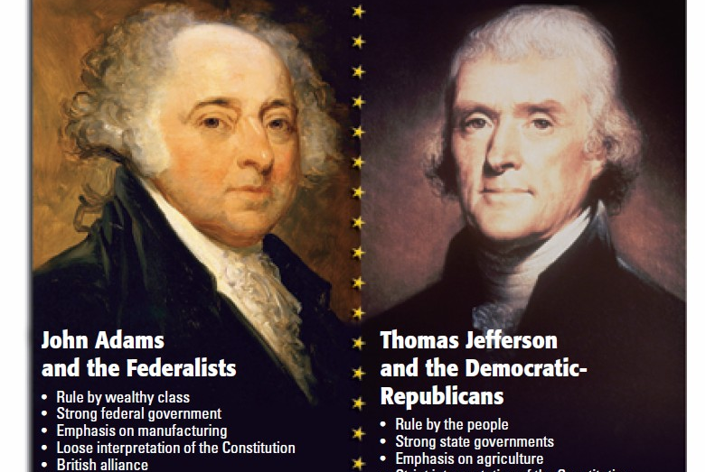
Election of 1800
The election revealed a flaw in the system for selecting the president
The Constitution does not let citizens vote directly for the chief executive
  Instead each state chooses electors – the same number as it has senators and representatives
  This group then votes for the president and they are called the Electoral College

Slide 49
Election of 1800
Constitution: called for each elector to vote for 2 people
Normal practice: an elector was to cast one vote for his party’s presidential candidate and another for the vice presidential candidate
To avoid a tie between Jefferson/Burr, Republicans intended for one elector to not vote for Burr, but things did not go according to plan

Slide 50
Election of 1800
Votes are counted: it’s a tie!
  Jefferson and Burr each have 73 votes
  The Federalist-controlled House of Representatives had to choose a president now
Federalists: hated Jefferson and wanted to select Burr
Hamilton: preferred Jefferson over Burr and again urged his followers to support Jefferson
  This led to another tie in the House of Representatives

Slide 51
Election of 1800
February 1801: Jefferson tells one of the Federalists (James Bayard) that if he is elected, he would not fire all of the Federalists in the government, nor dismantle Hamilton’s financial system
This convinced Bayard to cast a blank ballot and ensure Jefferson a victory
Jefferson becomes the new president

Slide 52
Election of 1800
This was an important turning point in American history
The Federalists controlled the army, the presidency, and the Congress
They could have easily refused to step down and get rid of the Constitution, but they respected the people’s right to choose the president
It also demonstrated that power in the US could be peacefully transferred despite strong disagreements between parties

Slide 53
Jefferson in Office
Federalists & Republicans

Slide 54
Jefferson Takes Office
To Jefferson the Election of 1800 was secretly the “Revolution of 1800” in his mind
He believed that Washington and Adams acted too much like royalty and he tried to create a less formal style for the presidency
  Traveling in carriages > rode horseback
  Formal reception – he entertained at more intimate dinners around a circular table
  “When brought together in society, all are perfectly equal”

Slide 55
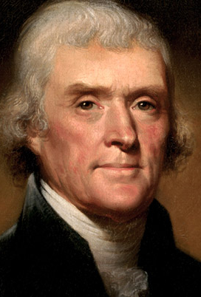
Jefferson in Office
Jefferson hoped to limit federal power and he began paying off the federal debt, cut government spending, and did away with the whiskey tax which everyone hated, and instead of a standing army, he planned to rely on local militia
His economic ideas had worried many Federalists who wanted the new president to dismantle the national bank

Slide 56
Rise of the Supreme Court
Before the Federalist majority’s term expired in Congress, they still managed to pass the Judiciary Act of 1801 which created 16 new federal judges
Before leaving office, Adams appointed Federalists to these positions and they became known as the “midnight judges” because Adams, supposedly, signed appointments until midnight of his last day in charge

Slide 57
Impeaching Judges
Jefferson (Republican) and his Republican friends in Congress weren’t too happy that the Federalists controlled the courts
One of the first acts of Congress was to repeal the Judiciary Act of 1801 and abolishing the offices of those Federalist judges
Republicans then tried to impeach other Federalists from the judiciary because they believed that impeachment was one of the checks and balances in the Constitution

Slide 58
Impeaching Judges
1804: the House impeached Supreme Court Justice Samuel Chase because during a trial Chase had ordered “any of those persons or creatures called democrats” be removed from the jury
Chase was also a great opponent of Jefferson
However after his removal, impeachment was only conducted to those who acted in criminal behavior, not because Congress disagreed with their decisions

Slide 59
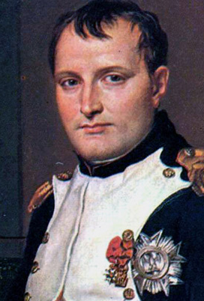
US Expands West
Jefferson strongly believed that a republic could not survive if most of the people owned land and this led him to support the idea of expanding the country westward
1800: Napoleon Bonaparte convinced Spain to give Louisiana back to France in exchange for helping Spain take control of part of Italy

Slide 60
Louisiana Purchase
Jefferson did not like this one bit because he believed that if France was back in North America then they would force the US into an alliance with the British, who Jefferson hated
Jefferson sent Robert Livingston, an ambassador, to try to block the deal in the spring of 1801, but didn’t achieve anything until 1803
1803: Napoleon made plans to conquer Europe and since it was short on funs, it agreed to sell all of the Louisiana Territory to the US

Slide 61
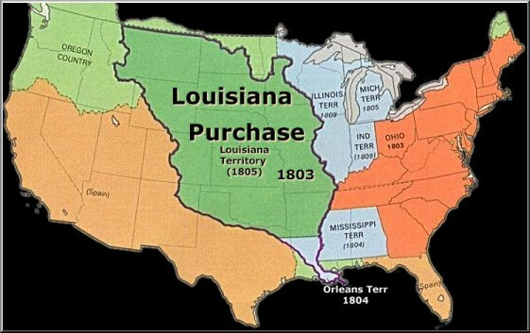
Louisiana Purchase
April 30, 1803: the US bought Louisiana from France for $11.25 million and also agreed to take on French debts owed to American citizens
The debts were worth $3.75 million which made the total coast about $15 million
This doubled the size of the United States

Slide 62
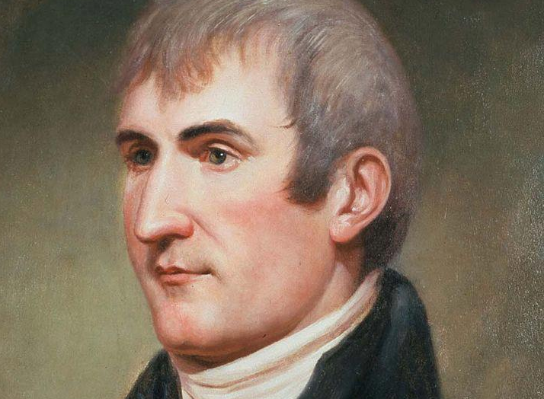
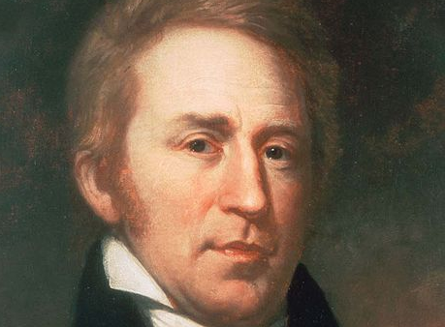
Lewis & Clark Expedition
Prior to purchasing Louisiana, Jefferson asked Congress to secretly fund an expedition into the Louisiana Territory to trace the Missouri River and find a route to the Pacific Ocean
Meriwether Lewis (Jefferson’s private secretary) and William Clark, the younger brother of Revolutionary War hero George Rogers Clark

Slide 63
Lewis & Clark Expedition
May 1804: the “Corps of Discovery” headed west up the Missouri River
Along the way they met Sacagawea (Shoshone woman who joined the expedition as a guide and interpreter)
They found a path through the Rockies and eventually traced the Columbia River to the Pacific Ocean
It greatly increased American knowledge of the Louisiana Territory and gave the US a claim to the Oregon territory

Slide 64
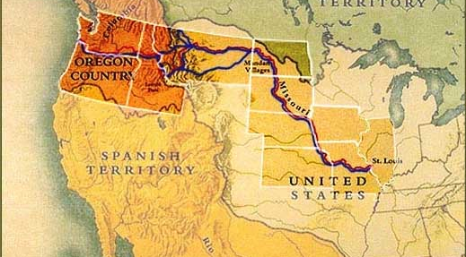
Lewis & Clark Expedition

Slide 65
Pike Expedition
1805: Zebulon Pike mapped much of the upper Mississippi
1806: Pike he headed west to find the headwaters of the Arkansas River
He traveled to Colorado where he charted the mountains now known as Pikes Peak
Later on he mapped part of the Rio Grande and traveled across northern Mexico and what is now southern Texas

Slide 66
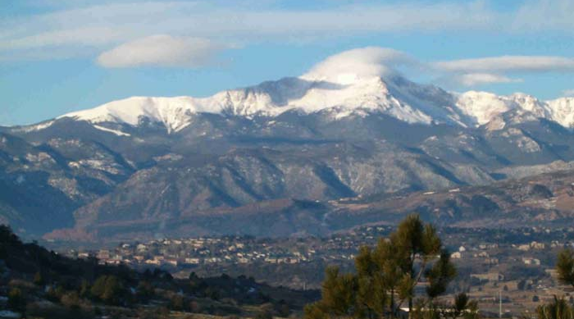
Pikes Peak

Slide 67
Essex Junto
The Louisiana Purchase alarmed the Federalists in New England because they felt their region would lose political influence in the nation’s affairs
Essex Junto – small group of Federalists who drafted a plan to take New England out of the Union
This group persuaded VP Aaron Burr to run for governor of New York
Hamilton called Burr “a dangerous man, and one who ought not be trusted with the reins of government”

Slide 68
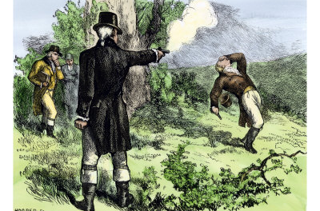
Essex Junto
Burr was offended and challenged Hamilton to a duel
The two met on July 11, 1804 but Hamilton refused to fire
Burr shot and killed Hamilton and in 1807 he was accused of plotting to create a new country in the western United States
He was charged with treason but not found guilty

Slide 69
The War of 1812
Federalists & Republicans

Slide 70
Decision for War
Republicans: nominated James Madison for president after Thomas Jefferson announced that he would not run again
Federalists: nominated Charles Pinkney
Madison won the election easily and assumed office in the middle of an international crisis
Tensions between the US and Britain were rising

Slide 71
Economic Pressure
Madison wanted to avoid war just like Jefferson and he asked Congress to pass the Non-Intercourse Act
  which forbade trade with France and Britain while authorizing the president to reopen trade with whichever country removed its trade restrictions first
  The idea was to play France and Britain against each other but this plan failed
Macon’s Bill Number Two – this reopened trade with both Britain and France but it stated that if either nation agreed to drop its restrictions on trade, the US would stop importing goods from the other nation

Slide 72
Economic Pressures
Napoleon agreed to no longer restrict American trade but the British still refused to do so and Congress passes a non-importation act against Britain in 1811
This strategy actually worked because by 1812 the refusal of the US to buy British goods began to hurt the British economy
June 1812: Britain ended all restrictions on American trade but it was too late because the US Congress had declared war on GB

Slide 73
War Hawks
Those who voted for the war came from the south and west
They were led by Henry Clay of Kentucky, John Calhoun of South Carolina, and Felix Grundy of Tennessee and they were nicknamed the War Hawks

Slide 74
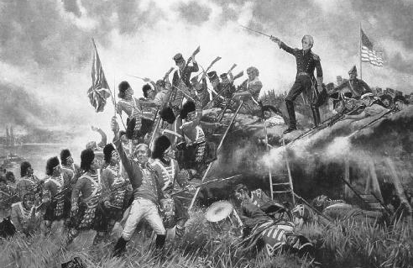
Reasons for War
Reason #1: British trade restrictions hurt southern planters and western farmers who made a living from tobacco, rice, wheat, and cotton
Reason #2: western farmers also blamed the British for clashes with Native Americans along the frontier

Slide 75
Tecumseh & Tippecanoe
Tecumseh – a Shawnee leader who believed that Native Americans needed to unite to protect their lands
His brother, Tenskwatawa, called for a spiritual rebirth of Native American cultures
William Henry Harrison, governor of the Indian territory, learned that Tecmuseh’s movement was becoming more militant
November 1811: Harrison gathered a force and marched towards the Native American town

Slide 76
Harrison vs The Natives
Tenskwatawa attacked Harrison first near the Tippecanoe River
This bloody battle left about ¼ of Harrison’s troops dead or wounded but the many of the Natives had left for Canada
With the Natives running towards British Canada, many western farmers argued that war with Britain would enable the US to seize Canada and stop these Native American attacks

Slide 77
Call for War?
June 1812: President Madison gave in to all of this pressure and asked Congress to declare war on Britain
The vote in Congress was split along regional lines
  South and west voted for the war
  Northeast did not favor the war

Slide 78
Is This War Possible?
Although Congress voted for the war, the nation wasn’t ready to fight
  We had fewer than 7,000 troops and very little equipment
  The navy had only 16 ships
  Americans were divided over the war!
  The war was too costly!
Republicans had shut down the Bank of the US a year earlier and this made it difficult for the government to borrow money because most private bankers were located in the Northeast

Slide 79
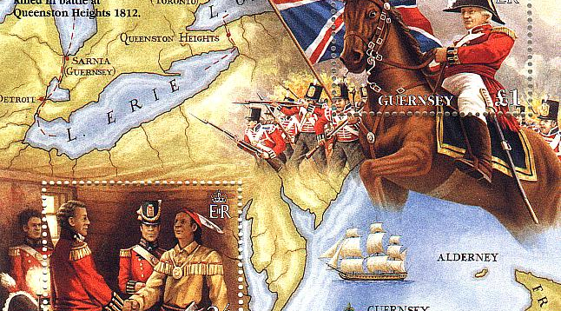
Invasion of Canada

Slide 80
Invasion of Canada
Despite all of these weaknesses, James Madison still ordered the military to invade Canada
3 Prong Attack
  Detroit
  Niagara Falls
  Up the Hudson River toward Montreal
All three attacks failed!!!! The British navy on Lake Erie moved troops to Detroit and forced the American commander, General William Hull, to surrender

Slide 81
Invasion of Canada
Then the British shifted their troops to Niagara Falls and they easily drove off about 600 American troops
One of the reasons this attack failed was because we were short on troops, since the New York militia refused to cross the river (many of them did not support the war)
Their argument was: “Our military service does not require us to leave the country”

Slide 82
Invasion of Canada
The third attack, up the Hudson River, was not much of a success either
General Henry Dearborn marched toward Montreal and called off the attack after the militia which accompanied his own troops refused to cross the border!
What is going on?! How does this make America look?!

Slide 83
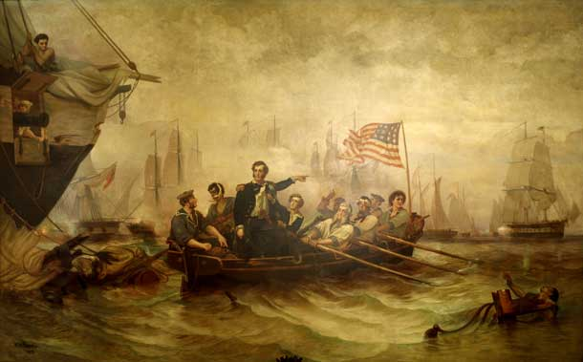
What to do Now?
The next year, America had more success after Commodore Oliver Perry secretly arranged for the construction of a fleet on the coast of Lake Erie in Ohio
September 10, 1813: after 4 hours of heavy battle the British surrendered
This victory gave us control of Lake Erie and also enabled us to recover much of Detroit and march into Canada where we defeated a force of British and N. American troops at the Battle of the Thames River

Slide 84
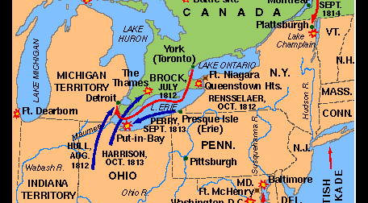
Victory for Americans

Slide 85
What Happens Next?
Harrison’s attack was supposed to meet up with American troops from Niagara Falls in the east
British and N. Americans stopped Americans from the east from advancing at the Battle of Stony Creek
Harrison learned about this defeat and retreated to Detroit
End of 1813: the US still had not conquered any territory in Canada

Slide 86
The War Ends; Well the French War
1814: Napoleon’s French empire collapses and this also ends the French war against the British
The British can now focus on the war against America and they send much of their navy and more troops here
British 3 Prong Attack:
  1st: British navy would raid American cities along the coast
  2nd: they march south into New York from Montreal cutting New England from the rest of the country
  3rd” seize New Orleans, Louisiana and close the Mississippi River

Slide 87
Not the White House!!!
August 1814: a British fleet sails into the Chesapeake Bay and lands within marching distance of Washington, DC.
They easily defeat the weak American local militia and enter the city without a problem
Madison and other government official fled the city and the British set fire to both the White House and the Capitol

Slide 88
Baltimore
Baltimore was ready for the British
City militia inflicted heavy casualties on the British troops that went ashore
After bombarding Fort McHenry throughout the night of September 13, the British abandoned their attack on the city

Slide 89
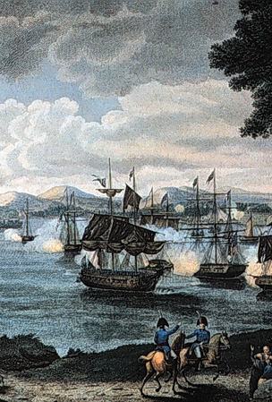
Battle of Lake Champlain
That same month about 15,000 well=trained British soldiers advanced from Montreal into New York
The idea was to control Lake Champlain
September 11, 1814: American naval forces on the lake defeated the British fleet
The British abandoned and retreated back to Montreal
Victory!!!

Slide 90
Hartford Conventions
December 1814: Federalists from New England met in Hartford, CT to discuss what they could do independently of the US
Members of the Essex Junto urged for NE to secede but moderate delegate refused to support extreme ideas like that
Hartford Convention – called for several constitutional amendments to increase the region’s political power

Slide 91
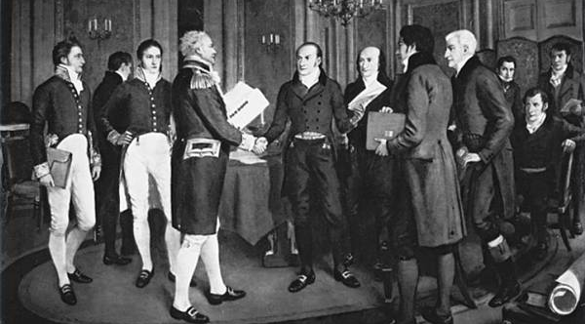
Hartford Convention

Slide 92
Battle of New Orleans
A month after the Convention began, Americans won a victory in the south and this stopped any Federalist complaints
January 1815: a British fleet with 7,500 men landed near New Orleans
American commander, General Andrew Jackson, quickly improvised a defense using cotton bales
Thick bales absorbed the British bullets and while the British were advancing in the open, they ere easy targets for American troops

Slide 93
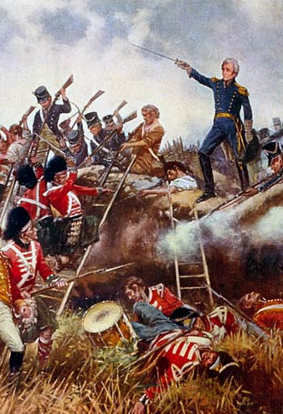
Battle of New Orleans
This made Andrew Jackson a national hero and it also helped to destroy the Federalist Party
Nationalism – feeling of strong patriotism, surged throughout the nation
The Federalists at the Convention appeared divisive and unpatriotic
They never recovered politically and within a few years the party completely disappeared

Slide 94
Treaty of Ghent
Peace negotiations began in the European city of Ghent
December 24, 1814: the treaty was signed and it ended the War of 1812
  It restored prewar boundaries but did not mention neutral rights or impressment
  No territory changed hands
The war increased the nation’s image overseas and generated a new spirit of patriotism and national unity

Slide 95
Convention of 1818
Four years after the Treaty of Ghent the US and GB set the US-Canadian border from what is now Minnesota to the Rocky Mountains at 49 degrees north latitude
The countries also agreed to claim jointly for the next ten years a region farther west known as the Oregon Country

