Slide 1
Cultural Geography
of the United States and Canada

Slide 2
Population Patterns
Immigration – the movement of people into one country from another
Less than 5% of the world’s population live in the US and Canada
285 million people in the US are all immigrants or descendants of immigrants

Slide 3
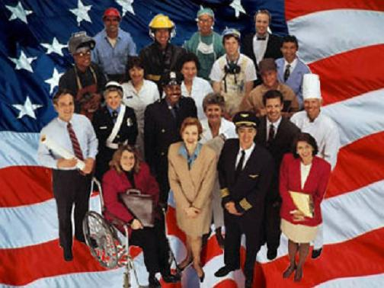
Waves of Immigrants
N. America’s first wave of immigrants probably came here from Asia thousands of years ago
They are known as descendants of Native Americans
Other peoples: Europeans, Asians, Africans, and Latin Americans

Slide 4
Waves of Immigrants
Immigrants came here for various reasons
  Religious or political freedom
  Fleeing wars or natural disasters
  Others wanted greater economic opportunities such as jobs and a higher standard of living

Slide 5
Population Density & Distribution
Canada has an average population density of only 8 people per square mile
Much of Canada’s territory is inhospitable to humans because of rugged terrain and bitterly cold climate
About 90% of Canadians live in a narrow strip of land along Canada’s border with the US

Slide 6
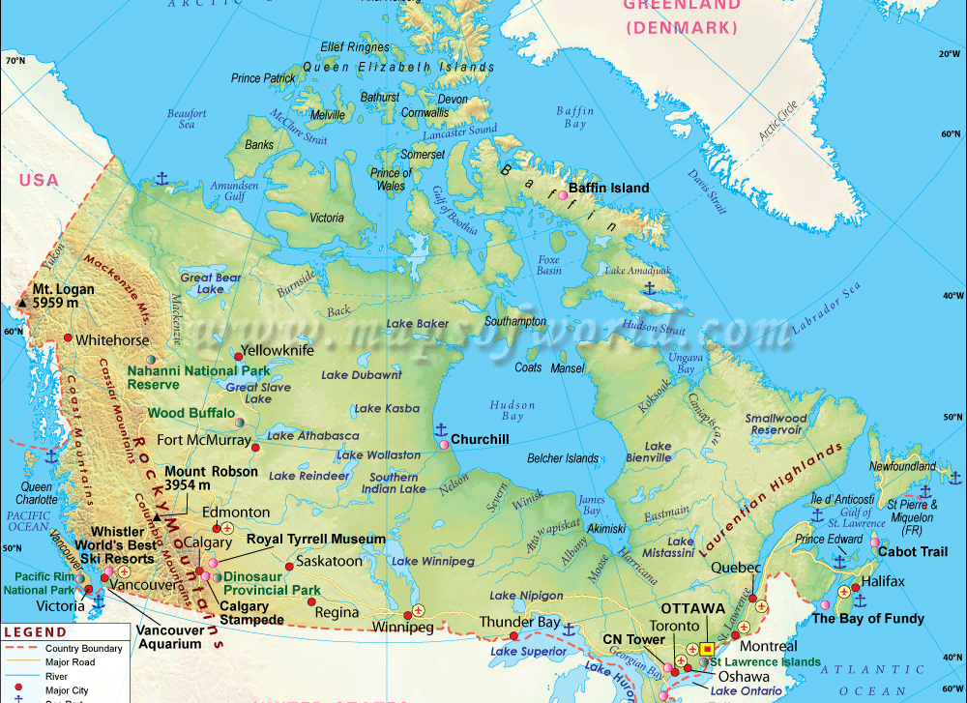
Q: Where do the Canadians live?
A: Along the strip which borders the US

Slide 7
Population Density & Distribution
The US has an average population density of 77 people per square mile
This may seem crowded but outside the urban cities the population is widely distributed
Northeast and the Great Lakes are the most densely populated areas

Slide 8
Population Density & Distribution
Other population clusters include the historic centers of commerce and industry
The Pacific Coast is abundant in natural resources
More people live in California than in any other state

Slide 9
The Sunbelt
Since the 1970s the American South and Southeast have become the country’s fastest growing areas
Sunbelt – area of the southern US which got its name because of its mild climate

Slide 10
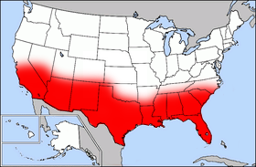
The Sunbelt

Slide 11
The Cities
Urbanization – the concentration of population in cities
Cities grew as a result of machines in agriculture gave rise to large commercial farms

Slide 12
The Cities
Today most people live in metropolitan areas
  Which include a city with a population of at least 50,000
  They also include suburbs which are outlying communities

Slide 13
The Cities
More than 75% of the population of the US live in the country’s 274 metropolitan areas
25% of Canada’s populations live in the metros

Slide 14
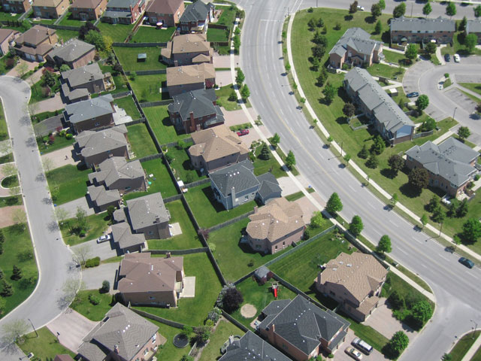
The Cities
Suburbs are outlying communities in metropolitan areas

Slide 15
Coastal Cities
Along the coastal cities, you can find the megalopolis
These are a chain of closely linked metropolitan areas
It is also known as a “great city”

Slide 16
BOSWASH
Boswash is the nickname given to Boston, New York, Philadelphia, Baltimore, and Washington D.C.

Slide 17
Other Important Coastal Cities
Miami on the Atlantic coast
New Orleans and Houston on the Gulf of Mexico
Los Angeles on the Pacific coast
Vancouver in British Columbia

Slide 18
Inland Cities
Ottowa in Canada through the St. Lawrence River
Detroit uses the Great Lakes

Slide 19
Future Trends
Like many developed countries, the US and Canada have low birthrates
Immigrants account for most of the population growth
Americans & Canadians cherish their mobility
1/6 Americans relocate from city to city

Slide 20
History & Government
The Cultural Geography of the United States

Slide 21
History
Archaeologists believe that nomads crossing the bridge from Asia to Alaska first settled in North America thousands of years ago

Slide 22
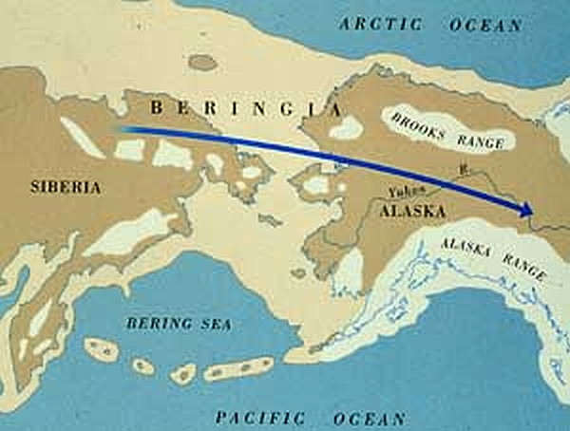
Beringia –
Land Bridge

Slide 23
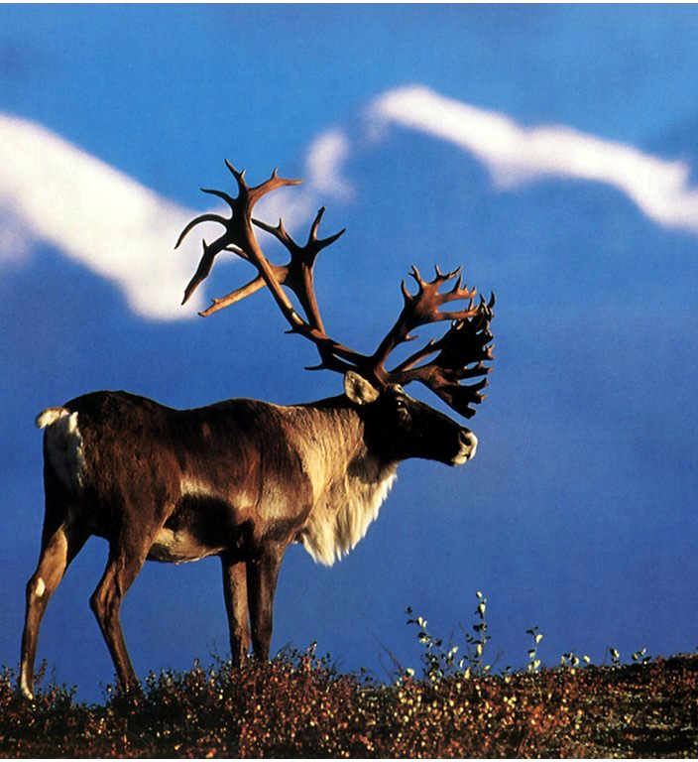
Caribou

Slide 24
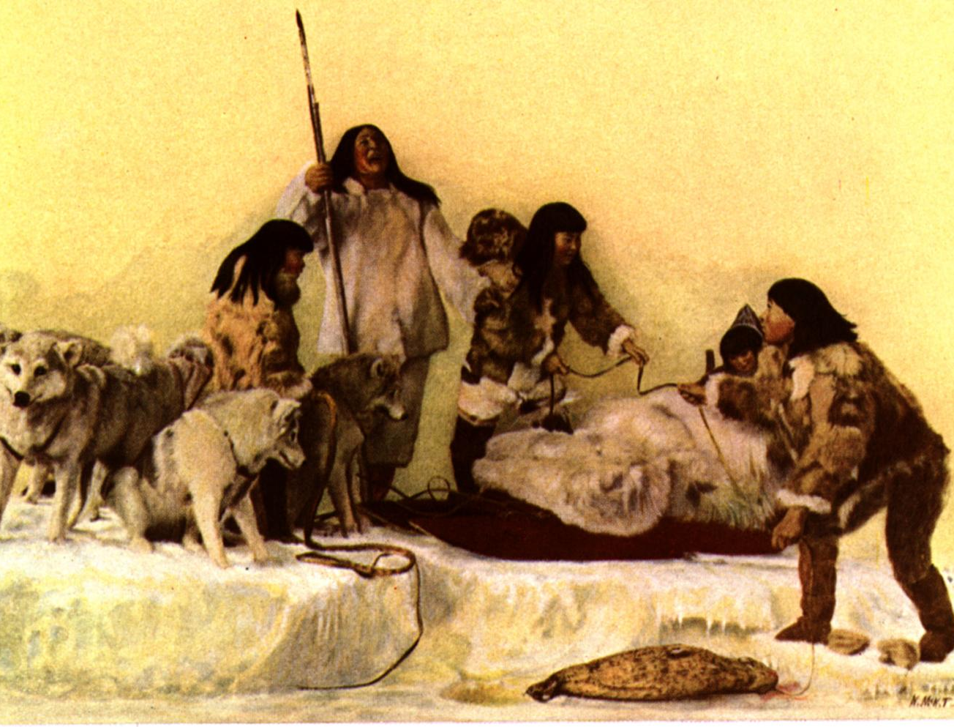
Native Americans
People of the Arctic tundra had scarce resources and lack of farmland
They hunted caribou and other animals for food and fur

Slide 25
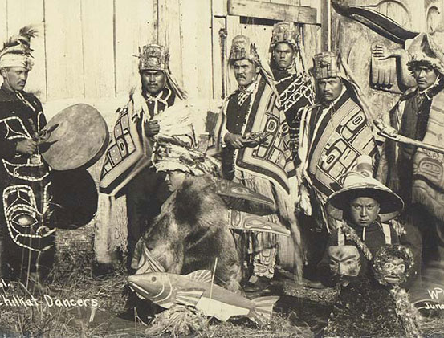
Native Americans
People of the Pacific Coast enjoyed a mild climate and abundant resources
They harvest salmon and used stone and copper tools to split cedar, fir, and redwood trees to build houses and canoes

Slide 26
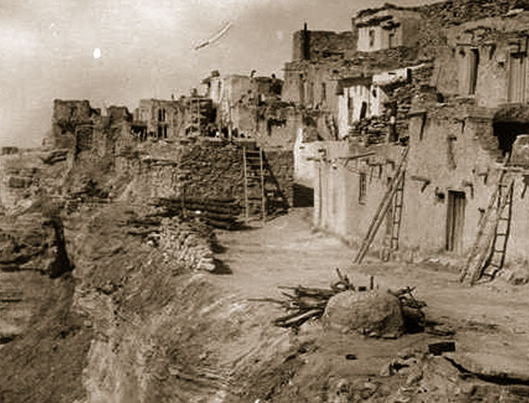
Native Americans
In the Southwest deserts they used irrigation to farm the dry land

Slide 27
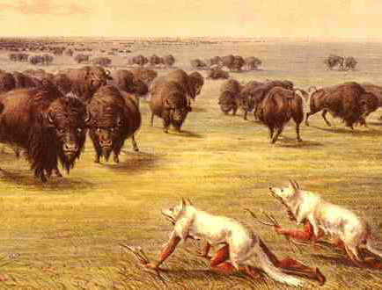
Native Americans
In the Great Plains they hunted the buffalo for food, clothing, tools, and shelter

Slide 28
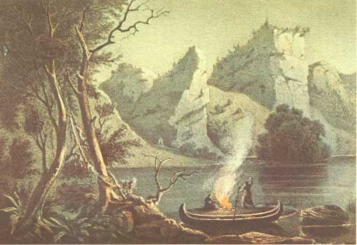
Native Americans
Along the Mississippi Rive they built ceremonial mounds, hunted game, grew crops, and traded for shells and freshwater pearls

Slide 29
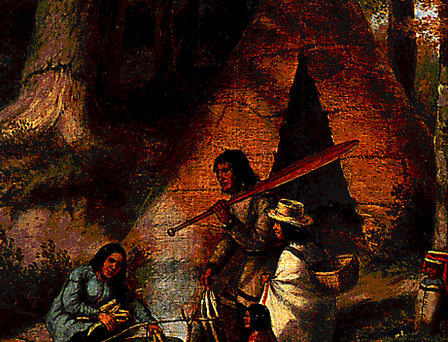
Native Americans
In the Northeast they hunted deer, turkeys, geese, and squirrels
They lived in closely knit villages, developed systems of government, and traded throughout the region

Slide 30
European Colonies
They came to the Americas by the late 1500s
They were searching for land, resources, political and religious freedom
Most came from Spain, France, and England

Slide 31
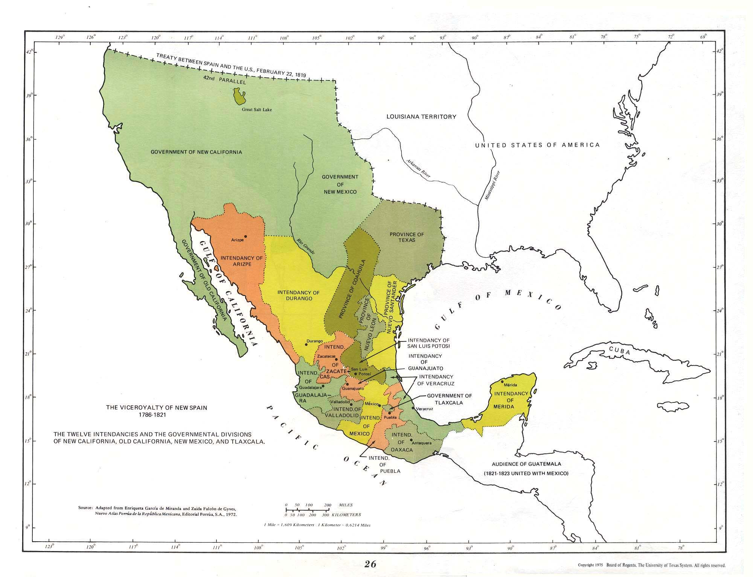
European Colonies
Spaniards controlled Florida and a large area west of the Mississippi River

Slide 32
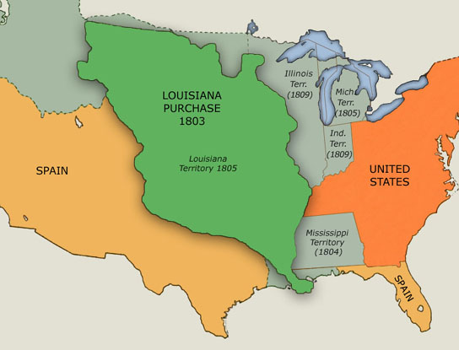
European Colonists
The French came for the fur trade
They set up trading posts
Those who settled live along the St. Lawrence Rive and the Mississippi River near the Gulf of Mexico

Slide 33
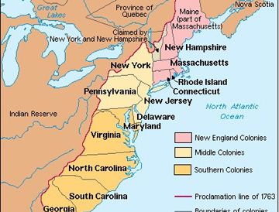
European Colonies
By 1700 England had colonies along the Atlantic Coast and around the Hudson Bay

Slide 34
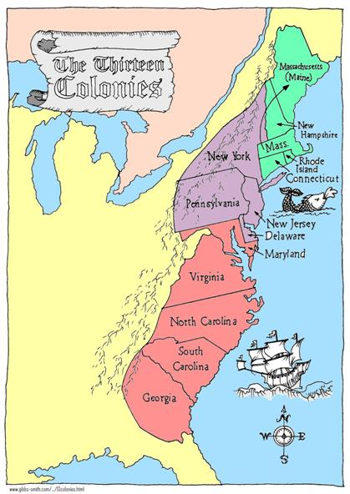
European Colonies
The Northern English Colonies had a difficult time farming because of the short growing season
But they had excellent harbors and good timber and fishing
They made a living by ship-building, trade, and fishing

Slide 35
European Colonies
The Middle Colonies had wide river valleys, level land, and fertile soil
They had mild winters, long warm summers, and an extended growing season
They raised cash crops

Slide 36
European Colonies
The Southern Colonies had mild climates, rich soils, and open land with plantation agriculture
Most plantation owners used slaves to provide for labor

Slide 37
Two New Countries
The British government was continuously taxing their colonies in America
The colonists began to get very angry about this
They decided to wage war against Britain and gain their independence

Slide 38
Two New Countries
The war they fought in was called the Revolutionary War
They did not want a monarchy but instead opted to have a republic – a government in which people elect their own officials, including the head of state

Slide 39
Two New Countries
Some of the American colonists who did not want to fight for independence eventually moved north to the only British colony in America, near Quebec

Slide 40
Two New Countries
English and French speaking people formed their own country within the British Empire
It was called the Dominion of Canada

Slide 41
Dominion of Canada
Included the four main colonies:
  Ontario
  Nova Scotia
  New Brunswick
  Quebec

Slide 42
Dominion of Canada
Neighboring areas later joined this new country:
  Manitoba
  British Columbia
  Alberta
  Saskatchewan

Slide 43
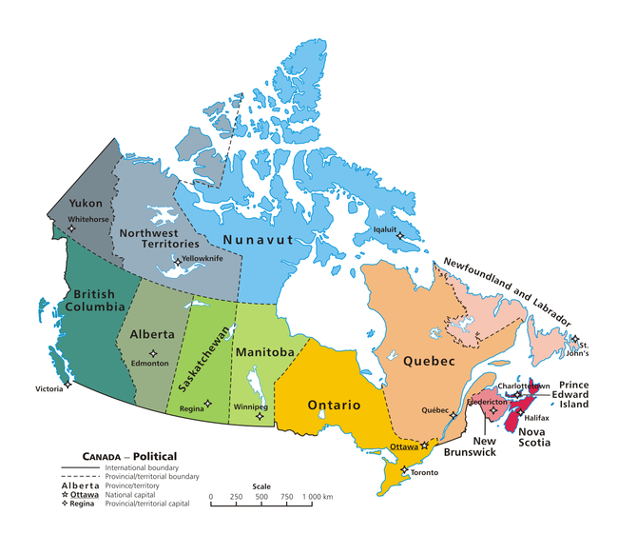
Dominion of Canada

Slide 44
Sea to Shining Sea
1803: the US bought almost all of the land between the Mississippi River and the Rocky Mountains from France
  This was known as the Louisiana Purchase
1845: Texas joined the US
Late 1840s: the US gained all of present-day California and Utah, parts of Nevada, Colorado, Wyoming, Arizona and New Mexico, from the Mexican War

Slide 45
Sea to Shining Sea
By trade or treaty the US gained much land
1867: purchased Alaska from Russia
Afterwards: acquired Hawaii and other Pacific islands as well as the Caribbean

Slide 46
Government
The US and Canada are both democracies with federal systems
1787: the US drafted the Constitution
Amendments – changes to the Constitution

Slide 47
Bill of Rights
The first 10 Amendments to the Constitution are called the Bill of Rights
They guarantee the basic rights of citizens

Slide 48
National Government
There are 3 branches of government:
  Executive
  Legislative
  Judicial

Slide 49
Canada
Canada was created as a dominion – partially self-governing country with close ties to Great Britain
In 1931 it finally gained its independence
In 1982 the legislative link to Great Britain finally ended

Slide 50
Canada
The executive part includes the governor-general, the prime minister, and the cabinet
The British monarch still serves as the head of state, appointing a governor-general to act in his or her place

Slide 51
Canada
Parliament – made up of the Senate and the House of Commons
They make up the national legislature

Slide 52
Canadian Parliament
The prime minster, is the leader he majority political party
Is also the actual head of government
Nine judge sit on the Supreme Court

Slide 53
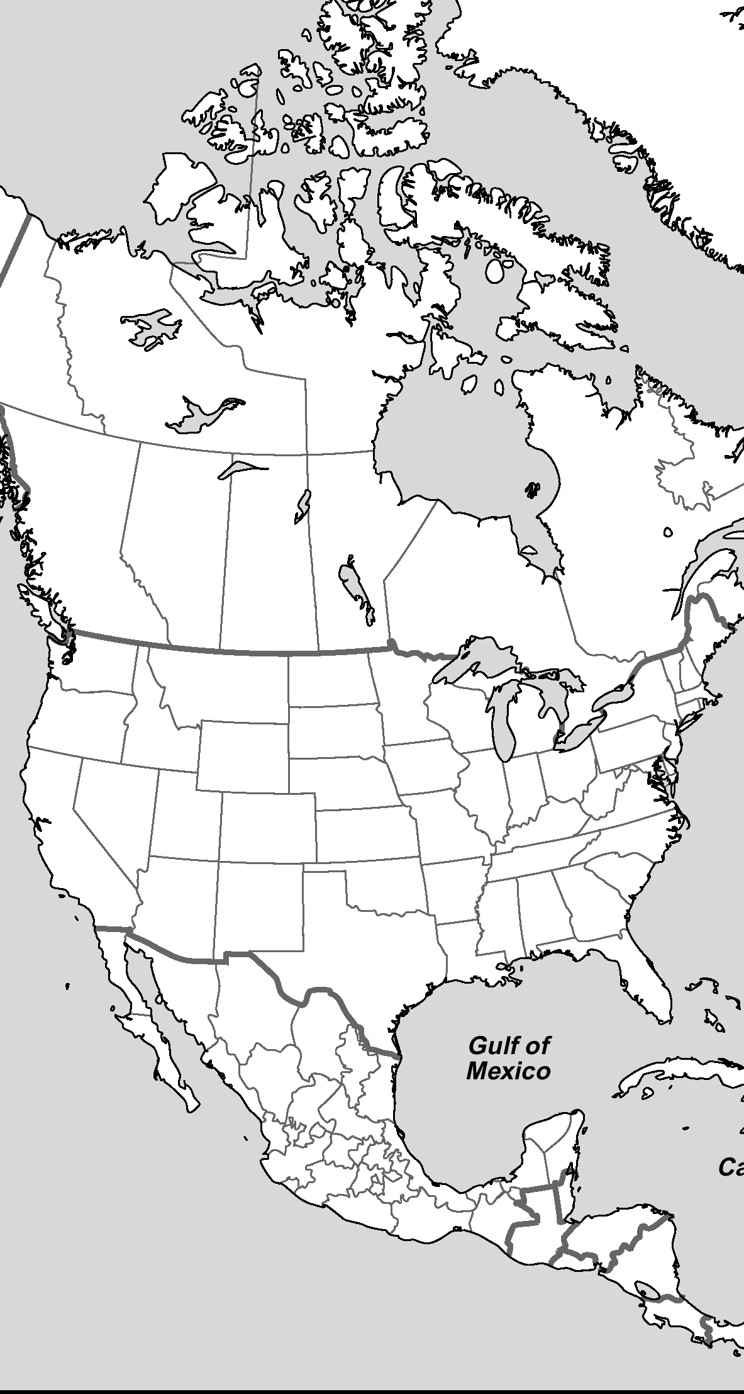
Assignment #1:
Please label the following Native American groups
Arctic
Subarctic
Northwest Coast
Plateau
Great Plains
Northeast
Great Basin
California
Southwest
Southeast
Mesoamerica
Circum-Caribbean

Slide 54
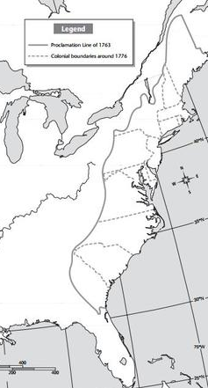
Assignment #2:
Please label all of the original 13 British colonies
Massachusetts
New Hampshire
New York
Rhode Island
Connecticut
New Jersey
Pennsylvania
Maryland
Delaware
Virginia
North Carolina
South Carolina
Georgia

Slide 55
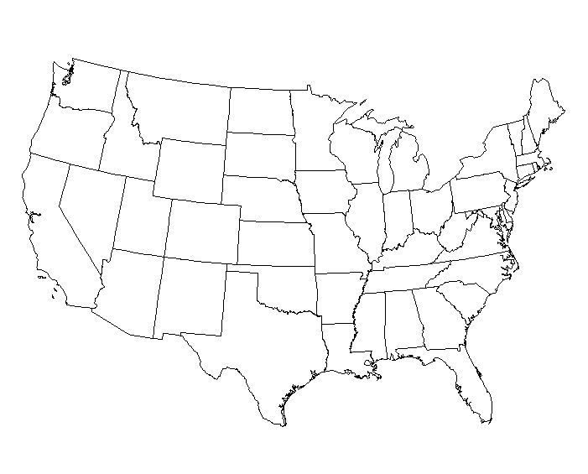
Assignment #3: Please label the territories of the following nations
New Spain
New France
United States of America

